Slide 1
Chapter 11
PWM and DC Motor Control

Slide 2
Selected DC Motor Characteristics
(http://www.Jameco.com)
Part No. | Nominal Volts | Volt Range | Current | RPM | Torque
154915CP | 3 V | 1.5–3 V | 0.070 A | 5,200 | 4.0 g-cm
154923CP | 3 V | 1.5–3 V | 0.240 A | 16,000 | 8.3 g-cm
177498CP | 4.5 V | 3–14 V | 0.150 A | 10,300 | 33.3 g-cm
181411CP | 5 V | 3–14 V | 0.470 A | 10,000 | 18.8 g-cm

Slide 3
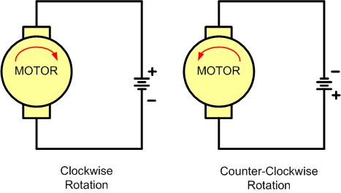
DC Motor Rotation (Permanent Magnet Field)

Slide 4
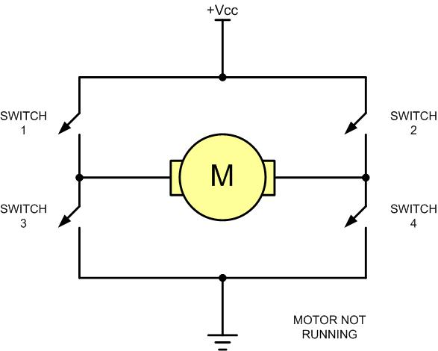
H-Bridge Motor Configuration

Slide 5
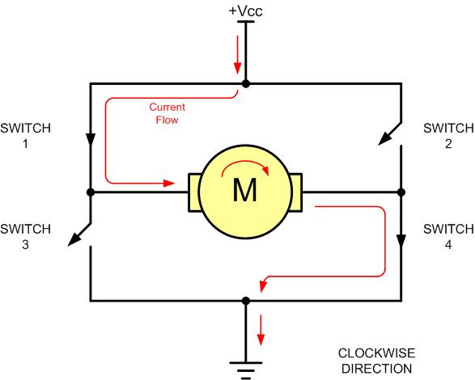
H-Bridge Motor Clockwise Configuration

Slide 6
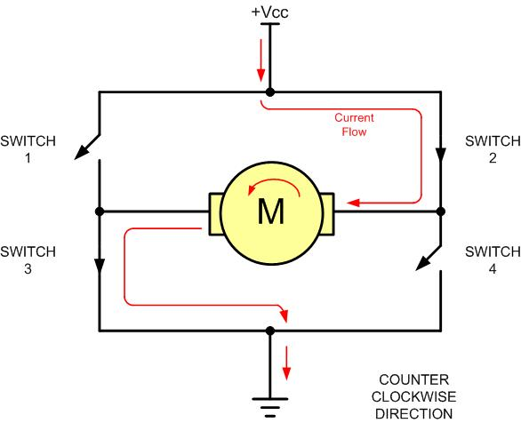
H-Bridge Motor Counterclockwise Configuration

Slide 7
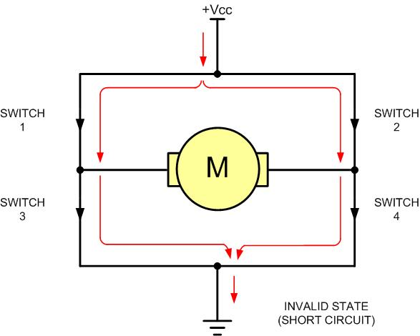
H-Bridge in an Invalid Configuration

Slide 8
Some H-Bridge Logic Configurations
Motor Operation | SW1 | SW2 | SW3 | SW4
Off | Open | Open | Open | Open
Clockwise | Closed | Open | Open | Closed
Counterclockwise | Open | Closed | Closed | Open
Invalid | Closed | Closed | Closed | Closed

Slide 9
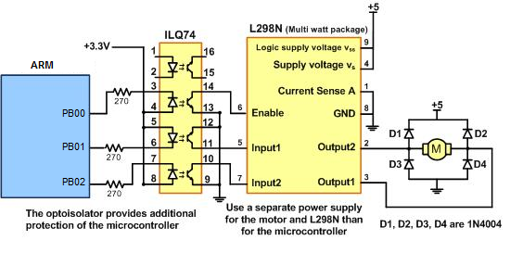
Bidirectional Motor Control Using an L298 Chip

Slide 10
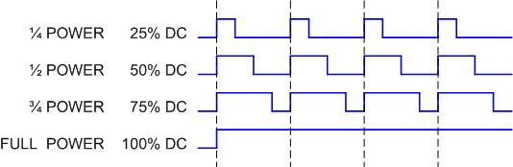
Pulse Width Modulation Comparison

Slide 11
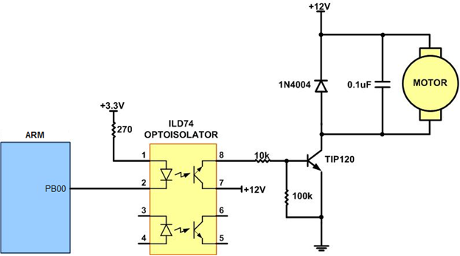
DC Motor Connection Using a Darlington Transistor

Slide 12
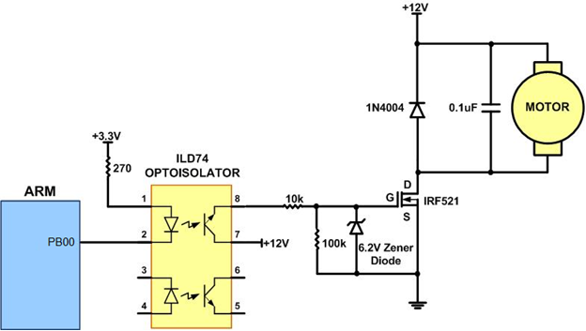
DC Motor Connection Using a MOSFET Transistor

Slide 13
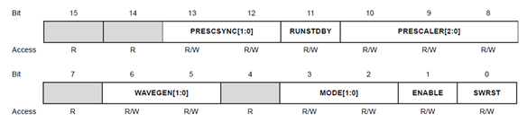
CTRLA (Control A) Register

Slide 14
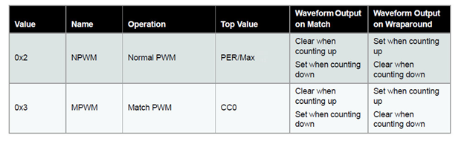
Wave Generation Options

Slide 15
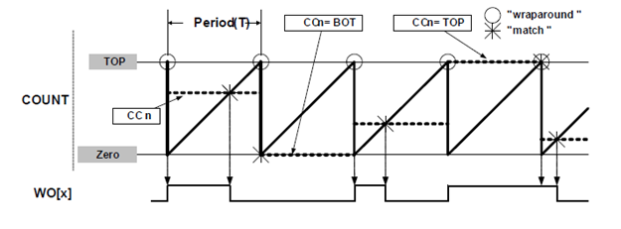
Normal PWM Operation

Slide 16
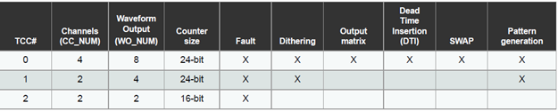
TCC Configuration Summary

Slide 17
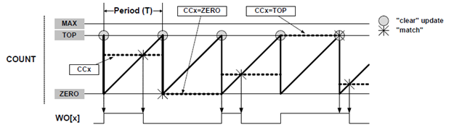
Single-Slope PWM Operation

Slide 18
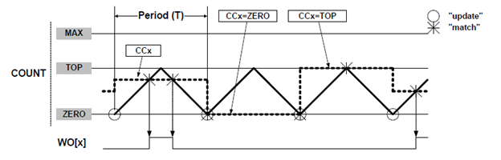
Dual-Slope Pulse Width Modulation

Slide 19
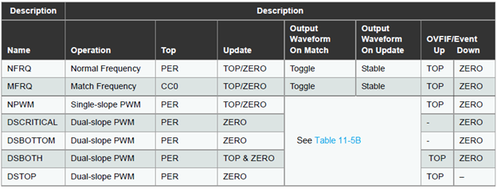
Counter Update and Overflow Event/Interrupt Conditions

Slide 20
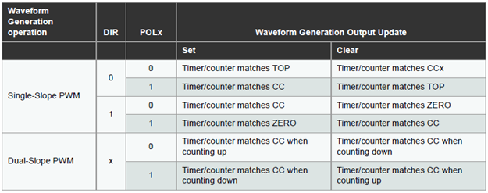
Waveform Generation Set/Clear Conditions

Slide 21
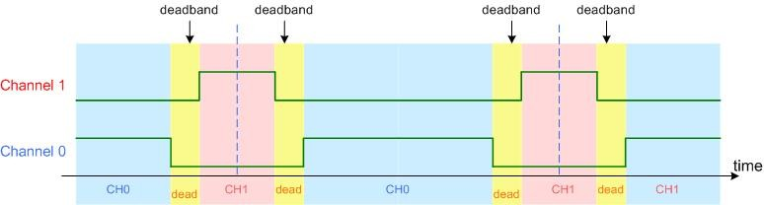
Deadband

