Slide 1
Chapter 2
Atmel ARM I/O Programming

Slide 2
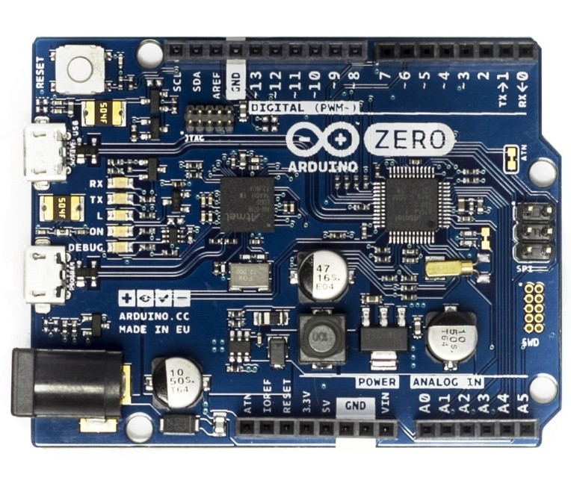
Arduino Zero using Atmel SAM D21

Slide 3
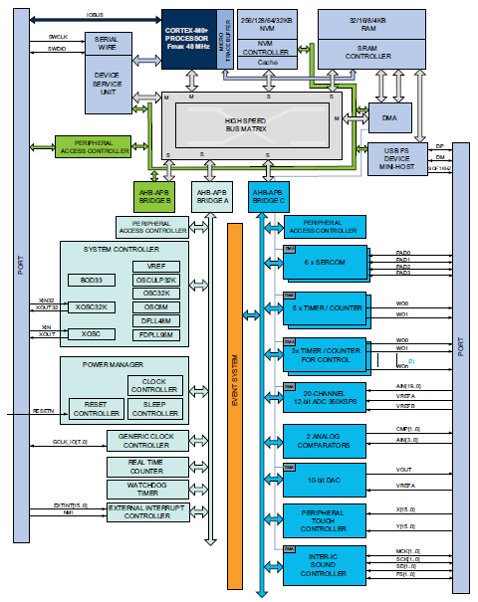
Atmel SAM D Microcontroller Block Diagram

Slide 4
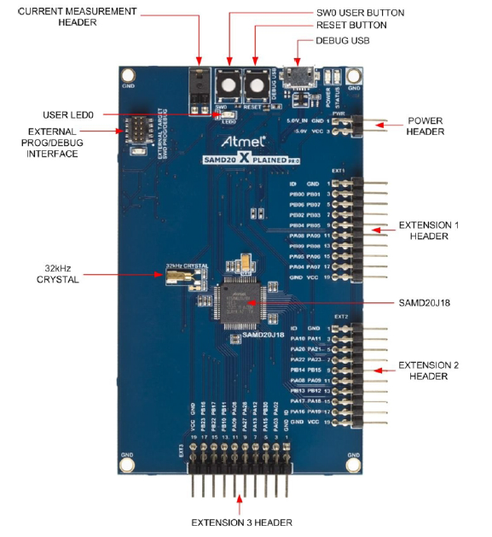
Atmel D20 Xplained Pro development board

Slide 5
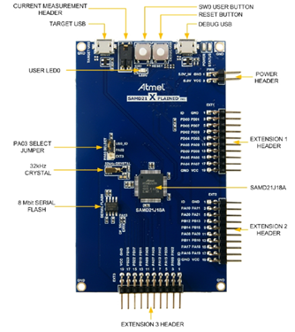
Atmel D21 Xplained Pro development board

Slide 6
Memory Map of Atmel SAM D2xJ18
 | Memory sizes | Address range
Flash | 256KB | 0x00000000-0x0003FFFF
SRAM | 32KB | 0x20000000-0x20007FFF
I/O | All the peripherals | 0x40000000-0x420053FF

Slide 7
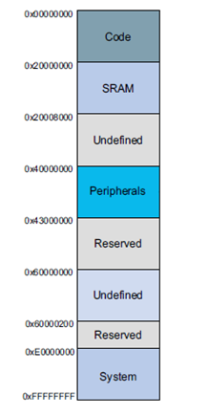
Memory map for ATSAMD21J18

Slide 8
Fields Values Description
Field | Description | Some Valid Values
SAM D | Product Family | General Purpose MCU
## | Product Series | • 09 = Cortex-M0+ Basic Feature Set •910 = Cortex-M0+ CPU, Basic Feature Set, TCC, DMA •011 = D10 + USB Device •120 = Cortex-M0+ CPU, Basic Feature Set •021 = D20 + USB Device and Embedded Host, I2S, DMA, TCC, 3.4MHz I2C
P | Pin Count | • C = 14 pins • D = 20/24 pins • E = 32 pins • G = 48 pins • J = 64 pins
FM | Flash Memory | • 13 = 8 KB •K14 = 16 KB •K15 = 32 KB •KB6 = 64 KB • = 64 KB8 KB • KB = 256 KB
A | Marketing Revision | • A = Initial Revision
X | Package Type | • A = TQFP • M = QFN • SS = SOIC
Y | Plating material and temp grade | •lU = -40 — 85°C Matte Sn plating •=N = -40 — 105°C Matte Sn plating
Z | Package carrier | •aT = Tape & Reel •=No character = Tray/Tube (Default)

Slide 9
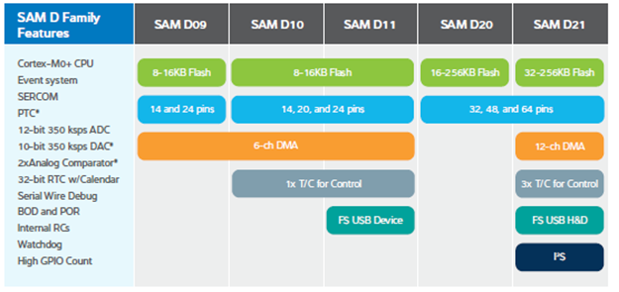
Atmel SAM D MCU features

Slide 10
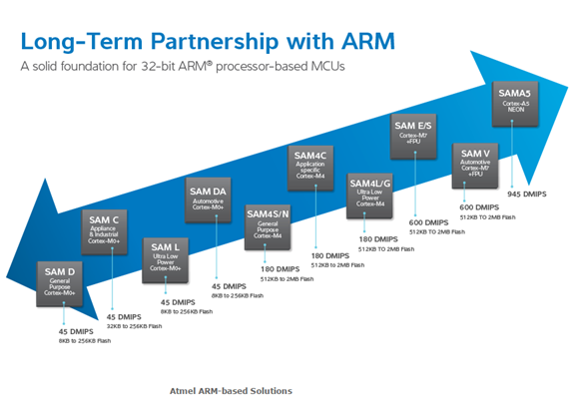
Atmel SAM MCU portfolio

Slide 11
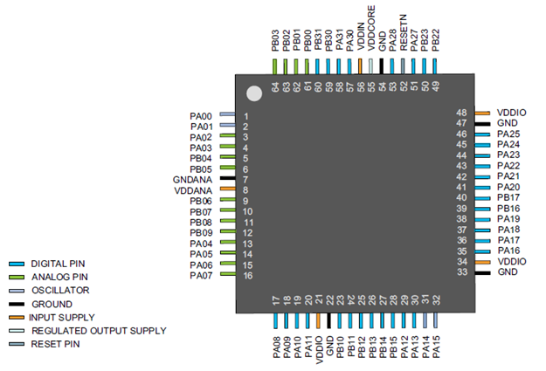
ATSAMD21J18 pinout

Slide 12
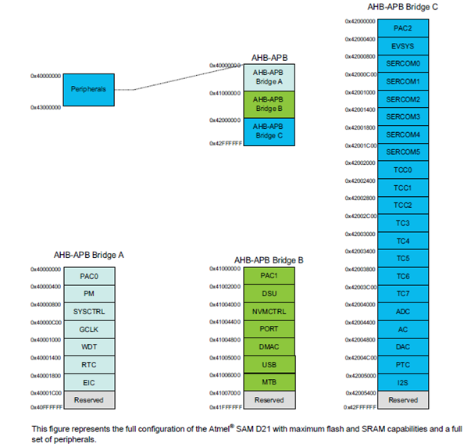
Peripheral address map of SAM D21

Slide 13
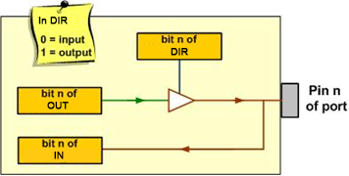
The Data and Direction Registers and a Simplified View of an I/O pin

Slide 14

OUTput Register

Slide 15

DIRection Register

Slide 16

APBB Mask register of Power Management

Slide 17
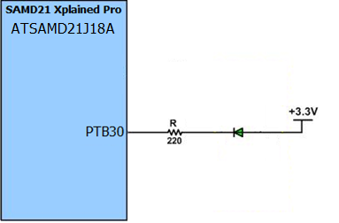
LED connection to PB30 of the SAMD21 Xplained Pro board

Slide 18
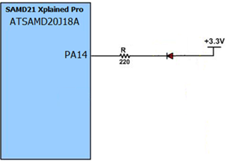
LED connection to PA14 of the SAMD20 Xplained Pro board

Slide 19

OUTSET (Output Set) Register

Slide 20

OUTCLR (Output Clear) Register

Slide 21

OUTTGL (Output Toggle) Register

Slide 22
Some GPIO registers
Address (Offset) | Name | Description | Type | Reset Value
0x00 | DIR | Port Data Direction Register | R/W | 0x00000000
0x04 | DIRCLR | Port Data Direction Clear Register | R/W | 0x00000000
0x08 | DIRSET | Port Direction Set Register | R/W | 0x00000000
0x0C | DIRTGL | Port Direction Toggle Register | R/W | 0x00000000
0x10 | OUT | Port Data Output Register | R/W | 0x00000000
0x14 | OUTCLR | Port Output Clear Register | R/W | 0x00000000
0x18 | OUTSET | Data Output Value Set | R/W | 0x00000000
0x1C | OUTTGL | Data Output Value Toggle | R/W | 0x00000000
0x20 | IN | Data Input Value | R | 0x00000000

Slide 23
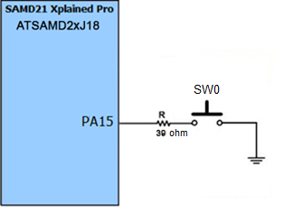
User switch connection on SAMD21 Xplained Pro board

Slide 24
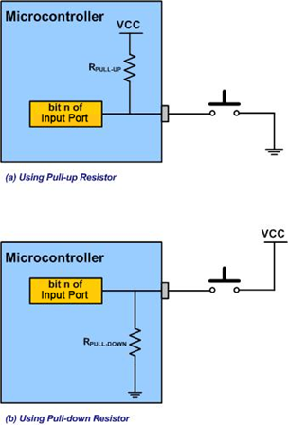
Connecting external switches to the microcontroller

Slide 25
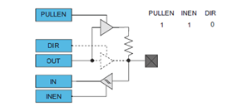
An input pin configured with pull-up/down enabled

Slide 26

PINCFG register

Slide 27
Bit descriptions of PINCFG registers
BIT | Field | Description
6 | DRVSTR | Output Driver Strength Selection 0: Pin drive strength is set to normal drive strength. 1: Pin drive strength is set to stronger drive strength.
2 | PULLEN | Pull Enable 0: Internal pull resistor is disabled, and the input is in a high-impedance configuration. 1: Internal pull resistor is enabled, and the input is driven to a defined logic level in the absence of external input.
1 | INEN | Input Enable 0: Input buffer for the I/O pin is disabled, and the input value will not be sampled. 1: Input buffer for the I/O pin is enabled, and the input value will be sampled when required.
0 | PMUXEN | Peripheral Multiplexer Enable 0: The peripheral multiplexer selection is disabled, and the PORT registers control the direction and output drive value. 1: The peripheral multiplexer selection is enabled, and the selected peripheral controls the direction and output drive value.

Slide 28
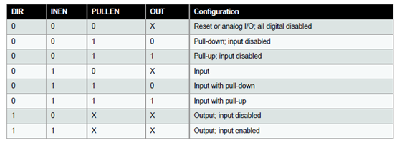
GPIO pin configurations

Slide 29
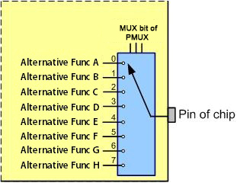
Pin multiplexing of alternate functions

Slide 30

PINCFGn register (notice the PMUXEN bit)

Slide 31

PMUX Register is used to select alternate pin functions

Slide 32
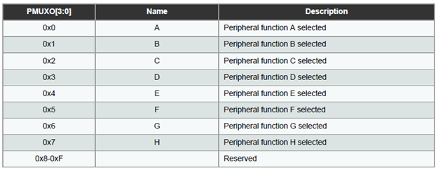
PMUX register options

Slide 33
Atmel SAM D21 Alternative Pin Functions
 |  | A (0) | B (1) |  |  |  |  | C (2) | D (3) | E (4) | F (5) | G (6) | H (7)
I/O Pin | Supply | EIC | REF | ADC | AC | PTC | DAC | SERCOM | SERCOM-ALT | TC/TCC | TCC | COM | AC/GCLK
PA00 | VDDANA | EXTINT[0] |  |  |  |  |  |  | SERCOM1/PAD[0] | TCC2/WO[0]
PA01 | VDDANA | EXTINT[1] |  |  |  |  |  |  | SERCOM1/PAD[1] | TCC2/WO[1]
PA02 | VDDANA | EXTINT[2] |  | AIN[0] |  | Y[0] | VOUT
PA03 | VDDANA | EXTINT[3] | ADC/VREFA DAC/VREFA | AIN[1] |  | Y[1]
PA04 | VDDANA | EXTINT[4] | ADC/VREFB | AIN[4] | AIN[0] | Y[2] |  |  | SERCOM0/PAD[0] | TCC0/WO[0]
PA05 | VDDANA | EXTINT[5] |  | AIN[5] | AIN[1] | Y[3] |  |  | SERCOM0/PAD[1] | TCC0/WO[1]
PA06 | VDDANA | EXTINT[6] |  | AIN[6] | AIN[2] | Y[4] |  |  | SERCOM0/PAD[2] | TCC1/WO[0]
PA07 | VDDANA | EXTINT[7] |  | AIN[7] | AIN[3] | Y[5] |  |  | SERCOM0/PAD[3] | TCC1/WO[1] |  | I2S/SD[0]
PA08 | VDDIO | NMI |  | AIN[16] |  | X[0] |  | SERCOM0/PAD[0] | SERCOM2/PAD[0] | TCC0/WO[0] | TCC1/WO[2] | I2S/SD[1]
PA09 | VDDIO | EXTINT[9] |  | AIN[17] |  | X[1] |  | SERCOM0/PAD[1] | SERCOM2/PAD[1] | TCC0/WO[1] | TCC1/WO[3] | I2S/MCK[0]
PA10 | VDDIO | EXTINT[10] |  | AIN[18] |  | X[2] |  | SERCOM0/PAD[2] | SERCOM2/PAD[2] | TCC1/WO[0] | TCC0/WO[2] | I2S/SCK[0] | GCLK_IO[4]
PA11 | VDDIO | EXTINT[11] |  | AIN[19] |  | X[3] |  | SERCOM0/PAD[3] | SERCOM2/PAD[3] | TCC1/WO[1] | TCC0/WO[3] | I2S/FS[0] | GCLK_IO[5]
PA12 | VDDIO | EXTINT[12] |  |  |  |  |  | SERCOM2/PAD[0] | SERCOM4/PAD[0] | TCC2/WO[0] | TCC0/WO[6] |  | AC/CMP[0]
PA13 | VDDIO | EXTINT[13] |  |  |  |  |  | SERCOM2/PAD[1] | SERCOM4/PAD[1] | TCC2/WO[1] | TCC0/WO[7] |  | AC/CMP[1]
PA14 | VDDIO | EXTINT[14] |  |  |  |  |  | SERCOM2/PAD[2] | SERCOM4/PAD[2] | TC3/WO[0] | TCC0/WO[4] |  | GCLK_IO[0]
PA15 | VDDIO | EXTINT[15] |  |  |  |  |  | SERCOM2/PAD[3] | SERCOM4/PAD[3] | TC3/WO[1] | TCC0/WO[5] |  | GCLK_IO[1]
PA16 | VDDIO | EXTINT[0] |  |  |  | X[4] |  | SERCOM1/PAD[0] | SERCOM3/PAD[0] | TCC2/WO[0] | TCC0/WO[6] |  | GCLK_IO[2]
PA17 | VDDIO | EXTINT[1] |  |  |  | X[5] |  | SERCOM1/PAD[1] | SERCOM3/PAD[1] | TCC2/WO[1] | TCC0/WO[7] |  | GCLK_IO[3]
PA18 | VDDIO | EXTINT[2] |  |  |  | X[6] |  | SERCOM1/PAD[2] | SERCOM3/PAD[2] | TC3/WO[0] | TCC0/WO[2] |  | AC/CMP[0]
PA19 | VDDIO | EXTINT[3] |  |  |  | X[7] |  | SERCOM1/PAD[3] | SERCOM3/PAD[3] | TC3/WO[1] | TCC0/WO[3] | I2S/SD[0] | AC/CMP[1]
PA20 | VDDIO | EXTINT[4] |  |  |  | X[8] |  | SERCOM5/PAD[2] | SERCOM3/PAD[2] | TC7/WO[0] | TCC0/WO[6] | I2S/SCK[0] | GCLK_IO[4]
PA21 | VDDIO | EXTINT[5] |  |  |  | X[9] |  | SERCOM5/PAD[3] | SERCOM3/PAD[3] | TC7/WO[1] | TCC0/WO[7] | I2S/FS[0] | GCLK_IO[5]
PA22 | VDDIO | EXTINT[6] |  |  |  | X[10] |  | SERCOM3/PAD[0] | SERCOM5/PAD[0] | TC4/WO[0] | TCC0/WO[4] |  | GCLK_IO[6]
PA23 | VDDIO | EXTINT[7] |  |  |  | X[11] |  | SERCOM3/PAD[1] | SERCOM5/PAD[1] | TC4/WO[1] | TCC0/WO[5] | USB/SOF 1kHz | GCLK_IO[7]

Slide 34
Atmel SAM D21 Alternative Pin Functions
PA24 | VDDIO | EXTINT[12] |  |  |  |  |  | SERCOM3/PAD[2] | SERCOM5/PAD[2] | TC5/WO[0] | TCC1/WO[2] | USB/DM
PA25 | VDDIO | EXTINT[13] |  |  |  |  |  | SERCOM3/PAD[3] | SERCOM5/PAD[3] | TC5/WO[1] | TCC1/WO[3] | USB/DP
PA27 | VDDIO | EXTINT[15] |  |  |  |  |  |  |  |  |  |  | GCLK_IO[0]
PA28 | VDDIO | EXTINT[8] |  |  |  |  |  |  |  |  |  |  | GCLK_IO[0]
PA30 | VDDIO | EXTINT[10] |  |  |  |  |  |  | SERCOM1/PAD[2] | TCC1/WO[0] |  | SWCLK | GCLK_IO[0]
PA31 | VDDIO | EXTINT[11] |  |  |  |  |  |  | SERCOM1/PAD[3] | TCC1/WO[1] |  | SWDIO(4)
PB00 | VDDANA | EXTINT[0] |  | AIN[8] |  | Y[6] |  |  | SERCOM5/PAD[2] | TC7/WO[0]
PB01 | VDDANA | EXTINT[1] |  | AIN[9] |  | Y[7] |  |  | SERCOM5/PAD[3] | TC7/WO[1]
PB02 | VDDANA | EXTINT[2] |  | AIN[10] |  | Y[8] |  |  | SERCOM5/PAD[0] | TC6/WO[0]
PB03 | VDDANA | EXTINT[3] |  | AIN[11] |  | Y[9] |  |  | SERCOM5/PAD[1] | TC6/WO[1]
PB04 | VDDANA | EXTINT[4] |  | AIN[12] |  | Y[10]
PB05 | VDDANA | EXTINT[5] |  | AIN[13] |  | Y[11]
PB06 | VDDANA | EXTINT[6] |  | AIN[14] |  | Y[12]
PB07 | VDDANA | EXTINT[7] |  | AIN[15] |  | Y[13]
PB08 | VDDANA | EXTINT[8] |  | AIN[2] |  | Y[14] |  |  | SERCOM4/PAD[0] | TC4/WO[0]
PB09 | VDDANA | EXTINT[9] |  | AIN[3] |  | Y[15] |  |  | SERCOM4/PAD[1] | TC4/WO[1]
PB10 | VDDIO | EXTINT[10] |  |  |  |  |  |  | SERCOM4/PAD[2] | TC5/WO[0] | TCC0/WO[4] | I2S/MCK[1] | GCLK_IO[4]
PB11 | VDDIO | EXTINT[11] |  |  |  |  |  |  | SERCOM4/PAD[3] | TC5/WO[1] | TCC0/WO[5] | I2S/SCK[1] | GCLK_IO[5]
PB12 | VDDIO | EXTINT[12] |  |  |  | X[12] |  | SERCOM4/PAD[0] |  | TC4/WO[0] | TCC0/WO[6] | I2S/FS[1] | GCLK_IO[6]
PB13 | VDDIO | EXTINT[13] |  |  |  | X[13] |  | SERCOM4/PAD[1] |  | TC4/WO[1] | TCC0/WO[7] |  | GCLK_IO[7]
PB14 | VDDIO | EXTINT[14] |  |  |  | X[14] |  | SERCOM4/PAD[2] |  | TC5/WO[0] |  |  | GCLK_IO[0]
PB15 | VDDIO | EXTINT[15] |  |  |  | X[15] |  | SERCOM4/PAD[3] |  | TC5/WO[1] |  |  | GCLK_IO[1]
PB16 | VDDIO | EXTINT[0] |  |  |  |  |  | SERCOM5/PAD[0] |  | TC6/WO[0] | TCC0/WO[4] | I2S/SD[1] | GCLK_IO[2]
PB17 | VDDIO | EXTINT[1] |  |  |  |  |  | SERCOM5/PAD[1] |  | TC6/WO[1] | TCC0/WO[5] | I2S/MCK[0] | GCLK_IO[3]
PB22 | VDDIO | EXTINT[6] |  |  |  |  |  |  | SERCOM5/PAD[2] | TC7/WO[0] |  |  | GCLK_IO[0]
PB23 | VDDIO | EXTINT[7] |  |  |  |  |  |  | SERCOM5/PAD[3] | TC7/WO[1] |  |  | GCLK_IO[1]
PB30 | VDDIO | EXTINT[14] |  |  |  |  |  |  | SERCOM5/PAD[0] | TCC0/WO[0] | TCC1/WO[2]
PB31 | VDDIO | EXTINT[15] |  |  |  |  |  |  | SERCOM5/PAD[1] | TCC0/WO[1] | TCC1/WO[3]

Slide 35
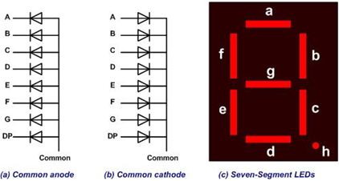
Seven-segment Display

Slide 36
Assignments of port pins to each segments of a 7-seg LED
D7 | D6 | D5 | D4 | D3 | D2 | D1 | D0
. | g | F | e | d | c | b | a

Slide 37
Segment patterns for the 10 decimal digits for a common cathode 7-seg LED
Num | D7 | D6 | D5 | D4 | D3 | D2 | D1 | D0 | Hex value
 | . | g | f | e | d | c | b | a
0 | 0 | 0 | 1 | 1 | 1 | 1 | 1 | 1 | 0x3F
1 | 0 | 0 | 0 | 0 | 0 | 1 | 1 | 0 | 0x06
2 | 0 | 1 | 0 | 1 | 1 | 0 | 1 | 1 | 0x5B
3 | 0 | 1 | 0 | 0 | 1 | 1 | 1 | 1 | 0x4F
4 | 0 | 1 | 1 | 0 | 0 | 1 | 1 | 0 | 0x66
5 | 0 | 1 | 1 | 0 | 1 | 1 | 0 | 1 | 0x6D
6 | 0 | 1 | 1 | 1 | 1 | 1 | 0 | 1 | 0x7D
7 | 0 | 0 | 0 | 0 | 0 | 1 | 1 | 1 | 0x07
8 | 0 | 1 | 1 | 1 | 1 | 1 | 1 | 1 | 0x7F
9 | 0 | 1 | 1 | 0 | 1 | 1 | 1 | 1 | 0x6F

Slide 38
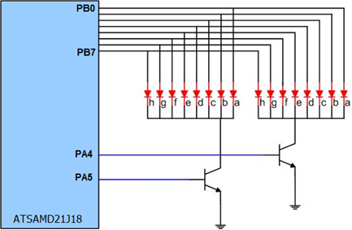
Connections between microcontroller and a two-digit 7-segment LED

Slide 39
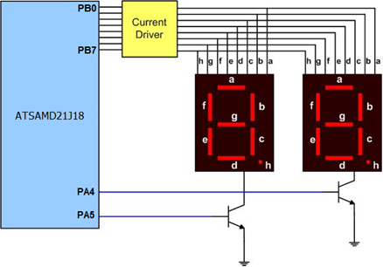
Connections between microcontroller and 7-segment LED with drivers

