Slide 1
Chapter 4
UART Serial Port Programming

Slide 2
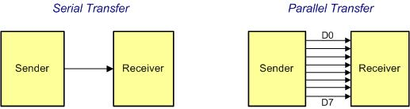
Serial vs. Parallel Data Transfer

Slide 3
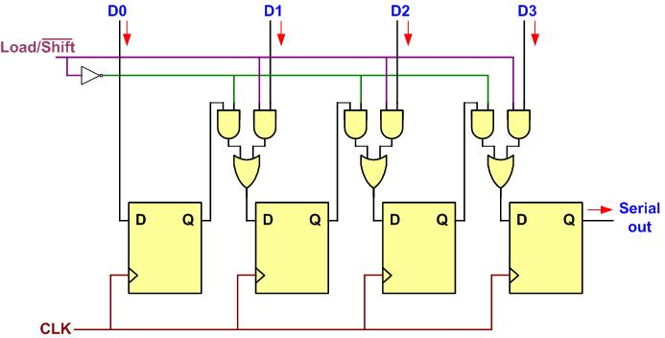
Parallel In Serial Out

Slide 4
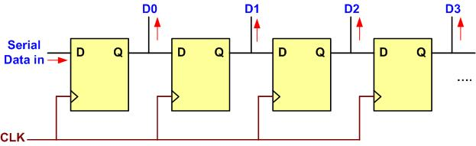
Serial In Parallel Out

Slide 5
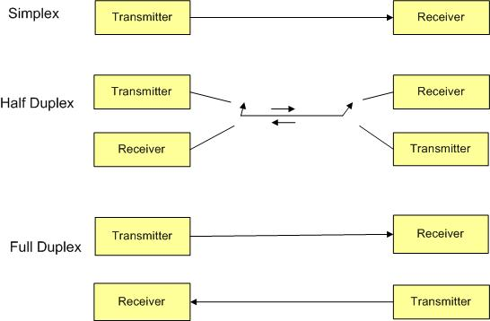
Simplex, Half-, and Full-Duplex Transfers

Slide 6
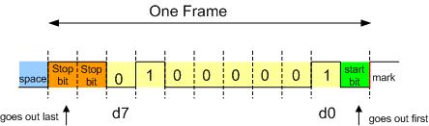
Framing ASCII "A" (0x41)

Slide 7
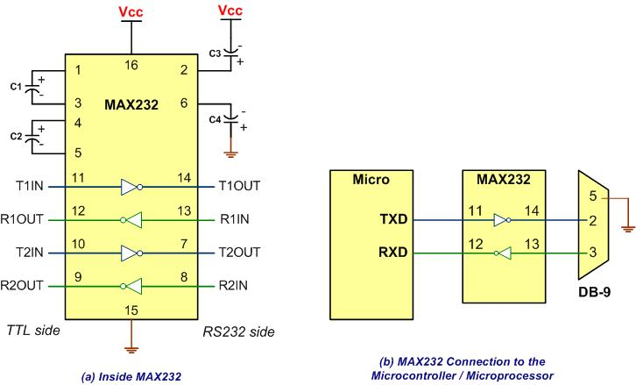
MAX232

Slide 8
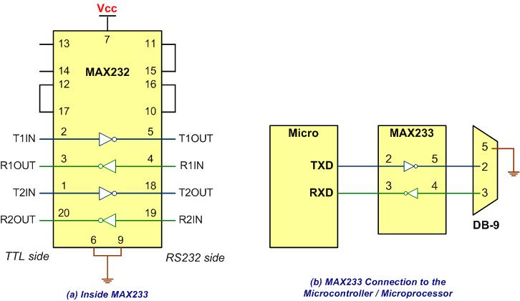
MAX233

Slide 9
RS232 Pins
Pin | Description
1 | Data carrier detect (DCD)
2 | Received data (RxD)
3 | Transmitted data (TxD)
4 | Data terminal ready (DTR)
5 | Signal ground (GND)
6 | Data set ready (DSR)
7 | Request to send (RTS)
8 | Clear to send (CTS)
9 | Ring indicator (RI)

Slide 10
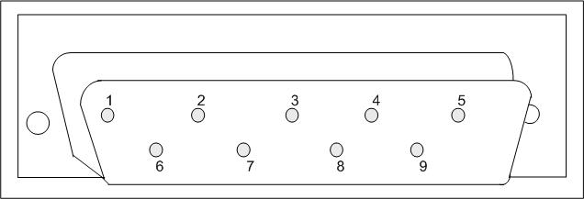
9-Pin Male Connector

Slide 11
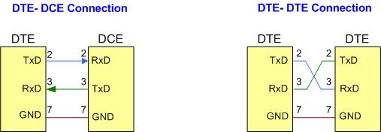
DTE-DCE and DTE-DTE Connections

Slide 12
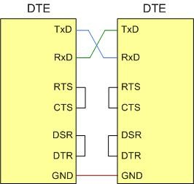
Null Modem Connection with Flow Control Signals

Slide 13
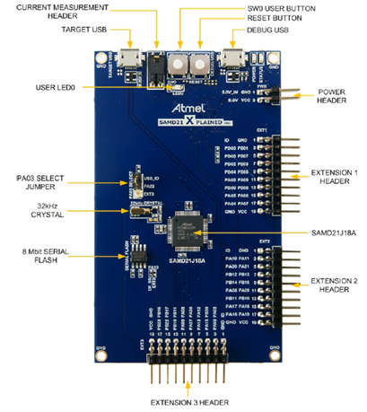
Atmel SAMD21 Xplained Pro board

Slide 14
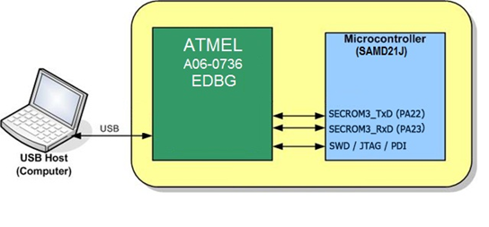
Embedded Debug USB port

Slide 15
Partial list of SERCOMx Registers and their addresses
Register Name | Register Function | Register Address Offset (Hex)
CTRLA | Control A | 0000
CTRLB | Control B | 0004
BAUD | Baud Rate | 000C
INTFLAG | Interrupt Flag | 0018
STATUS | Status 1 | 001A
DATA | DATA | 0028

Slide 16
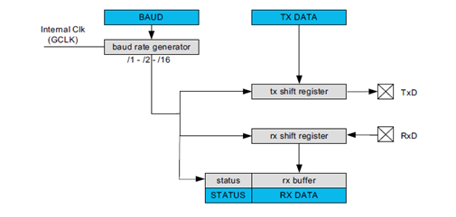
A Simplified Block Diagram of UART

Slide 17
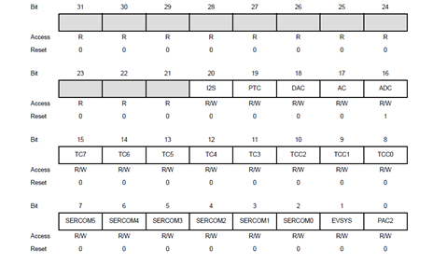
APBC MASK Resgister bit assignments

Slide 18
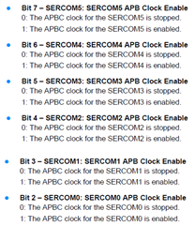
APBC MASK Resgister bit assignments

Slide 19

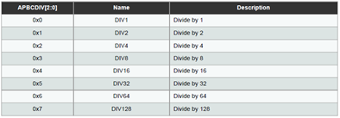
APBC Clock Select Resgister bit assignment

Slide 20
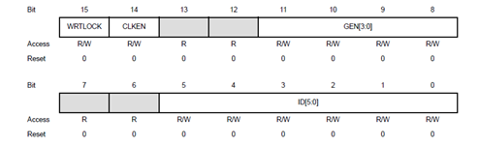
Generic Clock Control Resgister bit assignment

Slide 21

Clock division for SERCOM in USART mode

Slide 22
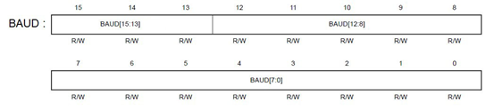
BAUD Register (as a 16-bit integer in arithmetic mode)

Slide 23
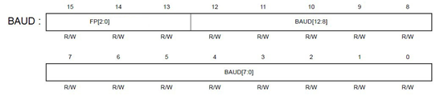
BAUD register with fraction in fraction mode

Slide 24

CTLA Register bits for sample rate factor

Slide 25
Sample rate options in CTRLA register
SAMPR[2:0] | Descriptions
0x0 | 16x over-sampling using arithmetic baud rate generation.
0x1 | 16x over-sampling using fractional baud rate generation.
0x2 | 8x over-sampling using arithmetic baud rate generation.
0x3 | 8x over-sampling using fractional baud rate generation.
0x4 | 3x over-sampling using arithmetic baud rate generation.
0x5-0x7 | Reserved

Slide 26
BAUD Register Values for Some Baud Rates using S=16 and clock of 48 MHz
Baud rate | BAUD (in decimal) | BAUD (in hex)
4,800 | 65,431 | 0xFF97
9,600 | 65,326 | 0xFF2E
19,200 | 65,117 | 0xFE5D
38,400 | 64,697 | 0xFCB9
115,200 | 63,019 | 0xF62B

Slide 27
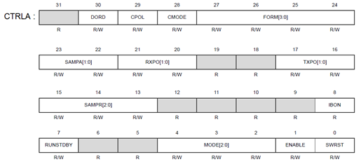
UART Control A (CTRLA) register

Slide 28
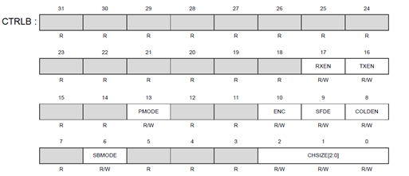
UART Control B (CTRLB) register

Slide 29
UART Data (DATA) register

Slide 30
UART Interrupt Flag Register (INTFLAG)

Slide 31
UART Interrupt Flag register (INTFLAG)
Field | Bit | Description
ERROR | 7 | Error This flag is cleared by writing a one to it. This bit is set when any error is detected. Errors that will set this flag have corresponding status flags in the STATUS register. Errors that will set this flag are COLL, ISF, BUFOVF, FERR, and PERR. 0 = No effect 1 = Clear the flag
 | 6 | Reserved
RXBRK | 5 | Receive Break This flag is cleared by writing a one to it. This flag is set when auto-baud is enabled (CTRLA.FORM) and a break character is received. 0 = No effect 1 = Clear the flag
CTSIC | 4 | Clear to Send Input Change This flag is cleared by writing a one to it. This flag is set when a change is detected on the CTS pin. 0 = No effect 1 = Clear the flag

Slide 32
UART Interrupt Flag register (INTFLAG)
Field | Bit | Description
RXS | 3 | Receive Start This flag is cleared by writing a one to it. This flag is set when a start condition is detected on the RxD line and start-of-frame detection is enabled (CTRLB.SFDE is one). 0 = No effect 1 = Clear the Receive Start interrupt flag
RXC | 2 | Receive Complete This flag is cleared by reading the Data register (DATA) or by disabling the receiver. This flag is set when there are unread data in DATA 0 = No effect 1 = No effect
TXC | 1 | Transmit Complete This flag is cleared by writing a one to it or by writing new data to DATA. This flag is set when the entire frame in the transmit shift register has been shifted out and there are no new data in DATA. 0 = No effect 1 = Clear the flag
DRE | 0 | Data Register Empty This flag is cleared by writing new data to DATA. This flag is set when DATA is empty and ready to be written. 0 = No effect 1 = No effect

Slide 33
UART Status Register (STATUS)

Slide 34

PINCFGn register (notice the PMUXEN bit)

Slide 35

PMUX register for choosing peripheral functions

Slide 36
SAMD2x Signals Used for UART (See CTRLA register)
TXPO[1:0] | PAD | RXPO[1:0] | PAD
0x0 | PAD[0] | 0x0 | PAD[0]
0x1 | PAD[2] | 0x1 | PAD[1]
0x2 | PAD[0] | 0x2 | PAD[2]
0x3 | Reserved | 0x3 | PAD[3]

Slide 37
Pin Multiplexing SAMD21J
 |  | A (0) | B (1) |  |  |  |  | C (2) | D (3) | E (4) | F (5) | G (6) | H (7)
I/O Pin | Supply | EIC | REF | ADC | AC | PTC | DAC | SERCOM | SERCOM-ALT | TC/TCC | TCC | COM | AC/GCLK
PA00 | VDDANA | EXTINT[0] |  |  |  |  |  |  | SERCOM1/PAD[0] | TCC2/WO[0]
PA01 | VDDANA | EXTINT[1] |  |  |  |  |  |  | SERCOM1/PAD[1] | TCC2/WO[1]
PA02 | VDDANA | EXTINT[2] |  | AIN[0] |  | Y[0] | VOUT
PA03 | VDDANA | EXTINT[3] | ADC/VREFA DAC/VREFA | AIN[1] |  | Y[1]
PA04 | VDDANA | EXTINT[4] | ADC/VREFB | AIN[4] | AIN[0] | Y[2] |  |  | SERCOM0/PAD[0] | TCC0/WO[0]
PA05 | VDDANA | EXTINT[5] |  | AIN[5] | AIN[1] | Y[3] |  |  | SERCOM0/PAD[1] | TCC0/WO[1]
PA06 | VDDANA | EXTINT[6] |  | AIN[6] | AIN[2] | Y[4] |  |  | SERCOM0/PAD[2] | TCC1/WO[0]
PA07 | VDDANA | EXTINT[7] |  | AIN[7] | AIN[3] | Y[5] |  |  | SERCOM0/PAD[3] | TCC1/WO[1] |  | I2S/SD[0]
PA08 | VDDIO | NMI |  | AIN[16] |  | X[0] |  | SERCOM0/PAD[0] | SERCOM2/PAD[0] | TCC0/WO[0] | TCC1/WO[2] | I2S/SD[1]
PA09 | VDDIO | EXTINT[9] |  | AIN[17] |  | X[1] |  | SERCOM0/PAD[1] | SERCOM2/PAD[1] | TCC0/WO[1] | TCC1/WO[3] | I2S/MCK[0]
PA10 | VDDIO | EXTINT[10] |  | AIN[18] |  | X[2] |  | SERCOM0/PAD[2] | SERCOM2/PAD[2] | TCC1/WO[0] | TCC0/WO[2] | I2S/SCK[0] | GCLK_IO[4]
PA11 | VDDIO | EXTINT[11] |  | AIN[19] |  | X[3] |  | SERCOM0/PAD[3] | SERCOM2/PAD[3] | TCC1/WO[1] | TCC0/WO[3] | I2S/FS[0] | GCLK_IO[5]
PA12 | VDDIO | EXTINT[12] |  |  |  |  |  | SERCOM2/PAD[0] | SERCOM4/PAD[0] | TCC2/WO[0] | TCC0/WO[6] |  | AC/CMP[0]
PA13 | VDDIO | EXTINT[13] |  |  |  |  |  | SERCOM2/PAD[1] | SERCOM4/PAD[1] | TCC2/WO[1] | TCC0/WO[7] |  | AC/CMP[1]
PA14 | VDDIO | EXTINT[14] |  |  |  |  |  | SERCOM2/PAD[2] | SERCOM4/PAD[2] | TC3/WO[0] | TCC0/WO[4] |  | GCLK_IO[0]
PA15 | VDDIO | EXTINT[15] |  |  |  |  |  | SERCOM2/PAD[3] | SERCOM4/PAD[3] | TC3/WO[1] | TCC0/WO[5] |  | GCLK_IO[1]
PA16 | VDDIO | EXTINT[0] |  |  |  | X[4] |  | SERCOM1/PAD[0] | SERCOM3/PAD[0] | TCC2/WO[0] | TCC0/WO[6] |  | GCLK_IO[2]
PA17 | VDDIO | EXTINT[1] |  |  |  | X[5] |  | SERCOM1/PAD[1] | SERCOM3/PAD[1] | TCC2/WO[1] | TCC0/WO[7] |  | GCLK_IO[3]
PA18 | VDDIO | EXTINT[2] |  |  |  | X[6] |  | SERCOM1/PAD[2] | SERCOM3/PAD[2] | TC3/WO[0] | TCC0/WO[2] |  | AC/CMP[0]
PA19 | VDDIO | EXTINT[3] |  |  |  | X[7] |  | SERCOM1/PAD[3] | SERCOM3/PAD[3] | TC3/WO[1] | TCC0/WO[3] | I2S/SD[0] | AC/CMP[1]
PA20 | VDDIO | EXTINT[4] |  |  |  | X[8] |  | SERCOM5/PAD[2] | SERCOM3/PAD[2] | TC7/WO[0] | TCC0/WO[6] | I2S/SCK[0] | GCLK_IO[4]
PA21 | VDDIO | EXTINT[5] |  |  |  | X[9] |  | SERCOM5/PAD[3] | SERCOM3/PAD[3] | TC7/WO[1] | TCC0/WO[7] | I2S/FS[0] | GCLK_IO[5]
PA22 | VDDIO | EXTINT[6] |  |  |  | X[10] |  | SERCOM3/PAD[0] | SERCOM5/PAD[0] | TC4/WO[0] | TCC0/WO[4] |  | GCLK_IO[6]
PA23 | VDDIO | EXTINT[7] |  |  |  | X[11] |  | SERCOM3/PAD[1] | SERCOM5/PAD[1] | TC4/WO[1] | TCC0/WO[5] | USB/SOF 1kHz | GCLK_IO[7]
PA24 | VDDIO | EXTINT[12] |  |  |  |  |  | SERCOM3/PAD[2] | SERCOM5/PAD[2] | TC5/WO[0] | TCC1/WO[2] | USB/DM
PA25 | VDDIO | EXTINT[13] |  |  |  |  |  | SERCOM3/PAD[3] | SERCOM5/PAD[3] | TC5/WO[1] | TCC1/WO[3] | USB/DP
PA27 | VDDIO | EXTINT[15] |  |  |  |  |  |  |  |  |  |  | GCLK_IO[0]
PA28 | VDDIO | EXTINT[8] |  |  |  |  |  |  |  |  |  |  | GCLK_IO[0]
PA30 | VDDIO | EXTINT[10] |  |  |  |  |  |  | SERCOM1/PAD[2] | TCC1/WO[0] |  | SWCLK | GCLK_IO[0]
PA31 | VDDIO | EXTINT[11] |  |  |  |  |  |  | SERCOM1/PAD[3] | TCC1/WO[1] |  | SWDIO(4)
PB00 | VDDANA | EXTINT[0] |  | AIN[8] |  | Y[6] |  |  | SERCOM5/PAD[2] | TC7/WO[0]
PB01 | VDDANA | EXTINT[1] |  | AIN[9] |  | Y[7] |  |  | SERCOM5/PAD[3] | TC7/WO[1]
PB02 | VDDANA | EXTINT[2] |  | AIN[10] |  | Y[8] |  |  | SERCOM5/PAD[0] | TC6/WO[0]
PB03 | VDDANA | EXTINT[3] |  | AIN[11] |  | Y[9] |  |  | SERCOM5/PAD[1] | TC6/WO[1]
PB04 | VDDANA | EXTINT[4] |  | AIN[12] |  | Y[10]
PB05 | VDDANA | EXTINT[5] |  | AIN[13] |  | Y[11]
PB06 | VDDANA | EXTINT[6] |  | AIN[14] |  | Y[12]
PB07 | VDDANA | EXTINT[7] |  | AIN[15] |  | Y[13]
PB08 | VDDANA | EXTINT[8] |  | AIN[2] |  | Y[14] |  |  | SERCOM4/PAD[0] | TC4/WO[0]
PB09 | VDDANA | EXTINT[9] |  | AIN[3] |  | Y[15] |  |  | SERCOM4/PAD[1] | TC4/WO[1]
PB10 | VDDIO | EXTINT[10] |  |  |  |  |  |  | SERCOM4/PAD[2] | TC5/WO[0] | TCC0/WO[4] | I2S/MCK[1] | GCLK_IO[4]
PB11 | VDDIO | EXTINT[11] |  |  |  |  |  |  | SERCOM4/PAD[3] | TC5/WO[1] | TCC0/WO[5] | I2S/SCK[1] | GCLK_IO[5]
PB12 | VDDIO | EXTINT[12] |  |  |  | X[12] |  | SERCOM4/PAD[0] |  | TC4/WO[0] | TCC0/WO[6] | I2S/FS[1] | GCLK_IO[6]
PB13 | VDDIO | EXTINT[13] |  |  |  | X[13] |  | SERCOM4/PAD[1] |  | TC4/WO[1] | TCC0/WO[7] |  | GCLK_IO[7]
PB14 | VDDIO | EXTINT[14] |  |  |  | X[14] |  | SERCOM4/PAD[2] |  | TC5/WO[0] |  |  | GCLK_IO[0]
PB15 | VDDIO | EXTINT[15] |  |  |  | X[15] |  | SERCOM4/PAD[3] |  | TC5/WO[1] |  |  | GCLK_IO[1]
PB16 | VDDIO | EXTINT[0] |  |  |  |  |  | SERCOM5/PAD[0] |  | TC6/WO[0] | TCC0/WO[4] | I2S/SD[1] | GCLK_IO[2]
PB17 | VDDIO | EXTINT[1] |  |  |  |  |  | SERCOM5/PAD[1] |  | TC6/WO[1] | TCC0/WO[5] | I2S/MCK[0] | GCLK_IO[3]
PB22 | VDDIO | EXTINT[6] |  |  |  |  |  |  | SERCOM5/PAD[2] | TC7/WO[0] |  |  | GCLK_IO[0]
PB23 | VDDIO | EXTINT[7] |  |  |  |  |  |  | SERCOM5/PAD[3] | TC7/WO[1] |  |  | GCLK_IO[1]
PB30 | VDDIO | EXTINT[14] |  |  |  |  |  |  | SERCOM5/PAD[0] | TCC0/WO[0] | TCC1/WO[2]

Slide 38
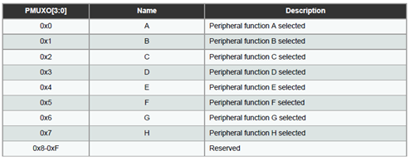
PMUX register options

