Slide 1
Chapter 5
Atmel ARM Timer Programming

Slide 2
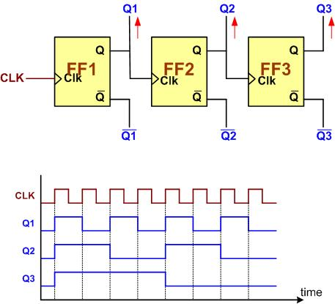
A 3-bit Counter

Slide 3

An 8-bit up-counter stages

Slide 4

An 8-bit down-counter stages

Slide 5

Counting Events Using a Counter

Slide 6
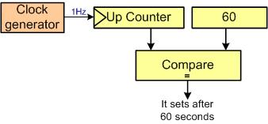
Using Counter as a Timer

Slide 7

Capturing

Slide 8
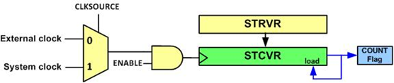
System Tick Timer Internal Structure

Slide 9
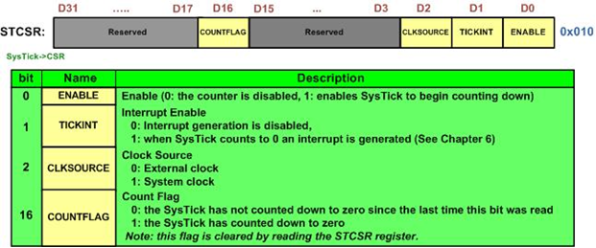
STCTRL (System Tick Control)

Slide 10
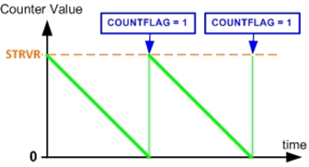
System Tick Counting

Slide 11
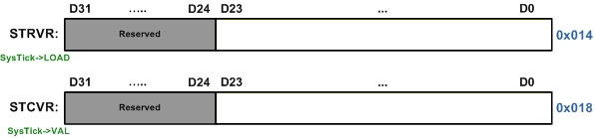
STRVR vs. STCVR

Slide 12
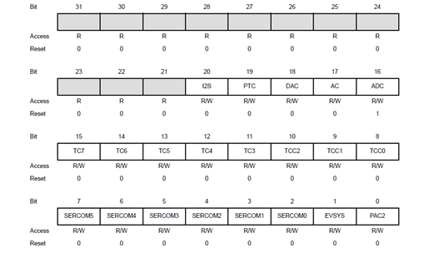

Bits 15-8 of APBCMASK Register is used to enable timer clock

Slide 13
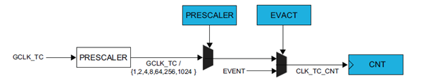
Atmel SAMD2x Timer/Counter Prescale Options

Slide 14

ID numbers of Timer Counter Clocks

Slide 15
Some of the Atmel SAMD2x Timer/Counter Registers
Offset | Register Name
0x00 | CTRLA
0x01
0x04 | CTRLBCLR
0x05 | CTRLBSET
0x06 | CTRLC
0x0A | EVCTRL
0x0B
0x0E | INTFLAG
0x0F | STATUS
0x10 | COUNT
0x11
0x12
0x13
0x18 | CC0
0x19
0x1A
0x1B
0x1C | CC1
0x1D
0x1E
0x1F

Slide 16
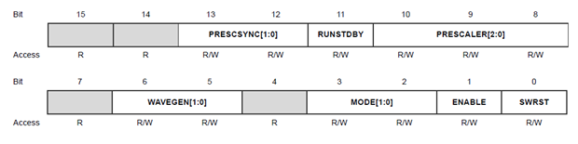
CTRLA (Control A) Register

Slide 17
CTRLA register
bit | Name | Description
0 | SWRST | Software Reset 0: There is no reset operation ongoing. 1: The reset operation is ongoing.
1 | ENABLE | Enable 0: The peripheral is disabled. 1: The peripheral is enabled.
3-2 | MODE[1:0] | Timer/Counter n-bit Mode 0x0: 16-bit 0x1: 8-bit 0x2: 32-bit
6-5 | WAVEGEN[1:0] | Waveform Generation Operation
10-8 | PRESCALER[2:0] | Prescaler 0x0: divide by 1 0x1: divide by 2 0x2: divide by 4 0x3: divide by 8 0x4: divide by 16 0x5: divide by 64 0x6: divide by 256 0x7: divide by 1024
11 | RUNSTDBY | Run in Standby 0: The TCC is halted in standby. 1: The TCC continues to run in standby.
13-12 | PRESCSYNC[1:0] | Prescaler and Counter Synchronization Selection

Slide 18
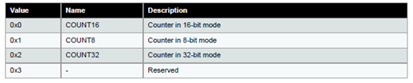
n-bit options

Slide 19
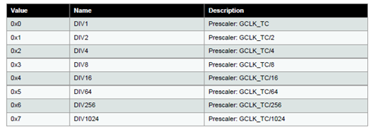
Prescaler Options

Slide 20
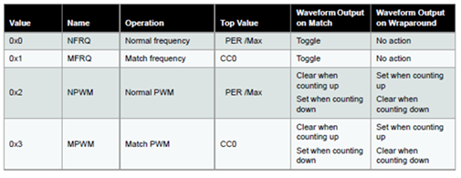
Wave Generation Options

Slide 21

CTRLBCLR Register

Slide 22

CTRLBSET Register

Slide 23

INTFLAG Register

Slide 24
INTFLAG Register Bits
bit | Name | Description
5-4 | MCx | Match or Capture Channel x This flag is set on the next CLK_TC_CNT cycle after a match with the compare condition or once CCx register contains a valid capture value.
0 | OVF | Overflow This flag is set on the next CLK_TC_CNT cycle after an overflow condition occurs.

Slide 25
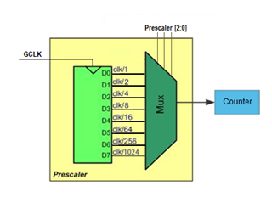
Timer Options for Prescaler

Slide 26
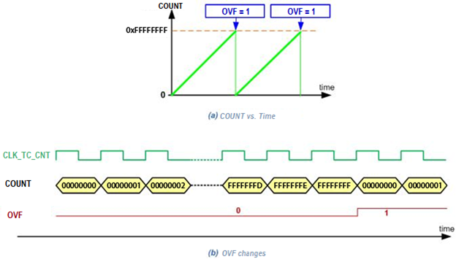
TC counter counting in 32-bit Mode

Slide 27
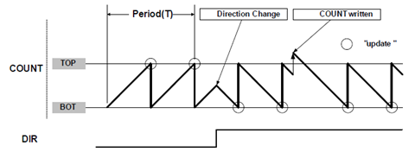
Counter operations with direction and counter value changes on the fly

Slide 28
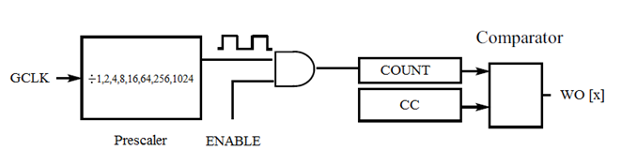
COUNT and Compare registers with Waveform Output

Slide 29
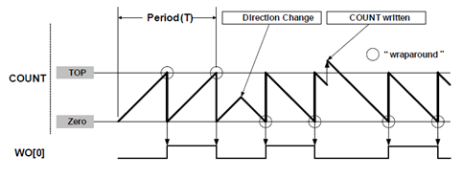
Match Frequency Operation with Waveform Output 0 (WO[0])

Slide 30
Port pin assignement of Timer/Counters
TC/WO | I/O Pin
TC3/WO[0] | PA14 | PA18
TC3/WO[1] | PA15 | PA19
TC4/WO[0] | PA22 | PB08 | PB12
TC4/WO[1] | PA23 | PB09 | PB13
TC5/WO[0] | PA24 | PB10 | PB14
TC5/WO[1] | PA25 | PB11 | PB15
TC6/WO[0] | PB02 | PB16
TC6/WO[1] | PB03 | PB17
TC7/WO[0] | PA20 | PB00 | PB22
TC7/WO[1] | PA21 | PB01 | PB23

Slide 31

PMUX Register is used to select multiplexing pin functions

Slide 32
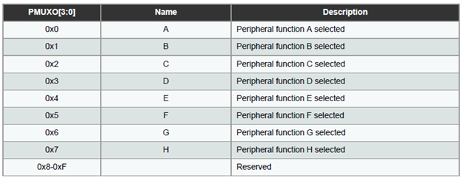
PMUX register options

Slide 33
Atmel SAM D21 Alternative Pin Functions
 |  | A (0) | B (1) |  |  |  |  | C (2) | D (3) | E (4) | F (5) | G (6) | H (7)
I/O Pin | Supply | EIC | REF | ADC | AC | PTC | DAC | SERCOM | SERCOM-ALT | TC/TCC | TCC | COM | AC/GCLK
PA00 | VDDANA | EXTINT[0] |  |  |  |  |  |  | SERCOM1/PAD[0] | TCC2/WO[0]
PA01 | VDDANA | EXTINT[1] |  |  |  |  |  |  | SERCOM1/PAD[1] | TCC2/WO[1]
PA02 | VDDANA | EXTINT[2] |  | AIN[0] |  | Y[0] | VOUT
PA03 | VDDANA | EXTINT[3] | ADC/VREFA DAC/VREFA | AIN[1] |  | Y[1]
PA04 | VDDANA | EXTINT[4] | ADC/VREFB | AIN[4] | AIN[0] | Y[2] |  |  | SERCOM0/PAD[0] | TCC0/WO[0]
PA05 | VDDANA | EXTINT[5] |  | AIN[5] | AIN[1] | Y[3] |  |  | SERCOM0/PAD[1] | TCC0/WO[1]
PA06 | VDDANA | EXTINT[6] |  | AIN[6] | AIN[2] | Y[4] |  |  | SERCOM0/PAD[2] | TCC1/WO[0]
PA07 | VDDANA | EXTINT[7] |  | AIN[7] | AIN[3] | Y[5] |  |  | SERCOM0/PAD[3] | TCC1/WO[1] |  | I2S/SD[0]
PA08 | VDDIO | NMI |  | AIN[16] |  | X[0] |  | SERCOM0/PAD[0] | SERCOM2/PAD[0] | TCC0/WO[0] | TCC1/WO[2] | I2S/SD[1]
PA09 | VDDIO | EXTINT[9] |  | AIN[17] |  | X[1] |  | SERCOM0/PAD[1] | SERCOM2/PAD[1] | TCC0/WO[1] | TCC1/WO[3] | I2S/MCK[0]
PA10 | VDDIO | EXTINT[10] |  | AIN[18] |  | X[2] |  | SERCOM0/PAD[2] | SERCOM2/PAD[2] | TCC1/WO[0] | TCC0/WO[2] | I2S/SCK[0] | GCLK_IO[4]
PA11 | VDDIO | EXTINT[11] |  | AIN[19] |  | X[3] |  | SERCOM0/PAD[3] | SERCOM2/PAD[3] | TCC1/WO[1] | TCC0/WO[3] | I2S/FS[0] | GCLK_IO[5]
PA12 | VDDIO | EXTINT[12] |  |  |  |  |  | SERCOM2/PAD[0] | SERCOM4/PAD[0] | TCC2/WO[0] | TCC0/WO[6] |  | AC/CMP[0]
PA13 | VDDIO | EXTINT[13] |  |  |  |  |  | SERCOM2/PAD[1] | SERCOM4/PAD[1] | TCC2/WO[1] | TCC0/WO[7] |  | AC/CMP[1]
PA14 | VDDIO | EXTINT[14] |  |  |  |  |  | SERCOM2/PAD[2] | SERCOM4/PAD[2] | TC3/WO[0] | TCC0/WO[4] |  | GCLK_IO[0]
PA15 | VDDIO | EXTINT[15] |  |  |  |  |  | SERCOM2/PAD[3] | SERCOM4/PAD[3] | TC3/WO[1] | TCC0/WO[5] |  | GCLK_IO[1]
PA16 | VDDIO | EXTINT[0] |  |  |  | X[4] |  | SERCOM1/PAD[0] | SERCOM3/PAD[0] | TCC2/WO[0] | TCC0/WO[6] |  | GCLK_IO[2]
PA17 | VDDIO | EXTINT[1] |  |  |  | X[5] |  | SERCOM1/PAD[1] | SERCOM3/PAD[1] | TCC2/WO[1] | TCC0/WO[7] |  | GCLK_IO[3]
PA18 | VDDIO | EXTINT[2] |  |  |  | X[6] |  | SERCOM1/PAD[2] | SERCOM3/PAD[2] | TC3/WO[0] | TCC0/WO[2] |  | AC/CMP[0]
PA19 | VDDIO | EXTINT[3] |  |  |  | X[7] |  | SERCOM1/PAD[3] | SERCOM3/PAD[3] | TC3/WO[1] | TCC0/WO[3] | I2S/SD[0] | AC/CMP[1]
PA20 | VDDIO | EXTINT[4] |  |  |  | X[8] |  | SERCOM5/PAD[2] | SERCOM3/PAD[2] | TC7/WO[0] | TCC0/WO[6] | I2S/SCK[0] | GCLK_IO[4]
PA21 | VDDIO | EXTINT[5] |  |  |  | X[9] |  | SERCOM5/PAD[3] | SERCOM3/PAD[3] | TC7/WO[1] | TCC0/WO[7] | I2S/FS[0] | GCLK_IO[5]
PA22 | VDDIO | EXTINT[6] |  |  |  | X[10] |  | SERCOM3/PAD[0] | SERCOM5/PAD[0] | TC4/WO[0] | TCC0/WO[4] |  | GCLK_IO[6]
PA23 | VDDIO | EXTINT[7] |  |  |  | X[11] |  | SERCOM3/PAD[1] | SERCOM5/PAD[1] | TC4/WO[1] | TCC0/WO[5] | USB/SOF 1kHz | GCLK_IO[7]

Slide 34
Atmel SAM D21 Alternative Pin Functions
PA24 | VDDIO | EXTINT[12] |  |  |  |  |  | SERCOM3/PAD[2] | SERCOM5/PAD[2] | TC5/WO[0] | TCC1/WO[2] | USB/DM
PA25 | VDDIO | EXTINT[13] |  |  |  |  |  | SERCOM3/PAD[3] | SERCOM5/PAD[3] | TC5/WO[1] | TCC1/WO[3] | USB/DP
PA27 | VDDIO | EXTINT[15] |  |  |  |  |  |  |  |  |  |  | GCLK_IO[0]
PA28 | VDDIO | EXTINT[8] |  |  |  |  |  |  |  |  |  |  | GCLK_IO[0]
PA30 | VDDIO | EXTINT[10] |  |  |  |  |  |  | SERCOM1/PAD[2] | TCC1/WO[0] |  | SWCLK | GCLK_IO[0]
PA31 | VDDIO | EXTINT[11] |  |  |  |  |  |  | SERCOM1/PAD[3] | TCC1/WO[1] |  | SWDIO(4)
PB00 | VDDANA | EXTINT[0] |  | AIN[8] |  | Y[6] |  |  | SERCOM5/PAD[2] | TC7/WO[0]
PB01 | VDDANA | EXTINT[1] |  | AIN[9] |  | Y[7] |  |  | SERCOM5/PAD[3] | TC7/WO[1]
PB02 | VDDANA | EXTINT[2] |  | AIN[10] |  | Y[8] |  |  | SERCOM5/PAD[0] | TC6/WO[0]
PB03 | VDDANA | EXTINT[3] |  | AIN[11] |  | Y[9] |  |  | SERCOM5/PAD[1] | TC6/WO[1]
PB04 | VDDANA | EXTINT[4] |  | AIN[12] |  | Y[10]
PB05 | VDDANA | EXTINT[5] |  | AIN[13] |  | Y[11]
PB06 | VDDANA | EXTINT[6] |  | AIN[14] |  | Y[12]
PB07 | VDDANA | EXTINT[7] |  | AIN[15] |  | Y[13]
PB08 | VDDANA | EXTINT[8] |  | AIN[2] |  | Y[14] |  |  | SERCOM4/PAD[0] | TC4/WO[0]
PB09 | VDDANA | EXTINT[9] |  | AIN[3] |  | Y[15] |  |  | SERCOM4/PAD[1] | TC4/WO[1]
PB10 | VDDIO | EXTINT[10] |  |  |  |  |  |  | SERCOM4/PAD[2] | TC5/WO[0] | TCC0/WO[4] | I2S/MCK[1] | GCLK_IO[4]
PB11 | VDDIO | EXTINT[11] |  |  |  |  |  |  | SERCOM4/PAD[3] | TC5/WO[1] | TCC0/WO[5] | I2S/SCK[1] | GCLK_IO[5]
PB12 | VDDIO | EXTINT[12] |  |  |  | X[12] |  | SERCOM4/PAD[0] |  | TC4/WO[0] | TCC0/WO[6] | I2S/FS[1] | GCLK_IO[6]
PB13 | VDDIO | EXTINT[13] |  |  |  | X[13] |  | SERCOM4/PAD[1] |  | TC4/WO[1] | TCC0/WO[7] |  | GCLK_IO[7]
PB14 | VDDIO | EXTINT[14] |  |  |  | X[14] |  | SERCOM4/PAD[2] |  | TC5/WO[0] |  |  | GCLK_IO[0]
PB15 | VDDIO | EXTINT[15] |  |  |  | X[15] |  | SERCOM4/PAD[3] |  | TC5/WO[1] |  |  | GCLK_IO[1]
PB16 | VDDIO | EXTINT[0] |  |  |  |  |  | SERCOM5/PAD[0] |  | TC6/WO[0] | TCC0/WO[4] | I2S/SD[1] | GCLK_IO[2]
PB17 | VDDIO | EXTINT[1] |  |  |  |  |  | SERCOM5/PAD[1] |  | TC6/WO[1] | TCC0/WO[5] | I2S/MCK[0] | GCLK_IO[3]
PB22 | VDDIO | EXTINT[6] |  |  |  |  |  |  | SERCOM5/PAD[2] | TC7/WO[0] |  |  | GCLK_IO[0]
PB23 | VDDIO | EXTINT[7] |  |  |  |  |  |  | SERCOM5/PAD[3] | TC7/WO[1] |  |  | GCLK_IO[1]
PB30 | VDDIO | EXTINT[14] |  |  |  |  |  |  | SERCOM5/PAD[0] | TCC0/WO[0] | TCC1/WO[2]
PB31 | VDDIO | EXTINT[15] |  |  |  |  |  |  | SERCOM5/PAD[1] | TCC0/WO[1] | TCC1/WO[3]

Slide 35
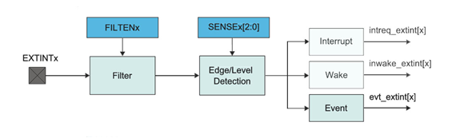
block diagram of External Interreupt Controller

Slide 36

EIC Configuration Register (only the lower 8 bits are shown)

Slide 37
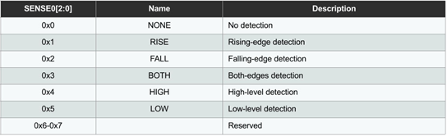
Choices of SENSE bits in Configuration register of EIC

Slide 38
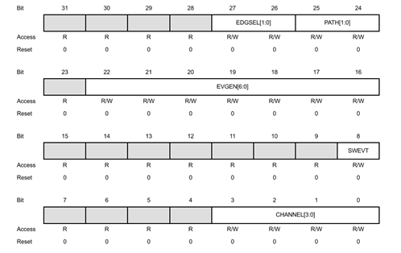
Channel Register bit assignments

Slide 39
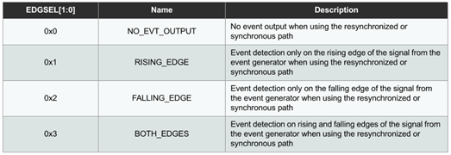
Edge selection bits of Channel register

Slide 40
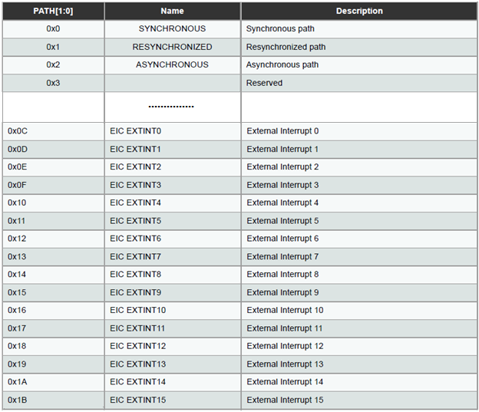
Partial Listing of Path selection for Event Generator of Channel register

Slide 41
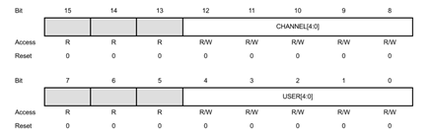
User Multiplexer register bit assignments

Slide 42
Event user identification numbers for Timer/Counter
User ID | Event User
0x12 | TC3
0x13 | TC4
0x14 | TC5
0x15 | TC6
0x16 | TC7

Slide 43

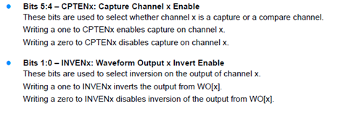
Control C register

Slide 44
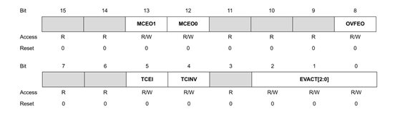

Event Control (EVCTRL) Register

Slide 45
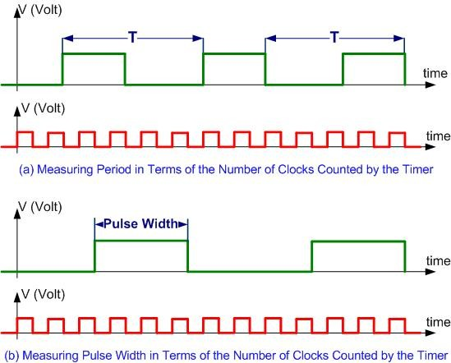
Measuring Period and Pulse Width

Slide 46
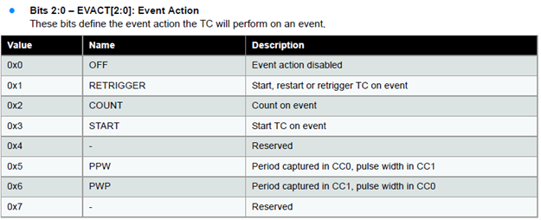
Event Control (EVCTRL) Register (Event Action Options)

