Slide 1
Chapter 6
Interrupt and Exception Programming

Slide 2
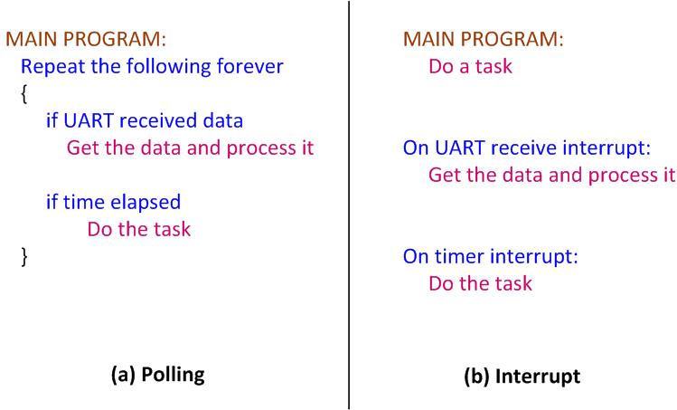
Polling vs. Interrupts

Slide 3
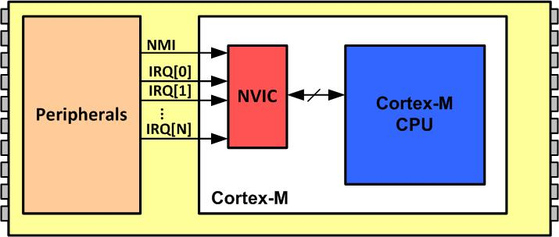
NVIC in ARM Cortex-M

Slide 4
Interrupt Vector Table for ARM Cortex-M
INT # | Interrupt | Memory Location
 | Stack Pointer initial value | 0x00000000
1 | Reset | 0x00000004
2 | NMI | 0x00000008
3 | Hard Fault | 0x0000000C
4 | Reserved | 0x00000010
5 | Reserved | 0x00000014
6 | Reserved | 0x00000018
7 | Reserved | 0x0000001C
8 | Reserved | 0x00000020
9 | Reserved | 0x00000024
10 | Reserved | 0x00000028
11 | SVCall | 0x0000002C
12 | Reserved | 0x00000030
13 | Reserved | 0x00000034
14 | PendSV | 0x00000038
15 | SysTick | 0x0000003C
16 | IRQ0 for peripherals | 0x00000040
17 | IRQ1 for peripherals | 0x00000044
… | … | …
47 | IRQ31 for peripherals | 0x000000BC

Slide 5
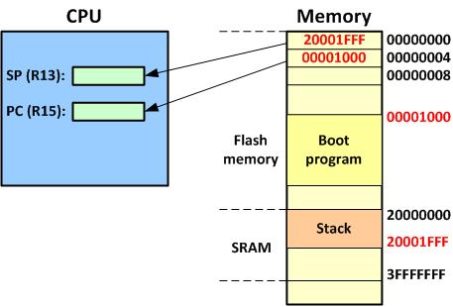
Going from Reset to Boot Program

Slide 6
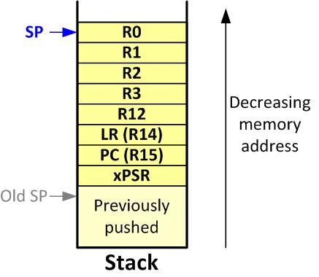
ARM Cortex-M Stack Frame upon Interrupt

Slide 7
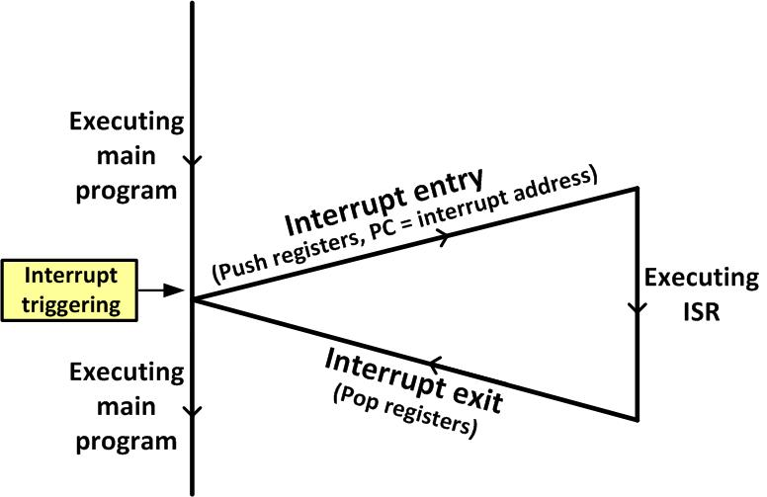
Main Program gets interrupted

Slide 8
Interrupt Priority for ARM Cortex-M
INT # | Interrupt | Priority Level
0 | Stack Pointer initial value
1 | Reset | -3 Highest
2 | NMI | -2
3 | Hard Fault | -1
4 | Reserved | Reserved
5 | Reserved | Reserved
6 | Reserved | Reserved
7 | Reserved | Reserved
8 | Reserved | Reserved
9 | Reserved | Reserved
10 | Reserved | Reserved
11 | SVCall | Programmable
12 | Reserved | Reserved
13 | Reserved | Reserved
14 | PendSV | Programmable
15 | SysTick | Programmable
16 | IRQ 0 for peripherals | Programmable
17 | IRQ 1 for peripherals | Programmable
… | … | Programmable
47 | IRQ 31 for peripherals | Programmable

Slide 9

CONTROL Register in ARM Cortex-M4
nPRIV (Privilege): Defines the Thread mode privilege level 0: Privileged 1: Unprivileged Active Stack Pointer (ASP): Defines the currently active stack pointer (ASP = SPSEL) 0: MSP is the current stack pointer. 1: PSP is the current stack pointer. Floating Point Context Active (FPCA) 0: No floating point context active. 1: Floating point context active.

Slide 10
Privileged level Execution and Processor Modes in ARM Cortex-M
Processor Mode | Software | Privilege level
Thread | Applications | Privileged and Unprivileged
Handler | ISR for Exceptions and IRQs | Always Privileged
Note: In Thread mode, use bit 0 of the CONTROL register to select Privileged or Unprivileged

Slide 11
Processor Modes and Stack Usage in ARM Cortex-M
Processor Mode | Software | Stack Usage
Thread | Applications | MSP or PSP
Handler | ISR for Exceptions and IRQs | MSP
Note: In Thread mode, use bit 1 of the Control register to select MSP or PSP for stack pointer.

Slide 12
Processor Mode, Privilege, and Stack in ARM Cortex
Mode | Privilege | Stack Pointer | Typical Example usage
Handler | Privileged | Main | Exception Handling
Handler | Unprivileged | Any | Reserved since Handler is always Privileged
Thread | Privileged | Main | Operating system kernel
Thread | Privileged | Process
Thread | Unprivileged | Main
Thread | Unprivileged | Process | Application threads

Slide 13
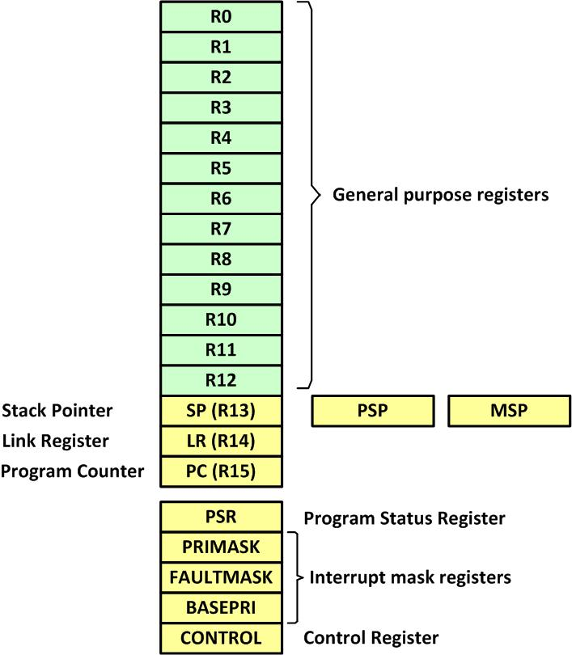
ARM Cortex-M Registers

Slide 14
Special function registers of ARM Cortex-M
Register name | Privilege Usage
MSP (main stack pointer) | Privileged
PSP (processor stack pointer) | Privileged or Unprivileged
PSR (Processor status register) | Privileged
APSR (application processor status register) | Privileged or Unprivileged
ISPR (interrupt processor status register) | Privileged
EPSR (execution processor status register) | Privileged
PRIMASK (Priority Mask register) | Privileged
FAULTMASK(fault mask register) | Privileged
BASEPRI (base priority register) | Privileged
CONTROL (control register) | Privileged
Note: We must use MSR and MRS instructions to access the above registers

Slide 15
IRQ assignment in SAMD21J
INT# | IRQ# | Vector location | Device
1-15 |  | 0000 0000 to 0000 003C | CPU Exception
16 | 0 | 0000 0040 | Power management
17 | 1 | 0000 0044 | System Control
18 | 2 | 0000 0048 | WDT - Watchdog Timer
19 | 3 | 0000 004C | RTC – Real Time Counter
20 | 4 | 0000 0050 | EIC – External Interrupt Controller
21 | 5 | 0000 0054 | NVMCTRL – Non-Volatile Memory Controller
22 | 6 | 0000 0058 | DMAC - Direct Memory Access Controller
23 | 7 | 0000 005C | USB - Universal Serial Bus
24 | 8 | 0000 0060 | EVSYS – Event System
25 | 9 | 0000 0064 | Serial Communication Interface 0
26 | 10 | 0000 0068 | Serial Communication Interface 1
27 | 11 | 0000 006C | Serial Communication Interface 2
28 | 12 | 0000 0070 | Serial Communication Interface 3

Slide 16
IRQ assignment in SAMD21J (Cont.)
INT# | IRQ# | Vector location | Device
29 | 13 | 0000 0074 | Serial Communication Interface 4
30 | 14 | 0000 0078 | Serial Communication Interface 5
31 | 15 | 0000 007C | TCC0 – Timer Counter for Control 0
32 | 16 | 0000 0080 | TCC1 – Timer Counter for Control 1
33 | 17 | 0000 0084 | TCC2 – Timer Counter for Control 2
34 | 18 | 0000 0088 | TC3 – Timer Counter 3
35 | 19 | 0000 008C | TC4 – Timer Counter 4
36 | 20 | 0000 0090 | TC5 – Timer Counter 5
37 | 21 | 0000 0094 | TC6 – Timer Counter 6
38 | 22 | 0000 0098 | TC7 – Timer Counter 7
39 | 23 | 0000 009C | ADC – Analog-to-Digital Converter
40 | 24 | 0000 00A0 | AC – Analog Comparator
41 | 25 | 0000 00A4 | DAC – Digital-to-Analog Converter
42 | 26 | 0000 00A8 | PTC – Peripheral Touch Controller
43 | 27 | 0000 00AC | I2S - Inter IC Sound

Slide 17
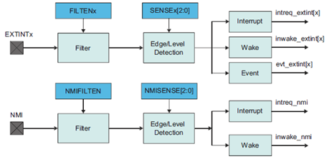
EIC Block Diagram

Slide 18
Associations of I/O pins to EXTINT signals
I/O Pin | EIC | I/O Pin | EIC | I/O Pin | EIC | I/O Pin | EIC
PA00 | EXTINT[0] | PA16 | EXTINT[0] | PB00 | EXTINT[0] | PB16 | EXTINT[0]
PA01 | EXTINT[1] | PA17 | EXTINT[1] | PB01 | EXTINT[1] | PB17 | EXTINT[1]
PA02 | EXTINT[2] | PA18 | EXTINT[2] | PB02 | EXTINT[2]
PA03 | EXTINT[3] | PA19 | EXTINT[3] | PB03 | EXTINT[3]
PA04 | EXTINT[4] | PA20 | EXTINT[4] | PB04 | EXTINT[4]
PA05 | EXTINT[5] | PA21 | EXTINT[5] | PB05 | EXTINT[5]
PA06 | EXTINT[6] | PA22 | EXTINT[6] | PB06 | EXTINT[6] | PB22 | EXTINT[6]
PA07 | EXTINT[7] | PA23 | EXTINT[7] | PB07 | EXTINT[7] | PB23 | EXTINT[7]
PA08 | NMI | PA28 | EXTINT[8] | PB08 | EXTINT[8]
PA09 | EXTINT[9] |  |  | PB09 | EXTINT[9]
PA10 | EXTINT[10] | PA30 | EXTINT[10] | PB10 | EXTINT[10]
PA11 | EXTINT[11] | PA31 | EXTINT[11] | PB11 | EXTINT[11]
PA12 | EXTINT[12] | PA24 | EXTINT[12] | PB12 | EXTINT[12]
PA13 | EXTINT[13] | PA25 | EXTINT[13] | PB13 | EXTINT[13]
PA14 | EXTINT[14] |  |  | PB14 | EXTINT[14] | PB30 | EXTINT[14]
PA15 | EXTINT[15] | PA27 | EXTINT[15] | PB15 | EXTINT[15] | PB31 | EXTINT[15]

Slide 19
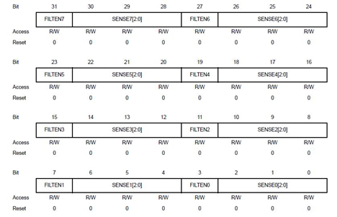
The CONFIGn registers with FILTENx and SENSEx bits packed into two registers

Slide 20
Input sense configuration
SENSEx[2:0] | Detection
0 | None
1 | Rising-edge
2 | Falling-edge
3 | Both-edges
4 | High-level
5 | Low-level
6-7 | reserved

Slide 21
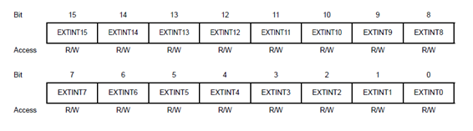
INTENSET register

Slide 22
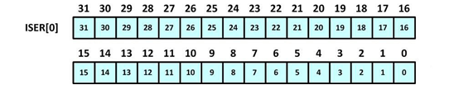
Set Enable Register (ISER[0]) for IRQ 0–31

Slide 23
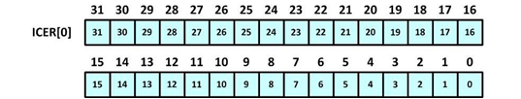
Clear Enable Register (ICER[0]) for IRQ 0–31

Slide 24

Enabling and Disabling an Interrupt

Slide 25

Interrupt Enable Set ( INTENSET) register

Slide 26
Interrupt flag (INTFLAG) register

Slide 27
SERCOMx Interrupt Enable Set (INTENSET) Register in USART mode
Field | Bit | Description
ERROR | 7 | Error Interrupt Enable 0: Error interrupt is disabled. 1: Error interrupt is enabled.
RXC | 2 | Receive Complete Interrupt Enable 0: Receive Complete interrupt is disabled. 1: Receive Complete interrupt is enabled.
TXC | 1 | Transmit Complete Interrupt Enable 0: Transmit Complete interrupt is disabled. 1: Transmit Complete interrupt is enabled.
DRE | 0 | Data Register Empty Interrupt Enable 0: Data Register Empty interrupt is disabled. 1: Data Register Empty interrupt is enabled.

Slide 28
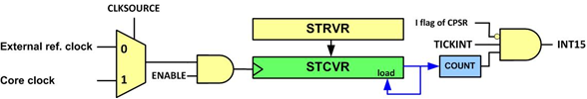
SysTick Internal Structure

Slide 29
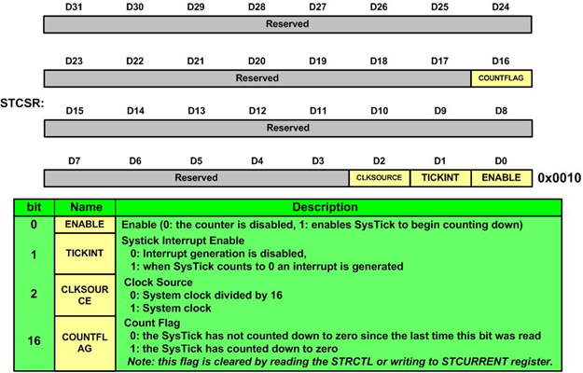
SysTick Control and Status Register (SYST_CSR)

Slide 30

Interrupt Enable Set (INTENSET) Register

Slide 31
INTENSET Register Bits
bit | Name | Description
5-4 | MCx | Match or Capture Channel x Interrupt Enable 0: The Match or Capture Channel x interrupt is disabled. 1: The Match or Capture Channel x interrupt is enabled.
0 | OVF | Overflow Interrupt Enable 0: The Overflow interrupt is disabled. 1: The Overflow interrupt is enabled.

Slide 32
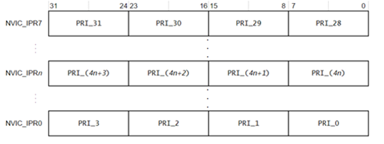
IPRn Registers

