Slide 1
Chapter 7
ADC, DAC, and Sensor Interfacing

Slide 2
Microcontroller Connection to Sensor via ADC

Slide 3
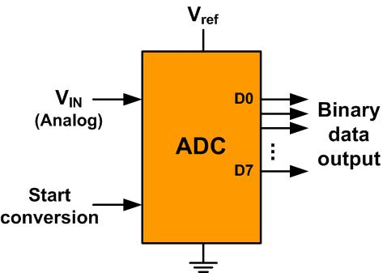
An 8-bit ADC Block Diagram

Slide 4
Resolution versus Step Size for ADC (Vref = 5V)
n-bit | Number of steps | Step size
8 | 256 | 5V /256 = 19.53 mV
10 | 1024 | 5V /1024 = 4.88 mV
12 | 4096 | 5V /4096 = 1.2 mV
16 | 65,536 | 5V /65,536 = 0.076 mV
Note: V_{ref} = 5V

Slide 5
Vref Relation to Vin Range for an 8-bit ADC
V_{ref} (V) | V_{in} in Range (V) | Step Size (mV)
5.00 | 0 to 5 | 5 / 256 = 19.53
4.00 | 0 to 4 | 4 / 256 = 15.62
3.00 | 0 to 3 | 3 / 256 = 11.71
2.56 | 0 to 2.56 | 2.56 / 256 = 10
2.00 | 0 to 2 | 2 / 256 = 7.81
1.28 | 0 to 1.28 | 1.28 / 256 = 5
1.00 | 0 to 1 | 1 / 256 = 3.90
Note: In an 8-bit ADC, step size is V_{ref}/256

Slide 6
Vref Relation to Vin Range for an 10-bit ADC
Vref (V) | V_{in}Range (V) | Step Size (mV)
5.00 | 0 to 5 | 5 / 1024 = 4.88
4.96 | 0 to 4.096 | 4.096 / 1024 = 4
3.00 | 0 to 3 | 3 / 1024 = 2.93
2.56 | 0 to 2.56 | 2.56 / 1024 = 2.5
2.00 | 0 to 2 | 2 / 1024 = 2
1.28 | 0 to 1.28 | 1.28 / 1024 = 1.25
1.024 | 0 to 1.024 | 1.024 / 1024 = 1
Note: In a 10-bit ADC, step size is V_{ref}/1024

Slide 7
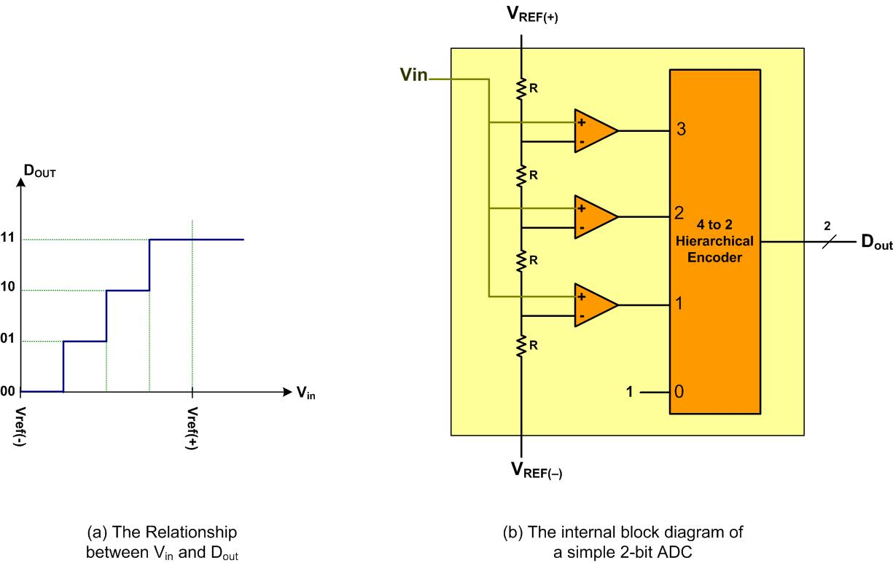
A Simultaneous 2-bit ADC

Slide 8
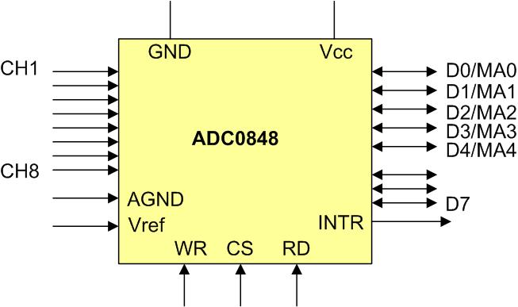
ADC0848 Parallel ADC Block Diagram

Slide 9
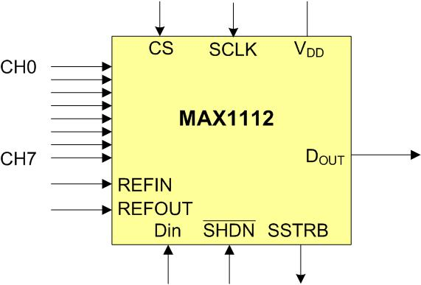
MAX1112 Serial ADC Block Diagram

Slide 10
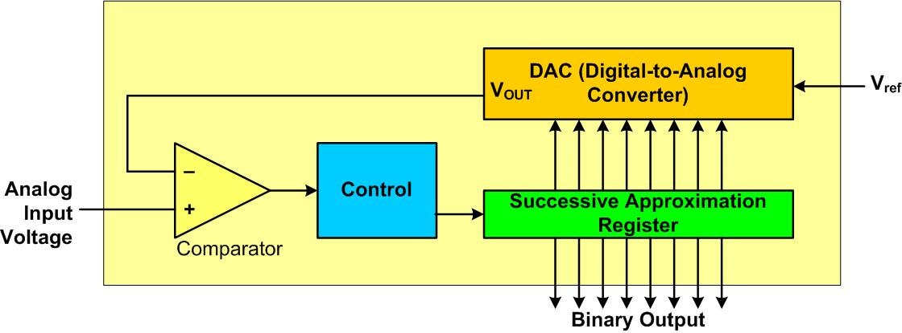
Successive Approximation ADC

Slide 11
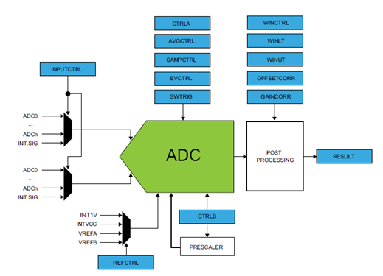
Simplified Block Diagram of ADC in SAMD2x chip

Slide 12
Some of the SAMD2x ADC Registers
Offset Address | Register
0x00 | CTRLA
0x01 | REFCTRL
0x03 | SAMPCTRL
0x04 | CTRLB
0x0C | SWTRIG
0x10 | INPUTCTRL
0x18 | INTGLAG
0x1A | RESULT
0x24 | GAINCORR
0x26 | OFFSETCORR
0x2A | DBGCTRL

Slide 13
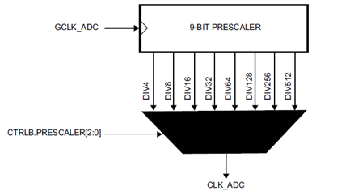
ADC Prescaler

Slide 14
ADC Prescaler Options
PRESCALER | Description
0x0 | Divided by 4
0x1 | Divided by 8
0x2 | Divided by 16
0x3 | Divided by 32
0x4 | Divided by 64
0x5 | Divided by 128
0x6 | Divided by 256
0x7 | Divided by 512

Slide 15

Sampling Time Control register

Slide 16
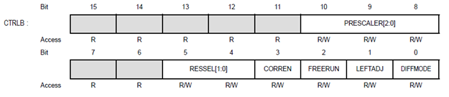
Control B (CTRLB) Register

Slide 17
ADC bit Resolution
RESSEL | Description
0x0 | 12-bit result
0x1 | For averaging
0x2 | 10-bit result
0x3 | 8-bit result

Slide 18

PINMUXEN Register

Slide 19

PINCFGn Register

Slide 20
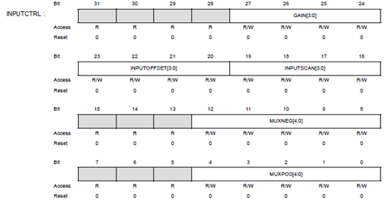
INPUTCTRL

Slide 21
Analog input pin assignment in SAMD2x
I/O Pin | ADC | V_{REF} | I/O Pin | ADC
PA02 | AIN[0] |  | PB02 | AIN[10]
PA03 | AIN[1] | VREFA | PB03 | AIN[11]
PB08 | AIN[2] |  | PB04 | AIN[12]
PB09 | AIN[3] |  | PB05 | AIN[13]
PA04 | AIN[4] | VREFB | PB06 | AIN[14]
PA05 | AIN[5] |  | PB07 | AIN[15]
PA06 | AIN[6] |  | PA08 | AIN[16]
PA07 | AIN[7] |  | PA09 | AIN[17]
PB00 | AIN[8] |  | PA10 | AIN[18]
PB01 | AIN[9] |  | PA11 | AIN[19]

Slide 22
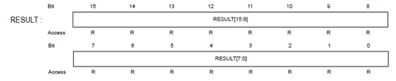
RESULT register holds conversion result

Slide 23
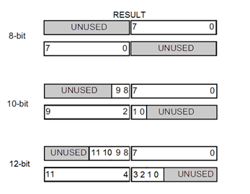
RESULT Register for Right and Left Justified

Slide 24

CTRLA (ADC Control A) register

Slide 25
CTRLA Register of SAMD2x
Bit | Field | Descriptions
2 | RUNSTDBY | Run in Standby 0: The ADC is halted during standby sleep mode. 1: The ADC continues normal operation during standby sleep mode.
1 | ENABLE | Enable 0: The ADC is disabled. 1: The ADC is enabled.
0 | SWRST | Software Reset 0: There is no reset operation ongoing. 1: The reset operation is ongoing.

Slide 26
INTFLG (Interrupt and Status Flag) Register for End-of-Conversion

Slide 27
INTFLG Register Bits
Bit | Field | Descriptions
7-4 | Reserved | Reserved
3 | SYNCRDY | Synchronization Ready Writing a zero to this bit has no effect. Writing a one to this bit clears the Synchronization Ready interrupt flag.
2 | WINMON | Window Monitor Writing a zero to this bit has no effect. Writing a one to this bit clears the Window Monitor interrupt flag.
1 | OVERRUN | Overrun Writing a zero to this bit has no effect. Writing a one to this bit clears the Overrun interrupt flag.
0 | RESRDY | Result Ready Writing a zero to this bit has no effect. Writing a one to this bit clears the Result Ready interrupt flag.

Slide 28

Reference Control register (REFCTRL)

Slide 29
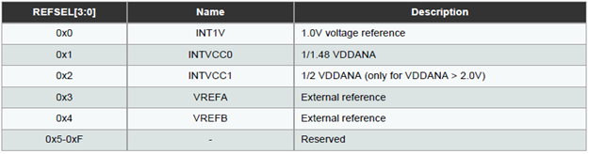
Reference Voltage Selection for Reference Control Register

Slide 30
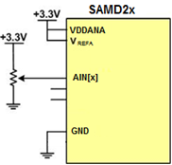
ADC Connection for Program 7-1

Slide 31

Voltage References System (VREF) Control VREF register

Slide 32
Voltage References System (VREF) Control Bit Definition
Bit | Field | Descriptions
1 | TSEN | Temperature Sensor Enable 0: Temperature sensor is disabled. 1: Temperature sensor is enabled and routed to an ADC input channel.
2 | BGOUTEN | Bandgap Output Enable 0: The bandgap output is not available as an ADC input channel. 1: The bandgap output is routed to an ADC input channel.

Slide 33
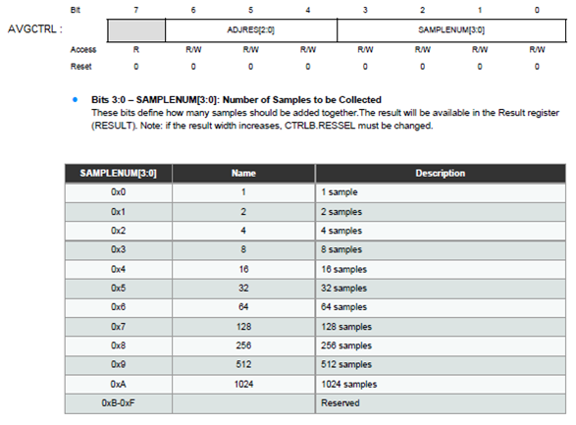
Average Control Register (AVGCTRL)

Slide 34
Accumulation Options for Multiple Consecutive Conversions
Number of Samples | SAMPLENUM | Intermediate Precision | Right Shift | Final Precision | Division Factor
1 | 0x0 | 12 bits | 0 | 12 bits | 1
2 | 0x1 | 13 bits | 0 | 13 bits | 1
4 | 0x2 | 14 bits | 0 | 14 bits | 1
8 | 0x3 | 15 bits | 0 | 15 bits | 1
16 | 0x4 | 16 bits | 0 | 16 bits | 1
32 | 0x5 | 17 bits | 1 | 16 bits | 2
64 | 0x6 | 18 bits | 2 | 16 bits | 4
128 | 0x7 | 19 bits | 3 | 16 bits | 8
256 | 0x8 | 20 bits | 4 | 16 bits | 16
512 | 0x9 | 21 bits | 5 | 16 bits | 32
1024 | 0xA | 22 bits | 6 | 16 bits | 64

Slide 35
Averaging Options for Multiple Consecutive Conversions
Number of Samples | SAMPLENUM | ADJRES | Total Right Shift | Final Precision
1 | 0x0 | 0x0 | 0 | 12 bits
2 | 0x1 | 0x1 | 1 | 12 bits
4 | 0x2 | 0x2 | 2 | 12 bits
8 | 0x3 | 0x3 | 3 | 12 bits
16 | 0x4 | 0x4 | 4 | 12 bits
32 | 0x5 | 0x4 | 5 | 12 bits
64 | 0x6 | 0x4 | 6 | 12 bits
128 | 0x7 | 0x4 | 7 | 12 bits
256 | 0x8 | 0x4 | 8 | 12 bits
512 | 0x9 | 0x4 | 9 | 12 bits
1024 | 0xA | 0x4 | 10 | 12 bits

Slide 36
Thermistor Resistance vs. Temperature
Temperature ('C) | Tf (K ohms)
0 | 29.490
25 | 10.000
50 | 3.893
75 | 1.700
100 | 0.817

Slide 37
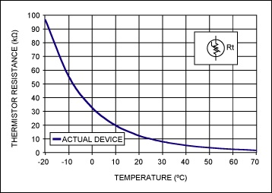
Thermistor
(Copied from http://www.maximintegrated.com)

Slide 38
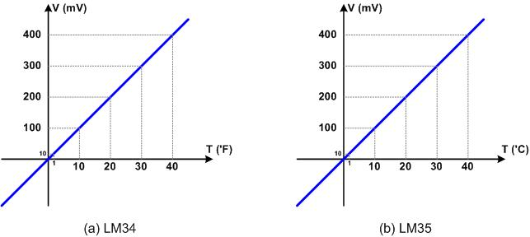
LM34 and LM35

Slide 39
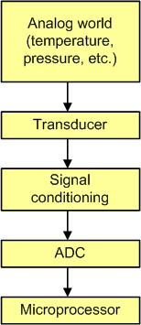
Getting Data to the CPU

Slide 40
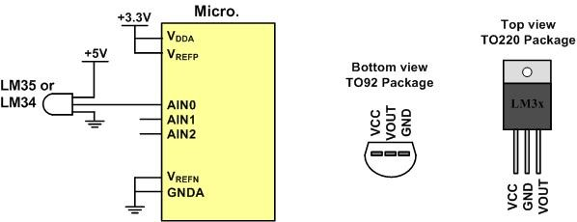
LM34/35 Connection to ARM and Its Pin Configuration

Slide 41
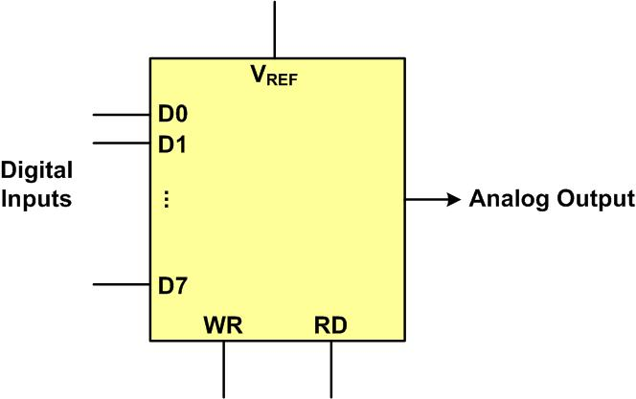
DAC Block Diagram

Slide 42
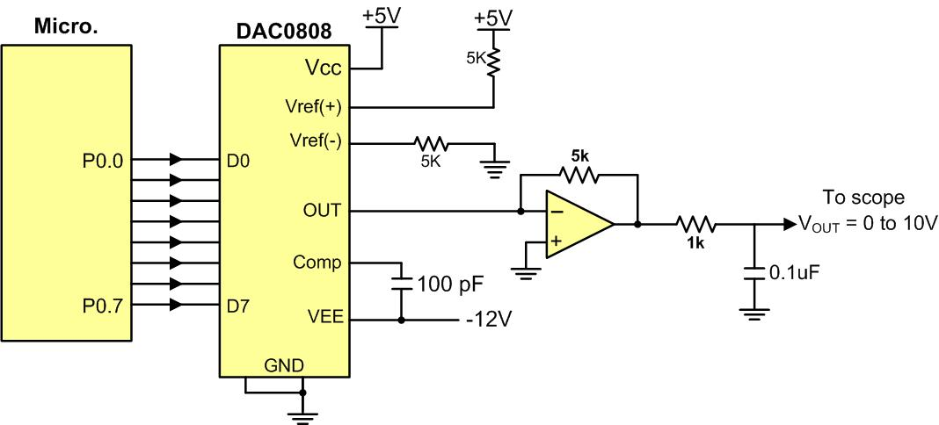
Microcontroller Connection to DAC0808

Slide 43
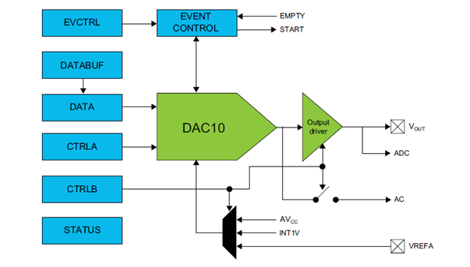
Atmel SADM2x DAC Block Diagram

Slide 44

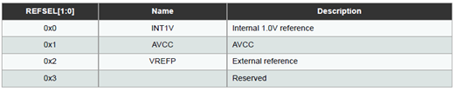

Control B Register (CTRLB)

Slide 45
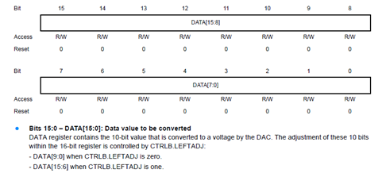
DAC Data Register

Slide 46

Control A Register (CTRLA)

Slide 47
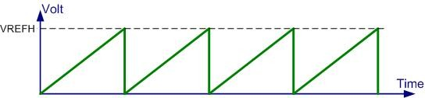
Saw Tooth WaveForm

Slide 48
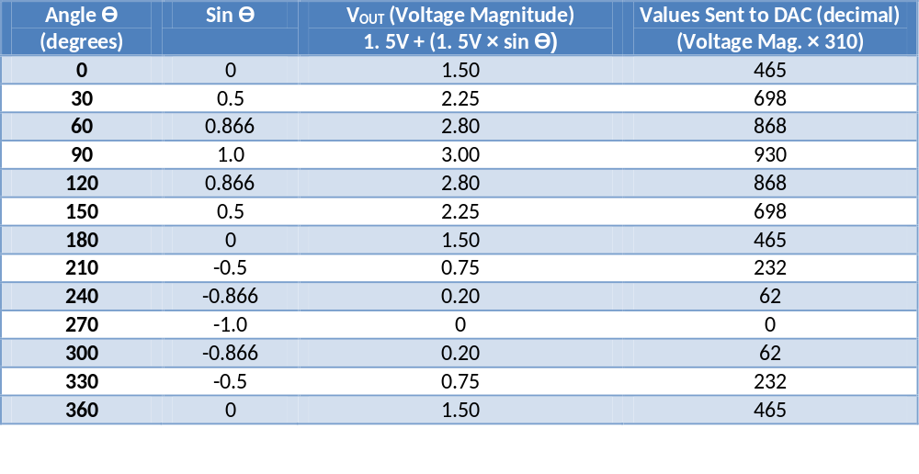
Angle vs. Voltage Magnitude for Sine Wave

Slide 49
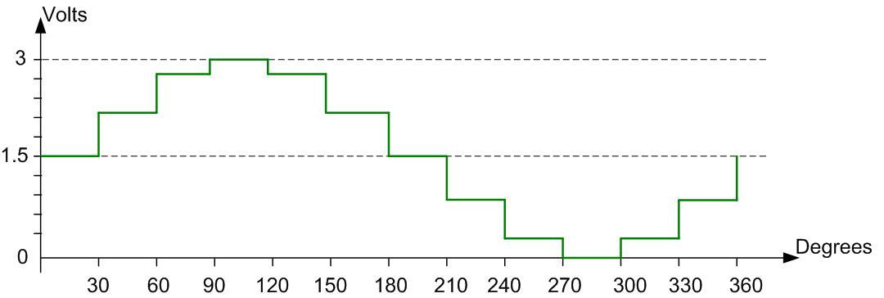
Angle vs. Voltage Magnitude for Sine Wave

