Slide 1
Chapter 8
SPI Protocol and DAC Interfacing

Slide 2
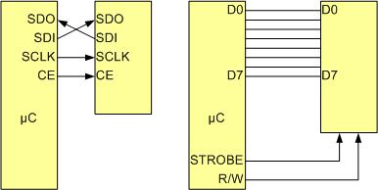
SPI Bus vs. Traditional Parallel Bus Connection to Microcontroller

Slide 3
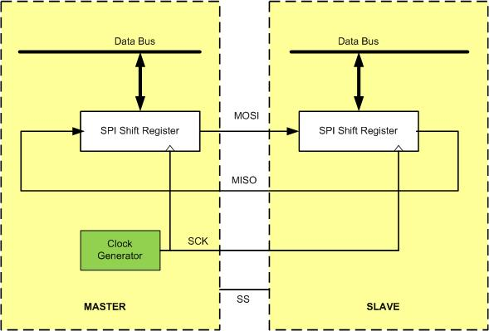
SPI Architecture

Slide 4
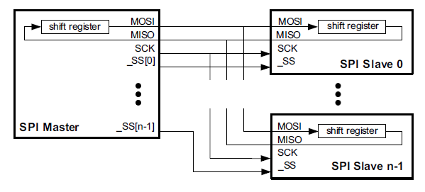
Master SPI Connection to multiple slaves SPI in Parallel

Slide 5
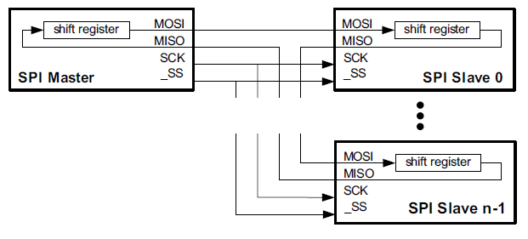
Master SPI Connection to multiple slaves SPI in serial

Slide 6
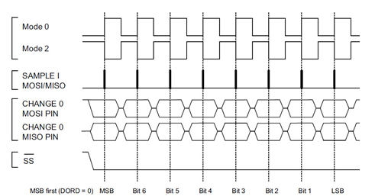
SPI Clock Polarity and phase Mode 0 (CPOL = 0, CPHA = 0) and Mode 2 (CPOL = 1, CPHA = 0)

Slide 7
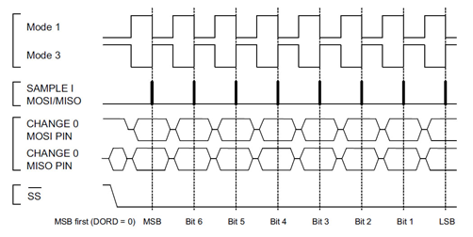
SPI Clock Polarity and phase Mode 1 (CPOL = 0, CPHA = 1) and Mode 3 (CPOL = 1, CPHA = 1)

Slide 8
SPI Clock Polarity and phase
Clock Polarity | Clock Phase | Data read and change time | SPI Mode
0 | 0 | read on rising edge, changed on a falling edge | 0
0 | 1 | read on falling edge, changed on a rising edge | 1
1 | 0 | read on falling edge, changed on a rising edge | 2
1 | 1 | read on rising edge, changed on a falling edge | 3

Slide 9
SAMD2x SPI Module Base Addresses
SERCOM Module | Base Address
SERCOM0 | 0x42000800
SERCOM1 | 0x42000C00
SERCOM2 | 0x42001000
SERCOM3 | 0x42001400
SERCOM4 | 0x42001800
SERCOM5 | 0x42001C00

Slide 10
SAMD2x SPI Registers
Register Name | Register Function | Register Address Offset (Hex)
CTRLA | Control A | 0x00
CTRLB | Control B | 0x04
BAUD | Baud rate | 0x0C
INTENCLR | Interrupt Enable Clear | 0x14
INTENSET | Interrupt Enable Set | 0x16
INTFLAG | Interrupt Flag | 0x18
STATUS | Status | 0x1A
SYNCBUSY | Synchronization Busy | 0x1D
ADDR | Address | 0x24
DATA | Receive and Transmit buffer | 0x28
DBGCTRL | Debug Control | 0x30

Slide 11
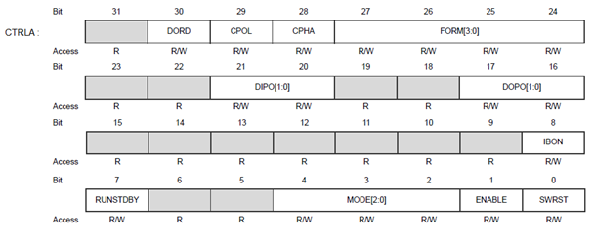
SPI Control A (CTRLA) Register in SAMD2x

Slide 12
CTRLA (Control A) Register
Bits | Name | Function | Description
30 | DORD | Data Order | 0: MSB is transferred first. 1: LSB is transferred first.
29 | CPOL | Clock Polarity | 0: SCK is low when idle. The leading edge of a clock cycle is a rising edge, while the trailing edge is a falling edge. 1: SCK is high when idle. The leading edge of a clock cycle is a falling edge, while the trailing edge is a rising edge.
28 | CPHA | Clock Phase | 0: The data is sampled on a leading SCK edge and changed on a trailing SCK edge. 1: The data is sampled on a trailing SCK edge and changed on a leading SCK edge.
27-24 | FORM[3:0] | Frame Format
21-20 | DIPO[1:0] | Data In Pinout | In master operation, DO is MOSI. In slave operation, DO is MISO.
8 | IBON | Immediate Buffer Overflow Notification | 0: STATUS.BUFOVF is asserted when it occurs in the data stream. 1: STATUS.BUFOVF is asserted immediately upon buffer overflow.
7 | RUNSTDBY | Run In Standby | This bit defines the functionality in standby sleep mode.
4-2 | MODE | Operating Mode | 0x2: SPI slave operation 0x3: SPI master operation For UART and I2C options, see relevant chapters
1 | ENABLE | Enable | 0: The peripheral is disabled or being disabled. 1: The peripheral is enabled or being enabled.
0 | SWRST | Software Reset | 0: There is no reset operation ongoing. 1: The reset operation is ongoing.

Slide 13
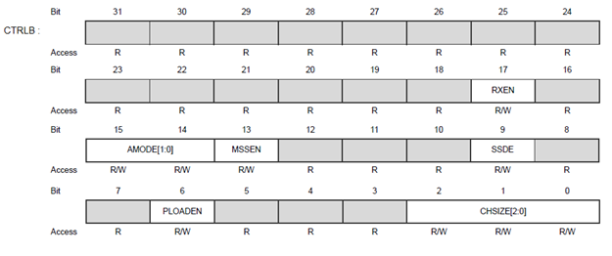
SPI Control B (CTRLB) Registers in SAMD2x

Slide 14
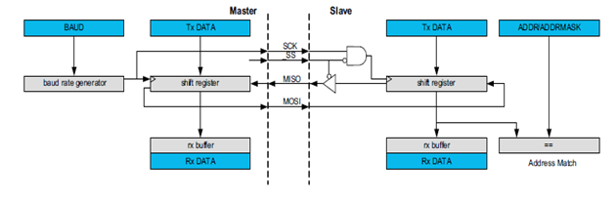
Using SAMD2x SPI module as Master

Slide 15

BAUD Register SPI Baud Rate

Slide 16
DATA register

Slide 17
Interrupt Flag (INTFLAG) Register

Slide 18
Interrupt Flag Register Bits
Bits | Name | Function | Description
0 | DRE | Data Register Empty | The bit is 1 when the transmit DATA is empty and can accept another byte of data.
1 | TXC | Transmit Complete | The bit is 1 when both transmit DATA is empty and the shift register is empty. It is cleared by writing a 1 to it.
2 | RXC | Receive Complete | The bit is 1 when there is new data in the receive buffer registers. It is cleared when data are read.

Slide 19

PINCFGn register (notice the PMUXEN bit)

Slide 20

PMUX register for choosing peripheral functions

Slide 21
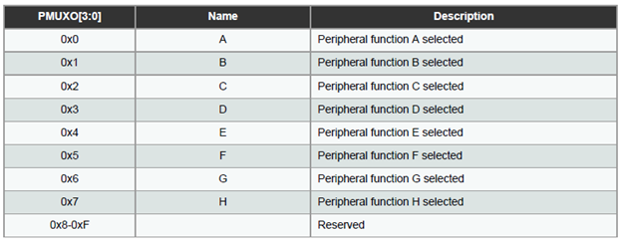
PORT pin Function multiplexing options

Slide 22
PORT pin Function multiplexing
 |  | A (0) | B (1) |  |  |  |  | C (2) | D (3) | E (4) | F (5) | G (6) | H (7)
I/O Pin | Supply | EIC | REF | ADC | AC | PTC | DAC | SERCOM | SERCOM-ALT | TC/TCC | TCC | COM | AC/GCLK
PA00 | VDDANA | EXTINT[0] |  |  |  |  |  |  | SERCOM1/PAD[0] | TCC2/WO[0]
PA01 | VDDANA | EXTINT[1] |  |  |  |  |  |  | SERCOM1/PAD[1] | TCC2/WO[1]
PA02 | VDDANA | EXTINT[2] |  | AIN[0] |  | Y[0] | VOUT
PA03 | VDDANA | EXTINT[3] | ADC/VREFA DAC/VREFA | AIN[1] |  | Y[1]
PA04 | VDDANA | EXTINT[4] | ADC/VREFB | AIN[4] | AIN[0] | Y[2] |  |  | SERCOM0/PAD[0] | TCC0/WO[0]
PA05 | VDDANA | EXTINT[5] |  | AIN[5] | AIN[1] | Y[3] |  |  | SERCOM0/PAD[1] | TCC0/WO[1]
PA06 | VDDANA | EXTINT[6] |  | AIN[6] | AIN[2] | Y[4] |  |  | SERCOM0/PAD[2] | TCC1/WO[0]
PA07 | VDDANA | EXTINT[7] |  | AIN[7] | AIN[3] | Y[5] |  |  | SERCOM0/PAD[3] | TCC1/WO[1] |  | I2S/SD[0]
PA08 | VDDIO | NMI |  | AIN[16] |  | X[0] |  | SERCOM0/PAD[0] | SERCOM2/PAD[0] | TCC0/WO[0] | TCC1/WO[2] | I2S/SD[1]
PA09 | VDDIO | EXTINT[9] |  | AIN[17] |  | X[1] |  | SERCOM0/PAD[1] | SERCOM2/PAD[1] | TCC0/WO[1] | TCC1/WO[3] | I2S/MCK[0]
PA10 | VDDIO | EXTINT[10] |  | AIN[18] |  | X[2] |  | SERCOM0/PAD[2] | SERCOM2/PAD[2] | TCC1/WO[0] | TCC0/WO[2] | I2S/SCK[0] | GCLK_IO[4]
PA11 | VDDIO | EXTINT[11] |  | AIN[19] |  | X[3] |  | SERCOM0/PAD[3] | SERCOM2/PAD[3] | TCC1/WO[1] | TCC0/WO[3] | I2S/FS[0] | GCLK_IO[5]
PA12 | VDDIO | EXTINT[12] |  |  |  |  |  | SERCOM2/PAD[0] | SERCOM4/PAD[0] | TCC2/WO[0] | TCC0/WO[6] |  | AC/CMP[0]
PA13 | VDDIO | EXTINT[13] |  |  |  |  |  | SERCOM2/PAD[1] | SERCOM4/PAD[1] | TCC2/WO[1] | TCC0/WO[7] |  | AC/CMP[1]
PA14 | VDDIO | EXTINT[14] |  |  |  |  |  | SERCOM2/PAD[2] | SERCOM4/PAD[2] | TC3/WO[0] | TCC0/WO[4] |  | GCLK_IO[0]
PA15 | VDDIO | EXTINT[15] |  |  |  |  |  | SERCOM2/PAD[3] | SERCOM4/PAD[3] | TC3/WO[1] | TCC0/WO[5] |  | GCLK_IO[1]
PA16 | VDDIO | EXTINT[0] |  |  |  | X[4] |  | SERCOM1/PAD[0] | SERCOM3/PAD[0] | TCC2/WO[0] | TCC0/WO[6] |  | GCLK_IO[2]
PA17 | VDDIO | EXTINT[1] |  |  |  | X[5] |  | SERCOM1/PAD[1] | SERCOM3/PAD[1] | TCC2/WO[1] | TCC0/WO[7] |  | GCLK_IO[3]
PA18 | VDDIO | EXTINT[2] |  |  |  | X[6] |  | SERCOM1/PAD[2] | SERCOM3/PAD[2] | TC3/WO[0] | TCC0/WO[2] |  | AC/CMP[0]
PA19 | VDDIO | EXTINT[3] |  |  |  | X[7] |  | SERCOM1/PAD[3] | SERCOM3/PAD[3] | TC3/WO[1] | TCC0/WO[3] | I2S/SD[0] | AC/CMP[1]
PA20 | VDDIO | EXTINT[4] |  |  |  | X[8] |  | SERCOM5/PAD[2] | SERCOM3/PAD[2] | TC7/WO[0] | TCC0/WO[6] | I2S/SCK[0] | GCLK_IO[4]
PA21 | VDDIO | EXTINT[5] |  |  |  | X[9] |  | SERCOM5/PAD[3] | SERCOM3/PAD[3] | TC7/WO[1] | TCC0/WO[7] | I2S/FS[0] | GCLK_IO[5]
PA22 | VDDIO | EXTINT[6] |  |  |  | X[10] |  | SERCOM3/PAD[0] | SERCOM5/PAD[0] | TC4/WO[0] | TCC0/WO[4] |  | GCLK_IO[6]
PA23 | VDDIO | EXTINT[7] |  |  |  | X[11] |  | SERCOM3/PAD[1] | SERCOM5/PAD[1] | TC4/WO[1] | TCC0/WO[5] | USB/SOF 1kHz | GCLK_IO[7]
PA24 | VDDIO | EXTINT[12] |  |  |  |  |  | SERCOM3/PAD[2] | SERCOM5/PAD[2] | TC5/WO[0] | TCC1/WO[2] | USB/DM
PA25 | VDDIO | EXTINT[13] |  |  |  |  |  | SERCOM3/PAD[3] | SERCOM5/PAD[3] | TC5/WO[1] | TCC1/WO[3] | USB/DP
PA27 | VDDIO | EXTINT[15] |  |  |  |  |  |  |  |  |  |  | GCLK_IO[0]
PA28 | VDDIO | EXTINT[8] |  |  |  |  |  |  |  |  |  |  | GCLK_IO[0]
PA30 | VDDIO | EXTINT[10] |  |  |  |  |  |  | SERCOM1/PAD[2] | TCC1/WO[0] |  | SWCLK | GCLK_IO[0]
PA31 | VDDIO | EXTINT[11] |  |  |  |  |  |  | SERCOM1/PAD[3] | TCC1/WO[1] |  | SWDIO(4)
PB00 | VDDANA | EXTINT[0] |  | AIN[8] |  | Y[6] |  |  | SERCOM5/PAD[2] | TC7/WO[0]
PB01 | VDDANA | EXTINT[1] |  | AIN[9] |  | Y[7] |  |  | SERCOM5/PAD[3] | TC7/WO[1]
PB02 | VDDANA | EXTINT[2] |  | AIN[10] |  | Y[8] |  |  | SERCOM5/PAD[0] | TC6/WO[0]
PB03 | VDDANA | EXTINT[3] |  | AIN[11] |  | Y[9] |  |  | SERCOM5/PAD[1] | TC6/WO[1]
PB04 | VDDANA | EXTINT[4] |  | AIN[12] |  | Y[10]
PB05 | VDDANA | EXTINT[5] |  | AIN[13] |  | Y[11]
PB06 | VDDANA | EXTINT[6] |  | AIN[14] |  | Y[12]
PB07 | VDDANA | EXTINT[7] |  | AIN[15] |  | Y[13]
PB08 | VDDANA | EXTINT[8] |  | AIN[2] |  | Y[14] |  |  | SERCOM4/PAD[0] | TC4/WO[0]
PB09 | VDDANA | EXTINT[9] |  | AIN[3] |  | Y[15] |  |  | SERCOM4/PAD[1] | TC4/WO[1]
PB10 | VDDIO | EXTINT[10] |  |  |  |  |  |  | SERCOM4/PAD[2] | TC5/WO[0] | TCC0/WO[4] | I2S/MCK[1] | GCLK_IO[4]
PB11 | VDDIO | EXTINT[11] |  |  |  |  |  |  | SERCOM4/PAD[3] | TC5/WO[1] | TCC0/WO[5] | I2S/SCK[1] | GCLK_IO[5]
PB12 | VDDIO | EXTINT[12] |  |  |  | X[12] |  | SERCOM4/PAD[0] |  | TC4/WO[0] | TCC0/WO[6] | I2S/FS[1] | GCLK_IO[6]
PB13 | VDDIO | EXTINT[13] |  |  |  | X[13] |  | SERCOM4/PAD[1] |  | TC4/WO[1] | TCC0/WO[7] |  | GCLK_IO[7]
PB14 | VDDIO | EXTINT[14] |  |  |  | X[14] |  | SERCOM4/PAD[2] |  | TC5/WO[0] |  |  | GCLK_IO[0]
PB15 | VDDIO | EXTINT[15] |  |  |  | X[15] |  | SERCOM4/PAD[3] |  | TC5/WO[1] |  |  | GCLK_IO[1]
PB16 | VDDIO | EXTINT[0] |  |  |  |  |  | SERCOM5/PAD[0] |  | TC6/WO[0] | TCC0/WO[4] | I2S/SD[1] | GCLK_IO[2]
PB17 | VDDIO | EXTINT[1] |  |  |  |  |  | SERCOM5/PAD[1] |  | TC6/WO[1] | TCC0/WO[5] | I2S/MCK[0] | GCLK_IO[3]
PB22 | VDDIO | EXTINT[6] |  |  |  |  |  |  | SERCOM5/PAD[2] | TC7/WO[0] |  |  | GCLK_IO[0]
PB23 | VDDIO | EXTINT[7] |  |  |  |  |  |  | SERCOM5/PAD[3] | TC7/WO[1] |  |  | GCLK_IO[1]
PB30 | VDDIO | EXTINT[14] |  |  |  |  |  |  | SERCOM5/PAD[0] | TCC0/WO[0] | TCC1/WO[2]

Slide 23
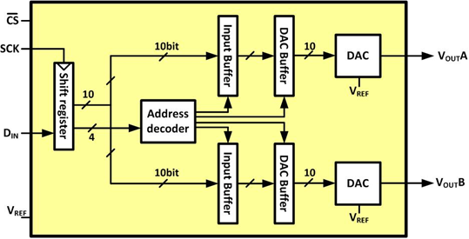
LTC1661 Internal Block Diagram

Slide 24

Sending a Packet of Data to LTC166x

Slide 25
LTC1661 DAC Control Functions
A3 A2 A1 A0 | Interrupt Register | DAC Register | Power Down Status | Comments
0 0 0 0 | No Change | No Update | No Change | No operation. power-down status unchanged
0 0 0 1 | Load DAC A | No Update | No Change | Load input register A with data. DAC outputs unchanged. power-down Status unchanged
0 0 1 0 | Load DAC B | No Update | No Change | Load input register B with data. DAC outputs unchanged. power-down status unchanged
0 0 1 1 | - | - | - | Reserved
0 1 0 0 | - | - | - | Reserved
0 1 0 1 | - | - | - | Reserved
0 1 1 0 | - | - | - | Reserved
0 1 1 1 | - | - | - | Reserved
1 0 0 0 | No Change | Update Outputs | Wake | Load both DAC Regs with existing contents of input Regs. Outputs update. Part wakes up
1 0 0 1 | Load DAC A | Update Outputs | Wake | Load input Reg A. Load DAC Regs with new contents of input Reg A and existing contents of Reg B. Outputs update.
1 0 1 0 | Load DAC B | Update Outputs | Wake | Load input Reg B. Load DAC Regs with existing contentsof input Reg A and new contents of Reg B. Outputs update
1 0 1 1 | - | - | - | Reserved
1 1 0 0 | - | - | - | Reserved
1 1 0 1 | No Change | No Update | Wake | Part wakes up. Input and DAC Regs unchanged. DAC outputs reflect existing contents of DAC Regs
1 1 1 0 | No Change | No Update | Sleep | Part goes to sleep. Input and DAC Regs unchanged. DAC outputs set to high impedance state
1 1 1 1 | Load ADCs A, B with same 10-bit code | Update Outputs | Wake | Load both input Regs. Load both DAC Regs with new contents of input Regs. Outputs update. Part wakes up

Slide 26
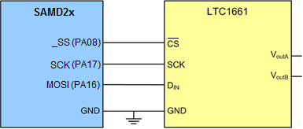
Connecting LTC1661 to the SAMD21

Slide 27
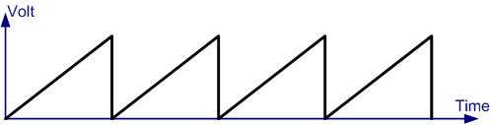
The Generated Sawtooth waveform

