Slide 1
Chapter9
I2C Protocol and RTC Interfacing

Slide 2
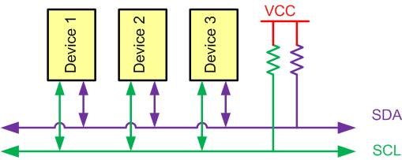
I2C Bus Characteristics

Slide 3
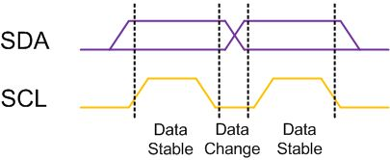
I2C Bit Format

Slide 4
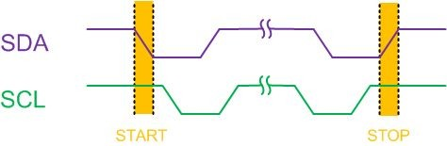
START and STOP Conditions

Slide 5
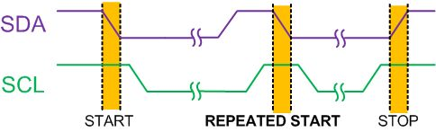
REPEATED START Condition

Slide 6
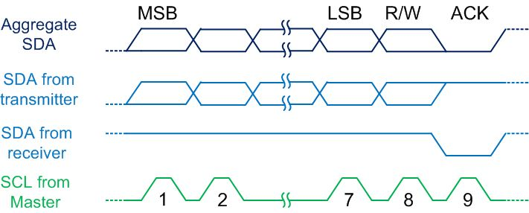
Byte Format in I2C

Slide 7
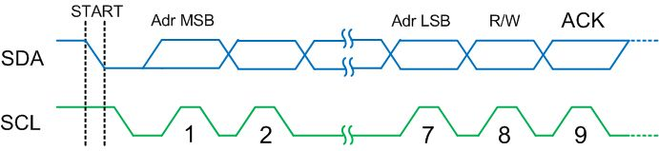
Address Byte Format in I2C

Slide 8
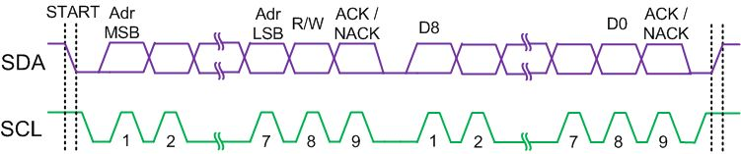
Typical Data Transmission

Slide 9
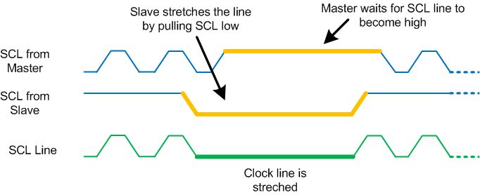
Clock Stretching

Slide 10
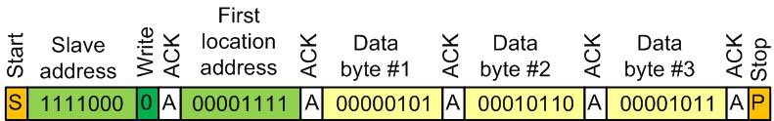
Multi-byte Burst Write

Slide 11
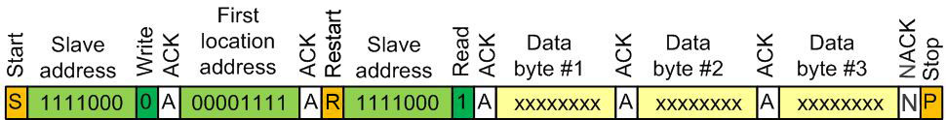
Multi-byte Burst Read

Slide 12
I2C Module Base Address for SAMD2x
I2C Module | Base Address
SERCOM0 | 0x4200 0800
SERCOM1 | 0x4200 0C00
SERCOM2 | 0x4200 1000
SERCOM3 | 0x4200 1400
SERCOM4 | 0x4200 1800
SERCOM5 | 0x4200 1C00

Slide 13
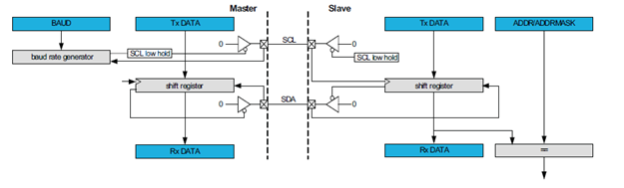

I2C Master Slave connection

Slide 14
Some I2C Registers
Register Name | Register Function | Register Address(Hex)
CTRLA | Control A | 0000
CTRLB | Control B | 0004
BAUD | Baud Rate | 000C
INTFLAG | Interrupt Flag | 0018
STATUS | Status | 001A
ADDR | Address | 0024
DATA | DATA | 0028

Slide 15
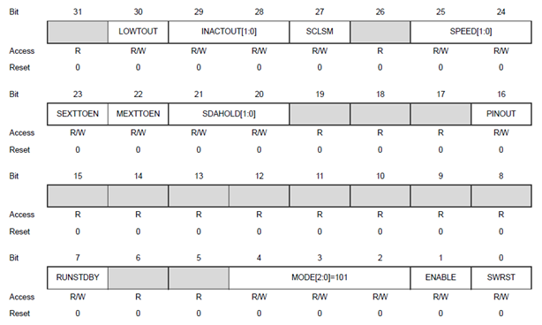
I2C CTRLA (Control A) Register

Slide 16
CTRLA (Control A) register bit description (See SAMD2x datasheet for other bits)
Field | Bit | Description
RUNSTDBY | 7 | Run In Standby This bit defines the functionality in standby sleep mode.
 | 6:5 | Reserved
MODE | 4:2 | Operating Mode (Selecting UART, SPI or I2C) 0x1: UART with internal clock. 0x2: SPI in slave operation. 0x3: SPI in master operation. 0x4: I2C in slave operation. 0x5: I2C in master operation.
ENABLE | 1 | Enable 0: The peripheral is disabled or being disabled. 1: The peripheral is enabled or being enabled.
SWRST | 0 | Software Reset 0: There is no reset operation ongoing. 1: The reset operation is ongoing.

Slide 17
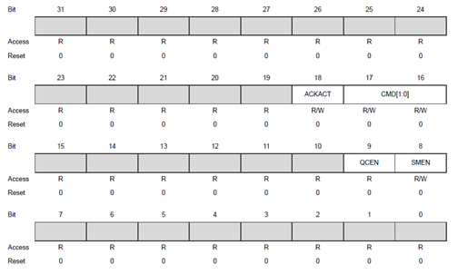
I2C CTRLB (Control B) Register

Slide 18
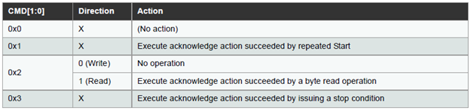
CTRLB (Control B) Register Bit Description (See SAMD2x datasheet for other bits)

Slide 19
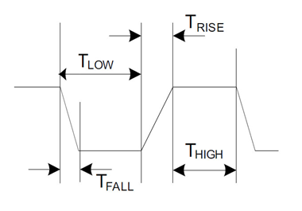
A clock period of I2C clock

Slide 20
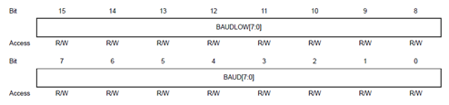
BAUD Register to Set I2C Baud Rate

Slide 21
BAUD Register Bits (See SAMD2x datasheet for other bits)
Bits | Description
15-8 | BAUDLOW – describes the low time of SCL
7-0 | BAUD – describes the high time of SCL

Slide 22
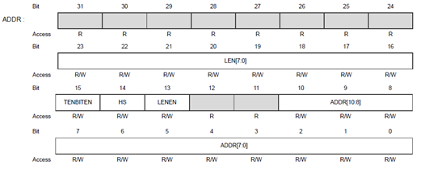
I2C ADDR register for slave address

Slide 23
ADDR Register Bits (See SAMD2x datasheet for other bits)
Bits | Field | Description
10-0 | ADDR[10:0] | Address When ADDR is written, the consecutive operation will depend on the bus state: Unknown: INTFLAG.MB and STATUS.BUSERR are set, and the operation is terminated. Busy: The I2C master will await further operation until the bus becomes idle. Idle: The I2C master will issue a start condition followed by the address written in ADDR. If the address is acknowledged, SCL is forced and held low, and STATUS.CLKHOLD and INTFLAG.MB are set. Owner: A repeated start sequence will be performed. If the previous transaction was a read, the acknowledge action is sent before the repeated start bus condition is issued on the bus. Writing ADDR to issue a repeated start is performed while INTFLAG.MB or INTFLAG.SB is set.

Slide 24
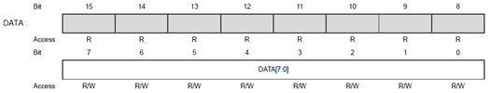
DATA Transmit/Receive Buffer Register

Slide 25
DATA Register Bits
Bits | Field | Description
7-0 | DATA[7:0] | Data The master data register I/O location (DATA) provides access to the master transmit and receive data buffers. Reading valid data or writing data to be transmitted can be successfully done only when SCL is held low by the master (STATUS.CLKHOLD is set). An exception occurs when reading the last data byte after the stop condition has been sent.

Slide 26
INTFLAG Register

Slide 27
INTFLAG Register Bit Description (See SAMD2x datasheet for other bits)
Bits | Field | Description
1 | MB | Master on Bus The Master on Bus flag (MB) is set when a byte is transmitted in master write mode.
0 | SB | Slave on Bus The Slave on Bus flag (SB) is set when a byte is successfully received in master read mode

Slide 28
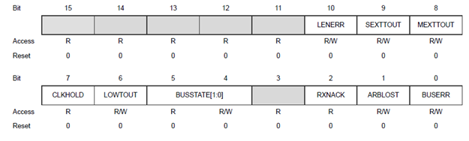
Status Register

Slide 29
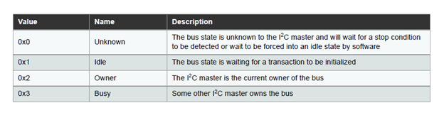
BUS State Bits for Status Register (See SAMD2x datasheet for other bits)

Slide 30
PORT pin function multiplexing
 |  | A (0) | B (1) |  |  |  |  | C (2) | D (3) | E (4) | F (5) | G (6) | H (7)
I/O Pin | Supply | EIC | REF | ADC | AC | PTC | DAC | SERCOM | SERCOM-ALT | TC/TCC | TCC | COM | AC/GCLK
PA00 | VDDANA | EXTINT[0] |  |  |  |  |  |  | SERCOM1/PAD[0] | TCC2/WO[0]
PA01 | VDDANA | EXTINT[1] |  |  |  |  |  |  | SERCOM1/PAD[1] | TCC2/WO[1]
PA02 | VDDANA | EXTINT[2] |  | AIN[0] |  | Y[0] | VOUT
PA03 | VDDANA | EXTINT[3] | ADC/VREFA DAC/VREFA | AIN[1] |  | Y[1]
PA04 | VDDANA | EXTINT[4] | ADC/VREFB | AIN[4] | AIN[0] | Y[2] |  |  | SERCOM0/PAD[0] | TCC0/WO[0]
PA05 | VDDANA | EXTINT[5] |  | AIN[5] | AIN[1] | Y[3] |  |  | SERCOM0/PAD[1] | TCC0/WO[1]
PA06 | VDDANA | EXTINT[6] |  | AIN[6] | AIN[2] | Y[4] |  |  | SERCOM0/PAD[2] | TCC1/WO[0]
PA07 | VDDANA | EXTINT[7] |  | AIN[7] | AIN[3] | Y[5] |  |  | SERCOM0/PAD[3] | TCC1/WO[1] |  | I2S/SD[0]
PA08 | VDDIO | NMI |  | AIN[16] |  | X[0] |  | SERCOM0/PAD[0] | SERCOM2/PAD[0] | TCC0/WO[0] | TCC1/WO[2] | I2S/SD[1]
PA09 | VDDIO | EXTINT[9] |  | AIN[17] |  | X[1] |  | SERCOM0/PAD[1] | SERCOM2/PAD[1] | TCC0/WO[1] | TCC1/WO[3] | I2S/MCK[0]
PA10 | VDDIO | EXTINT[10] |  | AIN[18] |  | X[2] |  | SERCOM0/PAD[2] | SERCOM2/PAD[2] | TCC1/WO[0] | TCC0/WO[2] | I2S/SCK[0] | GCLK_IO[4]
PA11 | VDDIO | EXTINT[11] |  | AIN[19] |  | X[3] |  | SERCOM0/PAD[3] | SERCOM2/PAD[3] | TCC1/WO[1] | TCC0/WO[3] | I2S/FS[0] | GCLK_IO[5]
PA12 | VDDIO | EXTINT[12] |  |  |  |  |  | SERCOM2/PAD[0] | SERCOM4/PAD[0] | TCC2/WO[0] | TCC0/WO[6] |  | AC/CMP[0]
PA13 | VDDIO | EXTINT[13] |  |  |  |  |  | SERCOM2/PAD[1] | SERCOM4/PAD[1] | TCC2/WO[1] | TCC0/WO[7] |  | AC/CMP[1]
PA14 | VDDIO | EXTINT[14] |  |  |  |  |  | SERCOM2/PAD[2] | SERCOM4/PAD[2] | TC3/WO[0] | TCC0/WO[4] |  | GCLK_IO[0]
PA15 | VDDIO | EXTINT[15] |  |  |  |  |  | SERCOM2/PAD[3] | SERCOM4/PAD[3] | TC3/WO[1] | TCC0/WO[5] |  | GCLK_IO[1]
PA16 | VDDIO | EXTINT[0] |  |  |  | X[4] |  | SERCOM1/PAD[0] | SERCOM3/PAD[0] | TCC2/WO[0] | TCC0/WO[6] |  | GCLK_IO[2]
PA17 | VDDIO | EXTINT[1] |  |  |  | X[5] |  | SERCOM1/PAD[1] | SERCOM3/PAD[1] | TCC2/WO[1] | TCC0/WO[7] |  | GCLK_IO[3]
PA18 | VDDIO | EXTINT[2] |  |  |  | X[6] |  | SERCOM1/PAD[2] | SERCOM3/PAD[2] | TC3/WO[0] | TCC0/WO[2] |  | AC/CMP[0]
PA19 | VDDIO | EXTINT[3] |  |  |  | X[7] |  | SERCOM1/PAD[3] | SERCOM3/PAD[3] | TC3/WO[1] | TCC0/WO[3] | I2S/SD[0] | AC/CMP[1]
PA20 | VDDIO | EXTINT[4] |  |  |  | X[8] |  | SERCOM5/PAD[2] | SERCOM3/PAD[2] | TC7/WO[0] | TCC0/WO[6] | I2S/SCK[0] | GCLK_IO[4]
PA21 | VDDIO | EXTINT[5] |  |  |  | X[9] |  | SERCOM5/PAD[3] | SERCOM3/PAD[3] | TC7/WO[1] | TCC0/WO[7] | I2S/FS[0] | GCLK_IO[5]
PA22 | VDDIO | EXTINT[6] |  |  |  | X[10] |  | SERCOM3/PAD[0] | SERCOM5/PAD[0] | TC4/WO[0] | TCC0/WO[4] |  | GCLK_IO[6]
PA23 | VDDIO | EXTINT[7] |  |  |  | X[11] |  | SERCOM3/PAD[1] | SERCOM5/PAD[1] | TC4/WO[1] | TCC0/WO[5] | USB/SOF 1kHz | GCLK_IO[7]
PA24 | VDDIO | EXTINT[12] |  |  |  |  |  | SERCOM3/PAD[2] | SERCOM5/PAD[2] | TC5/WO[0] | TCC1/WO[2] | USB/DM
PA25 | VDDIO | EXTINT[13] |  |  |  |  |  | SERCOM3/PAD[3] | SERCOM5/PAD[3] | TC5/WO[1] | TCC1/WO[3] | USB/DP
PA27 | VDDIO | EXTINT[15] |  |  |  |  |  |  |  |  |  |  | GCLK_IO[0]
PA28 | VDDIO | EXTINT[8] |  |  |  |  |  |  |  |  |  |  | GCLK_IO[0]
PA30 | VDDIO | EXTINT[10] |  |  |  |  |  |  | SERCOM1/PAD[2] | TCC1/WO[0] |  | SWCLK | GCLK_IO[0]
PA31 | VDDIO | EXTINT[11] |  |  |  |  |  |  | SERCOM1/PAD[3] | TCC1/WO[1] |  | SWDIO(4)
PB00 | VDDANA | EXTINT[0] |  | AIN[8] |  | Y[6] |  |  | SERCOM5/PAD[2] | TC7/WO[0]
PB01 | VDDANA | EXTINT[1] |  | AIN[9] |  | Y[7] |  |  | SERCOM5/PAD[3] | TC7/WO[1]
PB02 | VDDANA | EXTINT[2] |  | AIN[10] |  | Y[8] |  |  | SERCOM5/PAD[0] | TC6/WO[0]
PB03 | VDDANA | EXTINT[3] |  | AIN[11] |  | Y[9] |  |  | SERCOM5/PAD[1] | TC6/WO[1]
PB04 | VDDANA | EXTINT[4] |  | AIN[12] |  | Y[10]
PB05 | VDDANA | EXTINT[5] |  | AIN[13] |  | Y[11]
PB06 | VDDANA | EXTINT[6] |  | AIN[14] |  | Y[12]
PB07 | VDDANA | EXTINT[7] |  | AIN[15] |  | Y[13]
PB08 | VDDANA | EXTINT[8] |  | AIN[2] |  | Y[14] |  |  | SERCOM4/PAD[0] | TC4/WO[0]
PB09 | VDDANA | EXTINT[9] |  | AIN[3] |  | Y[15] |  |  | SERCOM4/PAD[1] | TC4/WO[1]
PB10 | VDDIO | EXTINT[10] |  |  |  |  |  |  | SERCOM4/PAD[2] | TC5/WO[0] | TCC0/WO[4] | I2S/MCK[1] | GCLK_IO[4]
PB11 | VDDIO | EXTINT[11] |  |  |  |  |  |  | SERCOM4/PAD[3] | TC5/WO[1] | TCC0/WO[5] | I2S/SCK[1] | GCLK_IO[5]
PB12 | VDDIO | EXTINT[12] |  |  |  | X[12] |  | SERCOM4/PAD[0] |  | TC4/WO[0] | TCC0/WO[6] | I2S/FS[1] | GCLK_IO[6]
PB13 | VDDIO | EXTINT[13] |  |  |  | X[13] |  | SERCOM4/PAD[1] |  | TC4/WO[1] | TCC0/WO[7] |  | GCLK_IO[7]
PB14 | VDDIO | EXTINT[14] |  |  |  | X[14] |  | SERCOM4/PAD[2] |  | TC5/WO[0] |  |  | GCLK_IO[0]
PB15 | VDDIO | EXTINT[15] |  |  |  | X[15] |  | SERCOM4/PAD[3] |  | TC5/WO[1] |  |  | GCLK_IO[1]
PB16 | VDDIO | EXTINT[0] |  |  |  |  |  | SERCOM5/PAD[0] |  | TC6/WO[0] | TCC0/WO[4] | I2S/SD[1] | GCLK_IO[2]
PB17 | VDDIO | EXTINT[1] |  |  |  |  |  | SERCOM5/PAD[1] |  | TC6/WO[1] | TCC0/WO[5] | I2S/MCK[0] | GCLK_IO[3]
PB22 | VDDIO | EXTINT[6] |  |  |  |  |  |  | SERCOM5/PAD[2] | TC7/WO[0] |  |  | GCLK_IO[0]
PB23 | VDDIO | EXTINT[7] |  |  |  |  |  |  | SERCOM5/PAD[3] | TC7/WO[1] |  |  | GCLK_IO[1]
PB30 | VDDIO | EXTINT[14] |  |  |  |  |  |  | SERCOM5/PAD[0] | TCC0/WO[0] | TCC1/WO[2]

Slide 31
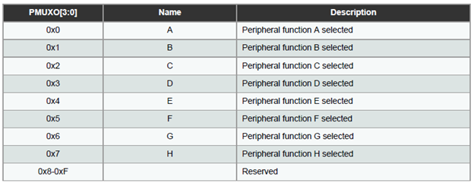
PMUX Register Options

Slide 32

Pin Configuration Register

Slide 33

PMUX Register

Slide 34
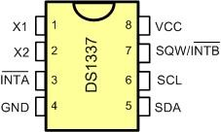
DS1337 Pins

Slide 35
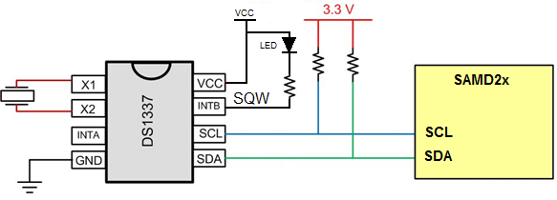
SAMD2x Connections to RTC

Slide 36
DS1337 Address Map
Address | Bit7 | Bit6 | Bit5 | Bit4 | Bit3 | Bit2 | Bit1 |  | Bit0 |  | Function | Range
00H | 0 | 10 Seconds |  |  | Seconds |  |  |  |  |  | Seconds | 00-59
01H | 0 | 10 Minutes |  |  | Minutes |  |  |  |  |  | Minutes | 00-59
02H | 0 | 12/24 | 10 hour PM/AM | 10hour | Hours |  |  |  |  |  | Hours | 1-12 0-23
03H | 0 | 0 | 0 | 0 | 0 | Day |  |  |  |  | Day | 0-7
04H | 0 | 0 | 10 Date |  | Date |  |  |  |  |  | Date | 01-31
05H | Century | 0 | 0 | 10Mnt | Month |  |  |  |  |  | Month Century | 1-12+ Century
06H | 10 Year |  |  |  | Year |  |  |  |  |  | Year | 00-99
07H | A1M1 | 10 Seconds |  |  | Seconds |  |  |  |  |  | Alarm 1 Seconds | 00-59
08H | A1M2 | 10 Minutes |  |  | Minutes |  |  |  |  |  | Alarm 1 Minutes | 00-59
09H | A1M3 | 12/24 | AM/PM | 10 Hour | Hour |  |  |  |  |  | Alarm 1 Hours | 1-12 00-23
 |  |  | 10 Hour
0AH | A1M4 | DY/DT | 10 Date |  | Day |  |  |  |  |  | Alarm 1 Day | 1-7
 |  |  |  |  | Date |  |  |  |  |  | Alarm 1 Date | 01-31
0BH | A2M2 | 10 Minutes |  |  | Minutes |  |  |  |  |  | Alarm 2 Minutes | 00-59
0CH | A2M3 | 12/24 | AM/PM | 10 Hour | Hour |  |  |  |  |  | Alarm 2 Hours | 1-12 00-23
 |  |  | 10 Hour
0DH | A2M4 | DY/DT | 10 Date |  | Day |  |  |  |  |  | Alarm 2 Day | 1-7
 |  |  |  |  | Date |  |  |  |  |  | Alarm 2 Date | 01-31
0EH | EOSC | 0 | 0 | RS2 | RS1 | INTCN |  | A2IE |  | A1IE | Control | -
0FH | OSF | 0 | 0 | 0 | 0 | 0 |  | A2F |  | A1F | Status | -

Slide 37
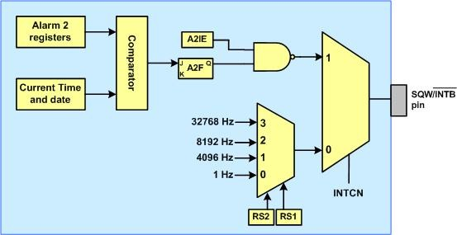
Simplified Structure of SQW/INTB Pin

Slide 38
RS bits
RS2 | RS1 | Output Frequency
0 | 0 | 1 Hz
0 | 1 | 4.096 kHz
1 | 0 | 8.192 kHz
1 | 1 | 32.768 kHz

Slide 39
Alarm 2 Register Mask Bits
DY/DT | A2M4 | A2M3 | A2M2 | Alarm Rate
X | 1 | 1 | 1 | Alarm once per minute
X | 1 | 1 | 0 | Alarm when minutes match
X | 1 | 0 | 0 | Alarm when hours and minutes match
0 | 0 | 0 | 0 | Alarm when date, hours, and minutes match
1 | 0 | 0 | 0 | Alarm when day, hours, and minutes match

