Slide 1
Chapter 11
PWM and DC Motor Control

Slide 2
Selected DC Motor Characteristics
(http://www.Jameco.com)
Part No. | Nominal Volts | Volt Range | Current | RPM | Torque
154915CP | 3 V | 1.5–3 V | 0.070 A | 5,200 | 4.0 g-cm
154923CP | 3 V | 1.5–3 V | 0.240 A | 16,000 | 8.3 g-cm
177498CP | 4.5 V | 3–14 V | 0.150 A | 10,300 | 33.3 g-cm
181411CP | 5 V | 3–14 V | 0.470 A | 10,000 | 18.8 g-cm

Slide 3
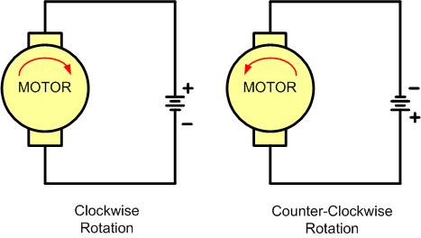
DC Motor Rotation (Permanent Magnet Field)

Slide 4
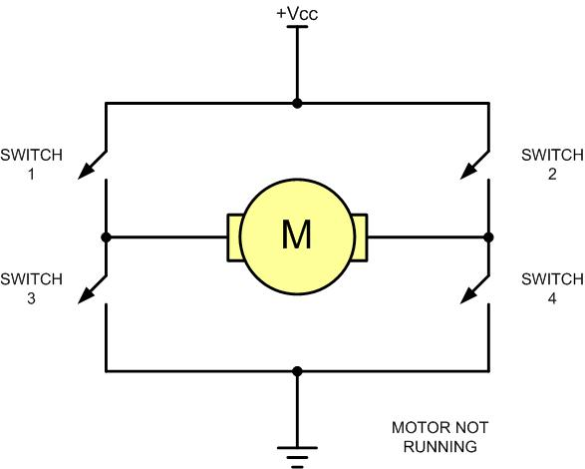
H-Bridge Motor Configuration

Slide 5
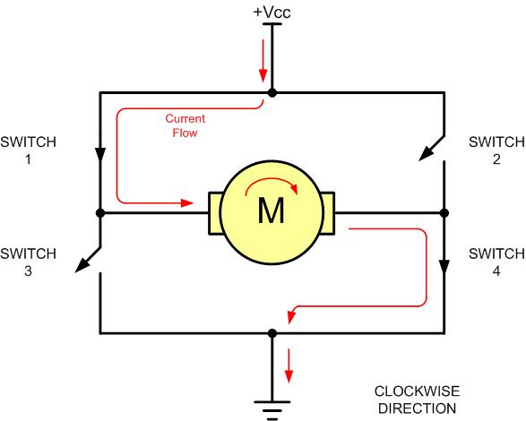
H-Bridge Motor Clockwise Configuration

Slide 6
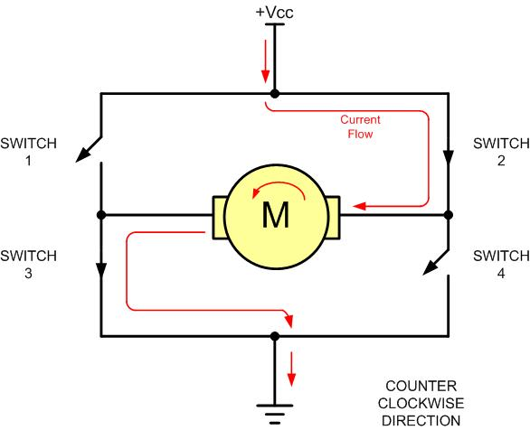
H-Bridge Motor Counterclockwise Configuration

Slide 7
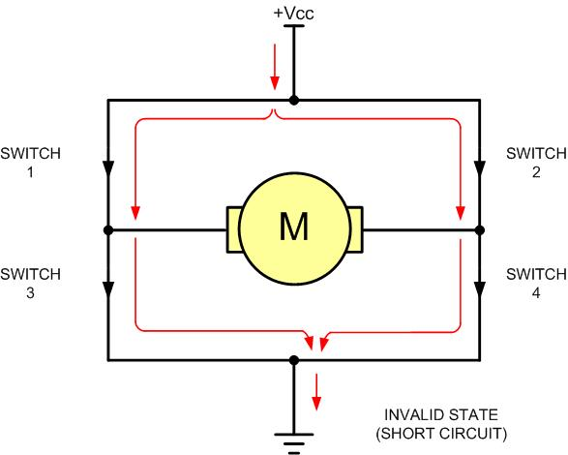
H-Bridge in an Invalid Configuration

Slide 8
Some H-Bridge Logic Configurations
Motor Operation | SW1 | SW2 | SW3 | SW4
Off | Open | Open | Open | Open
Clockwise | Closed | Open | Open | Closed
Counterclockwise | Open | Closed | Closed | Open
Invalid | Closed | Closed | Closed | Closed

Slide 9
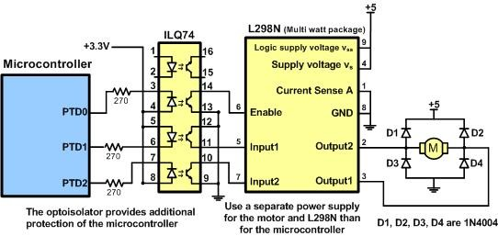
Bidirectional Motor Control Using an L298 Chip

Slide 10
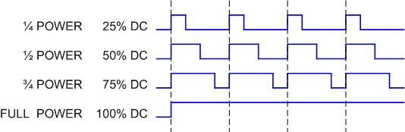
Pulse Width Modulation Comparison

Slide 11
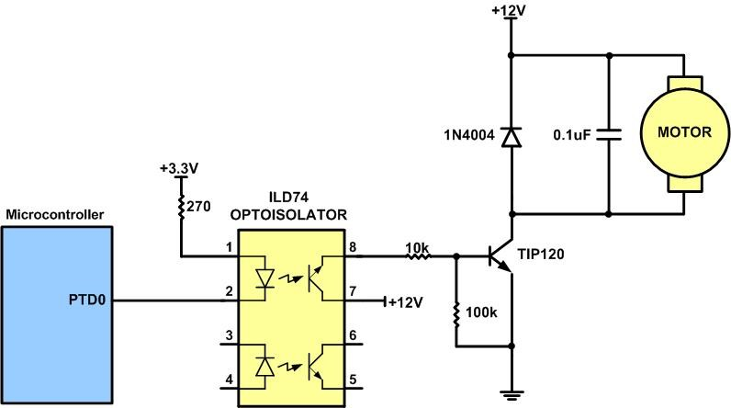
DC Motor Connection Using a Darlington Transistor

Slide 12
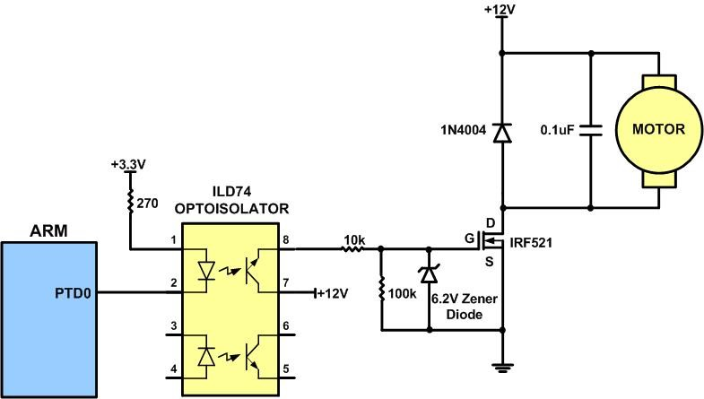
DC Motor Connection Using a MOSFET Transistor

Slide 13
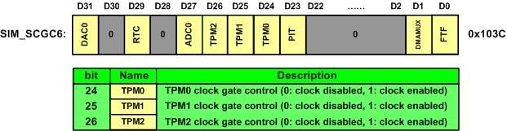
SIM_SCGC6 Register

Slide 14
Timer Status and Control (TPMx_SC) Register

Slide 15
Timer Status and Control (TPMx_SC) Register
Field | Bits | Description
PS | 0–2 | In the prescaler, the clock is divided by 2PS.
CMOD | 3–4 | Clock Mode Selection
CPWMS | 5 | Center-aligned PWM select (0: Up counter mode, 1: up-down counter mode).
TOIE | 6 | Time Overflow Interrupt Enable (0: Disabled, 1: Enabled).
TOF | 7 | Timer Overflow Flag
DMA | 8 | DMA Enable (0: Disabled, 1: Enabled)

Slide 16
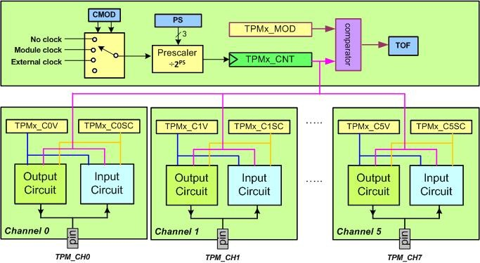
CMOD and PS (Prescaler) bits

Slide 17
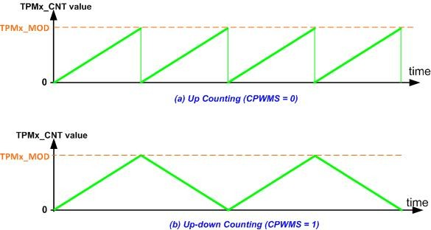
Up/Down-Counter and Up-Counter

Slide 18
TPMxCnSC (TPMx Channel Status and Control)

Slide 19
TPMxCnSC Register
Field | Bit | Description
CHF | 7 | Channel Flag
CHIE | 6 | Channel interrupt enable
MSB and MSA | 5-4 | Channel mode select
ELSB and ELSA | 3-2 | Edge or Level Select
DMA | 0 | DMA enable (0: Disabled, 1: Enabled)

Slide 20
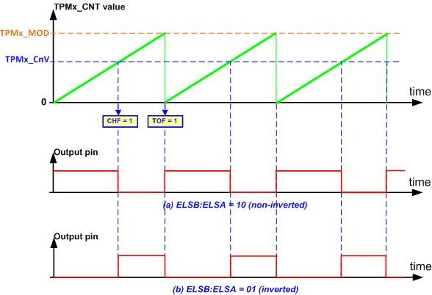
Edge-Aligned PWM

Slide 21
Edge-Aligned PWM (notice bit CPWMS=0)
CPWMS | MSnB:MSnA | ELSnB:ELSnA | Mode | Configuration
0 | 10 | 10 | Edge-Aligned PWM (non-inverted) | Set output on reload, clear output on match
0 | 10 | 01 or 11 | Edge-Aligned PWM (inverted) | Clear output on reload, set output on match

Slide 22
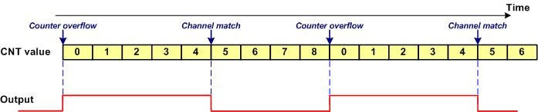
The PWM output for MOD = 8, CnV = 5, ELSB:ELSA = 10 (non-inverted)

Slide 23
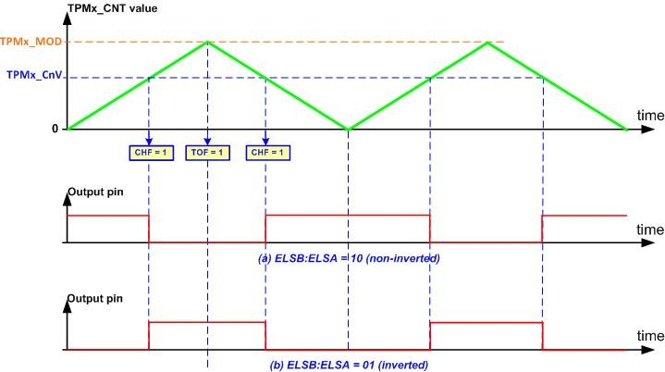
Center-Aligned PWM

Slide 24
Center-Aligned PWM (notice CPWMMS=1)
CPWMS | MSnB:MSnA | ELSnB:ELSnA | Mode | Configuration
1 | 10 | 10 | Center-Aligned PWM | Clear output on match-up, set output on match-down
1 | 10 | X1 | Center-Aligned PWM | Set output on match-up, clear output on match-down

Slide 25
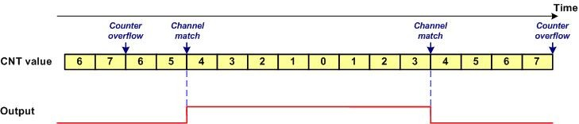
The PWM output for MOD = 7, CnV = 4, ELSB:ELSA = 10 (non-inverted)

Slide 26
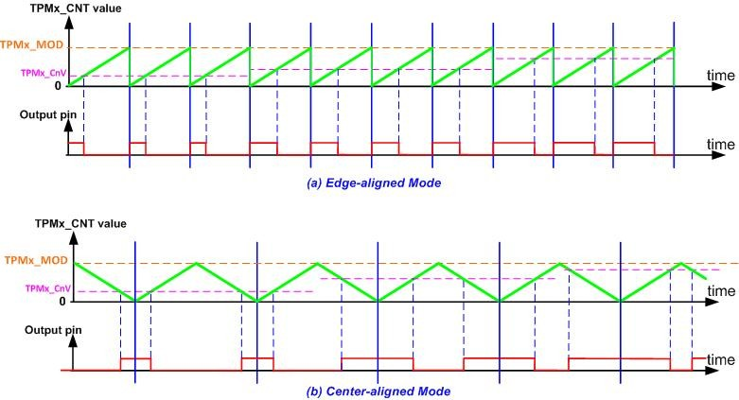
Edge-aligned vs. Center-aligned Mode

Slide 27
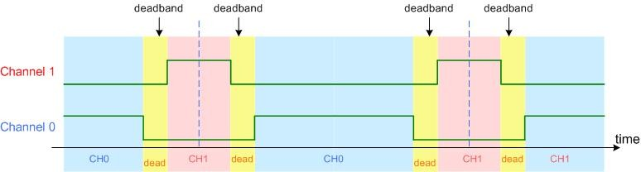
Deadband

