Slide 1
Chapter 2
Freescale ARM I/O Programming

Slide 2
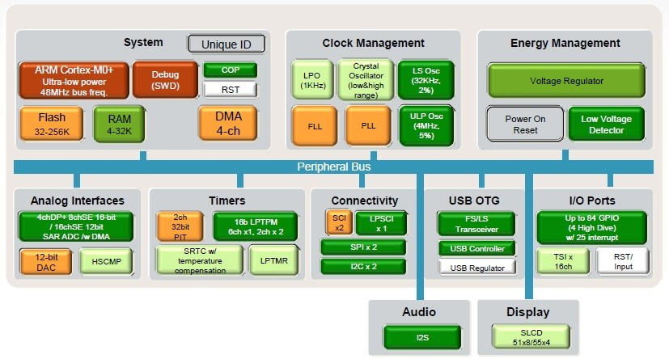
Freescale KL25Z128VLK4 Microcontroller High-Level Block Diagram

Slide 3
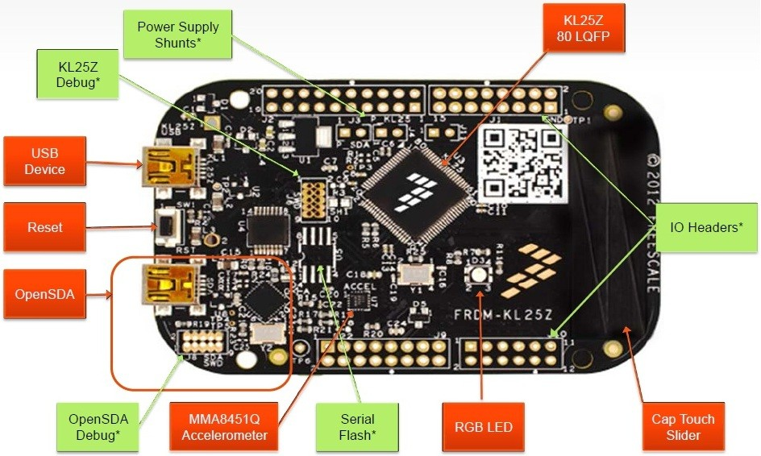
Freescale FRDM Trainer board

Slide 4
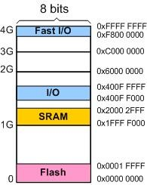
Memory Map

Slide 5
Memory Map in KL25Z128VLK4
 | Allocated size | Allocated address
Flash | 128KB | 0x00000000 to 0x0001FFFF
SRAM | 16KB | 0x1FFFF000 to 0x20002FFF
I/O | All the peripherals | 0x400FF000 to 0x400FFFFF

Slide 6
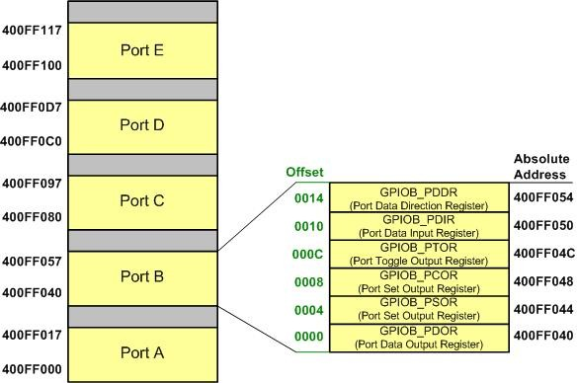
GPIO Memory Map

Slide 7
Fields Values Description
Field | Description | Some Valid Values
Q | Qualification status | • M = Fully qualified, general market flow • P = Prequalification
KL## | Kinetis family | • KL25
A | Key attribute | • Z = Cortex-M0+
FFF | Program Flash memory size | • 32 = 32 KB • 64 = 64 KB • 128 = 128 KB
T | Temperature range (°C) | • V = –40 to 105
PP | Package identifier | • FM = 32 QFN (5 mm x 5 mm) • FT = 48 QFN (7 mm x 7 mm) • LH = 64 LQFP (10 mm x 10 mm) • LK = 80 LQFP (12 mm x 12 mm)
CC | Maximum CPU frequency (MHz) | • 4 = 48 MHz

Slide 8
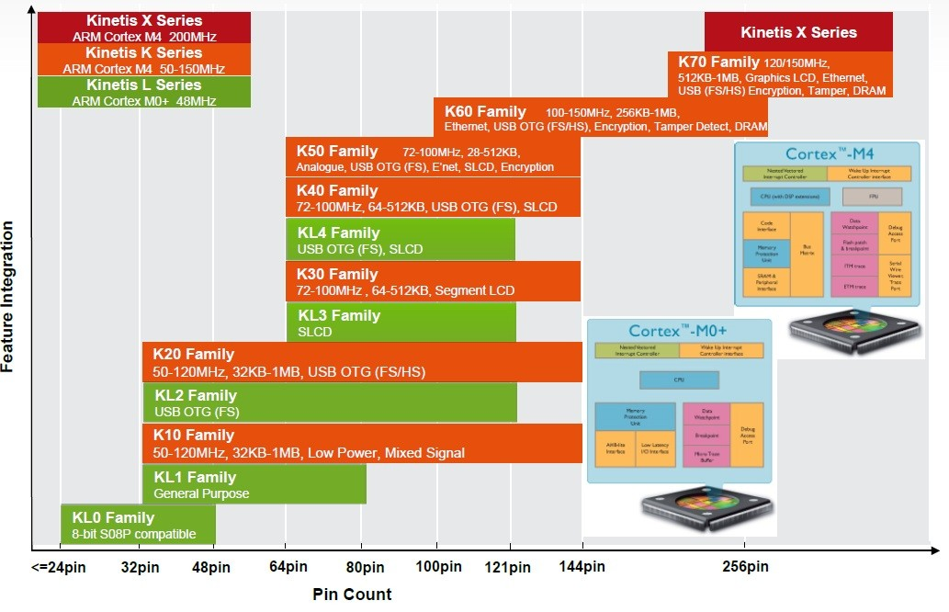
Kinetis MCU Portfolio

Slide 9
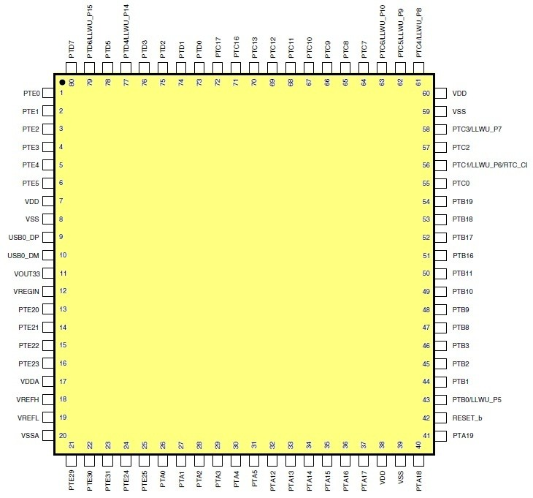
KL25Z128VLK4 Pin-out

Slide 10
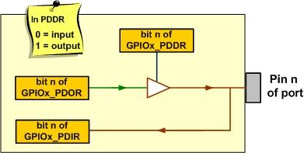
The Data and Direction Registers and a Simplified View of an I/O pin

Slide 11

GPIOx_PDOR (Port Data Output Register)

Slide 12

GPIOx_PDDR (Port Data Direction Register)

Slide 13
Some GPIO Registers for PORTA
Address | Name | Description | Type | Reset Value
0x400F F000 | GPIOA_PDOR | Port Data Output Register | R/W | 0x00000000
0x400F F004 | GPIOA_PSOR | Port Set Output register | W (always reads 0) | 0x00000000
0x400F F008 | GPIOA_PCOR | Port Clear Output Register | W (always reads 0) | 0x00000000
0x400F F00C | GPIOA_PTOR | Port Toggle Output Register | W (always reads 0) | 0x00000000
0x400F F010 | GPIOA_PDIR | Port Data Input Register | R | 0x00000000
0x400F F014 | GPIOA_PDDR | Port Data Direction Register | R/W | 0x00000000

Slide 14
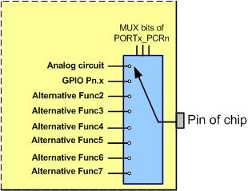
Alternative Functions of Pins

Slide 15

PORTx_PCRn Register is used to select alternate pin functions (from Sec 11.5 of KL25 Ref. Man.)

Slide 16

SIM_SCGC5 (System Clock Gating Control Register 5) Register

Slide 17
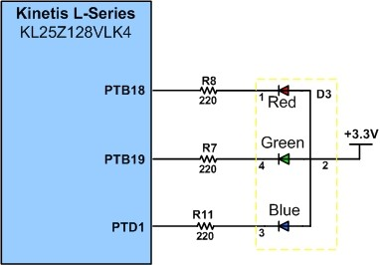
LED connection to PTB and PTD Freescale FRDM board

Slide 18

PSOR (Port Set Output Register)

Slide 19

PCOR (Port Clear Output Register)

Slide 20

PTOR (Port Toggle Output Register)

Slide 21
Clock setup modes in Keil MDK-ARM v5 Freescale Kinetis KLxx Series Device Family Support Pack
CLOCK_SETUP | Mode | Reference clock source | Core clock | Bus clock
0 | FLL Engaged Internal | slow internal clock 32.768kHz | 41.94MHz | 13.98MHz
1 | PLL Engaged External | external crystal 8MHz | 48MHz | 24MHz
2 | Bypassed Low Power External | external crystal 8MHz | 8MHz | 8MHz

Slide 22
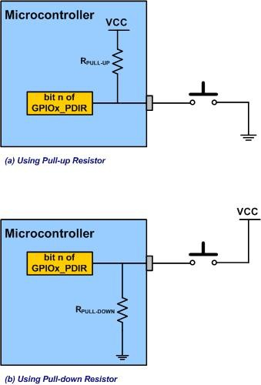
Connecting External Switches to the Microcontroller

Slide 23
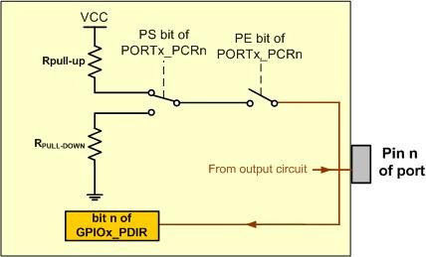
PS and PE bits

Slide 24
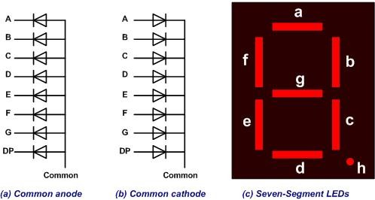
Seven-Segment

Slide 25
Assignments of port pins to each segments of a 7-seg LED
D7 | D6 | D5 | D4 | D3 | D2 | D1 | D0
. | g | f | e | d | c | b | a

Slide 26
Segment patterns for the 10 decimal digits for a common cathode 7-seg LED
Num | D7 | D6 | D5 | D4 | D3 | D2 | D1 | D0 | Hex value
 | . | g | f | e | d | c | b | a
0 | 0 | 0 | 1 | 1 | 1 | 1 | 1 | 1 | 0x3F
1 | 0 | 0 | 0 | 0 | 0 | 1 | 1 | 0 | 0x06
2 | 0 | 1 | 0 | 1 | 1 | 0 | 1 | 1 | 0x5B
3 | 0 | 1 | 0 | 0 | 1 | 1 | 1 | 1 | 0x4F
4 | 0 | 1 | 1 | 0 | 0 | 1 | 1 | 0 | 0x66
5 | 0 | 1 | 1 | 0 | 1 | 1 | 0 | 1 | 0x6D
6 | 0 | 1 | 1 | 1 | 1 | 1 | 0 | 1 | 0x7D
7 | 0 | 0 | 0 | 0 | 0 | 1 | 1 | 1 | 0x07
8 | 0 | 1 | 1 | 1 | 1 | 1 | 1 | 1 | 0x7F
9 | 0 | 1 | 1 | 0 | 1 | 1 | 1 | 1 | 0x6F

Slide 27
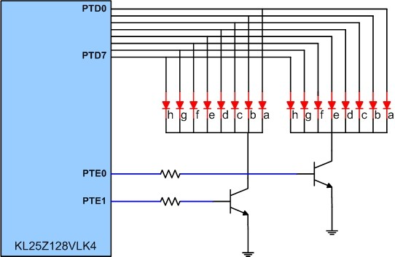
Microcontroller Connection to 7-segment LED

Slide 28
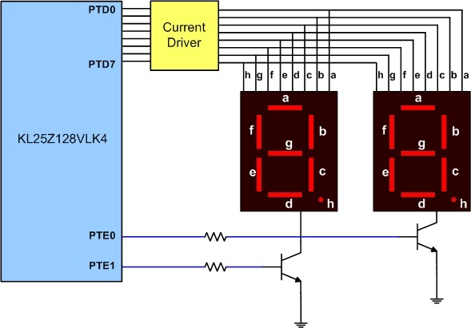
Microcontroller Connection to 7-segment LED with Buffer Driver

