Slide 1
Chapter 4
UART Serial Port Programming

Slide 2
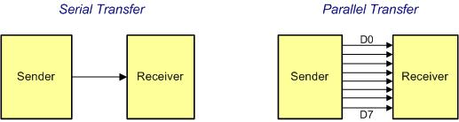
Serial vs. Parallel Data Transfer

Slide 3
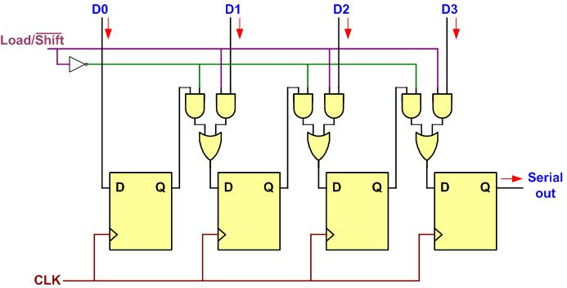
Parallel In Serial Out

Slide 4
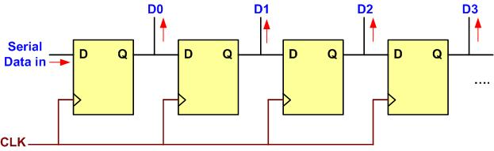
Serial In Parallel Out

Slide 5
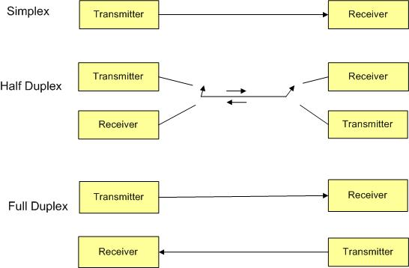
Simplex, Half-, and Full-Duplex Transfers

Slide 6
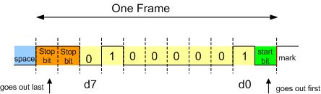
Framing ASCII "A" (0x41)

Slide 7
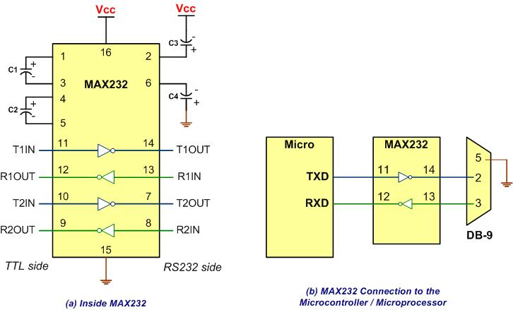
MAX232

Slide 8
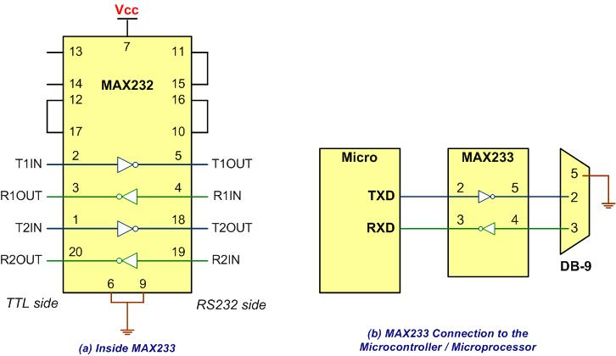
MAX233

Slide 9
RS232 Pins
Pin | Description
1 | Data carrier detect (DCD)
2 | Received data (RxD)
3 | Transmitted data (TxD)
4 | Data terminal ready (DTR)
5 | Signal ground (GND)
6 | Data set ready (DSR)
7 | Request to send (RTS)
8 | Clear to send (CTS)
9 | Ring indicator (RI)

Slide 10
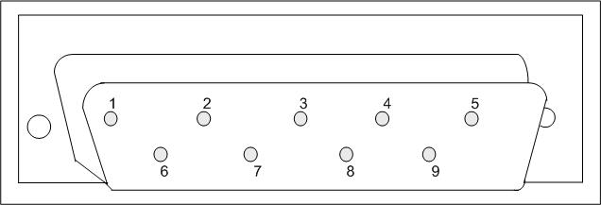
9-Pin Male Connector

Slide 11
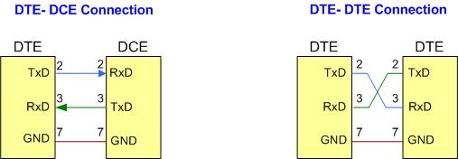
DTE-DCE and DTE-DTE Connections

Slide 12
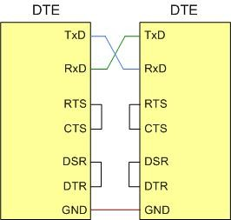
Null Modem Connection with Flow Control Signals

Slide 13
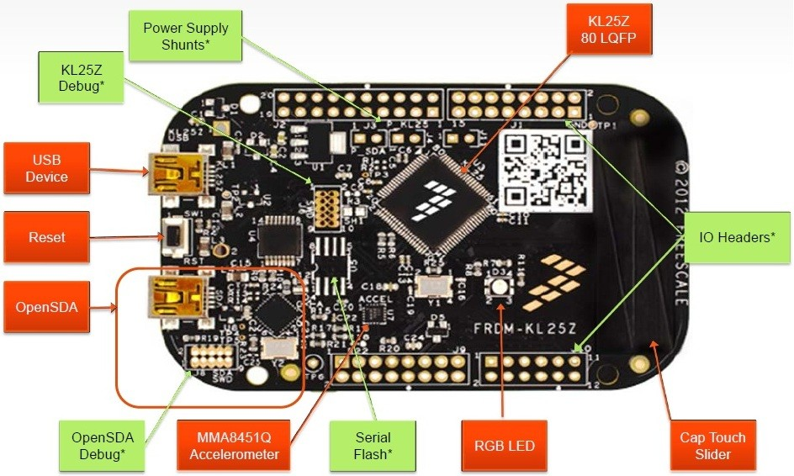
Freescale FRDM board

Slide 14
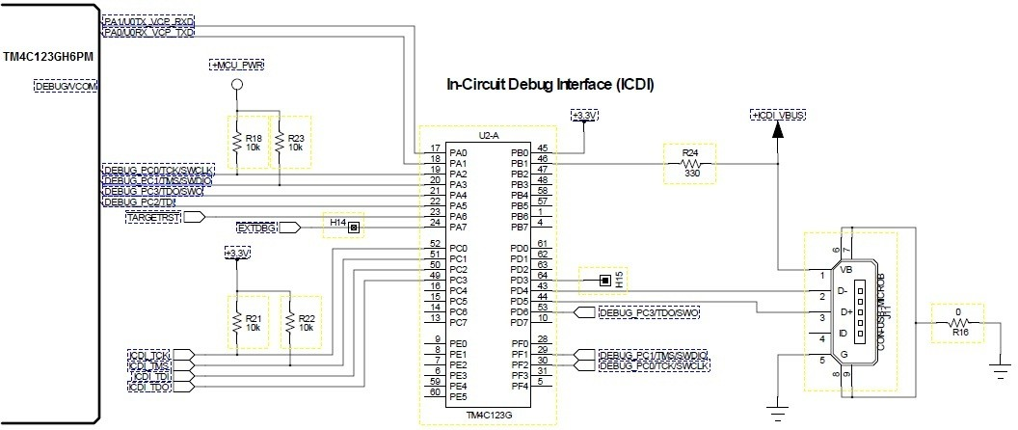
ICDI USB Port

Slide 15
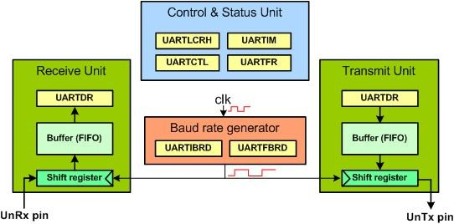
a Simplified Block Diagram of UARTn

Slide 16
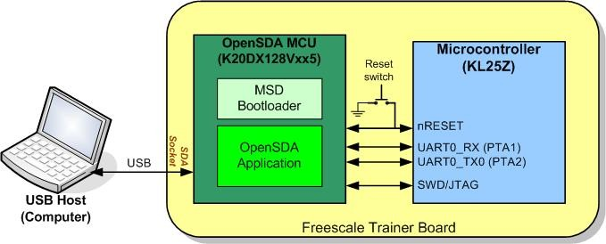
OpenSDA USB Port

Slide 17
Partial list of UART0 Registers and their addresses
Register Name | Register Function | Register Address
UART0_BDH | Baud Rate High | 4006 A000
UART0_BDL | Baud Rate Low | 4006 A001
UART0_C1 | Control 1 | 4006 A002
UART0_C2 | Control 2 | 4006 A003
UART0_S1 | Status 1 | 4006 A004

Slide 18
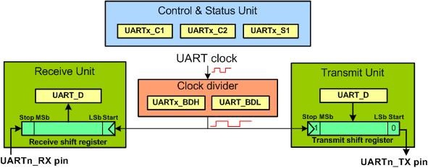
a Simplified Block Diagram of UARTn

Slide 19
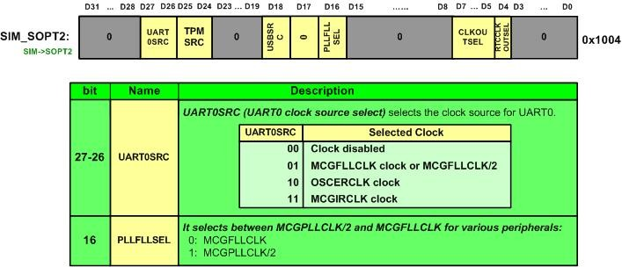
SIM_SOPT2 Register

Slide 20
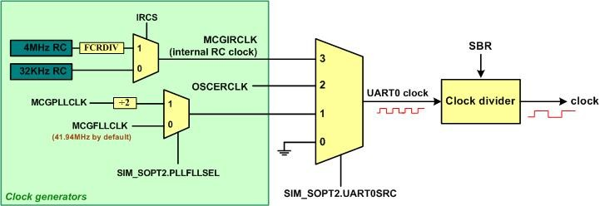
Clock Circuit of UART0

Slide 21
UARTx_BDH

Slide 22
UARTx_BDL

Slide 23
UARTx_C4 Register

Slide 24
UARTx_C4 Register
Bit | Field | Descriptions
7 | MAEN1 | Match Address Enable 1: In your programs set the bit to 0. For more information see the KL25 user manual.
6 | MAEN2 | Match Address Enable 2: In your programs set the bit to 0.
5 | M10 | 10-bit Mode select: 0: Receiver and transmitter use 8-bit or 9-bit data characters 1: Receiver and transmitter use 10-bit data characters
0-4 | OSR | Over Sampling Ration (the value can be between 00011 to 11111)

Slide 25
UART0 SBR Values for Some Baud Rates using default OSR=15 and FLL clock output of 41.94 MHz.
Baud rate | SBR (in decimal) | SBR (in hex)
4,800 | 546 | 0x0222
9,600 | 273 | 0x0111
19,200 | 137 | 0x0089
38,400 | 68 | 0x0044
115,200 | 23 | 0x0017

Slide 26
UART Control 1 (UARTx_C1) register

Slide 27
UART Control 1 (UARx_C1) register
Field | Bit | Description
LOOPS | D7 | 0 = Normal operation. RX and TX use separate pins. 1 = LOOP operation enabled. See KL25Z manual
DOZEEN | D6 | Doze Mode Using this we can disable or enable UARTx in wait mode 0 = UART enabled in Wait mode 1 = UART disabled in Wait mode
RSRC | D5 | Receiver source bit. Used only when LOOPS=1 (see KL25Z manual) 0 = for internally connected loop 1 = for externally connected loop
M | D4 | Data format mode bit. We must use this to select 8-bit data frame size 0 = select 8-bit data frame, one stop bit and one start bit 1 = Select 9-bit data frame, one stop bit and one start bit
WAKE | D3 | Wake-up condition bit. See the KL25Z manual 0 = Idle line wakeup 1 = Address mark wake-up
ILT | D2 | Idle line type bit. See the KL25Z manual 0 = Idle character bit count begins after start bit 1 = Idle character bit count begins after stop bit
PE | D1 | Parity Enable bit. This will allow us to insert a parity bit right after the 8th (MSB) bit. 0 = no parity bit 1 = parity bit
PT | D0 | Parity bit type (used only if PE is one.) 0 = even parity bit 1 = odd parity bit
Note: The most important bit in this register is the M bit. The vast majority of the applications use M=0 for 8-bit data size. The rest of the bits are for testing purpose and we do not use them unless we are writing UART diagnostic test software. For that reason, we make them all zeros and we use UARTx_C1 = 0x00.

Slide 28
UART Control 2 (UARTx_C2) register

Slide 29
UART Control 2 (UARTx_C2) register
Field | Bit | Description
TIE | D7 | Transmit Interrupt Enable bit. Used for interrupt-driven UART. See Chapter 6. 0 = TDRE Interrupt Request is disabled. 1 = TDRE Interrupt Request is enabled.
TCIE | D6 | Transmission Complete Interrupt Enable bit. Used for interrupt-driven UART. See Chapter 6. 0 = TC Interrupt Request is disabled. 1 = TC Interrupt Request is enabled.
RIE | D5 | Receiver Full Interrupt Enable bit. Used for interrupt-driven UART. See Chapter 6. 0 = RDRF Interrupt Request is disabled. 1 = RDRF Interrupt Request is enabled.
ILIE | D4 | Idle Line Interrupt Enable bit. Used for interrupt-driven UART. 0 = IDLE Interrupt Request is disabled. 1 = IDLE Interrupt Request is enabled.
TE | D3 | Transmitter Enable bit. We must enable this bit to transmit data. 0 = Transmitter is disabled. 1 = Transmitter is enabled.
RE | D2 | Receiver Enable bit. We must enable this bit to receive data. 0 = Receiver is disabled. 1 = Receiver is enabled.
RWU | D1 | Used for wake-up condition in stand-by mode. See the KL25Z manual. 0 = Normal operation 1 = RWU is enabled.
SBK | D0 | Used for break bit. See the KL25Z manual. 0 = No break character 1 = Transmit break character
Note: The most important bits in this register are the TE and RE bits. In applications using the polling method we make the interrupt request bits all zeros. For the polling method, we use UARTx_C2 = 0x0C. The rest of the bits are for testing purposes. To use interrupt-driven UART, see Chapter 6.

Slide 30
UART Data (UART_D) register

Slide 31

UART Status Register (UARTx_S1)

Slide 32
UART Status Register (UARTx_S1)
Field | Bit | Description
TDRE | D7 | Transmit Data Register Empty 0 = The shift register is loaded and shifting. An additional byte is waiting in the Data Register. 1 = The Data Register is empty and ready for the next byte.
TC | D6 | Transmit Complete flag 0 = Transmission is in progress (shift register is occupied) 1 = No transmission in progress (both shift register and Data Register are empty)
RDRF | D5 | Receive Data Register Full flag. This indicates a byte has been received and is sitting in UART Data Register and ready to be picked up. 0 = No data is available in UART Data Register. 1 = Data is available in UART Data Register and ready to be picked up.
IDLE | D4 | Idle line flag. See the KL25Z manual.
OR | D3 | D3 Overrun error 0 = No overrun 1 = Overrun error
NF | D2 | Noise Flag error bit 0 = No noise 1 = Noise error
FE | D1 | Framing Error bit 0 = No framing error 1 = Framing error
PF | D0 | Parity flag error bit 0 = No parity error 1 = Parity error

Slide 33

SIM_SCGC4 (System Clock Gating Control) Register

Slide 34

PORTx_PCRn Alternate Function Selection register

Slide 35
Pins available for UARTs
FRDM I/O Pin | KL25Z Pin | ALT2 | ALT3 | ALT4
J1 02 | PTA1 | UART0_RX
J1 04 | PTA2 | UART0_TX
― | PTA14 |  | UART0_TX
― | PTA15 |  | UART0_RX
― | PTA18 |  | UART1_RX
― | PTA19 |  | UART1_TX
― | PTB16 |  | UART0_RX
― | PTB17 |  | UART0_TX
J1 05 | PTC3 |  | UART1_RX
J1 07 | PTC4 |  | UART1_TX
J2 08 | PTD2 |  | UART2_RX
J2 10 | PTD3 |  | UART2_TX
J1 06 | PTD4 |  | UART2_RX
J2 04 | PTD5 |  | UART2_TX
J2 17 | PTD6 |  | UART0_RX
J2 19 | PTD7 |  | UART0_TX
J2 20 | PTE0 |  | UART1_TX
J2 18 | PTE1 |  | UART1_RX
J10 01 | PTE20 |  |  | UART0_TX
J10 03 | PTE21 |  |  | UART0_RX
J10 05 | PTE22 |  |  | UART2_TX
J10 07 | PTE23 |  |  | UART2_RX

Slide 36
UART1 and UART2 SBR Values for Some Baud Rates using bus clock of 13.98 MHz
Baud rate | SBR (in decimal) | SBR (in hex)
4,800 | 182 | 0x00B6
9,600 | 91 | 0x005B
19,200 | 46 | 0x002E
38,400 | 23 | 0x0017

