Slide 1
Chapter 6
Interrupt and Exception Programming

Slide 2
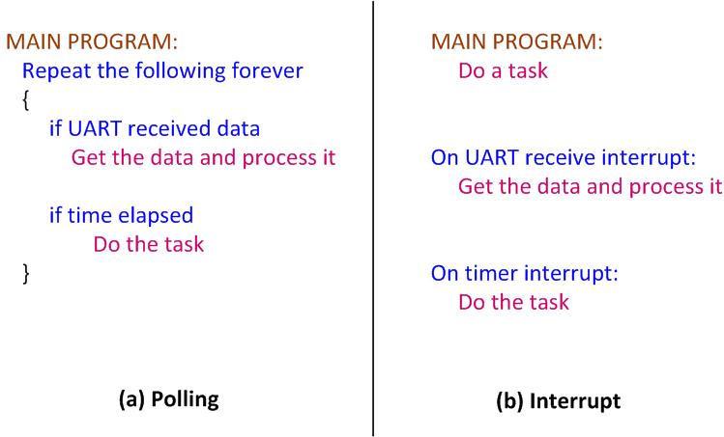
Polling vs. Interrupts

Slide 3
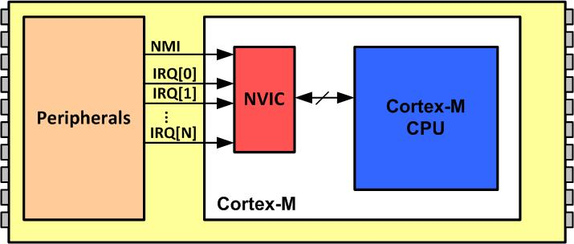
NVIC in ARM Cortex-M

Slide 4
Interrupt Vector Table for ARM Cortex-M
Interrupt # | Interrupt | Memory Location (Hex)
 | Stack Pointer initial value | 0x00000000
1 | Reset | 0x00000004
2 | NMI | 0x00000008
3 | Hard Fault | 0x0000000C
4 | Memory Management Fault | 0x00000010
5 | Bus Fault | 0x00000014
6 | Usage Fault (undefined instructions, divide by zero, unaligned memory access,...) | 0x00000018
7 | Reserved | 0x0000001C
8 | Reserved | 0x00000020
9 | Reserved | 0x00000024
10 | Reserved | 0x00000028
11 | SVCall | 0x0000002C
12 | Debug Monitor | 0x00000030
13 | Reserved | 0x00000034
14 | PendSV | 0x00000038
15 | SysTick | 0x0000003C
16 | IRQ 0 for peripherals | 0x00000040
17 | IRQ 1 for peripherals | 0x00000044
… | … | …
255 | IRQ 239 for peripherals | 0x000003FC

Slide 5
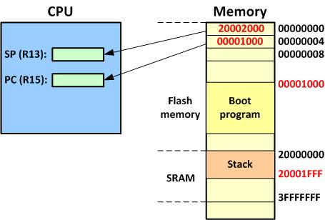
Going from Reset to Boot Program

Slide 6
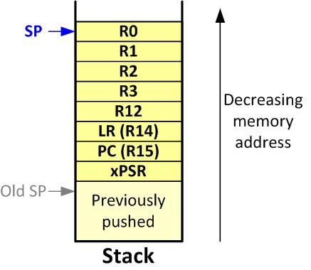
ARM Cortex-M Stack Frame upon Interrupt

Slide 7
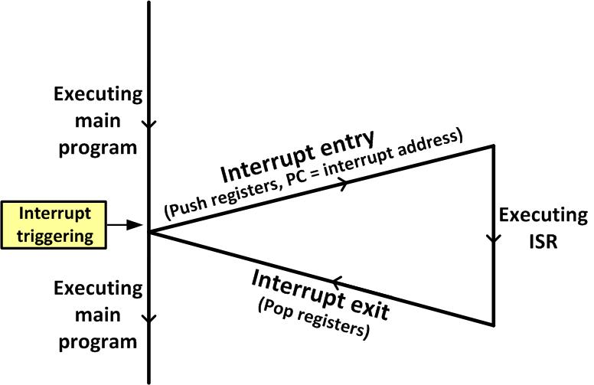
Main Program gets interrupted

Slide 8
Interrupt Priority for ARM Cortex-M
Interrupt # | Interrupt | Priority Level
0 | Stack Pointer initial value
1 | Reset | -3 Highest
2 | NMI | -2
3 | Hard Fault | -1
4 | Memory Management Fault | Programmable
5 | Bus Fault | Programmable
6 | Usage Fault (undefined instructions, divide by zero, unaligned memory access,....) | Programmable
7 | Reserved | Programmable
8 | Reserved | Programmable
9 | Reserved | Programmable
10 | Reserved | Programmable
11 | SVCall | Programmable
12 | Debug Monitor | Programmable
13 | Reserved | Programmable
14 | PendSV | Programmable
15 | SysTick | Programmable
16 | IRQ 0 for peripherals | Programmable
17 | IRQ 1 for peripherals | Programmable
… | … | Programmable
255 | IRQ 239 for peripherals | Programmable

Slide 9

CONTROL Register in ARM Cortex-M4
nPRIV (Privilege): Defines the Thread mode privilege level 0: Privileged 1: Unprivileged Active Stack Pointer (ASP): Defines the currently active stack pointer (ASP = SPSEL) 0: MSP is the current stack pointer. 1: PSP is the current stack pointer. Floating Point Context Active (FPCA) 0: No floating point context active. 1: Floating point context active.

Slide 10
Processor Modes and Stack Usage in ARM Cortex-M
Processor Mode | Software | Stack Usage
Thread | Applications | MSP or PSP
Handler | ISR for Exceptions and IRQs | MSP
Note: In Thread mode, use bit 1 of the Control register to select MSP or PSP for stack pointer.

Slide 11
Privileged level Execution and Processor Modes in ARM Cortex-M
Processor Mode | Software | Privilege level
Thread | Applications | Privileged and Unprivileged
Handler | ISR for Exceptions and IRQs | Always Privileged
Note: In Thread mode, use bit 0 of the CONTROL register to select Privileged or Unprivileged

Slide 12
Processor Mode, Privilege, and Stack in ARM Cortex
Mode | Privilege | Stack Pointer | Typical Example usage
Handler | Privileged | Main | Exception Handling
Handler | Unprivileged | Any | Reserved since Handler is always Privileged
Thread | Privileged | Main | Operating system kernel
Thread | Privileged | Process
Thread | Unprivileged | Main
Thread | Unprivileged | Process | Application threads

Slide 13
Special function registers of ARM Cortex-M
Register name | Privilege Usage
MSP (main stack pointer) | Privileged
PSP (processor stack pointer) | Privileged or Unprivileged
PSR (Processor status register) | Privileged
APSR (application processor status register) | Privileged or Unprivileged
ISPR (interrupt processor status register) | Privileged
EPSR (execution processor status register) | Privileged
PRIMASK (Priority Mask register) | Privileged
FAULTMASK(fault mask register) | Privileged
BASEPRI (base priority register) | Privileged
CONTROL (control register) | Privileged
Note: We must use MSR and MRS instructions to access the above registers

Slide 14
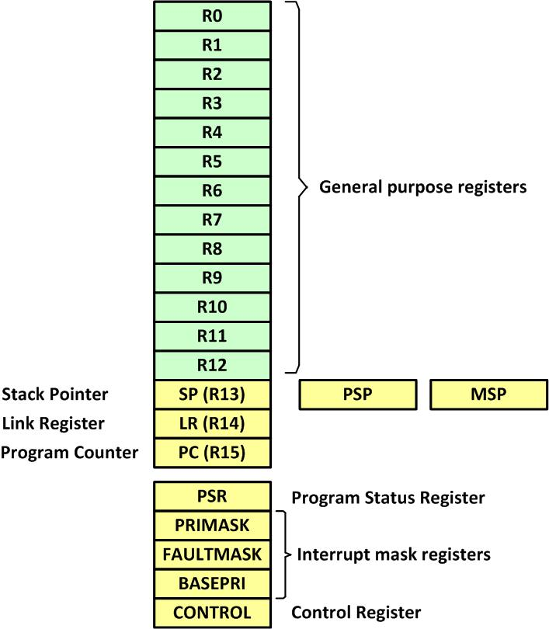
ARM Cortex-M Registers

Slide 15
IRQ assignment in KL25Z of FRDM board
INT# | IRQ# | Vector location | Device
1-15 | None | 0000 0000 to 0000 003C | CPU Exception (set by ARM)
16 | 0 | 0000 0040 | DMA
17 | 1 | 0000 0044 | DMA
18 | 2 | 0000 0048 | DMA
19 | 3 | 0000 004C | DMA
20 | 4 | 0000 0050 | ----
21 | 5 | 0000 0054 | FTFA
22 | 6 | 0000 0058 | PMC
23 | 7 | 0000 005C | LLWU
24 | 8 | 0000 0060 | I2C0
25 | 9 | 0000 0064 | I2C1
26 | 10 | 0000 0068 | SPI0
27 | 11 | 0000 006C | SPI1
28 | 12 | 0000 0070 | UART0

Slide 16
IRQ assignment in KL25Z of FRDM board (Cont.)
INT# | IRQ# | Vector location | Device
29 | 13 | 0000 0074 | UART1
30 | 14 | 0000 0078 | UART2
31 | 15 | 0000 007C | ADC0
32 | 16 | 0000 0080 | CMP0
33 | 17 | 0000 0084 | TPM0
34 | 18 | 0000 0088 | TPM1
35 | 19 | 0000 008C | TPM2
36 | 20 | 0000 0090 | RTC
37 | 21 | 0000 0094 | RTC
38 | 22 | 0000 0098 | PIT
39 | 23 | 0000 009C | -----
40 | 24 | 0000 00A0 | USB OTG
41 | 25 | 0000 00A4 | DAC0
42 | 26 | 0000 00A8 | TSI0
43 | 27 | 0000 00AC | MCG
44 | 28 | 0000 00B0 | LPTMR0
45 | 29 | 0000 00B4 | -----
46 | 30 | 0000 00B8 | I/O PORTA
47 | 31 | 0000-00BC | I/O PORTD

Slide 17
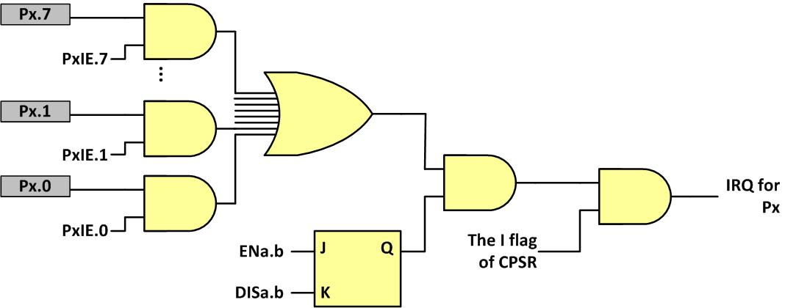
Interrupt enabling with all 3 levels

Slide 18

PORTx_PCRn register

Slide 19
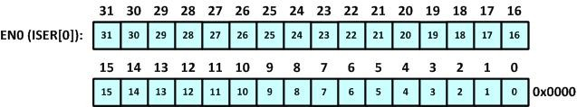
Interrupts 0–31 Set Enable (EN0)

Slide 20
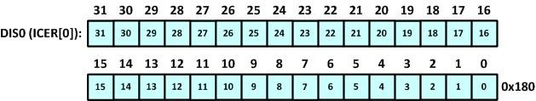
Interrupts 0–31 Clear Enable (DIS0)

Slide 21

Enabling and Disabling an Interrupt

Slide 22
PORTx_PCR Interrupt activation bits

Slide 23
I/O Interrupt Trigger
D19 | D18 | D17 | D16
1 | 0 | 0 | 0 | Interrupt when logic zero (Active Low-level).
1 | 0 | 0 | 1 | Interrupt on rising edge.
1 | 0 | 1 | 0 | Interrupt on falling edge.
1 | 0 | 1 | 1 | Interrupt on either edge.
1 | 1 | 0 | 0 | Interrupt when logic one (Active High-level)

Slide 24
UARTx_Control2 (UARTx_C2)

Slide 25
UART Control 2 (UARTx_C2) register
Field | Bit | Description
TIE | D7 | Transmit Interrupt Enable bit. Used for interrupt-driven UART. 0 = TDRE Interrupt Request is disabled. 1 = TDRE Interrupt Request is enabled.
TCIE | D6 | Transmission Complete Interrupt Enable bit. Used for interrupt-driven UART. 0 = TC Interrupt Request is disabled. 1 = TC Interrupt Request is enabled.
RIE | D5 | Receiver Full Interrupt Enable bit. Used for interrupt-driven UART. 0 = RDRF Interrupt Request is disabled. 1 = RDRF Interrupt Request is enabled.
ILIE | D4 | Idle Line Interrupt Enable bit. Used for interrupt-driven UART. 0 = IDLE Interrupt Request is disabled. 1 = IDLE Interrupt Request is enabled.
TE | D3 | Transmitter Enable bit. We must enable this bit to transmit data. 0 = Transmitter is disabled. 1 = Transmitter is enabled.
RE | D2 | Receiver Enable bit. We must enable this bit to receive data. 0 = Receiver is disabled. 1 = Receiver is enabled.
RWU | D1 | Used for wake-up condition in stand-by mode. See the KL25Z manual. 0 = Normal operation 1 = RWU is enabled.
SBK | D0 | Used for break bit. See the KL25Z manual. 0 = No break character 1 = Transmit break character

Slide 26
TOIE in TPMx_SC (Timer Status Control) register

Slide 27
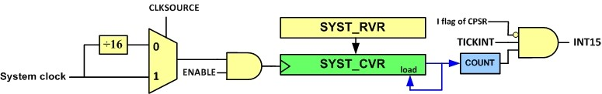
SysTick Internal Structure

Slide 28
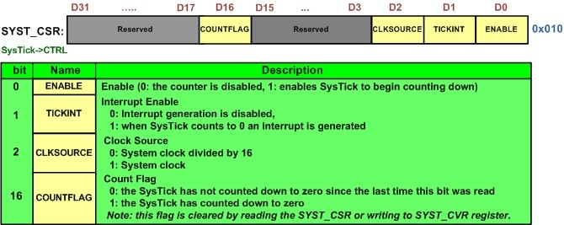
SysTick Control and Status Register (SYST_CSR)

Slide 29
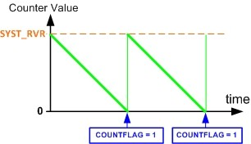
SysTick Counting

Slide 30
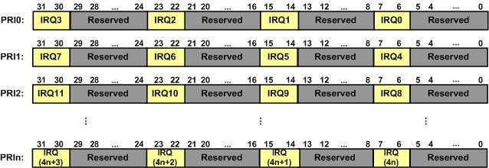
IPRn Registers

