Slide 1
Chapter 7
ADC, DAC, and Sensor Interfacing

Slide 2
Microcontroller Connection to Sensor via ADC

Slide 3
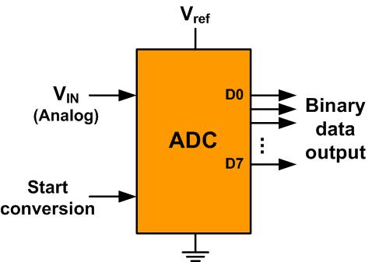
An 8-bit ADC Block Diagram

Slide 4
Resolution versus Step Size for ADC (Vref = 5V)
n-bit | Number of steps | Step size
8 | 256 | 5V /256 = 19.53 mV
10 | 1024 | 5V /1024 = 4.88 mV
12 | 4096 | 5V /4096 = 1.2 mV
16 | 65,536 | 5V /65,536 = 0.076 mV
Note: V_{ref} = 5V

Slide 5
Vref Relation to Vin Range for an 8-bit ADC
V_{ref} (V) | V_{in} in Range (V) | Step Size (mV)
5.00 | 0 to 5 | 5 / 256 = 19.53
4.00 | 0 to 4 | 4 / 256 = 15.62
3.00 | 0 to 3 | 3 / 256 = 11.71
2.56 | 0 to 2.56 | 2.56 / 256 = 10
2.00 | 0 to 2 | 2 / 256 = 7.81
1.28 | 0 to 1.28 | 1.28 / 256 = 5
1.00 | 0 to 1 | 1 / 256 = 3.90
Note: In an 8-bit ADC, step size is V_{ref}/256

Slide 6
Vref Relation to Vin Range for an 10-bit ADC
Vref (V) | V_{in}Range (V) | Step Size (mV)
5.00 | 0 to 5 | 5 / 1024 = 4.88
4.96 | 0 to 4.096 | 4.096 / 1024 = 4
3.00 | 0 to 3 | 3 / 1024 = 2.93
2.56 | 0 to 2.56 | 2.56 / 1024 = 2.5
2.00 | 0 to 2 | 2 / 1024 = 2
1.28 | 0 to 1.28 | 1.28 / 1024 = 1.25
1.024 | 0 to 1.024 | 1.024 / 1024 = 1
Note: In a 10-bit ADC, step size is V_{ref}/1024

Slide 7
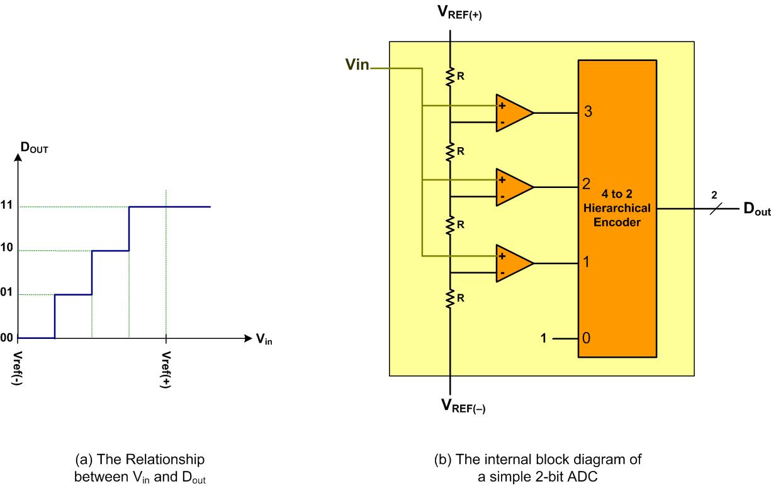
A Simultaneous 2-bit ADC

Slide 8
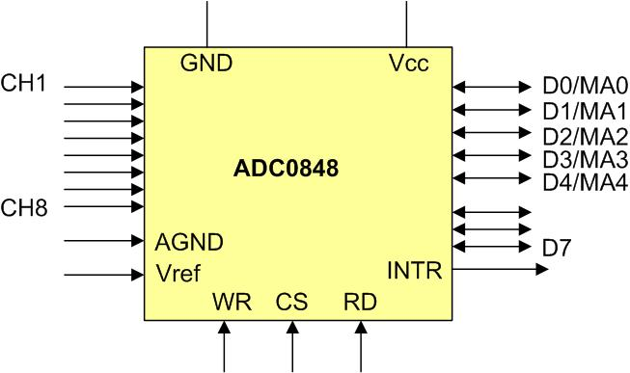
ADC0848 Parallel ADC Block Diagram

Slide 9
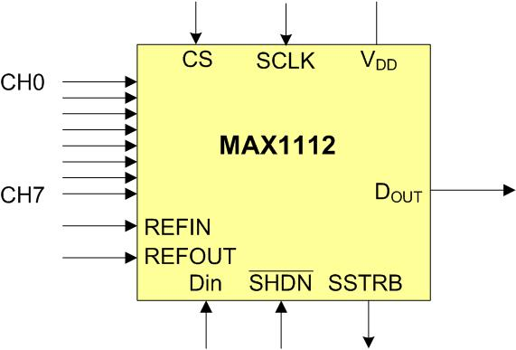
MAX1112 Serial ADC Block Diagram

Slide 10
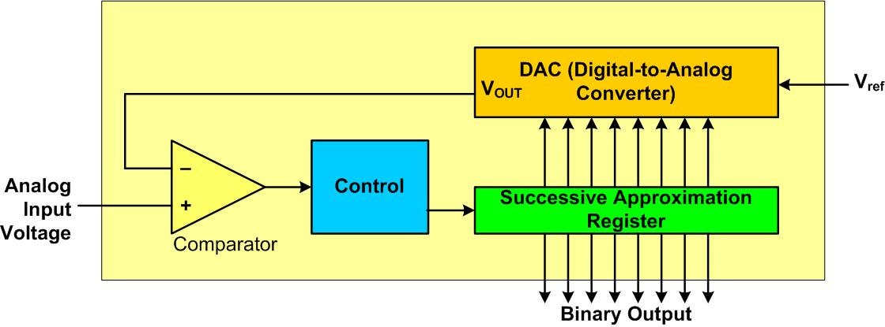
Successive Approximation ADC

Slide 11
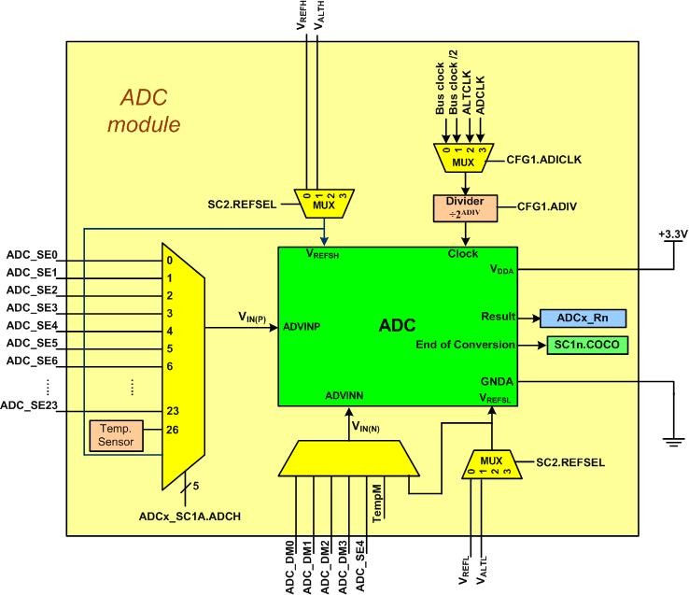
Simplified Block Diagram of a Freescale KL25Z chip

Slide 12
KL25Z ADC Registers
Absolute Address | Register
4003 B000 | ADC Status and Control Registers 1 (ADC0_SC1A)
4003 B004 | ADC Status and Control Registers 1 (ADC0_SC1B)
4003 B008 | ADC Configuration Register 1 (ADC0_CFG1)
4003 B00C | ADC Configuration Register 2 (ADC0_CFG2)
4003 B010 | ADC Data Result Register (ADC0_RA)
4003 B014 | ADC Data Result Register (ADC0_RB)

Slide 13

SIM_SCGC6 register t for Enableing to ADC0

Slide 14
ADCx_SC2 Register

Slide 15
ADCx_SC2 Register
Bit | Field | Descriptions
7 | ADACT | Conversion active: Indicates that the ADC is converting data (0: Conversion not in progress, 1: Conversion in progress)
6 | ADTRG | ADC conversion trigger select (0: software trigger, 1: hardware trigger)
5 | ACFE | Compare Function Enable (0: compare function disabled, 1: enabled)
4 | ACFGT | Compare Function Greater Than Enable
3 | ACREN | Compare range Enable
2 | DMAEN | DMA Enable
1-0 | REFSEL | Voltage Reference Select

Slide 16

ADCx_SC1A Register

Slide 17
ADCx_SC1 Register
Bit | Field | Descriptions
7 | COCO | Conversion Complete Flag: (0: Conversion is not completed, 1: Conversion is completed) The COCO is cleared when the ADCx_SC1n register is written or the ADCx_Rn register is read.
6 | AIEN | Interrupt Enable: The ADC interrupt is enabled by setting the bit to HIGH. If the interrupt enable is set, an interrupt is triggered when the COCO flag is set.
5 | DIFF | Differential mode (0: Single-ended mode, 1: Differential mode)
4-0 | ADCH | ADC input channel: The field selects the input channel as shown in Figure 7-7. When DIFF = 0 (single-ended mode), values 0 to 23 choose between the 24 input channels (ADC_SE0 to ADC_SE23). When DIFF = 1 (Differential mode), values 0 to 3 select between the 4 differential channels. See the reference manual for more information. When ADCH = 11111, the module is disabled.

Slide 18
Analog input pin assignment in Freescale KL25Z
Pin Name | Description | Pin
ADC_SE0 | ADC input 0 | PTE20
ADC_SE3 | ADC input 3 | PTE22
ADC_SE4 | ADC input 4 | PTE21, PTE29
ADC_SE5 | ADC input 5 | PTD1
ADC_SE6 | ADC input 6 | PTD5
ADC_SE7 | ADC input 7 | PTD6, PTE23
ADC_SE8 | ADC input 8 | PTB0
ADC_SE9 | ADC input 9 | PTB1
ADC_SE11 | ADC input 11 | PTC2
ADC_SE12 | ADC input 12 | PTB2
ADC_SE13 | ADC input 13 | PTB3
ADC_SE14 | ADC input 14 | PTC0
ADC_SE15 | ADC input 15 | PTC1
ADC_SE23 | ADC input 23, DAC0 output | PTE30
ADC_SE26 | Temperature sensor
ADC_SE27 | Bandgap reference
ADC_SE29 | V_{REFH}
ADC_SE30 | V_{REFL}
ADC_SE31 | Module disabled

Slide 19

ADC Result Reister (ADCx_Rn) See Table 28-43 in KL25Z Ref man

Slide 20
ADCx_CFG1 Register
Bit | Field | Descriptions
7 | ADLPC | Low-Power Configuration
6-5 | ADIV | Clock Divide Select: The clock is divided by 2^{ADIV} as shown in Figure 7-7.
4 | ADLSMP | Sample time configuration (0: Short sample time, 1: Long sample time)
3-2 | MODE | Conversion mode selection
1-0 | ADICLK | Input Clock Select

Slide 21

ADCx_CFG2 Register

Slide 22
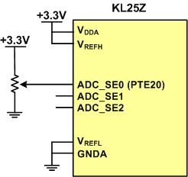
ADC Connection for Program 7-1

Slide 23
Thermistor Resistance vs. Temperature
Temperature ('C) | Tf (K ohms)
0 | 29.490
25 | 10.000
50 | 3.893
75 | 1.700
100 | 0.817

Slide 24
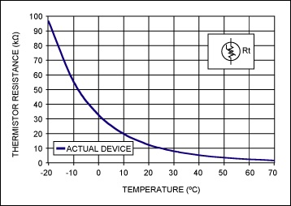
Thermistor
(Copied from http://www.maximintegrated.com)

Slide 25
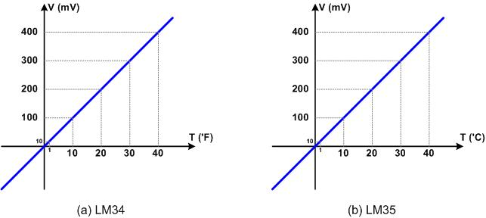
LM34 and LM35

Slide 26
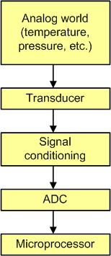
Getting Data to the CPU

Slide 27
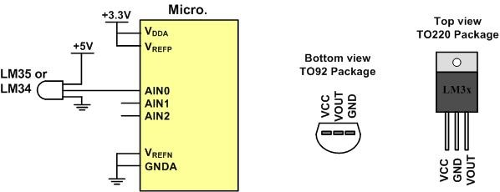
LM34/35 Connection to ARM and Its Pin Configuration

Slide 28
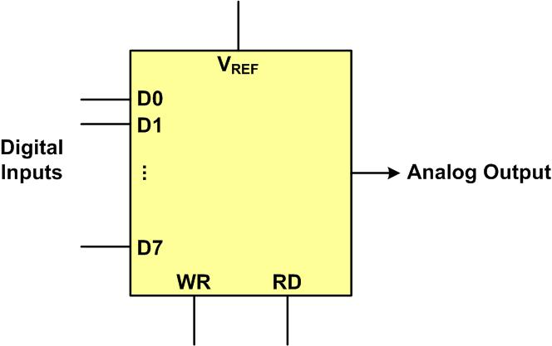
DAC Block Diagram

Slide 29
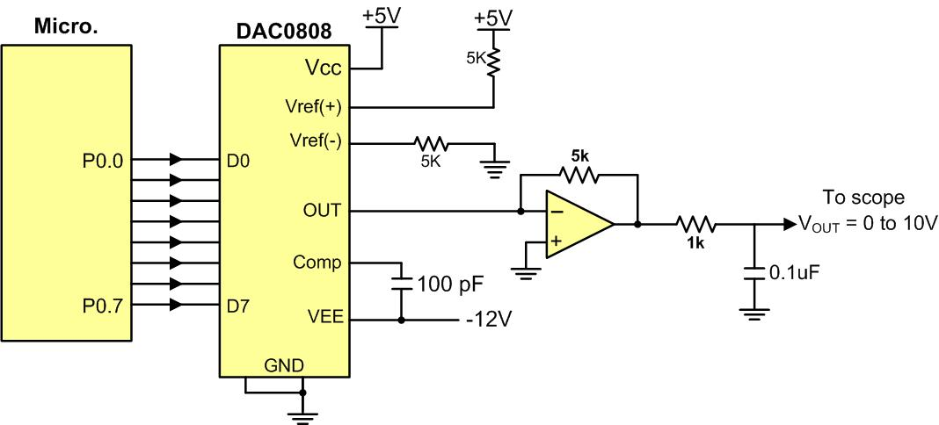
Microcontroller Connection to DAC0808

Slide 30
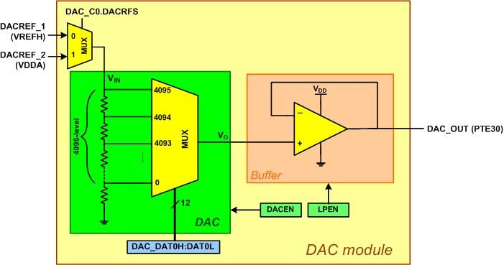
Simplified Block Diagram of KL25Z on-chip DAC

Slide 31
DAC Registers
Absolute Address | Register
4003 F000 | DAC Data Low Register (DAC0_DAT0L)
4003 F001 | DAC Data High Register (DAC0_DAT0H)
4003 F002 | DAC Data Low Register (DAC0_DAT1L)
4003 F003 | DAC Data High Register (DAC0_DAT1H)
4003 F020 | DAC Status Register (DAC0_SR)
4003 F021 | DAC Control Register (DAC0_C0)

Slide 32
SIM_SCGC6 register to provide clock to DAC

Slide 33
DAC0_C0 Register to enable on-chip DAC

Slide 34
DAC0_C0 Register to enable on-chip DAC
Bit | Field | Descriptions
7 | DACEN | DAC Enable (0: DAC is disabled, 1: DAC is enabled)
6 | DACRFS | DAC Reference Select (0: DACREF_1, 1: DACREF_2)
5 | DACTRGSEL | DAC Trigger Select (0: hardware trigger, 1: software trigger)
4 | DACSWTRG | DAC Software Trigger
3 | LPEN | DAC Low Power Control (0: High-Power mode, 1: Low-Power mode)
1 | DACBTIEN | DAC Buffer read pointer Top flag Interrupt Enable
0 | DACBBIEN | DAC Buffer read pointer Bottom flag Interrupt Enable

Slide 35

DAC0_DAT0L Register

Slide 36

DAC0_DAT0H Register

Slide 37
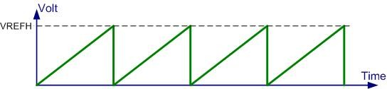
Saw Tooth WaveForm

Slide 38
Angle vs. Voltage Magnitude for Sine Wave
Angle Ɵ (degrees) | Sin Ɵ | V_{OUT} (Voltage Magnitude) (1.5V × sin Ɵ) + 1.5V | Values Sent to DAC (decimal) (Voltage Mag. ÷ 0.000806 V)
0 | 0.000 | 1.500 | 1862
30 | 0.500 | 2.250 | 2793
60 | 0.866 | 2.799 | 3474
90 | 1.000 | 3.000 | 3724
120 | 0.866 | 2.799 | 3474
150 | 0.500 | 2.250 | 2793
180 | 0.000 | 1.500 | 1862
210 | -0.500 | 0.750 | 931
240 | -0.866 | 0.201 | 249
270 | -1.000 | 0.000 | 0
300 | -0.866 | 0.201 | 249
330 | -0.500 | 0.750 | 931
360 | 0.000 | 1.500 | 1862

Slide 39
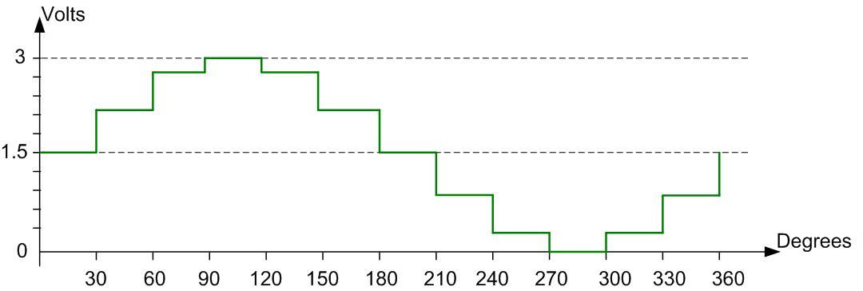
Angle vs. Voltage Magnitude for Sine Wave

