Slide 1
Chapter 8
SPI Protocol and DAC Interfacing

Slide 2
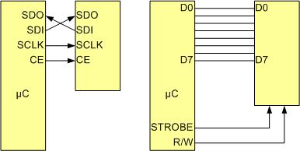
SPI Bus vs. Traditional Parallel Bus Connection to Microcontroller

Slide 3
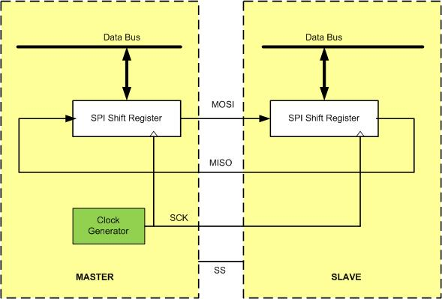
SPI Architecture

Slide 4
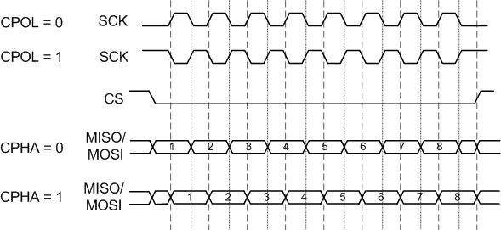
SPI Clock Polarity and phase

Slide 5
SPI Clock Polarity and phase
CPOL | CPHA | Data Read and change time | SPI Mode
0 | 0 | read on rising edge, changed on a falling edge | 0
0 | 1 | read on falling edge, changed on a rising edge | 1
1 | 0 | read on falling edge, changed on a rising edge | 2
1 | 1 | read on rising edge, changed on a falling edge | 3

Slide 6
Some of the KL25Z SPI Registers
Absolute Address | Register
4007 6000 | SPI control register 1 (SPI0_C1)
4007 6001 | SPI control register 2 (SPI0_C2)
4007 6002 | SPI baud rate register (SPI0_BR)
4007 6003 | SPI status register (SPI0_S)
4007 6005 | SPI data register (SPI0_D)
4007 7000 | SPI control register 1 (SPI1_C1)
4007 7001 | SPI control register 2 (SPI1_C2)
4007 7002 | SPI baud rate register (SPI1_BR)
4007 7003 | SPI status register (SPI1_S)
4007 7005 | SPI data register (SPI1_D)

Slide 7

SIM_SCGC4 register for enabling Clock to SPI

Slide 8
SPIx_C1 Control 1 Register

Slide 9
SPIx_C1 Control 1 Register
Field | Bit | Descriptions
SPIE | D7 | SPI Interrupt Enable. This bit enables SPI interrupt request for SPRF and MODF. 1 = SPRF and MODF interrupts enabled 0 = SPRF and MODF interrupts disabled
SPE | D6 | SPI System Enable bit 1 = Enables SPI port and configures pins as serial port pins 0 = Disables SPI port and configures these pins as I/O ports
SPTIE | D5 | SPI Transmit Interrupt Enable. This bit enables the SPI interrupt request if SPTEF = 1. 1 = SPTEF interrupt enabled 0 = SPTEF interrupt disabled
MSTR | D4 | SPI Master/Slave mode Select bit. This bit selects master or slave mode. 1 = SPI in master mode 0 = SPI in slave mode
CPOL | D3 | SPI Clock Polarity bit 1 = Active-LOW clocks selected. In idle state SCK is high. 0 = Active-HIGH clocks selected. In idle state SCK is low.
CPHA | D2 | SPI Clock Phase bit 1 = Sampling of data occurs at even edges of the SCK clock. 0 = Sampling of data occurs at odd edges of the SCK clock.
SSOE | D1 | Slave Select Output Enable. See the KL25Z manual.
LSBFE | D0 | LSB First Enable 1 = Data is transferred least significant bit first. 0 = Data is transferred most significant bit first.

Slide 10
SPIxC2 (SPI Control 2) Register

Slide 11
SPIxC2 (SPI Control 2) Register
Field | Bit | Descriptions
MODFEN | D4 | Mode Fault Enable Bit. See the KL25Z reference manual. 1 = SS port pin with MODF feature 0 = SS port pin is not used by the SPI (default)
BIDIROE | D3 | Bidirectional Output Enable. Used in bidirectional mode. 1 = Output Buffer enabled. See the HCS12 manual. 0 = Output Buffer enabled. (default)
SPC0 | D0 | Serial Pin Control bit 0. Used in bidirectional mode. 1 = Bidirectional. See the KL25Z reference manual. 0 = Normal (default)

Slide 12
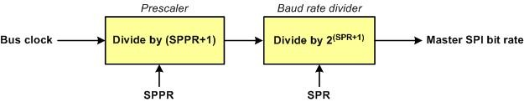
SPI Baud Rate Generation

Slide 13
SPIx_BR Register

Slide 14
SPIx_BR Register
Field | Bit | Description
SPPR2–SPPR0 | D6–D4 | SPI Baud Rate Prescaler Divisor bits
SPR3–SPR0 | D3–D0 | SPI Baud Rate Divisor bits These bits specify the SPI baud rates as shown in the following two equations: BaudRateDivisor = (SPPR + 1) × 2 ^{(SPR + 1)} Baud Rate = BusClock / BaudRateDivisor

Slide 15
Some possible Values for SPIx_BR Register
SPPR2 SPPR1 SPPR0 | SPR3 - SPR0 | SPIx_BR (Hex) | BaudRateDivisor
0 0 0 | 0 0 0 0 | 00 | 2
0 0 0 | 0 0 0 1 | 01 | 4
0 0 0 | 0 0 1 0 | 02 | 8
0 0 0 | 0 0 1 1 | 03 | 16
0 0 0 | 0 1 0 0 | 04 | 32
0 0 0 | 0 1 0 1 | 05 | 64
. . . . . . . . | . . . . . . . . | . . . . | . . . . . . . .
1 1 0 | 0 1 1 1 | 67 | 1792
1 1 1 | 0 0 0 0 | 70 | 16
1 1 1 | 0 0 0 1 | 71 | 32
1 1 1 | 0 0 1 0 | 72 | 64
1 1 1 | 0 0 1 1 | 73 | 128
1 1 1 | 0 1 0 0 | 74 | 256
1 1 1 | 0 1 0 1 | 75 | 512
1 1 1 | 0 1 1 0 | 76 | 1024
1 1 1 | 0 1 1 1 | 77 | 2048
Note: The highest Baud Rate = BusFreq/2 and the lowest Baud Rate is BusFreq/2048

Slide 16
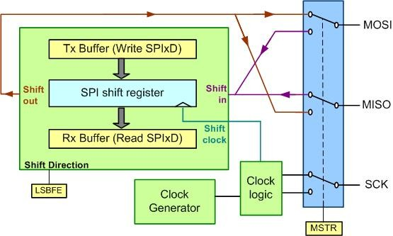
SPI Data (SPIx_D) Register

Slide 17
SPI Status (SPIx_S) Register

Slide 18
SPI Status (SPIx_S) Register
Field | Bit | Descriptions
SPRF | D7 | SPI read buffer full Flag. This bit is set after a received byte of data has been placed into the SPI Data Register. This bit is cleared by reading the SPI Status Register (SPIx_S) followed by a read from the SPI Data Register. 1 = New data has been received and placed in SPIx_D. 0 = Transfer not yet complete
SPTEF | D5 | SPI Transmit Buffer Empty Flag. If set, this bit indicates that the transmit data register is empty and ready for a new byte of data. 1 = SPI Data Register empty 0 = SPI Data Register not empty
MODF | D4 | Mode Fault flag is used for mode selection error. See the KL25Z manual. 1 = Mode fault has occurred. 0 = Mode fault has not occurred.

Slide 19
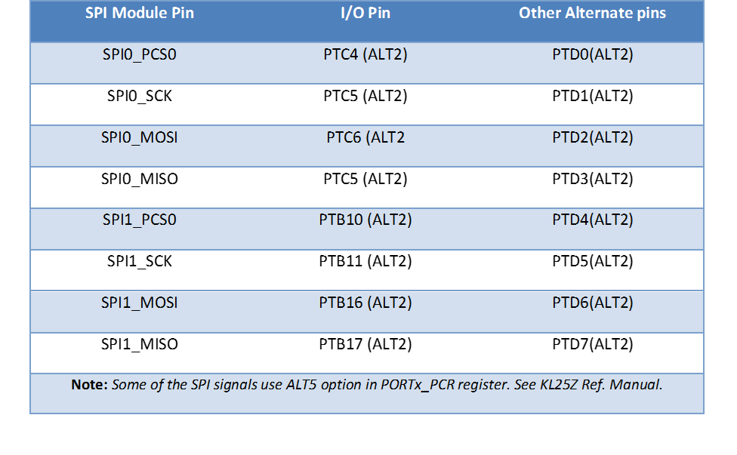
I/O Pin Assignment for both SPI0 and SPI1 Modules

Slide 20
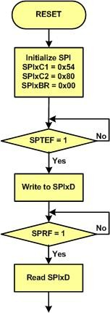
Initialization Flowchart for SPI Master Device

Slide 21
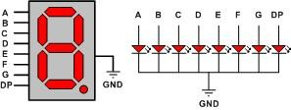
Common Cathode Connections in a 7-Segment Display

Slide 22
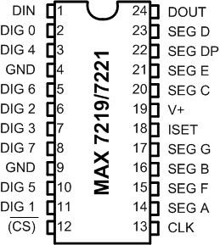
MAX7219 and MAX7221

Slide 23
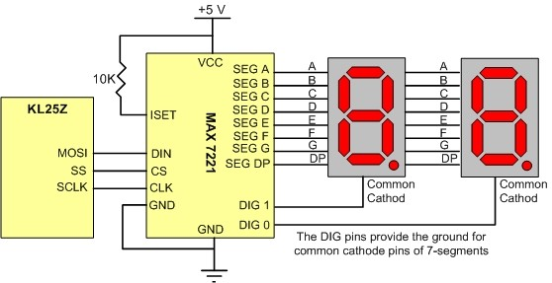
MAX7221 Connections to the Microcontroller

Slide 24
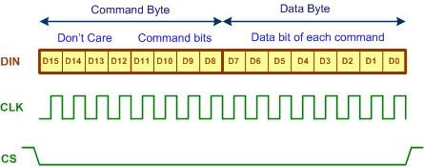
MAX7221 Packet Format

Slide 25
List of Commands in MAX7221/MAX7219
Command | D15-12 | D11 | D10 | D9 | D8 | Hex Code
No operation | X | 0 | 0 | 0 | 0 | X0
Set value of digit 0 | X | 0 | 0 | 0 | 1 | X1
Set value of digit 1 | X | 0 | 0 | 1 | 0 | X2
Set value of digit 2 | X | 0 | 0 | 1 | 1 | X3
Set value of digit 3 | X | 0 | 1 | 0 | 0 | X4
Set value of digit 4 | X | 0 | 1 | 0 | 1 | X5
Set value of digit 5 | X | 0 | 1 | 1 | 0 | X6
Set value of digit 6 | X | 0 | 1 | 1 | 1 | X7
Set value of digit 7 | X | 1 | 0 | 0 | 0 | X8
Set decoding mode | X | 1 | 0 | 0 | 1 | X9
Set intensity of light | X | 1 | 0 | 1 | 0 | XA
Set scan limit | X | 1 | 0 | 1 | 1 | XB
Turn on/off | X | 1 | 1 | 0 | 0 | XC
Display test | X | 1 | 1 | 1 | 1 | XF
Notes: X means don't care. Digits are designated as 0-7 to drive total of eight 7-segment LEDs.

Slide 26

Set Decoding Mode Command Format

Slide 27

Bits Assigned to Segments

