Slide 1
Chapter 11
PWM and DC Motor Control

Slide 2
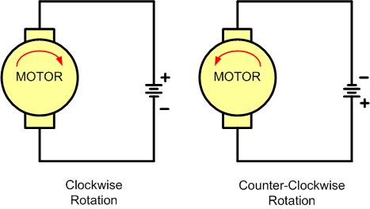
DC Motor Rotation (Permanent Magnet Field)

Slide 3
Selected DC Motor Characteristics
(http://www.Jameco.com)
Part No. | Nominal Volts | Volt Range | Current | RPM | Torque
154915CP | 3 V | 1.5–3 V | 0.070 A | 5,200 | 4.0 g-cm
154923CP | 3 V | 1.5–3 V | 0.240 A | 16,000 | 8.3 g-cm
177498CP | 4.5 V | 3–14 V | 0.150 A | 10,300 | 33.3 g-cm
181411CP | 5 V | 3–14 V | 0.470 A | 10,000 | 18.8 g-cm

Slide 4
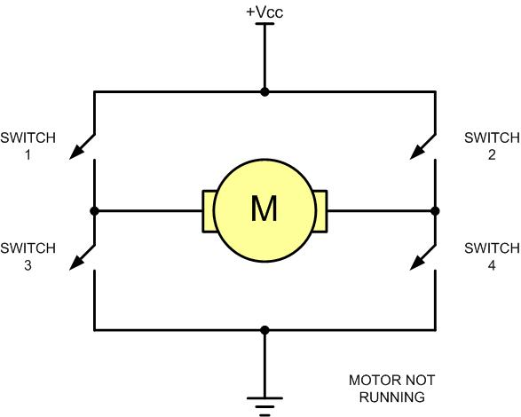
H-Bridge Motor Configuration

Slide 5
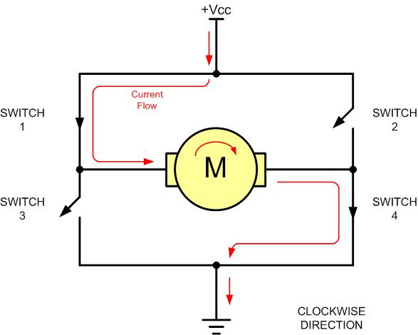
H-Bridge Motor Clockwise Configuration

Slide 6
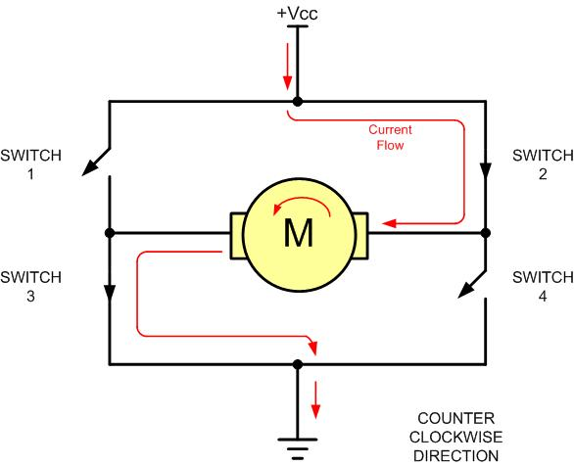
H-Bridge Motor Counterclockwise Configuration

Slide 7
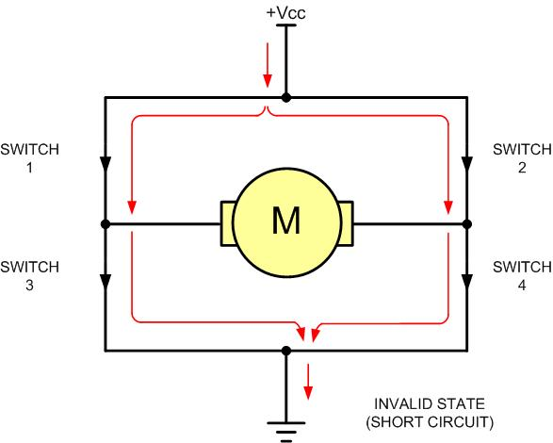
H-Bridge in an Invalid Configuration

Slide 8
Some H-Bridge Logic Configurations
Motor Operation | SW1 | SW2 | SW3 | SW4
Off | Open | Open | Open | Open
Clockwise | Closed | Open | Open | Closed
Counterclockwise | Open | Closed | Closed | Open
Invalid | Closed | Closed | Closed | Closed

Slide 9
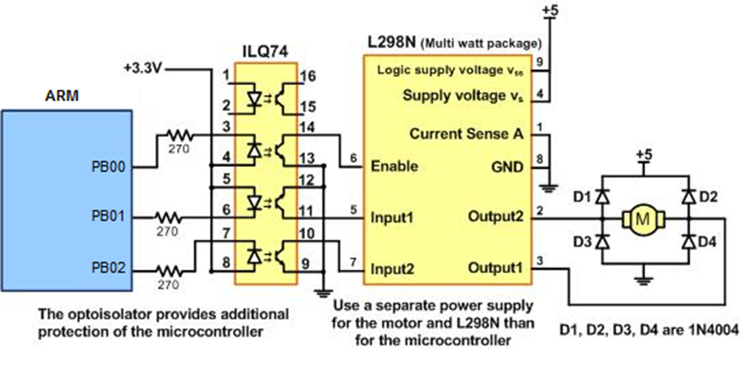
Bidirectional Motor Control Using an L298 Chip

Slide 10
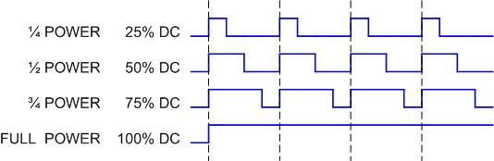
Pulse Width Modulation Comparison

Slide 11
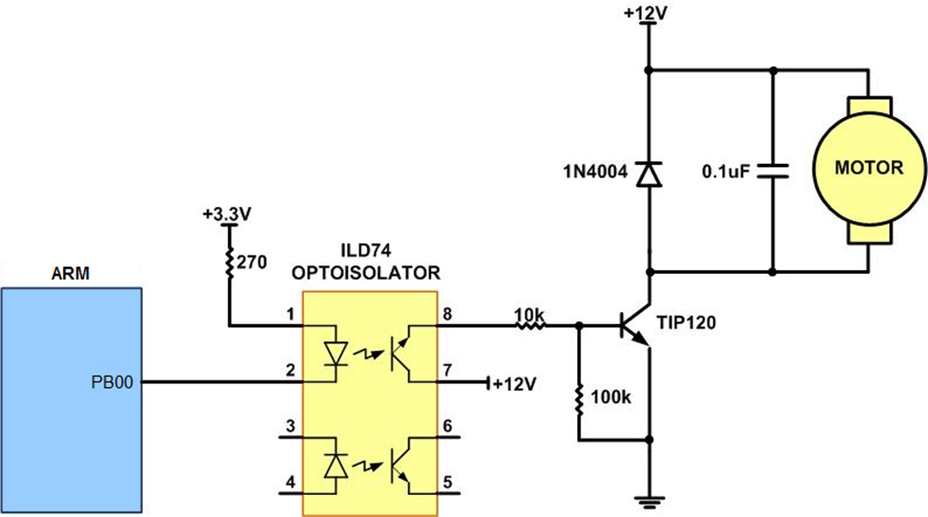
DC Motor Connection Using a Darlington Transistor

Slide 12
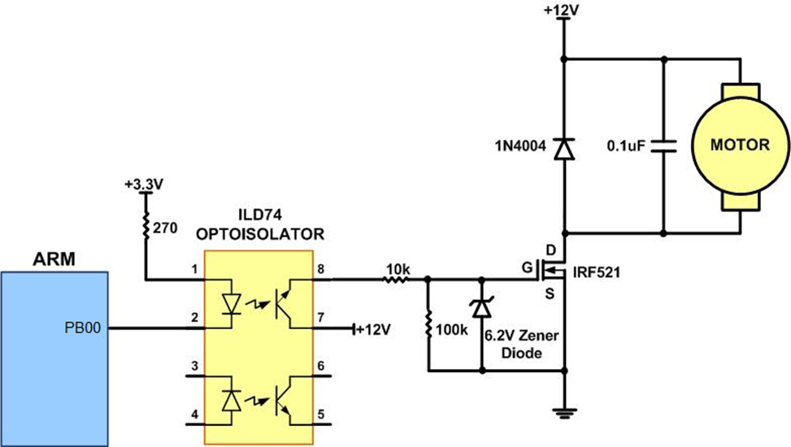
DC Motor Connection Using a MOSFET Transistor

Slide 13
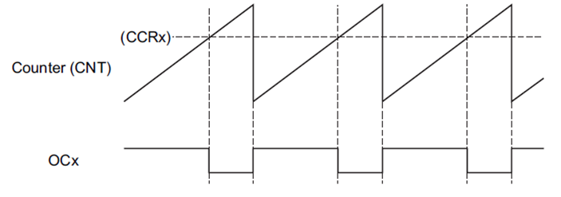
PWM Mode

Slide 14
TIM8_CCER

Slide 15
TIM8_BDTR
Bit 15 MOE: Main output enable
This bit is cleared asynchronously by hardware as soon as the break input is active. It is set
by software or automatically depending on the AOE bit. It is acting only on the channels
which are configured in output.
0: OC and OCN outputs are disabled or forced to idle state.
1: OC and OCN outputs are enabled if their respective enable bits are set (CCxE, CCxNE in
TIMx_CCER register).

Slide 16
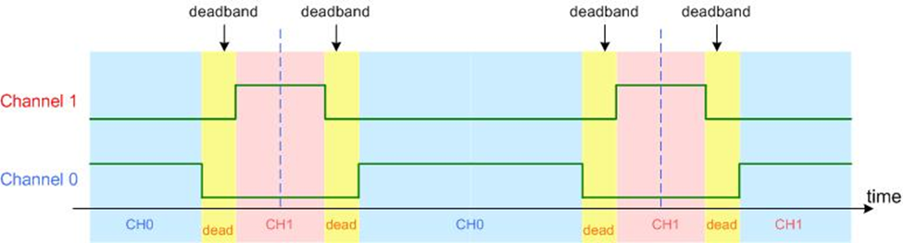
Dead band

