Slide 1
Chapter 12
Programming Graphic LCD

Slide 2
A picture on a Mono-color LCD

Slide 3

A Zoomed Picture on a Mono-color LCD

Slide 4

Dot Pitch and Dot Size

Slide 5
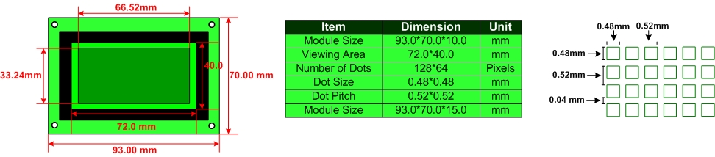
Mechanical specifications of a GDM12864 128x64 LCD

Slide 6
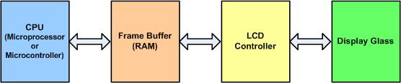
The Relationship between CPU and LCD

Slide 7
BPP (bit per pixel) vs. color
BPP | Colors
1 | on or off (monochrome)
2 | 4
4 | 16
8 | 256
16 | 65,536
24 | 16,777,216

Slide 8
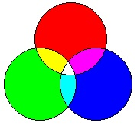
Making New Light Colors by Mixing the 3 Primary Light Colors

Slide 9
The 16 Possible Colors
I | R | G | B | Color
0 | 0 | 0 | 0 | Black
0 | 0 | 0 | 1 | Blue
0 | 0 | 1 | 0 | Green
0 | 0 | 1 | 1 | Cyan
0 | 1 | 0 | 0 | Red
0 | 1 | 0 | 1 | Magenta
0 | 1 | 1 | 0 | Brown
0 | 1 | 1 | 1 | Light Gray
1 | 0 | 0 | 0 | Dark Gray
1 | 0 | 0 | 1 | Light blue
1 | 0 | 1 | 0 | Light green
1 | 0 | 1 | 1 | Light cyan
1 | 1 | 0 | 0 | Light red
1 | 1 | 0 | 1 | Light Magenta
1 | 1 | 1 | 0 | Yellow
1 | 1 | 1 | 1 | White

Slide 10
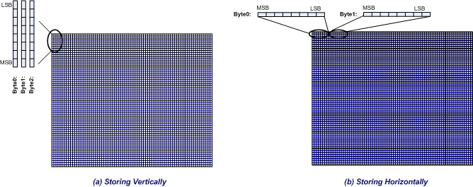
Storing Data in the LCD Memory of Mono-colored LCDs

Slide 11
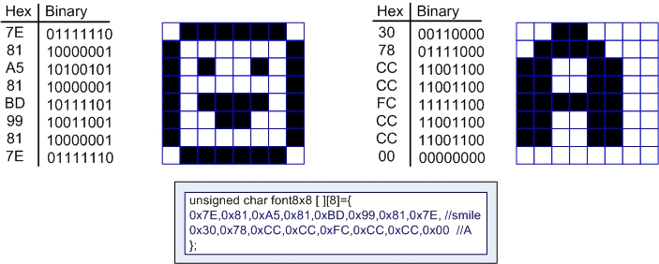
Pixel Patterns of Characters Happy Face and Letter A

Slide 12
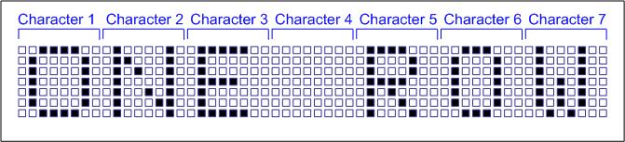
A Sample Text

Slide 13
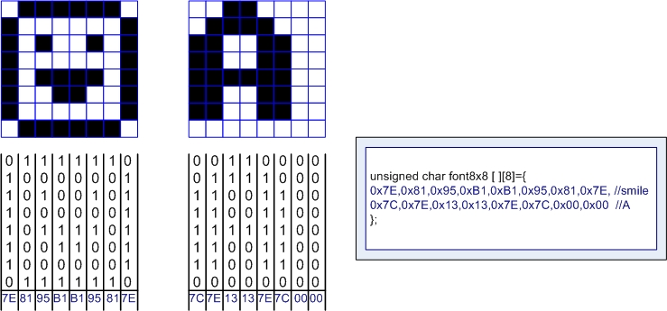
Pixel Patterns of Happy Face and Character A and its Font for Vertical LCD

Slide 14
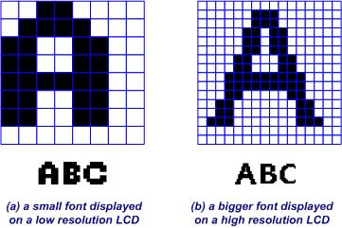
A Bigger Font vs. a Smaller Font

Slide 15
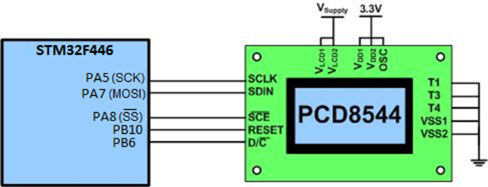
The PCD8544 LCD connection to the STM32F446 Nucleo

