Slide 1
Chapter 13
DMA Programming

Slide 2
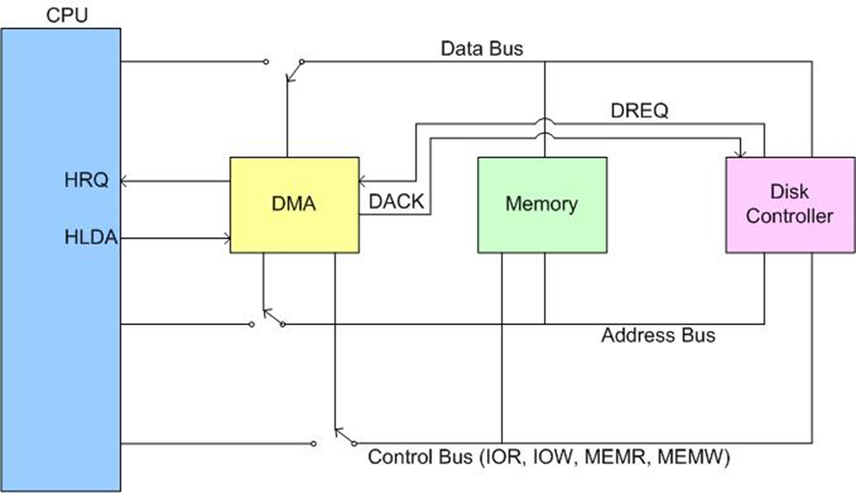
DMA Usage of System Bus

Slide 3
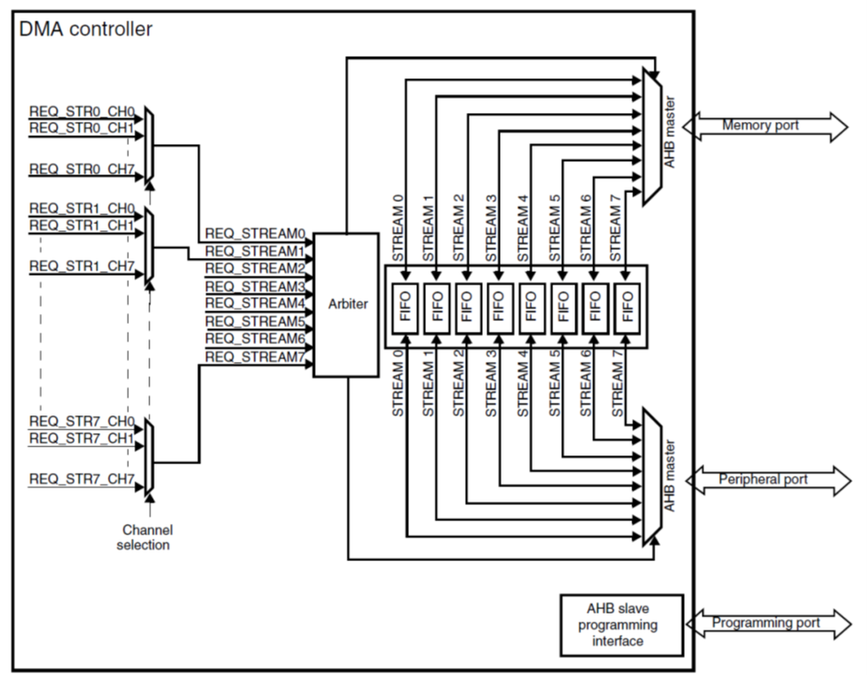
DMA Block Diagram in STM32F4xx

Slide 4
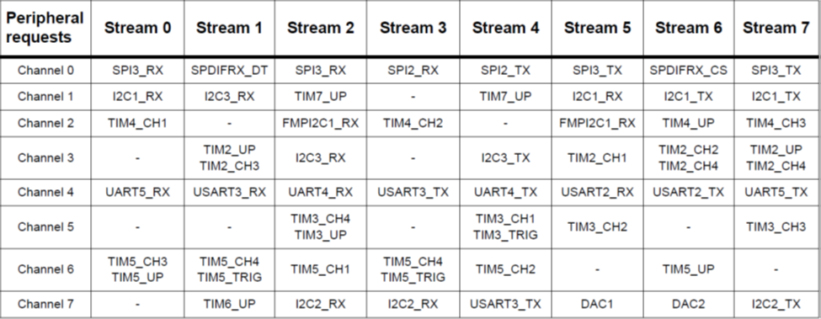
DMA1 Mapping in STM32F4xx

Slide 5
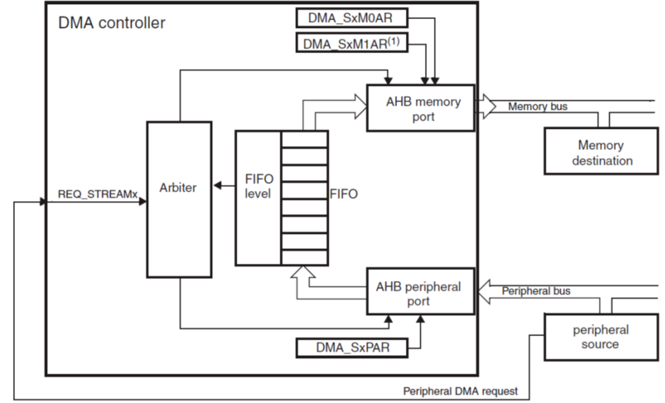
Peripheral-to-memory mode

Slide 6
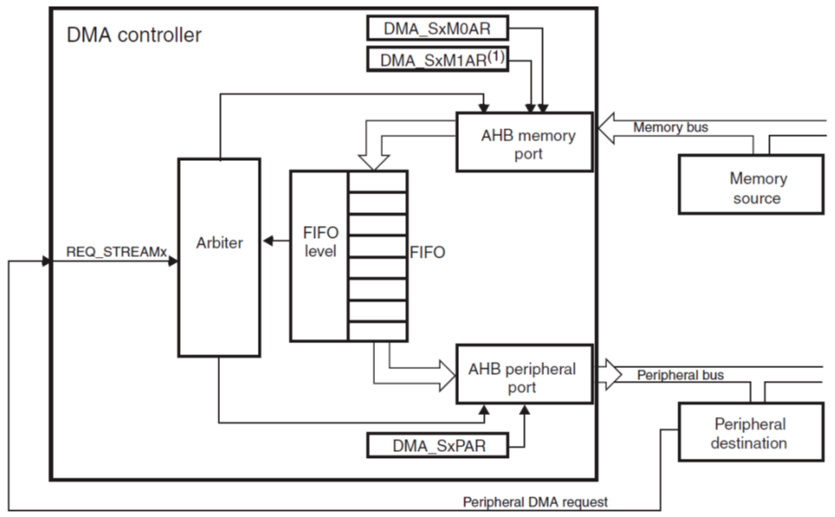
Memory-to-peripheral mode

Slide 7
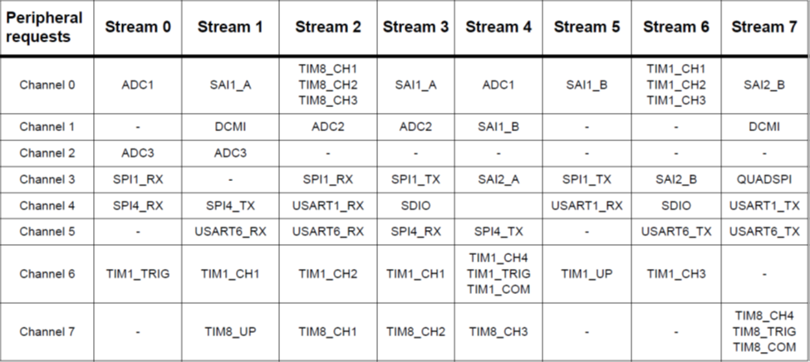
DMA2 Mapping in STM32F4xx

Slide 8
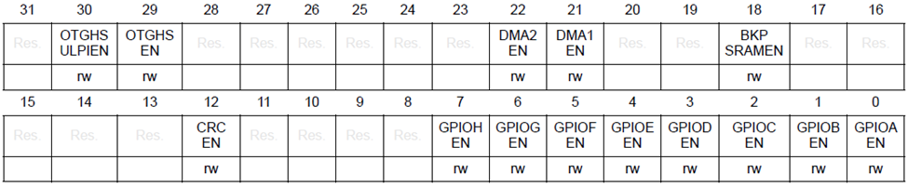
RCC_AHB1ENR Register to Enable DMA Clock
Bit 22 DMA2EN: DMA2 clock enable
This bit is set and cleared by software.
0: DMA2 clock disabled
1: DMA2 clock enabled
Bit 21 DMA1EN: DMA1 clock enable
This bit is set and cleared by software.
0: DMA1 clock disabled
1: DMA1 clock enabled

Slide 9
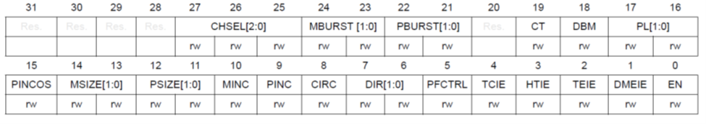
DMA Stream x Configuration Register (DMA_SxCR, x = 0..7)

Slide 10
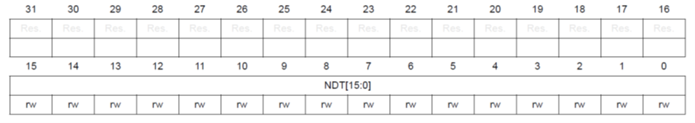
DMA Stream x Number of Data Register (DMA_SxNDTR, x = 0..7)
Bits 31:16 Reserved, must be kept at reset value.
Bits 15:0 NDT[15:0]: number of data items to transfer (0 up to 65535)
This register can be written only when the stream is disabled. When the stream is enabled,
this register is read-only, indicating the remaining data items to be transmitted. This register
decrements after each DMA transfer.
Once the transfer is completed, this register can either stay at zero (when the stream is in
normal mode) or be reloaded automatically with the previously programmed value in the
following cases:
– when the stream is configured in circular mode.
– when the stream is enabled again by setting EN bit to '1'.
If the value of this register is zero, no transaction can be served even if the stream is enabled.

Slide 11
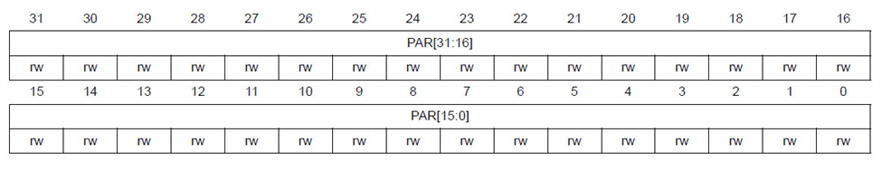
DMA Stream x Peripheral Address Register (DMA_SxPAR, x = 0..7)
Bits 31:0 PAR[31:0]: peripheral address
Base address of the peripheral data register from/to which the data is read/written.
These bits are write-protected and can be written only when bit EN = '0' in the DMA_SxCR register.

Slide 12
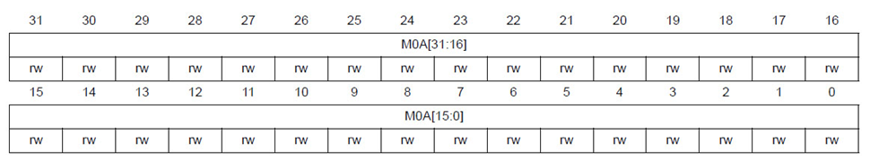
DMA Stream x Memory 0 Address Register (DMA_SxM0AR, x = 0..7)
Bits 31:0 M0A[31:0]: memory 0 address
Base address of memory area 0 from/to which the data is read/written.
These bits are write-protected. They can be written only if:
– the stream is disabled (bit EN= '0' in the DMA_SxCR register) or
– the stream is enabled (EN=’1’ in DMA_SxCR register) and bit CT = '1' in the
DMA_SxCR register (in double-buffer mode).

Slide 13
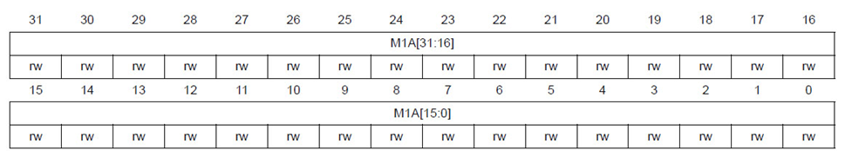
DMA Stream x Memory 1 Address Register (DMA_SxM1AR, x = 0..7)
Bits 31:0 M1A[31:0]: memory 1 address (used in case of double-buffer mode)
Base address of memory area 1 from/to which the data is read/written.
This register is used only for the double-buffer mode.
These bits are write-protected. They can be written only if:
– the stream is disabled (bit EN= '0' in the DMA_SxCR register) or
– the stream is enabled (EN=’1’ in DMA_SxCR register) and bit CT = '0' in the
DMA_SxCR register.

Slide 14
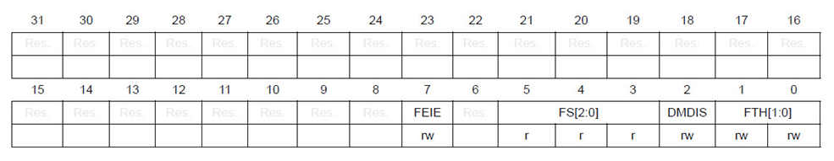
DMA Stream x FIFO Control Register (DMA_SxFCR, x = 0..7)
Bits 31:8 Reserved, must be kept at reset value.
Bit 7 FEIE: FIFO error interrupt enable
This bit is set and cleared by software.
0: FE interrupt disabled
1: FE interrupt enabled
Bit 6 Reserved, must be kept at reset value.
Bits 5:3 FS[2:0]: FIFO status
These bits are read-only.
000: 0 < fifo_level < 1/4
001: 1/4 ≤ fifo_level < 1/2
010: 1/2 ≤ fifo_level < 3/4
011: 3/4 ≤ fifo_level < full
100: FIFO is empty
101: FIFO is full
others: no meaning
These bits are not relevant in the direct mode (DMDIS bit is zero).
Bit 2 DMDIS: direct mode disable
This bit is set and cleared by software. It can be set by hardware.
0: direct mode enabled
1: direct mode disabled
This bit is protected and can be written only if EN is ‘0’.
This bit is set by hardware if the memory-to-memory mode is selected (DIR bit in
DMA_SxCR are “10”) and the EN bit in the DMA_SxCR register is ‘1’ because the direct
mode is not allowed in the memory-to-memory configuration.
Bits 1:0 FTH[1:0]: FIFO threshold selection
These bits are set and cleared by software.
00: 1/4 full FIFO
01: 1/2 full FIFO
10: 3/4 full FIFO
11: full FIFO
These bits are not used in the direct mode when the DMIS value is zero.
These bits are protected and can be written only if EN is ‘0’.

Slide 15
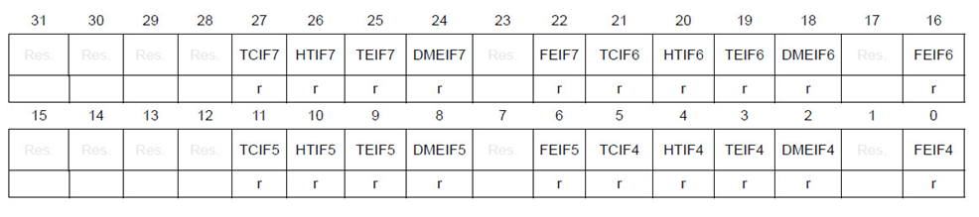
DMA High Interrupt Status Register (DMA_HISR)
Bits 31:28, 15:12 Reserved, must be kept at reset value.
Bits 27, 21, 11, 5 TCIFx: stream x transfer complete interrupt flag (x = 7..4)
This bit is set by hardware. It is cleared by software writing 1 to the corresponding bit in the
DMA_HIFCR register.
0: no transfer complete event on stream x
1: atransfer complete event occurred on stream x
Bits 26, 20, 10, 4 HTIFx: stream x half transfer interrupt flag (x = 7..4)
This bit is set by hardware. It is cleared by software writing 1 to the corresponding bit in the
DMA_HIFCR register.
0: no half transfer event on stream x
1: a half transfer event occurred on stream x
Bits 25, 19, 9, 3 TEIFx: stream x transfer error interrupt flag (x = 7..4)
This bit is set by hardware. It is cleared by software writing 1 to the corresponding bit in the
DMA_HIFCR register.
0: no transfer error on stream x
1: a transfer error occurred on stream x
Bits 24, 18, 8, 2 DMEIFx: stream x direct mode error interrupt flag (x = 7..4)
This bit is set by hardware. It is cleared by software writing 1 to the corresponding bit in the
DMA_HIFCR register.
0: no direct mode error on stream x
1: a direct mode error occurred on stream x
Bits 23, 17, 7, 1 Reserved, must be kept at reset value.
Bits 22, 16, 6, 0 FEIFx: stream x FIFO error interrupt flag (x = 7..4)
This bit is set by hardware. It is cleared by software writing 1 to the corresponding bit in the
DMA_HIFCR register.
0: no FIFO error event on stream x
1: a FIFO error event occurred on stream x

Slide 16
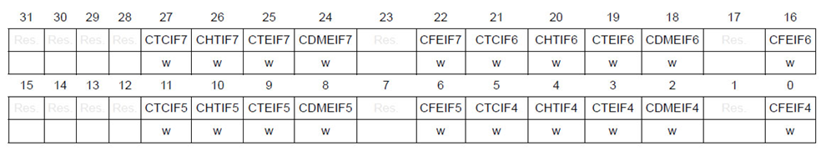
DMA High Interrupt Flag Clear Register (DMA_HIFCR)
Bits 31:28, 15:12 Reserved, must be kept at reset value.
Bits 27, 21, 11, 5 CTCIFx: stream x clear transfer complete interrupt flag (x = 7..4)
Writing 1 to this bit clears the corresponding TCIFx flag in the DMA_HISR register.
Bits 26, 20, 10, 4 CHTIFx: stream x clear half transfer interrupt flag (x = 7..4)
Writing 1 to this bit clears the corresponding HTIFx flag in the DMA_HISR register.
Bits 25, 19, 9, 3 CTEIFx: stream x clear transfer error interrupt flag (x = 7..4)
Writing 1 to this bit clears the corresponding TEIFx flag in the DMA_HISR register.
Bits 24, 18, 8, 2 CDMEIFx: stream x clear direct mode error interrupt flag (x = 7..4)
Writing 1 to this bit clears the corresponding DMEIFx flag in the DMA_HISR register.
Bits 23, 17, 7, 1 Reserved, must be kept at reset value.
Bits 22, 16, 6, 0 CFEIFx: stream x clear FIFO error interrupt flag (x = 7..4)
Writing 1 to this bit clears the corresponding CFEIFx flag in the DMA_HISR register.

Slide 17
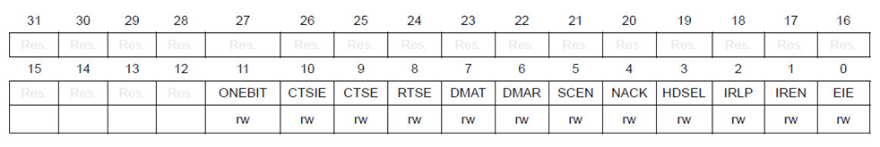
USART Control Register 3 (USART_CR3)
Bit 7 DMAT: DMA enable transmitter
This bit is set/reset by software
1: DMA mode is enabled for transmission.
0: DMA mode is disabled for transmission.
Bit 6 DMAR: DMA enable receiver
This bit is set/reset by software
1: DMA mode is enabled for reception
0: DMA mode is disabled for reception

