Slide 1
Chapter 2
STM Arm I/O Programming

Slide 2
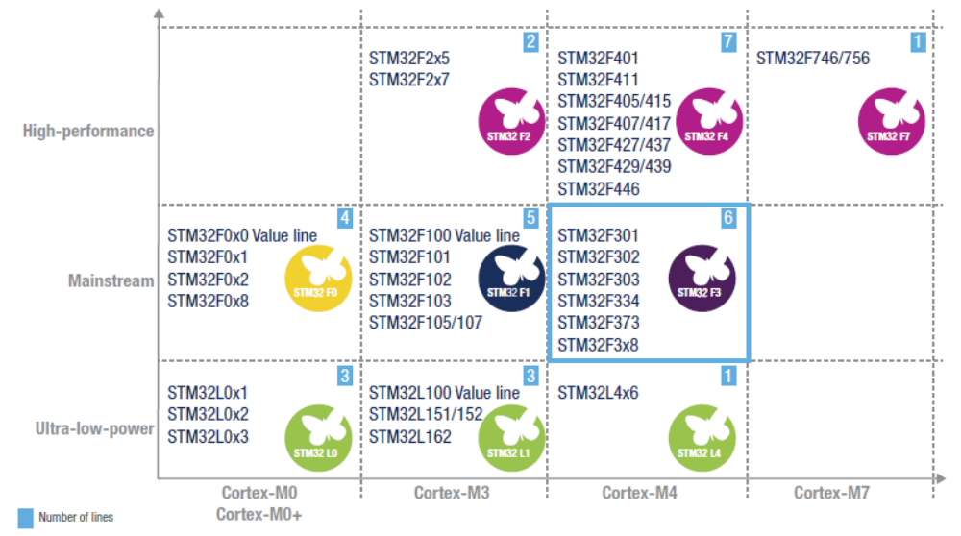
STM32 Arm Cortex Portfolio

Slide 3
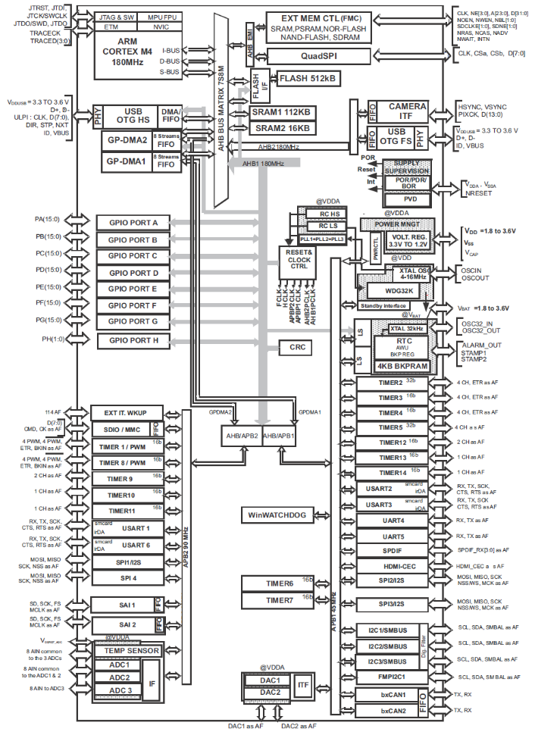
STM32F446RE Arm Microcontroller Block Diagram

Slide 4
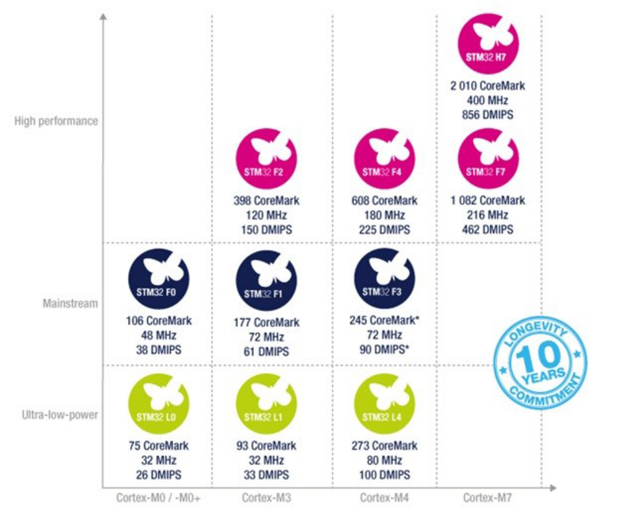
STM32 Arm Cortex Portfolio

Slide 5
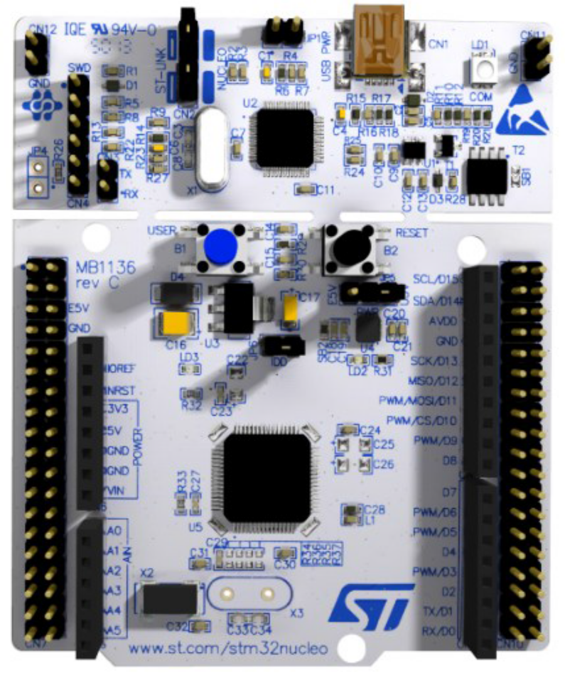
STM32F446RE Nucleo Board

Slide 6
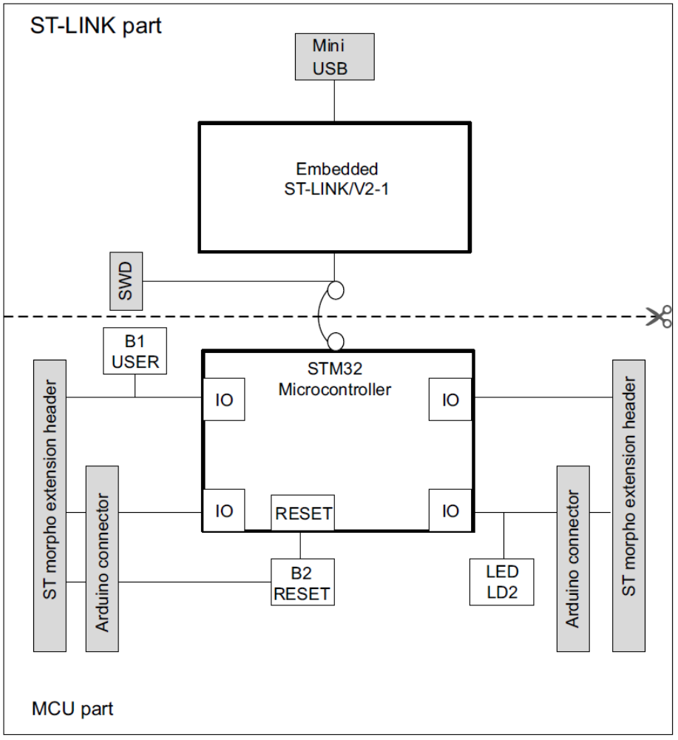
STM32F446RE Nucleo Block Diagram

Slide 7
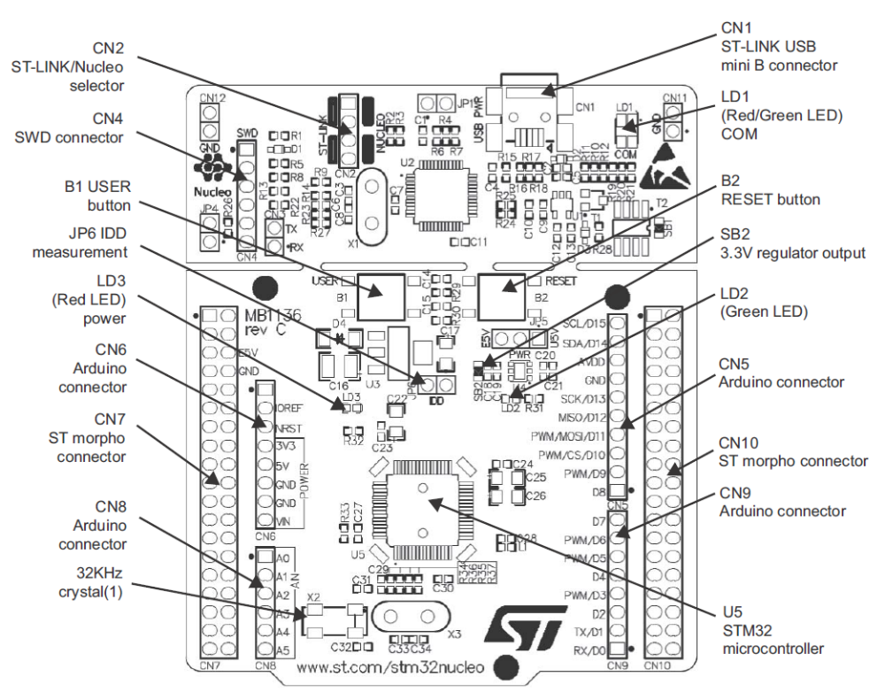
STM32F446RE Nucleo board top layout

Slide 8
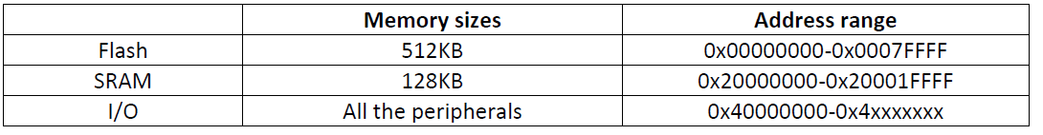
Memory Map of STMF446RE

Slide 9
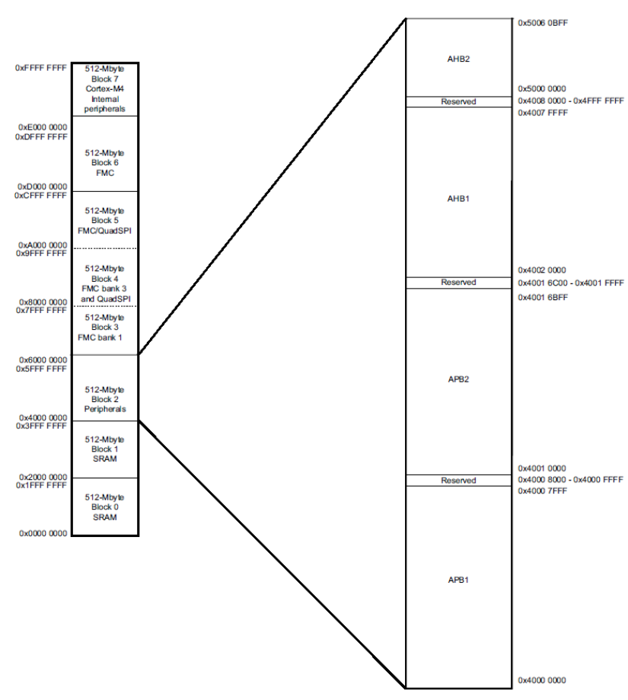
Memory map for STM32F446RE

Slide 10
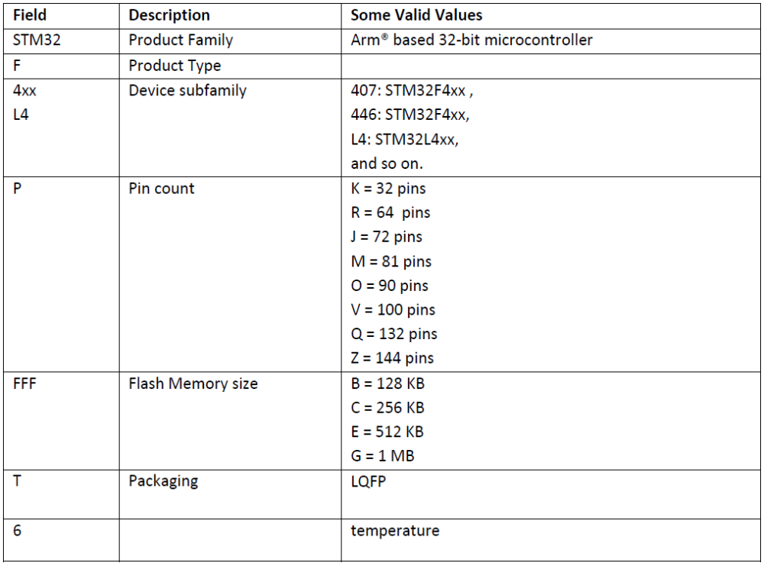
STM32 Arm Naming

Slide 11
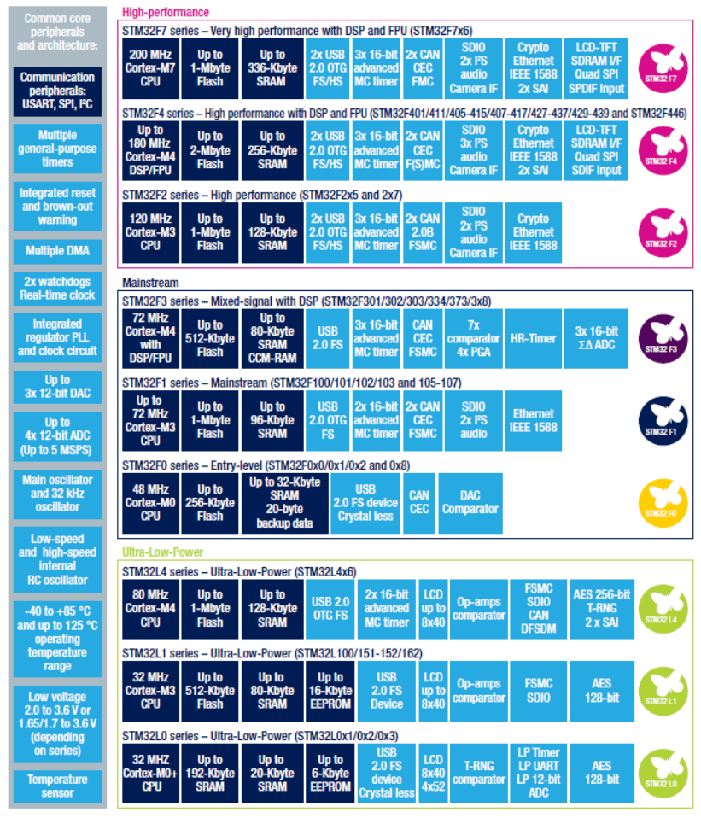
STM32 Cortex-M Portfolio

Slide 12
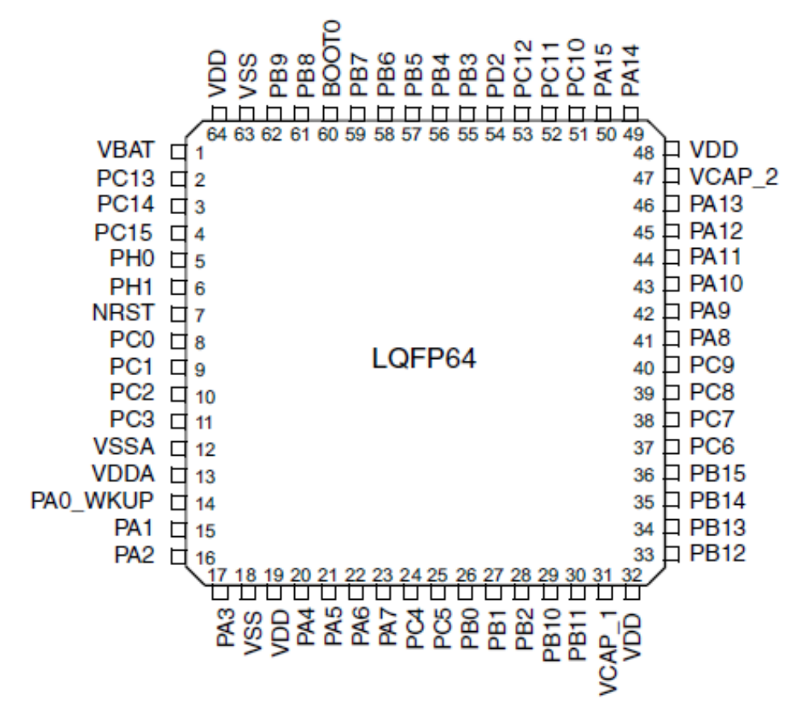
STM32F4xx LQFP 64 pinout used in Nucleo-F446RE board

Slide 13
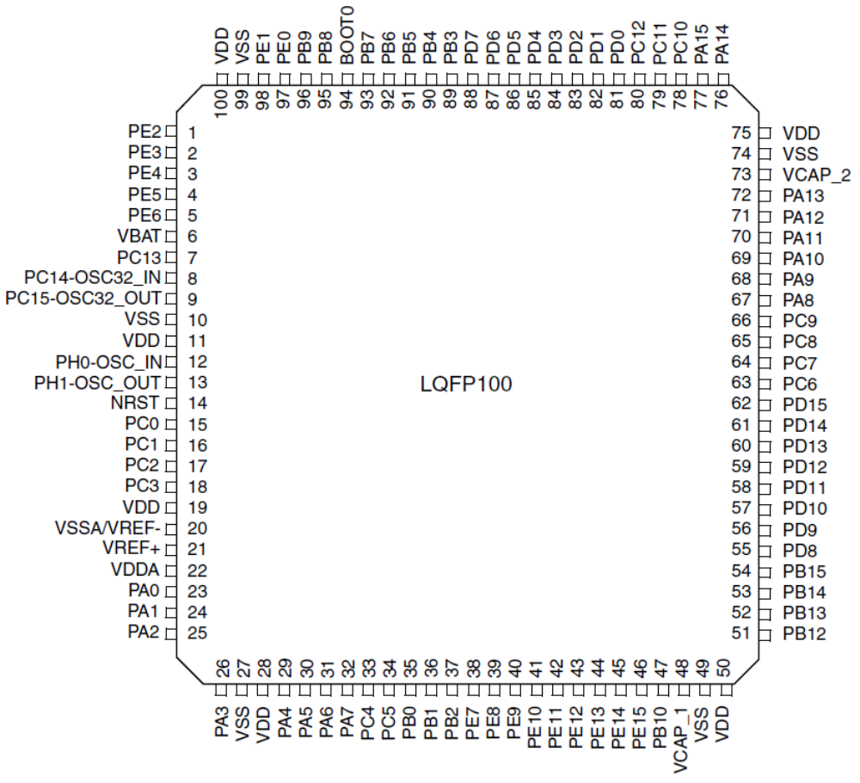
STM32F4xx LQFP 100 pinout

Slide 14
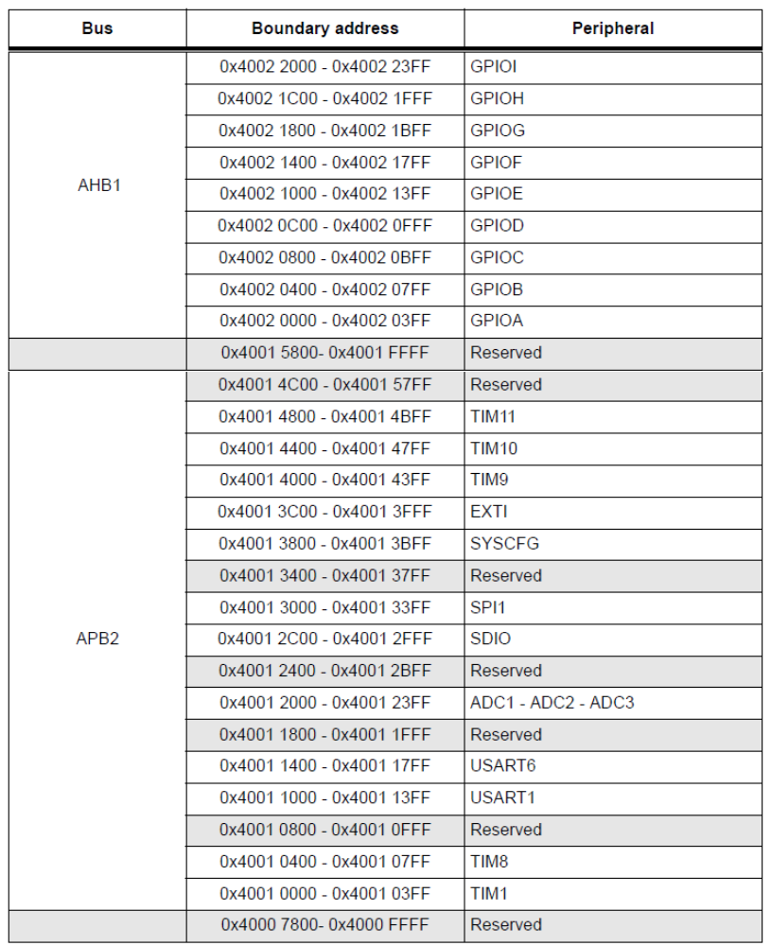
Partial listing of Peripheral address map for STM32F446

Slide 15
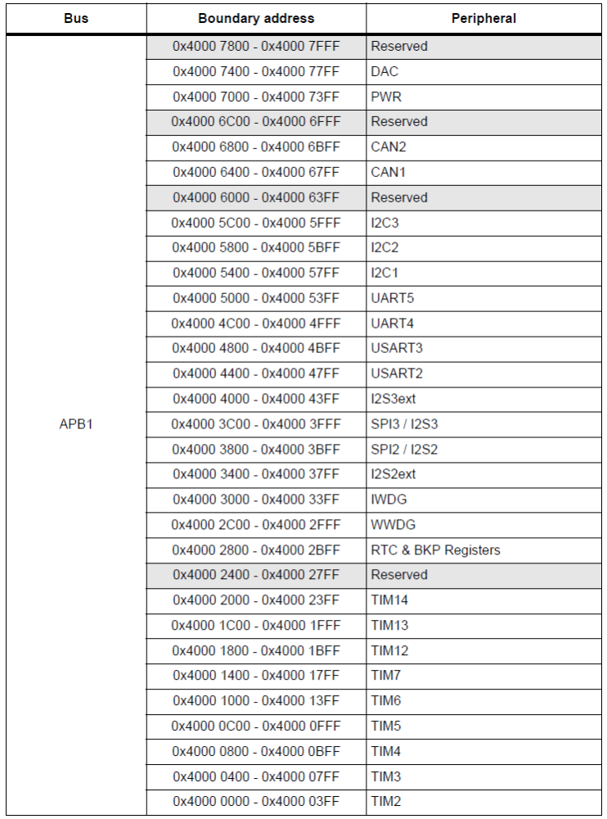
Partial listing of Peripheral address map for STM32F446

Slide 16
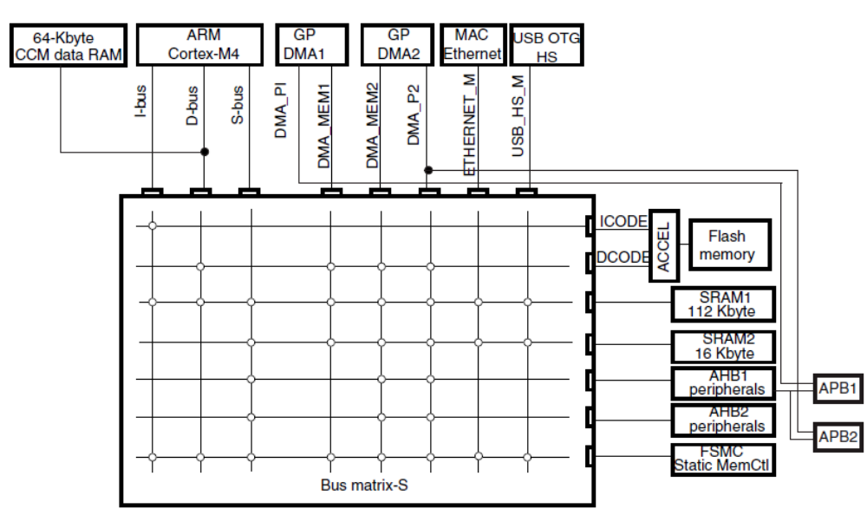
STM Arm Bus Matrix

Slide 17
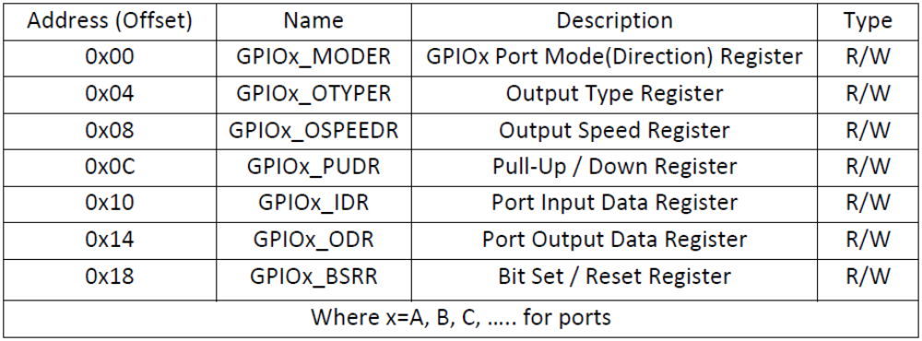
Some of the GPIO Registers in STM32F4xx Arm

Slide 18
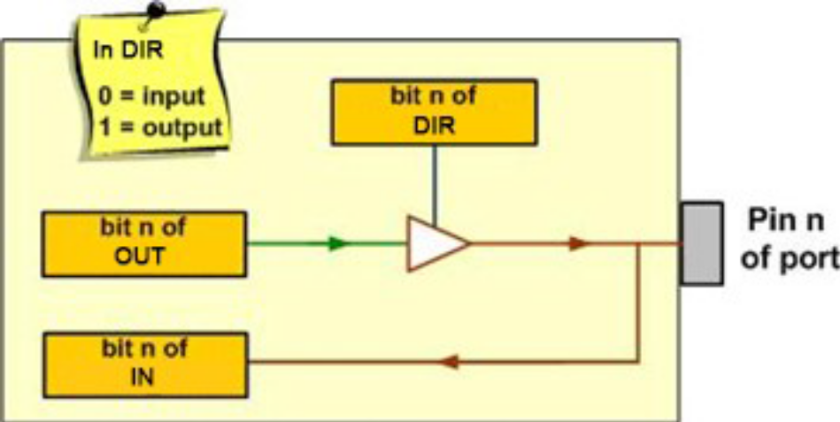
The Data and Direction Registers and a Simplified View of an I/O pin

Slide 19
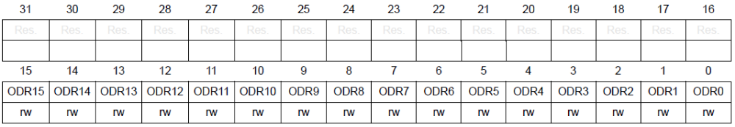
GPIOx_ODR Output Data Register (x=A, B,C, ..)

Slide 20
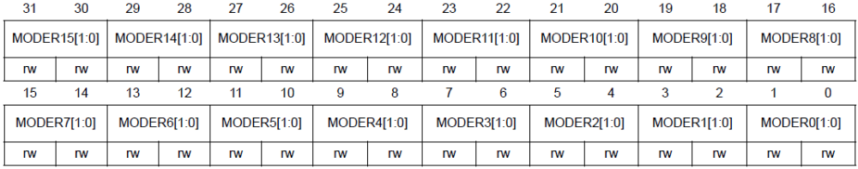
GPIOx_MODER (GPIO Mode) for Direction Register (x=A, B, C, …)

Slide 21
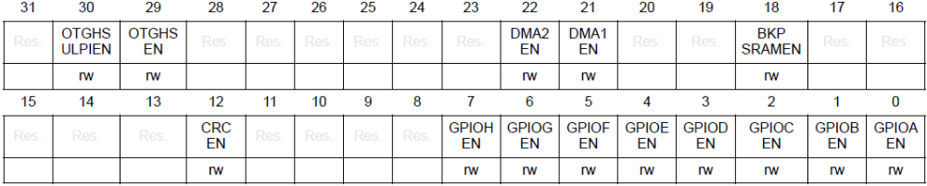
RCC_AHB1ENR register bits to enable clock to I/O ports

Slide 22
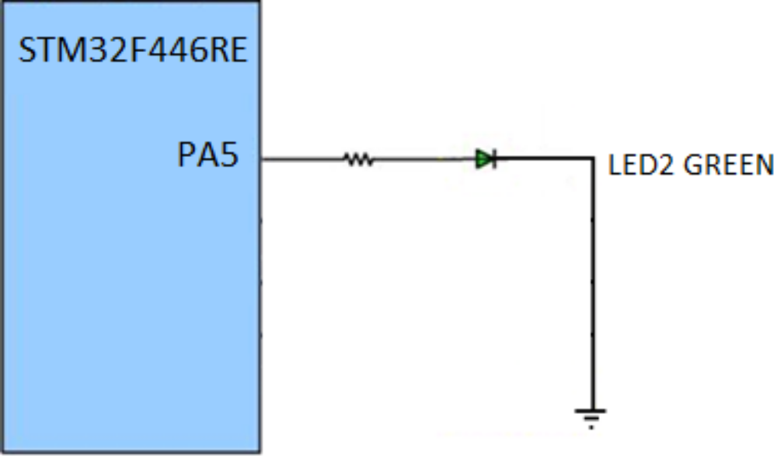
User LED connection for STM32F446RE Nucleo board

Slide 23
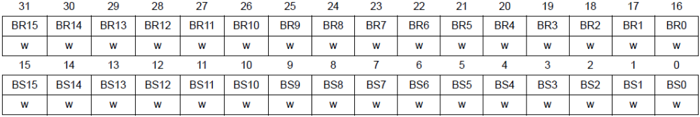
GPIOx_BSRR (GPIO Bit Set Reset) Register

Slide 24
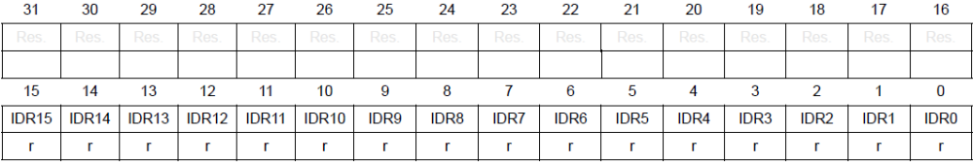
GPIOx_IDR (Input Data) Register

Slide 25
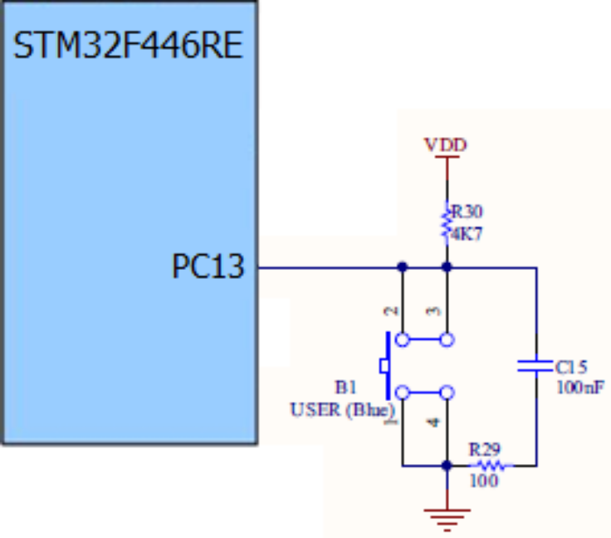
Switch connection to STM32F4-NUCLEO board

Slide 26
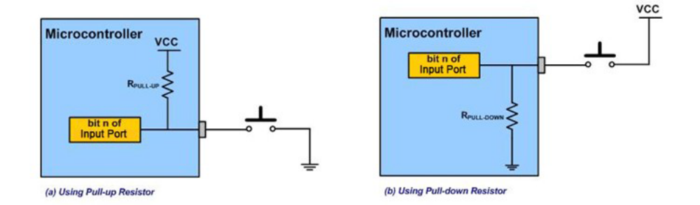
Connecting external switches to the microcontroller

Slide 27
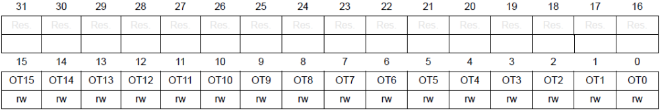
GPIOx_OTYPER Register

Slide 28
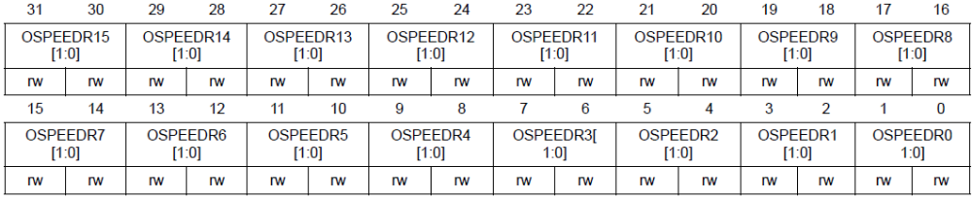
GPIOx_OSPEEDR Register

Slide 29
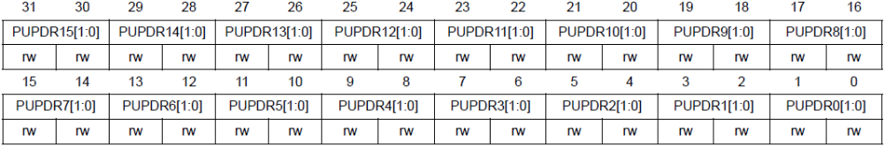
GPIOx_PUPDR Register

Slide 30
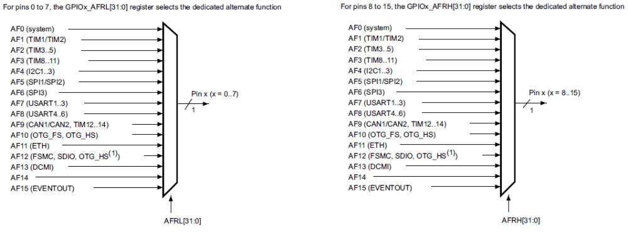
STM32 Arm Pin Multiplexing of Alternate Functions

Slide 31
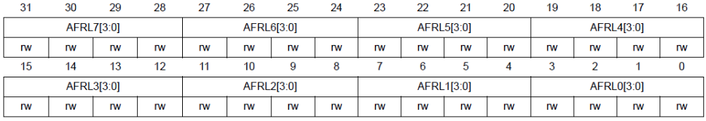
GPIOx_AFRL (GPIOx Alternate Function Low) register to select alternate pin functions

Slide 32
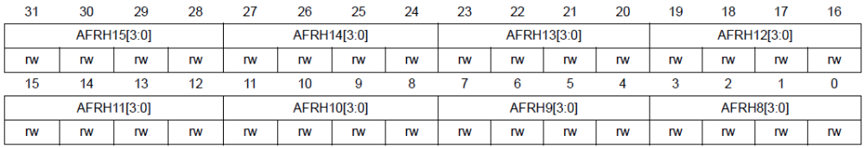
GPIOx_AFRH (GPIOx Alternate Function High) register to select alternate pin functions

Slide 33
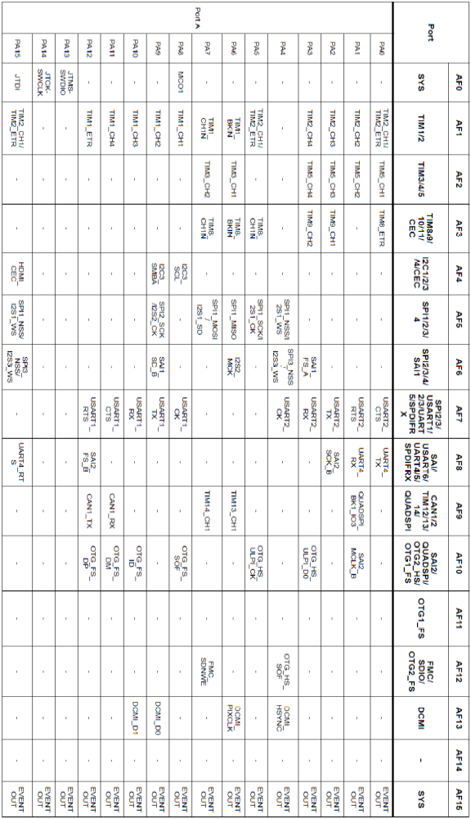
STM32F446RE Alternative Functions (AF0-AF15) Pin Selection (Partial listing, see Appendix B for full listing)

Slide 34
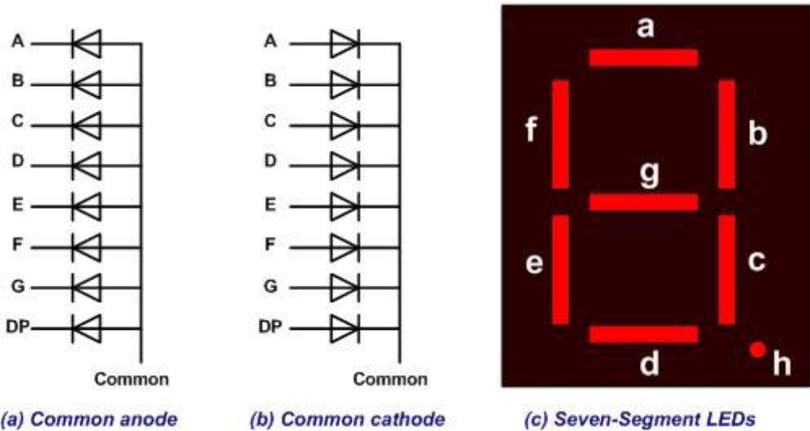
Seven-segment Display

Slide 35
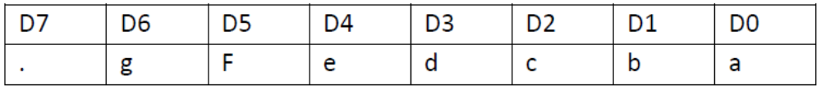
Assignments of port pins to each segments of a 7-seg LED

Slide 36
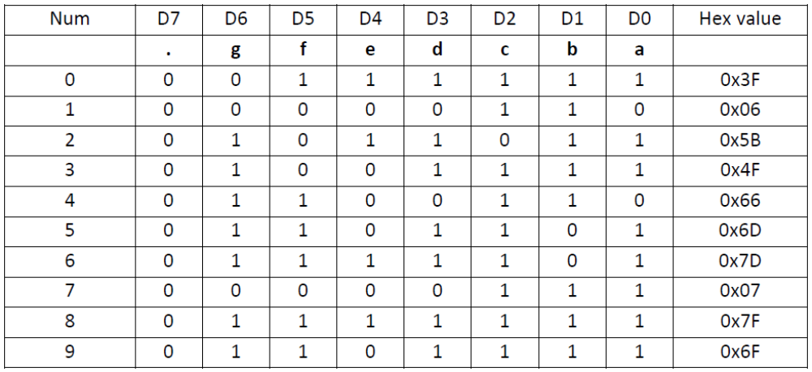
Segment patterns for the 10 decimal digits for a common cathode 7-seg LED

Slide 37
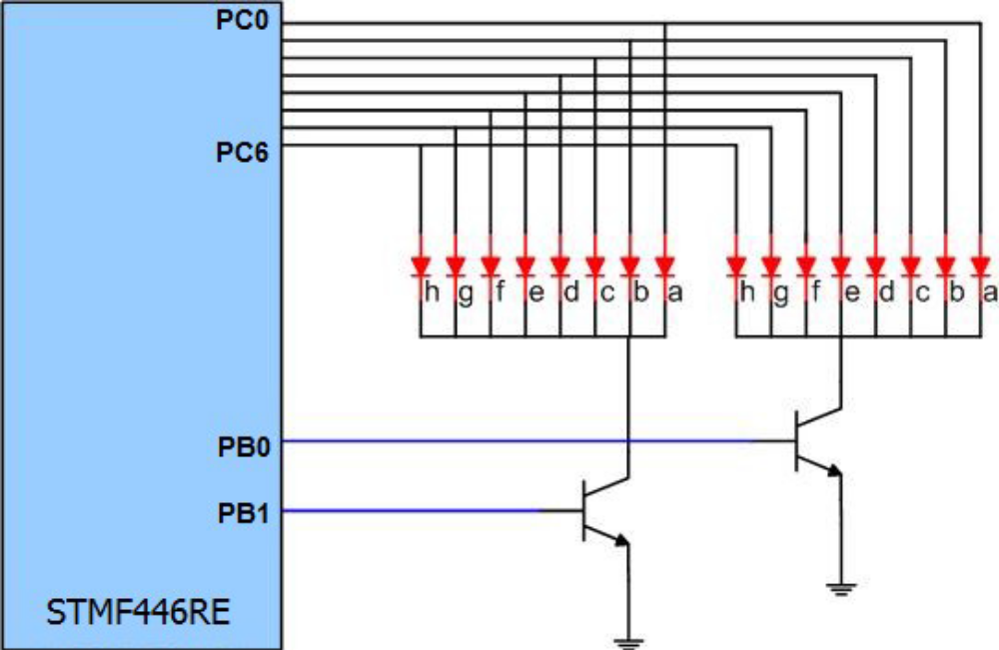
Connections between microcontroller and a two-digit 7-segment LED

Slide 38
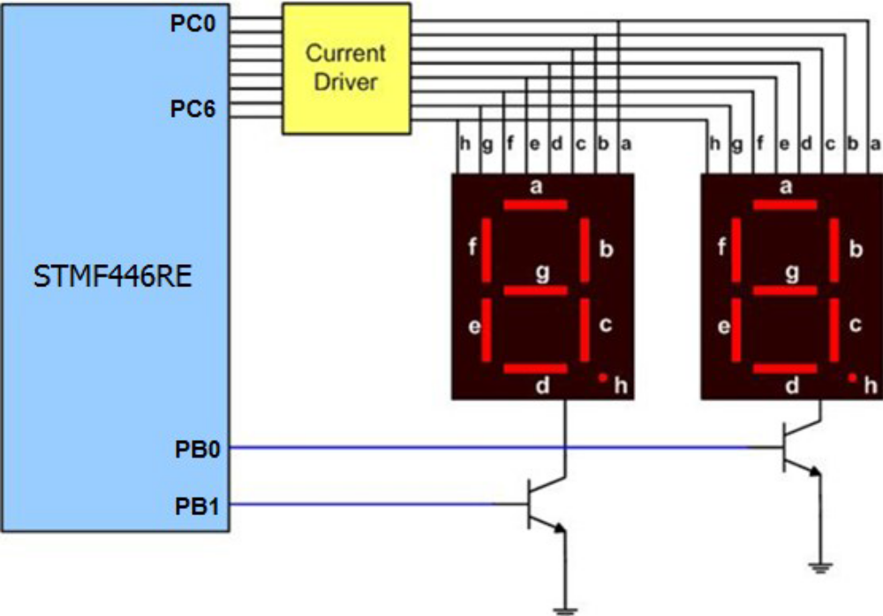
Connections between microcontroller and 7-segment LED with drivers

