Slide 1
Chapter 5
STM Arm Timer Programming

Slide 2
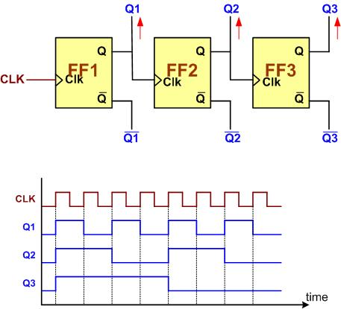
A 3-bit Counter

Slide 3

An 8-bit up-counter stages

Slide 4

An 8-bit down-counter stages

Slide 5

Counting Events Using a Counter

Slide 6
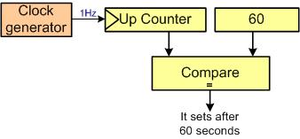
Using Counter as a Timer

Slide 7

Capturing

Slide 8
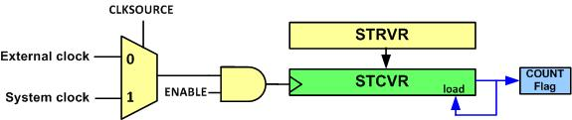
System Tick Timer Internal Structure

Slide 9
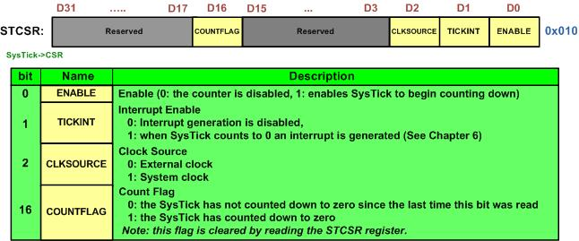
STCTRL (System Tick Control)

Slide 10
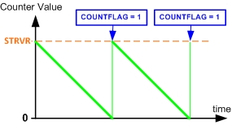
System Tick Counting

Slide 11
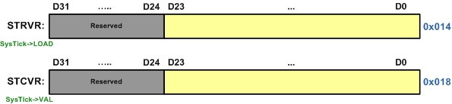
STRELOAD vs. STCURRENT

Slide 12
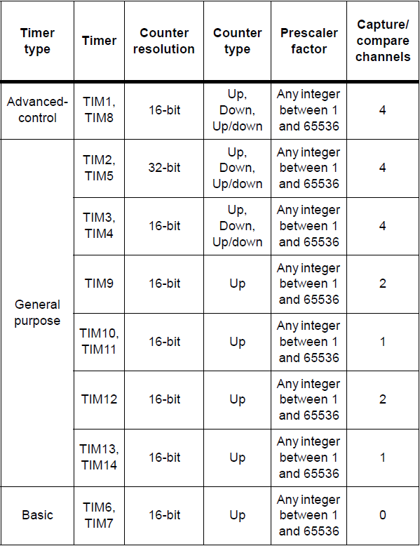
STMF466RE Arm timers

Slide 13
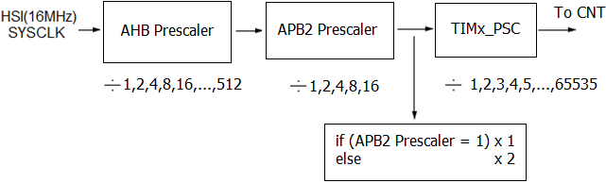
STM32F4xx Timer Prescale Options

Slide 14
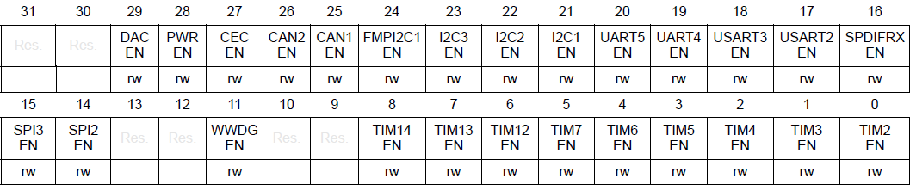
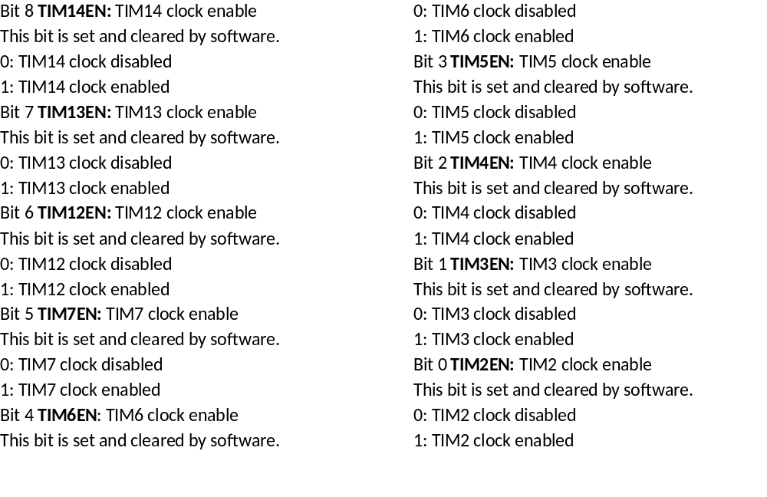
RCC_APB1ENR Register is used to enable timer clock

Slide 15
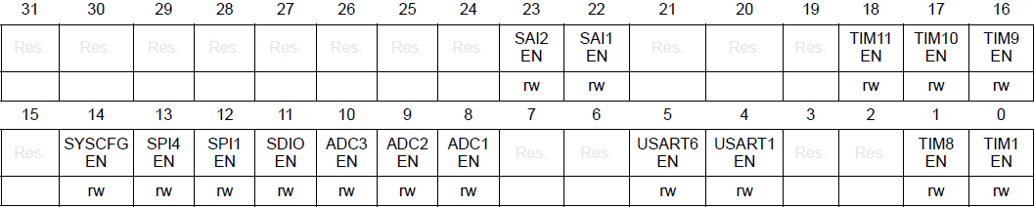
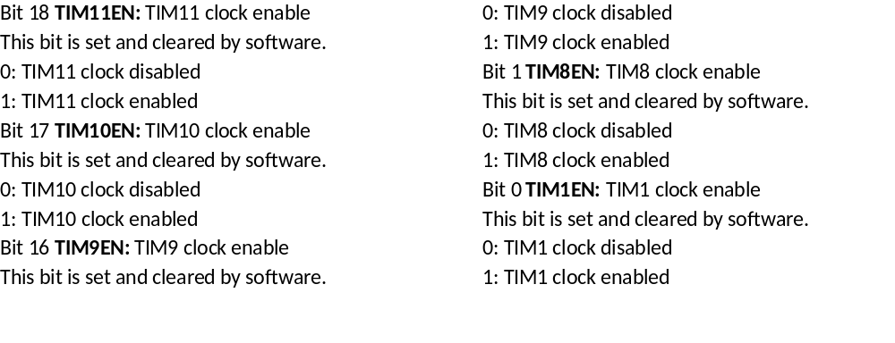
RCC_APB2ENR Register is used to enable timer clock

Slide 16
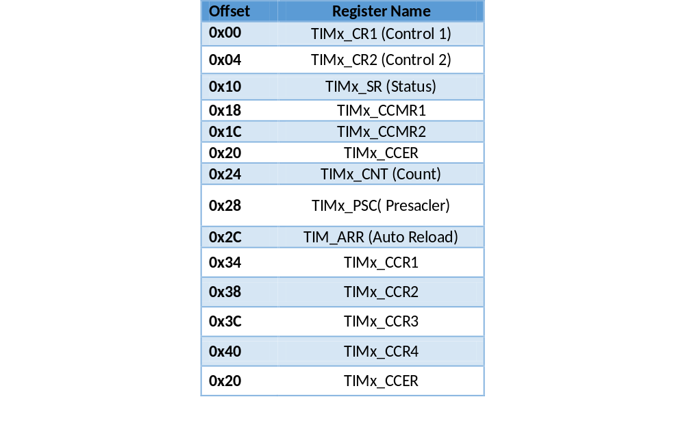
Some of the STM32F4xx Timer Registers

Slide 17
CR1 (Control 1) Register

Slide 18
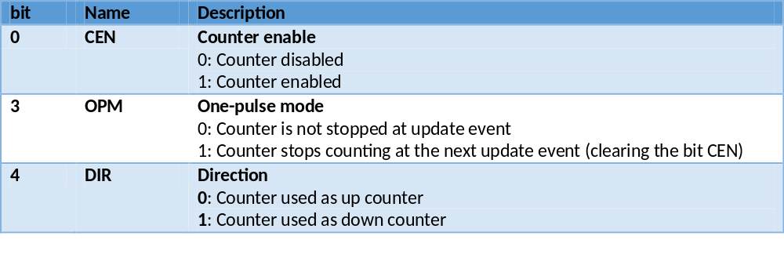
Some of the CR1 register bits

Slide 19
TIMxSR Register

Slide 20
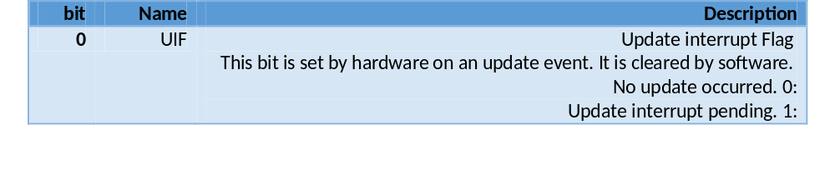
TIMx_SR (Staus) Register UIF Bit

Slide 21
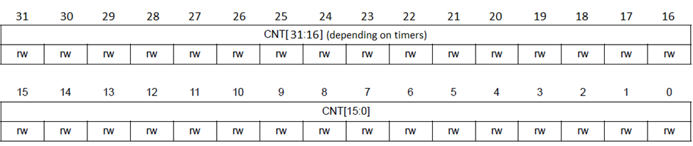
TIMx counter (TIMx_CNT)

Slide 22
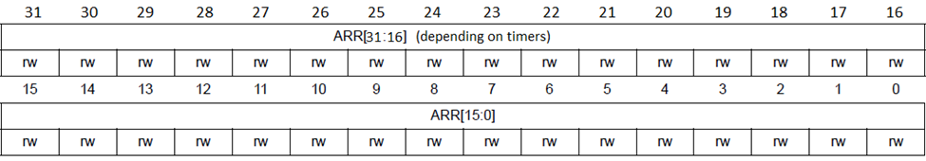
TIMx auto-reload register (TIMx_ARR)

Slide 23
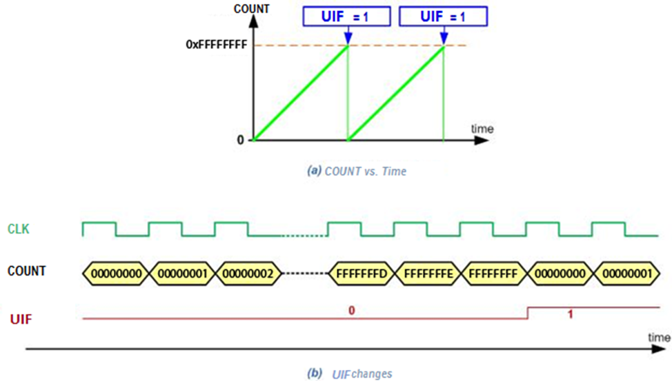
TIM2_CNT counter counting for 32-bit

Slide 24
TIMx prescaler (TIMx_PSC)

Slide 25
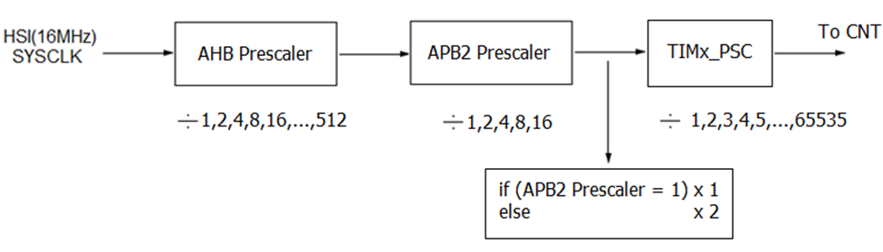
TIMx Options for Prescaler

Slide 26
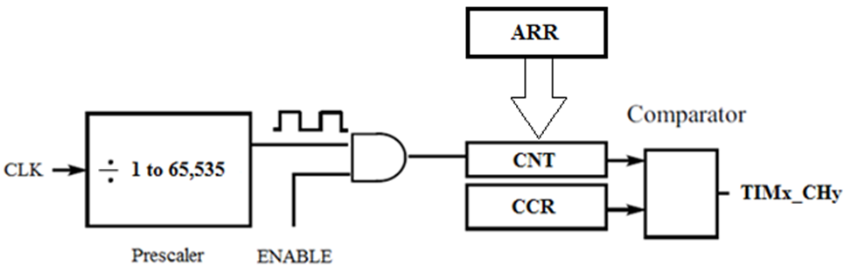
CNT, ARR and Compare registers (CCR) with Waveform Output

Slide 27
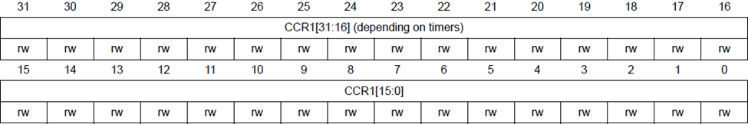
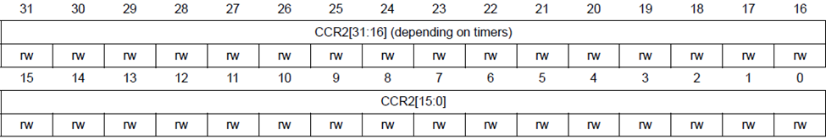
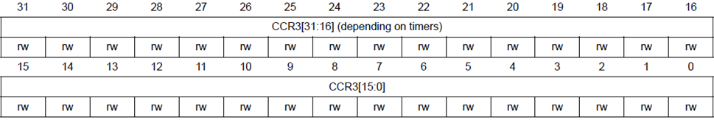
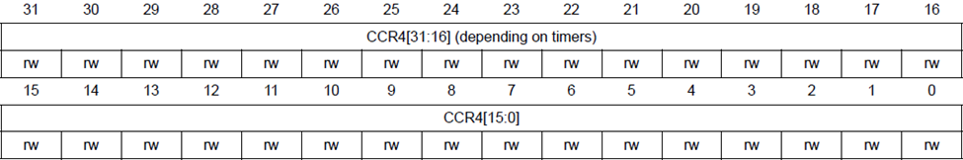
TIMx capture/compare registers (TIMx_CCRy)

Slide 28
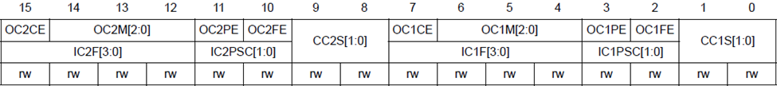
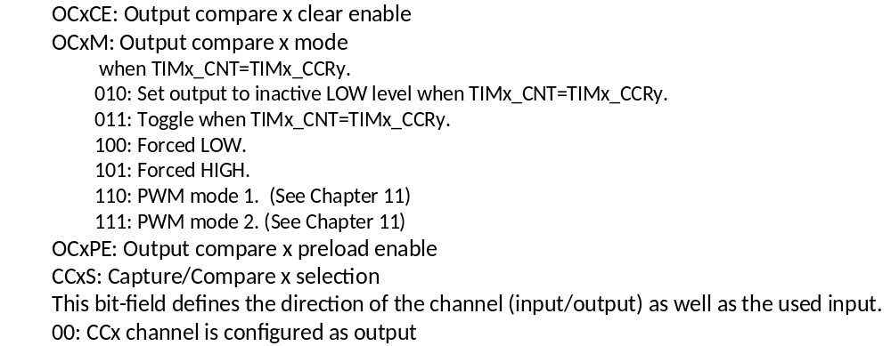
TIMx_CCMR1 for output option

Slide 29
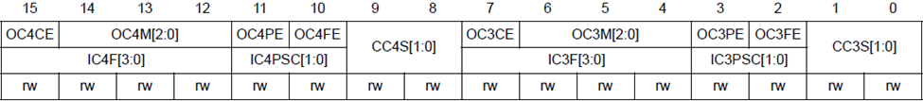
TIMx_CCMR2 for output option
OCxCE: Output compare x clear enable
OCxM: Output compare x mode
The OCxM bits in TIMx_CCMRy register are used to decide the output operation. Here are the options for output pin:
000: Frozen
001: Set output to active HIGH level when TIMx_CNT=TIMx_CCRy.
010: Set output to inactive LOW level when TIMx_CNT=TIMx_CCRy.
011: Toggle when TIMx_CNT=TIMx_CCRy.
100: Forced LOW.
101: Forced HIGH.
110: PWM mode 1. (See Chapter 11)
111: PWM mode 2. (See Chapter 11)
OCxPE: Output compare x preload enable
CCxS: Capture/Compare x selection
This bit-field defines the direction of the channel (input/output) as well as the used input.
00: CCx channel is configured as output

Slide 30
TIMx_CCER (TIMx capture/compare enable register)

Slide 31
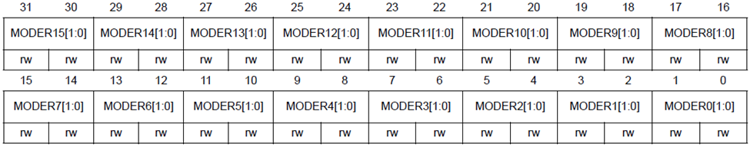
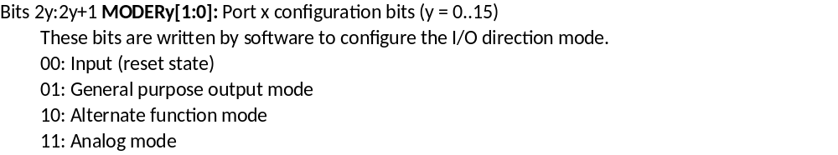
MODER Register is used to select alternative pin functions

Slide 32
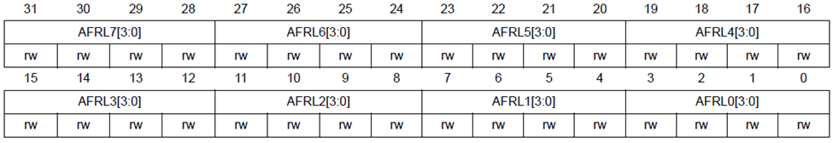
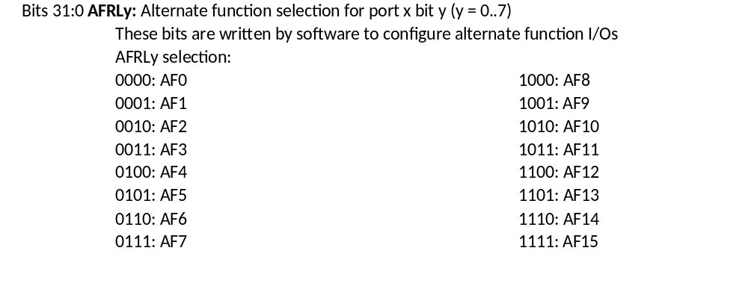
GPIOx_AFRL Register

Slide 33
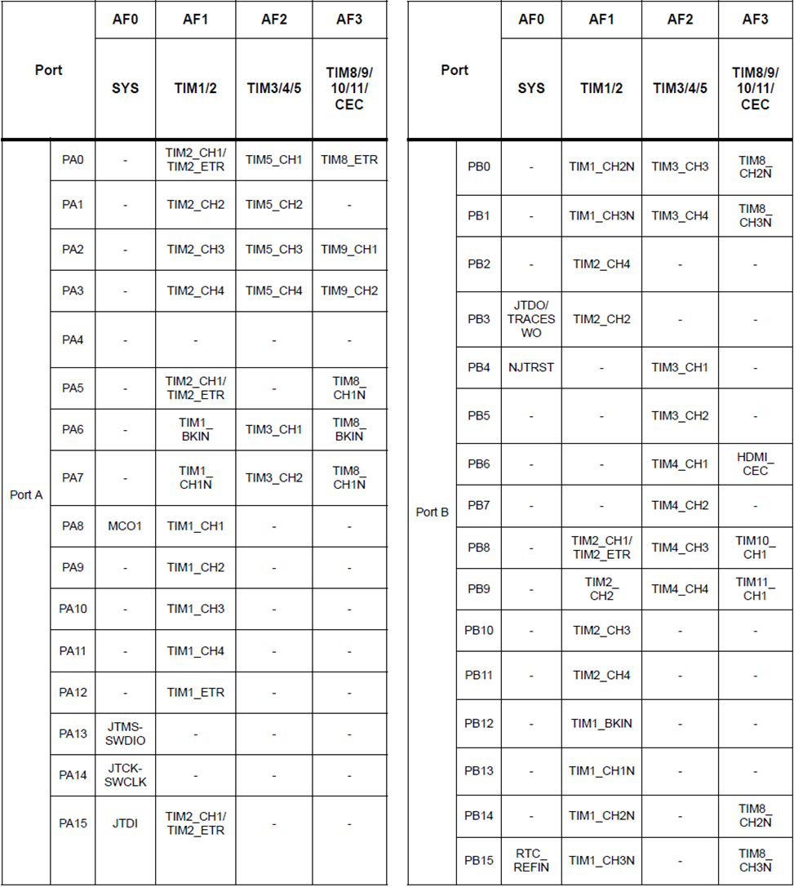
STMF466RE Alternative Function Table for Ports A and B (See Appendix B for other Ports)

Slide 34
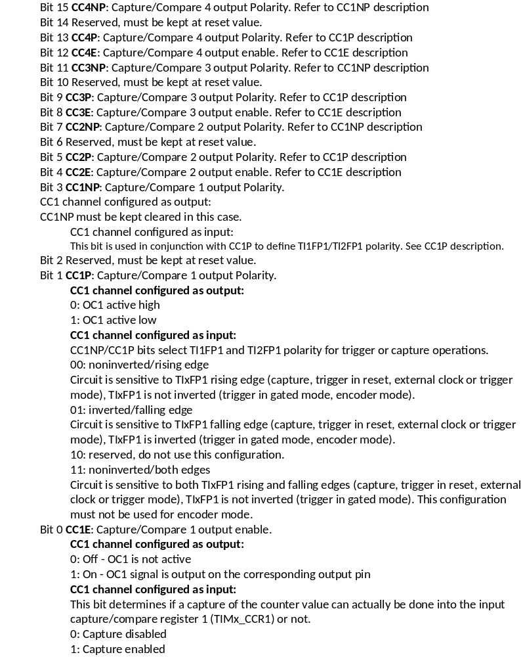
TIM_CCER Register (Notice the input capture)

Slide 35
TIMx_CCMR1 and TIMx_CCMR2 (register details are shown in the last section)

Slide 36
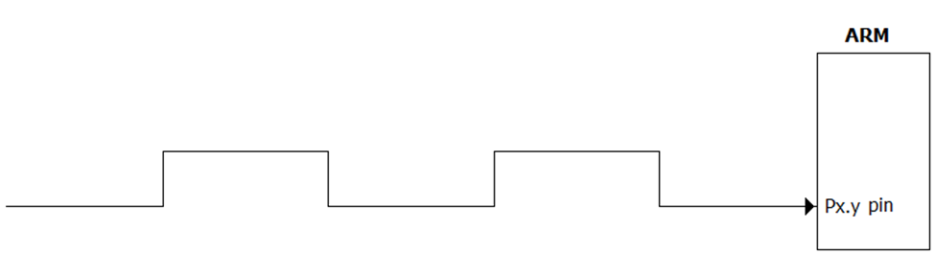
Inputing Signal

Slide 37
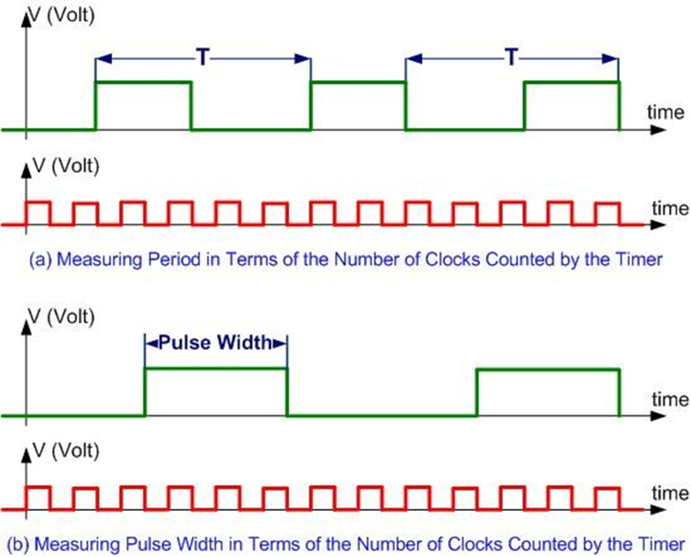
Messuring Period and Puls Width

Slide 38
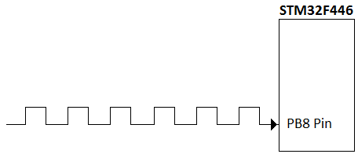
Counting Pulses

