Slide 1
Chapter 6
Interrupt and Exception Programming

Slide 2
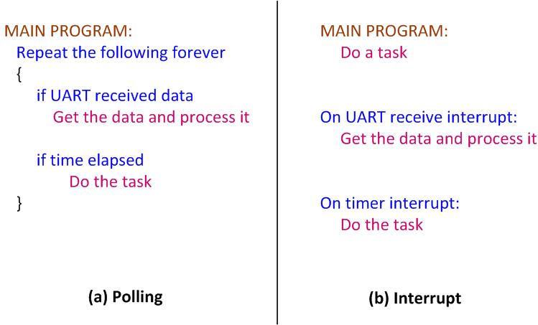
Polling vs. Interrupts

Slide 3
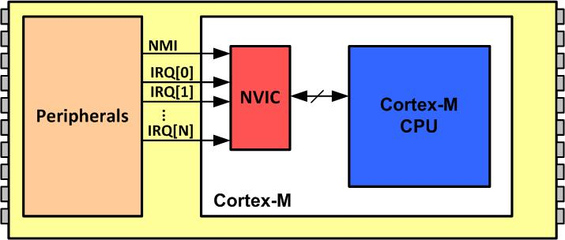
NVIC in ARM Cortex-M

Slide 4
Interrupt Vector Table for Arm Cortex-M4
Interrupt # | Interrupt | Memory Location (Hex)
 | Stack Pointer initial value | 0x00000000
1 | Reset | 0x00000004
2 | NMI | 0x00000008
3 | Hard Fault | 0x0000000C
4 | Memory Management Fault | 0x00000010
5 | Bus Fault | 0x00000014
6 | Usage Fault (undefined instructions, divide by zero, unaligned memory access,...) | 0x00000018
7 | Reserved | 0x0000001C
8 | Reserved | 0x00000020
9 | Reserved | 0x00000024
10 | Reserved | 0x00000028
11 | SVCall | 0x0000002C
12 | Debug Monitor | 0x00000030
13 | Reserved | 0x00000034
14 | PendSV | 0x00000038
15 | SysTick | 0x0000003C
16 | IRQ 0 for peripherals | 0x00000040
17 | IRQ 1 for peripherals | 0x00000044
… | … | …
255 | IRQ 239 for peripherals | 0x000003FC

Slide 5
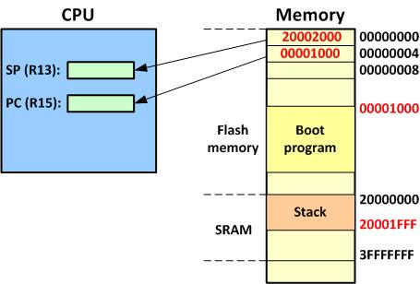
Going from Reset to Boot Program

Slide 6
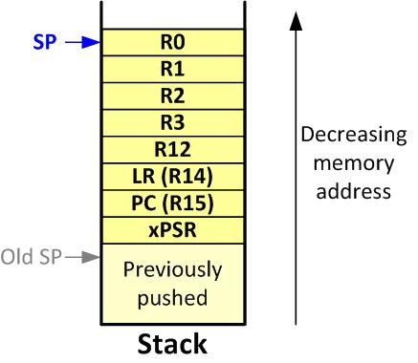
Arm Cortex-M Stack Frame upon Interrupt

Slide 7
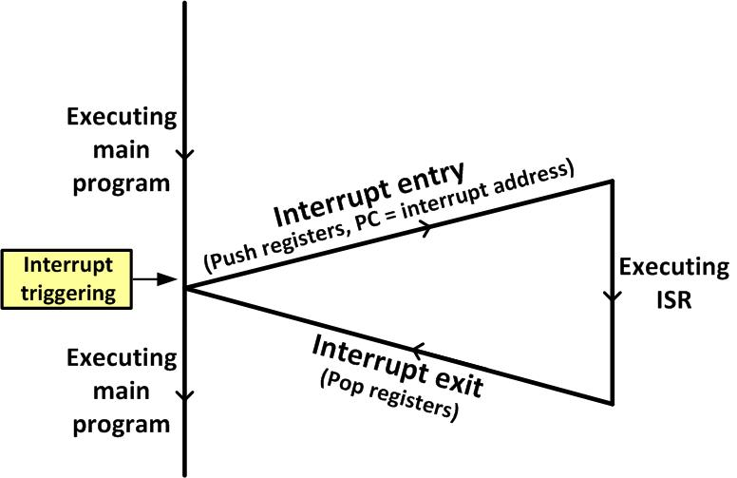
Main Program gets interrupted

Slide 8
Interrupt Priority for Arm Cortex-M4
Interrupt # | Interrupt | Priority Level
0 | Stack Pointer initial value
1 | Reset | -3 Highest
2 | NMI | -2
3 | Hard Fault | -1
4 | Memory Management Fault | Programmable
5 | Bus Fault | Programmable
6 | Usage Fault (undefined instructions, divide by zero, unaligned memory access,....) | Programmable
7 | Reserved | Programmable
8 | Reserved | Programmable
9 | Reserved | Programmable
10 | Reserved | Programmable
11 | SVCall | Programmable
12 | Debug Monitor | Programmable
13 | Reserved | Programmable
14 | PendSV | Programmable
15 | SysTick | Programmable
16 | IRQ 0 for peripherals | Programmable
17 | IRQ 1 for peripherals | Programmable
… | … | Programmable
255 | IRQ 239 for peripherals | Programmable

Slide 9

CONTROL Register in Arm Cortex-M4
nPRIV (Privilege): Defines the Thread mode privilege level 0: Privileged 1: Unprivileged Active Stack Pointer (ASP): Defines the currently active stack pointer (ASP = SPSEL) 0: MSP is the current stack pointer. 1: PSP is the current stack pointer. Floating Point Context Active (FPCA) 0: No floating point context active. 1: Floating point context active.

Slide 10
Privileged level Execution and Processor Modes in Arm Cortex-M
Processor Mode | Software | Privilege level
Thread | Applications | Privileged and Unprivileged
Handler | ISR for Exceptions and IRQs | Always Privileged
In Thread mode, use bit 0 of the CONTROL register to select Privileged or Unprivileged

Slide 11
Processor Modes and Stack Usage in Arm Cortex-M
Processor Mode | Software | Stack Usage
Thread | Applications | MSP or PSP
Handler | ISR for Exceptions and IRQs | MSP
Note: In Thread mode, use bit 1 of the Control register to select MSP or PSP for stack pointer.

Slide 12
Processor Mode, Privilege, and Stack in Arm Cortex
Mode | Privilege | Stack Pointer | Typical Example usage
Handler | Privileged | Main | Exception Handling
Handler | Unprivileged | Any | Reserved since Handler is always Privileged
Thread | Privileged | Main | Operating system kernel
Thread | Privileged | Process
Thread | Unprivileged | Main
Thread | Unprivileged | Process | Application threads

Slide 13
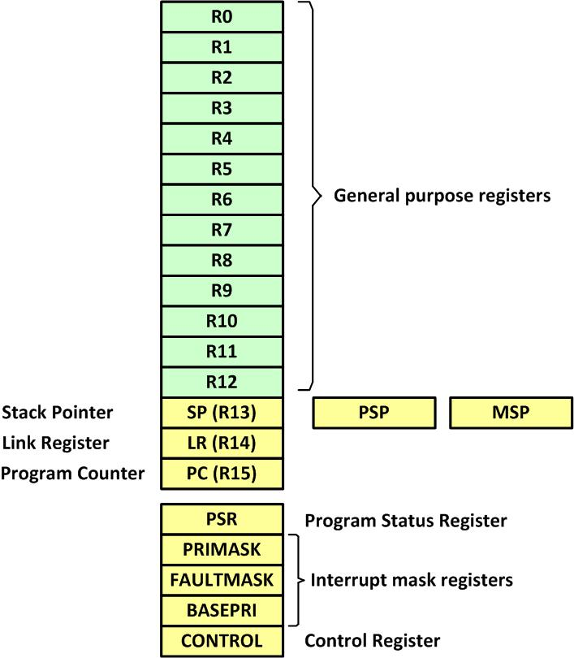
Arm Cortex-M Registers

Slide 14
Special function registers of Arm Cortex-M
Register name | Privilege Usage
MSP (main stack pointer) | Privileged
PSP (processor stack pointer) | Privileged or Unprivileged
PSR (Processor status register) | Privileged
APSR (application processor status register) | Privileged or Unprivileged
ISPR (interrupt processor status register) | Privileged
EPSR (execution processor status register) | Privileged
PRIMASK (Priority Mask register) | Privileged
FAULTMASK(fault mask register) | Privileged
BASEPRI (base priority register) | Privileged
CONTROL (control register) | Privileged
Note: We must use MSR and MRS instructions to access the above registers

Slide 15
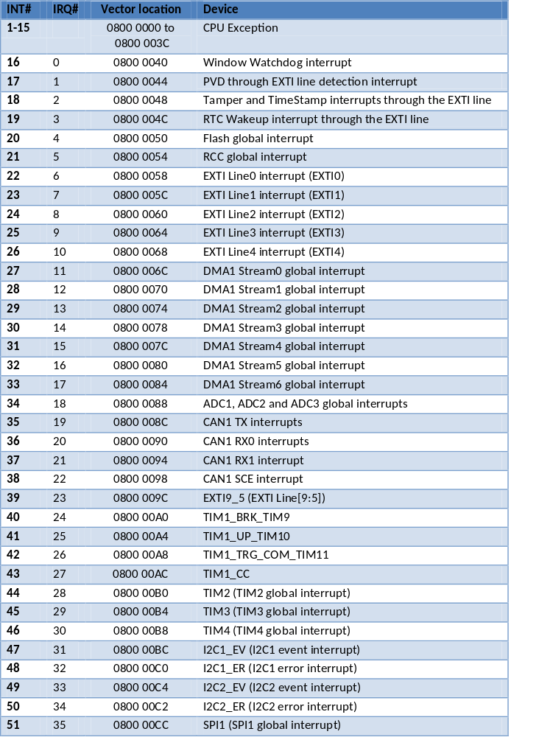
IRQ assignment in STM32F4xx (Partial Listing – For complete list see STM32F4 ref. manual)

Slide 16

External Interrupts Assignments to various Ports

Slide 17
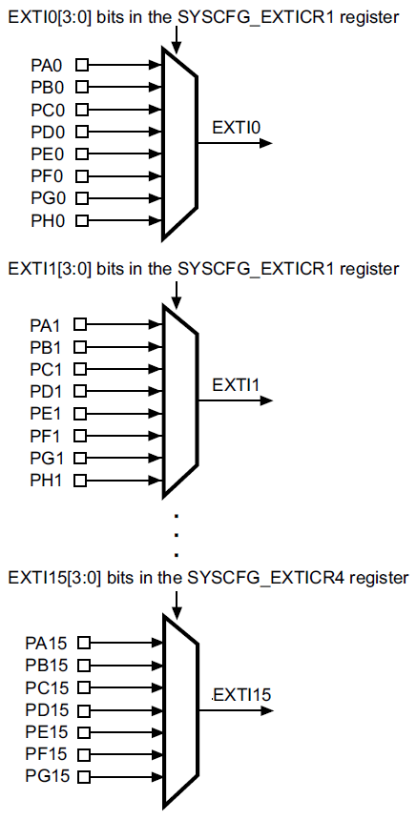
External interrupt/event GPIO mapping

Slide 18
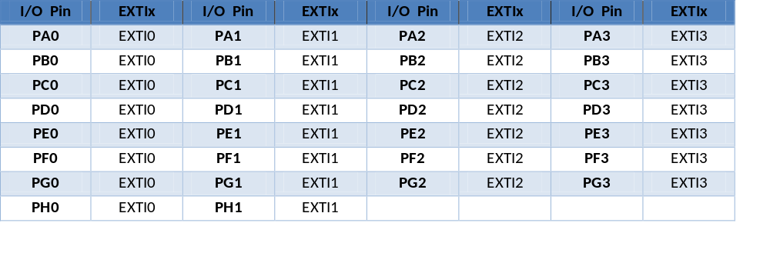
Associations of I/O pins to EXTINT signals (External interrupt/event GPIO mapping)

Slide 19
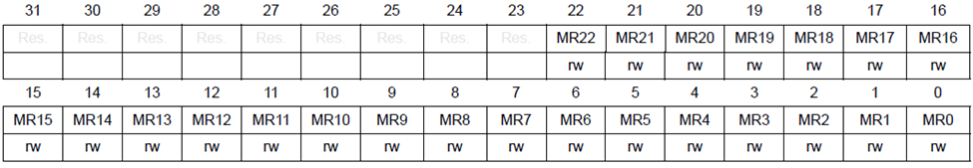
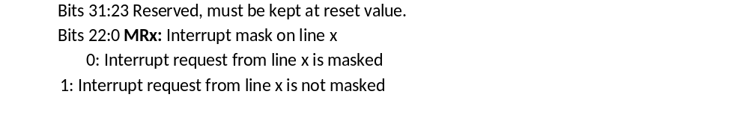
Interrupt Mask Register (EXTI_IMR)

Slide 20
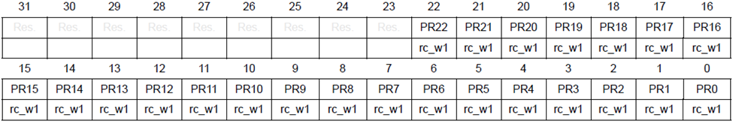
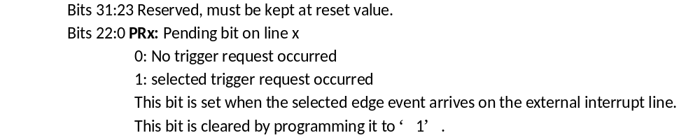
Pending Interrupt Register (EXTI_PR)

Slide 21
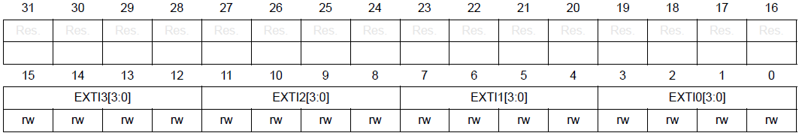
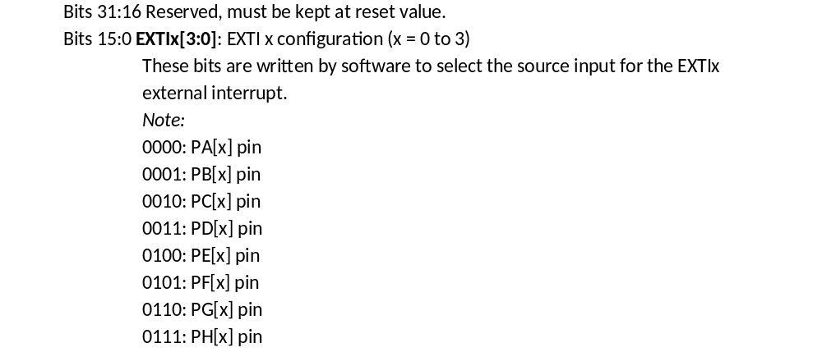
SYSCFG external interrupt configuration register 1 (SYSCFG_EXTICR1)

Slide 22
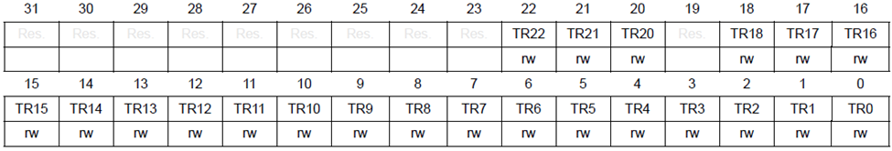
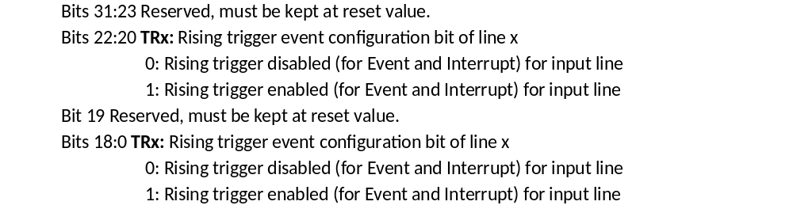
Rising trigger selection register (EXTI_RTSR)

Slide 23
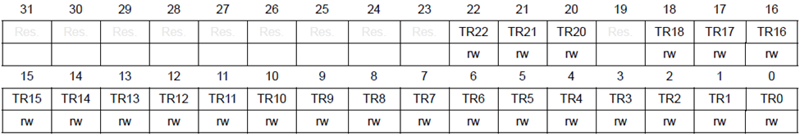

Falling trigger selection register (EXTI_FTSR)

Slide 24
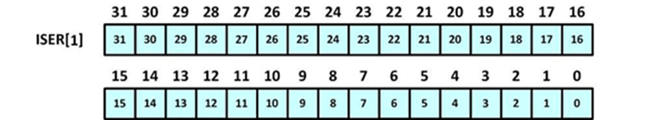
Set Enable Register (ISER[1]) for IRQ 32–63

Slide 25
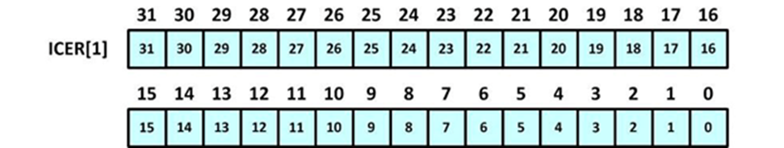
Clear Enable Register (ICER[1]) for IRQ 32–63

Slide 26
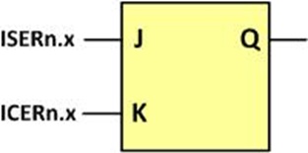
Enabling and Disabling an Interrupt

Slide 27
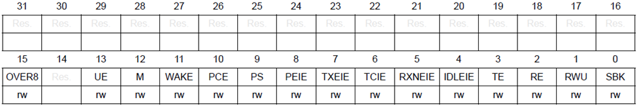
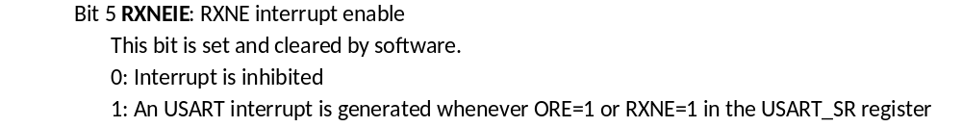
USARTx_CR1 to Enable Register to Enable RX interrupt

Slide 28
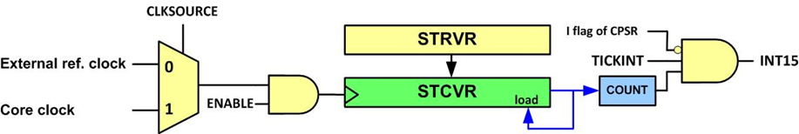
SysTick Internal Structure

Slide 29
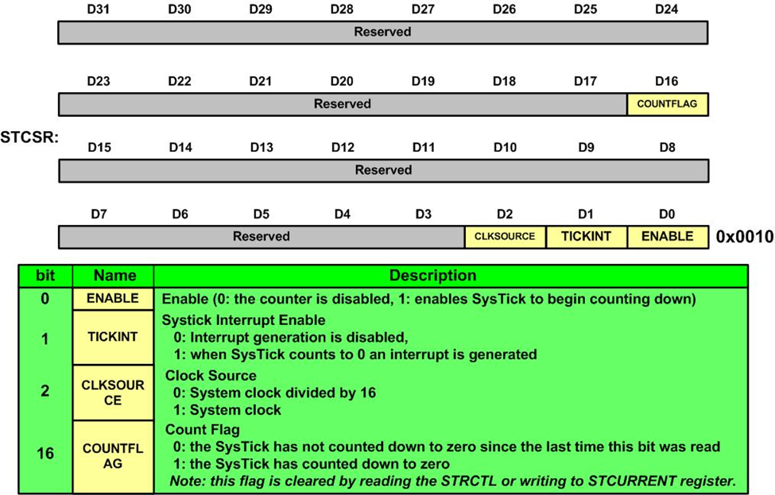
SysTick Control and Status Register (SYST_CSR)

Slide 30
TIMx DMA/Interrupt enable register (TIMx_DIER) to Enbale Timer interrupt

Slide 31
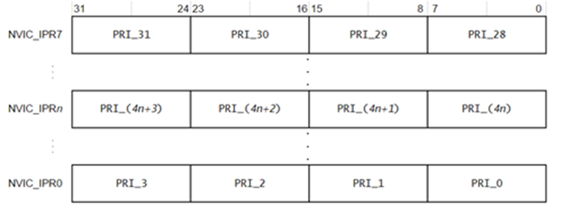
IPRn Registers

