Slide 1
Chapter 7
ADC, DAC, and Sensor Interfacing

Slide 2
Microcontroller Connection to Sensor via ADC

Slide 3
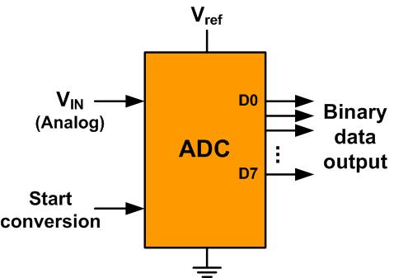
An 8-bit ADC Block Diagram

Slide 4
Resolution versus Step Size for ADC (Vref = 5V)
n-bit | Number of steps | Step size
8 | 256 | 5V /256 = 19.53 mV
10 | 1024 | 5V /1024 = 4.88 mV
12 | 4096 | 5V /4096 = 1.2 mV
16 | 65,536 | 5V /65,536 = 0.076 mV
Note: V_{ref} = 5V

Slide 5
Vref Relation to Vin Range for an 8-bit ADC
V_{ref} (V) | V_{in} in Range (V) | Step Size (mV)
5.00 | 0 to 5 | 5 / 256 = 19.53
4.00 | 0 to 4 | 4 / 256 = 15.62
3.00 | 0 to 3 | 3 / 256 = 11.71
2.56 | 0 to 2.56 | 2.56 / 256 = 10
2.00 | 0 to 2 | 2 / 256 = 7.81
1.28 | 0 to 1.28 | 1.28 / 256 = 5
1.00 | 0 to 1 | 1 / 256 = 3.90
Note: In an 8-bit ADC, step size is V_{ref}/256

Slide 6
Vref Relation to Vin Range for an 10-bit ADC
Vref (V) | V_{in}Range (V) | Step Size (mV)
5.00 | 0 to 5 | 5 / 1024 = 4.88
4.96 | 0 to 4.096 | 4.096 / 1024 = 4
3.00 | 0 to 3 | 3 / 1024 = 2.93
2.56 | 0 to 2.56 | 2.56 / 1024 = 2.5
2.00 | 0 to 2 | 2 / 1024 = 2
1.28 | 0 to 1.28 | 1.28 / 1024 = 1.25
1.024 | 0 to 1.024 | 1.024 / 1024 = 1
Note: In a 10-bit ADC, step size is V_{ref}/1024

Slide 7
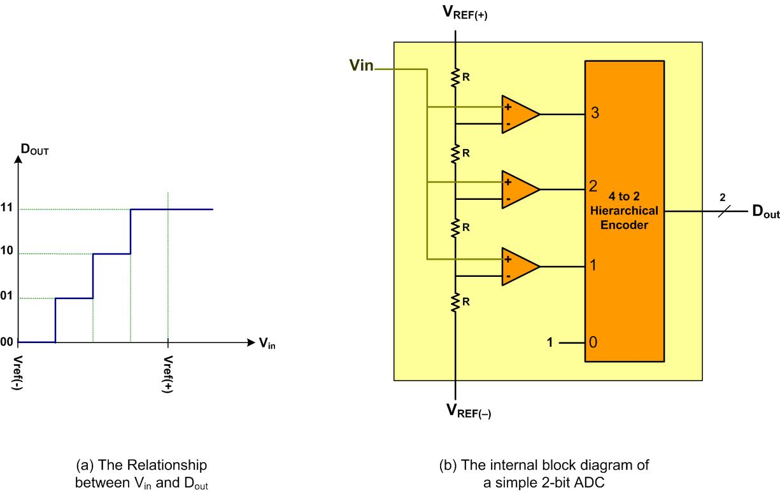
A Simultaneous 2-bit ADC

Slide 8
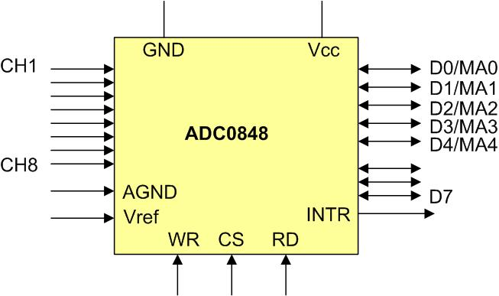
ADC0848 Parallel ADC Block Diagram

Slide 9
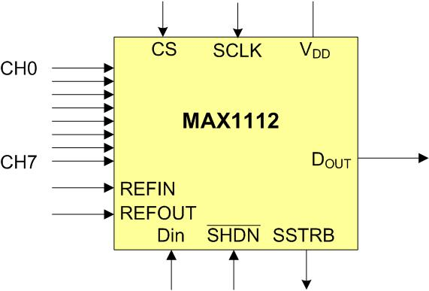
MAX1112 Serial ADC Block Diagram

Slide 10
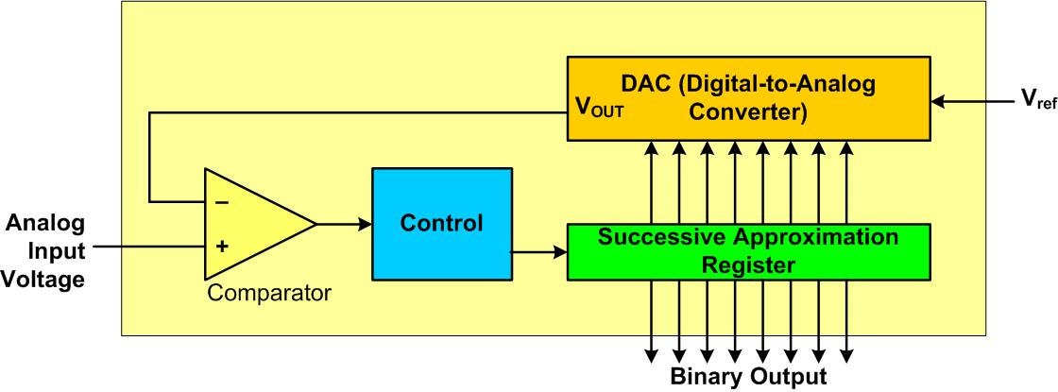
Successive Approximation ADC

Slide 11
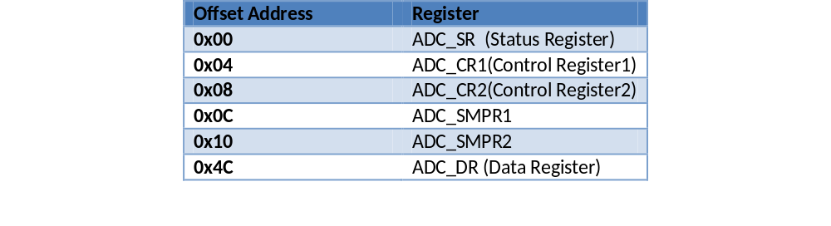
Some of the STM32F4xx Registers

Slide 12
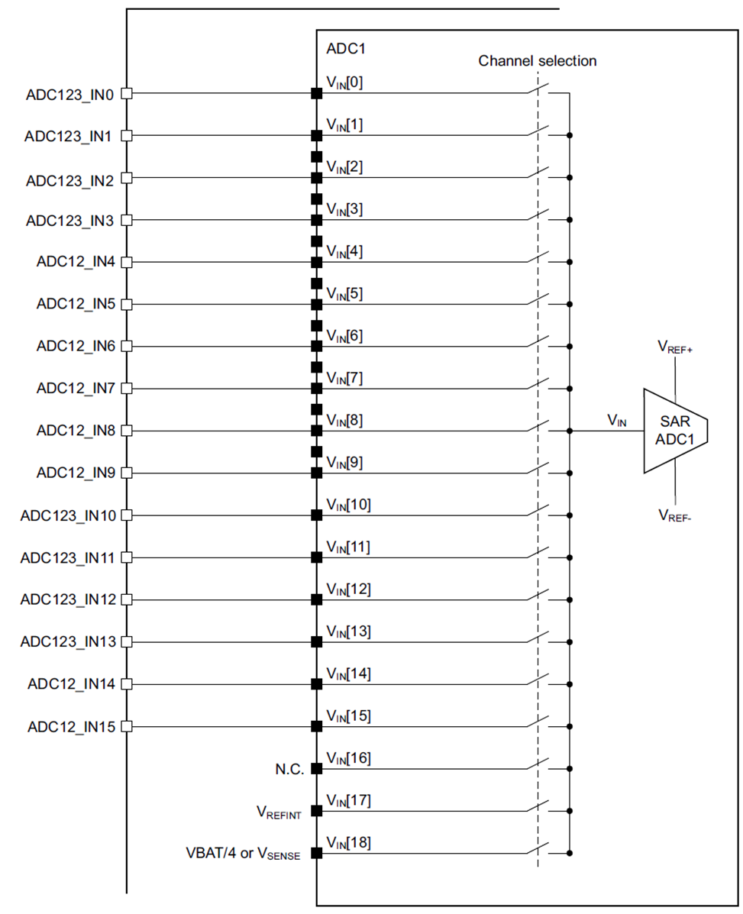
Simplified Block Diagram of STM32F4xx chip

Slide 13
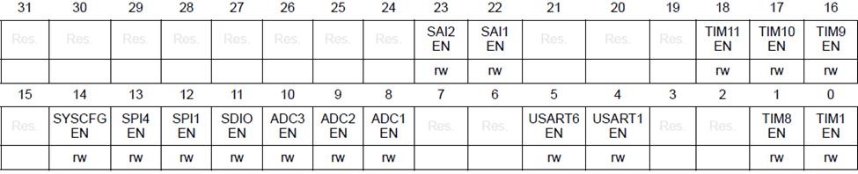
RCC_APB2ENR (RCC APB2 peripheral clock enable register) to enable clock to ADC
Bit 10
ADC3EN
: ADC3 clock enable
This bit is set and cleared by software.
0: ADC3 clock disabled
1: ADC3 clock disabled
Bit 9
ADC2EN
: ADC2 clock enable
This bit is set and cleared by software.
0: ADC2 clock disabled
1: ADC2 clock disabled
Bit 8
ADC1EN
: ADC1 clock enable
This bit is set an
d cleared by software.
0: ADC1 clock disabled
1: ADC1 clock disabled

Slide 14
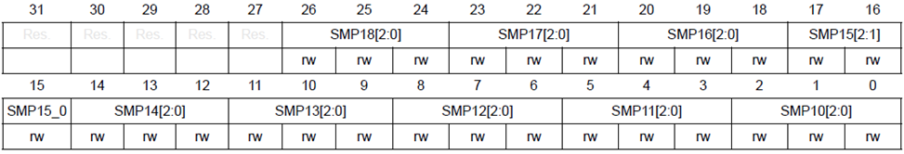
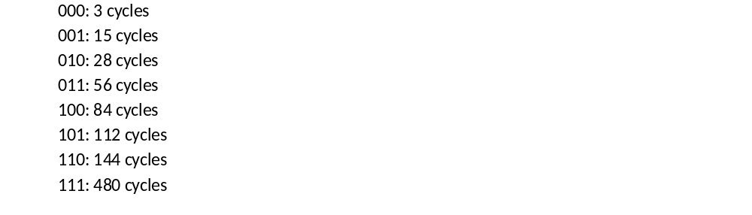
ADC sample time register (ADC_SMPR1) to set sampling time

Slide 15
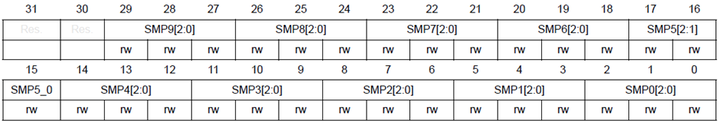
ADC sample time register (ADC_SMPR2) to set sampling time
000: 3 cycles
001: 15 cycles
010: 28 cycles
011: 56 cycles
100: 84 cycles
101: 112 cycles
110: 144 cycles
111: 480 cycles

Slide 16
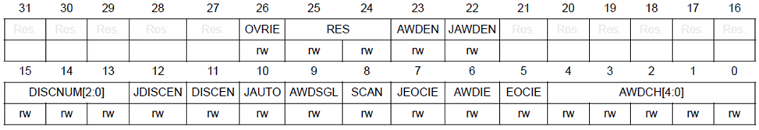
Control 1 (ADC_CR1) Register (Not all bits are shown)

Slide 17

ADC bit Resolution Selection in ADC_CR1 register

Slide 18
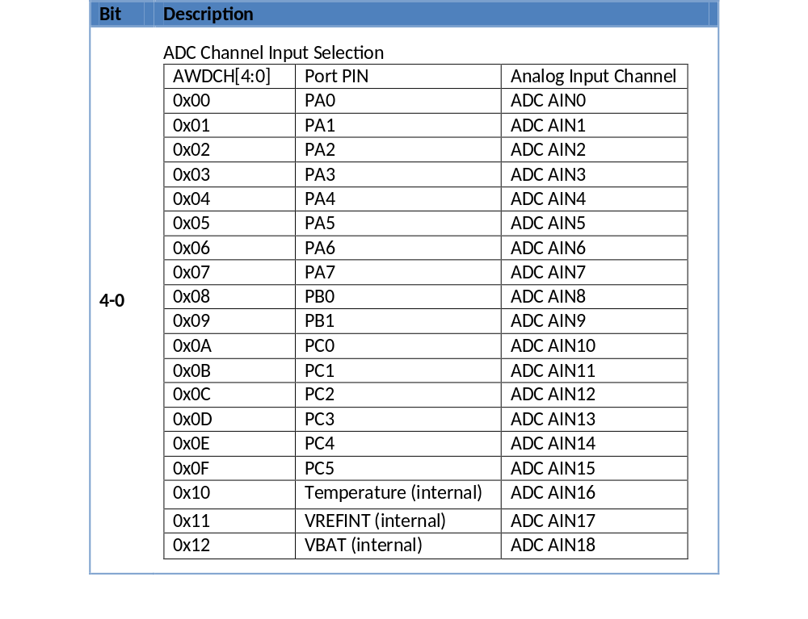
Control R1 (ADC_CR1) Register bits for ADC Channel Selection

Slide 19
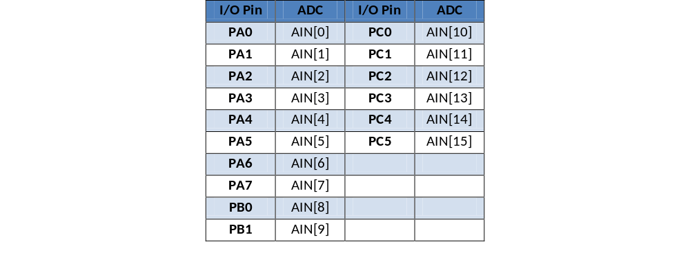
Analog input pin assignment in STM32F4xx

Slide 20
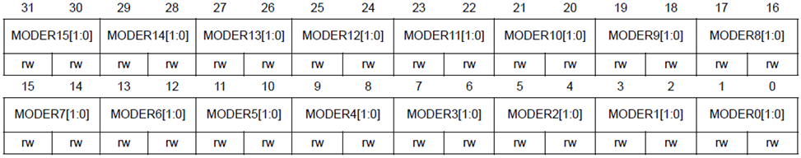
GPIO_MODER Register
Bits 2y:2y+1
MODERy[1:0]:
Port x configuration bits
(y = 0..15)
These bits are written by software to configure the I/O direction mode.
00: Input (reset state)
01: General purpose output mode
10: Alternate function mode
11: Analog mode

Slide 21
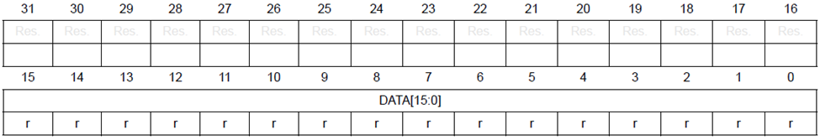
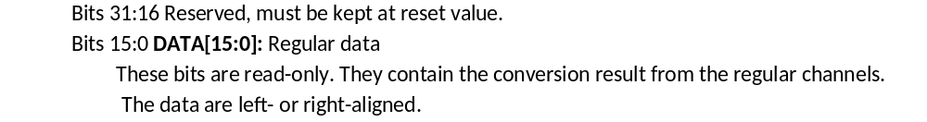
ADC_DR (ADC Data Register) register holds conversion result

Slide 22
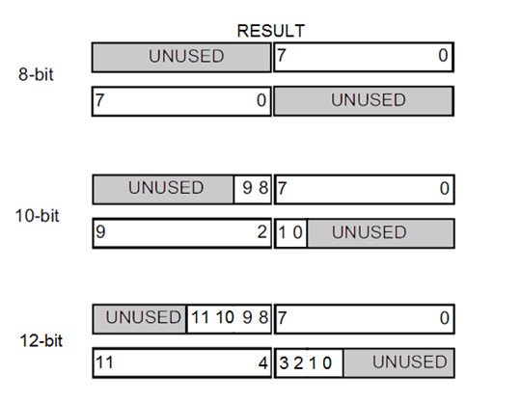
ADC_DR (DATA) Register has the result and can be Right and Left Justified

Slide 23
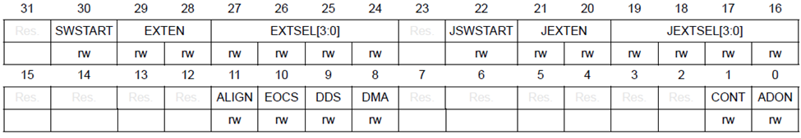
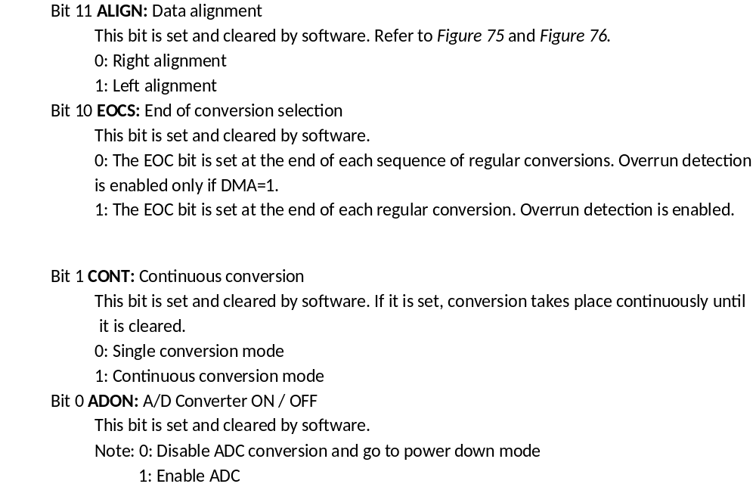
ADC_CR2 (ADC Control 2) register

Slide 24
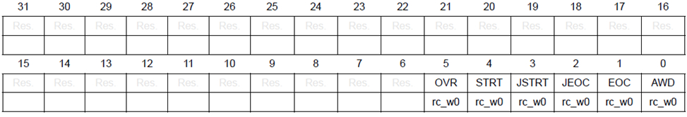
ADC_SR(ADC Status g) Register for End-of-Conversion

Slide 25
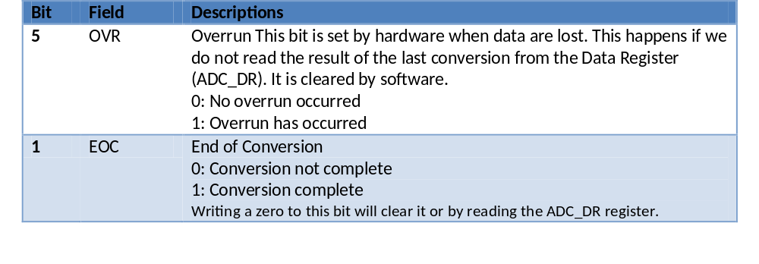
ADC_SR (Status) Register Bits

Slide 26
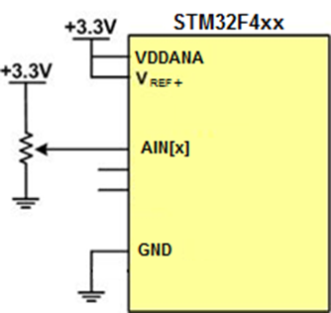
ADC Connection for Program 7-1

Slide 27
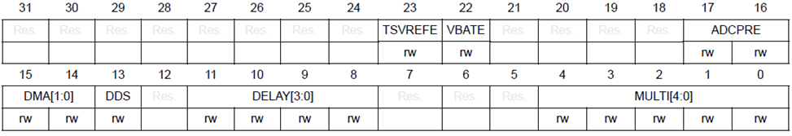
ADC common control register (ADC_CCR) register

Slide 28
ADC common control register (ADC_CCR) register
Bit | Field | Descriptions
22 | TSVREFE: | Temperature Sensor and VREINT Enable This bit is set and cleared by software to enable/disable the temperature sensor and the VREFINT channel. 0: Temperature sensor and VREFINT channel disabled. 1: Temperature sensor and VREFINT channel enabled.
23 | VBATE: VBAT enable | VBAT enable 0: VBAT channel disabled. 1: VBAT channel enabled.
17:16 |  | ADCPRE: ADC prescaler Set and cleared by software to select the frequency of the clock to the ADC. The clock is common for all the ADCs. 00: PCLK2 divided by 2 01: PCLK2 divided by 4 10: PCLK2 divided by 6 11: PCLK2 divided by 8

Slide 29
Thermistor Resistance vs. Temperature
Temperature ('C) | Tf (K ohms)
0 | 29.490
25 | 10.000
50 | 3.893
75 | 1.700
100 | 0.817

Slide 30
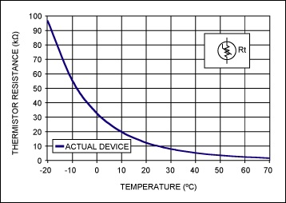
Thermistor
(Copied from http://www.maximintegrated.com)

Slide 31
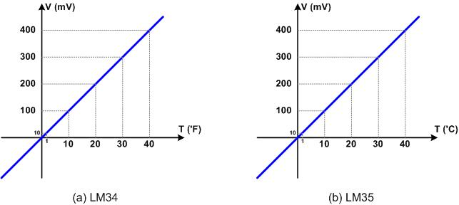
LM34 and LM35

Slide 32
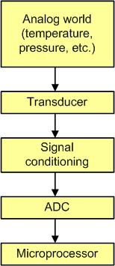
Getting Data to the CPU

Slide 33
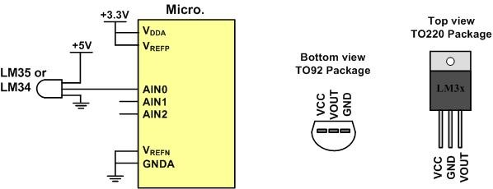
LM34/35 Connection to ARM and Its Pin Configuration

Slide 34
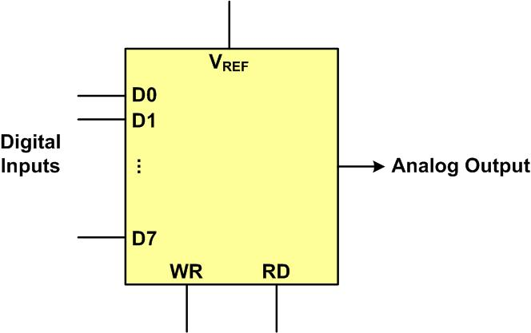
DAC Block Diagram

Slide 35
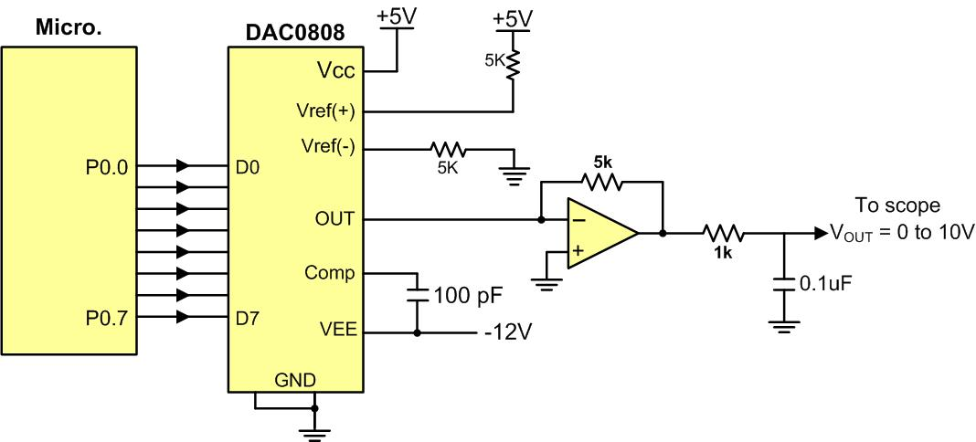
Microcontroller Connection to DAC0808

Slide 36
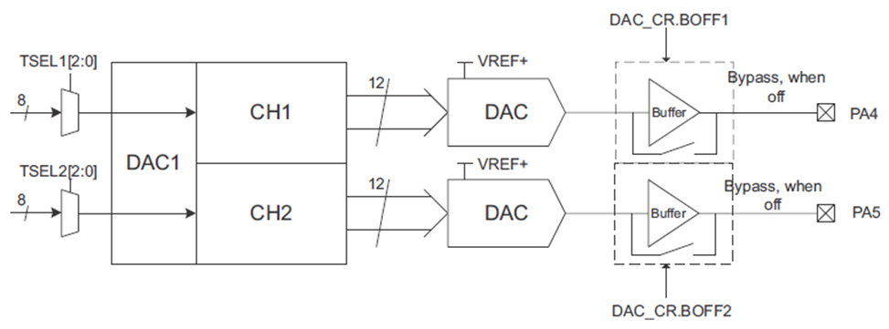
STM32F4xx DAC Block Diagram

Slide 37
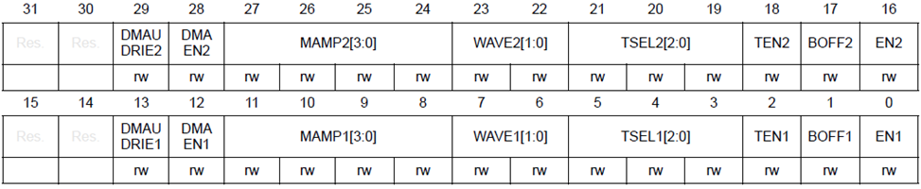
DAC_CR (DAC Conntrol Register)
Bit 18
TEN2
: DAC channel2 trigger enable
This bit
is set and cleared by software to enable/disable DAC channel2 trigger
0: DAC channel2 trigger disabled and data written into the DAC_DHRx register are
transferred one APB1 clock cycle later to the DAC_DOR2 register
1: DAC channel2 trigger enabled and data
from the DAC_DHRx register are transferred
three APB1 clock cycles later to the DAC_DOR2 register
Bit 17
BOFF2
: DAC channel2 output buffer disable
This bit is set and cleared by software to enable/disable DAC channel2 output buffer.
0: DAC channel2 output
buffer enabled
1: DAC channel2 output buffer disabled
Bit 16
EN2
: DAC channel2 enable
This bit is set and cleared by software to enable/disable DAC channel2.
0: DAC channel2 disabled
1: DAC channel2 enabled

Slide 38
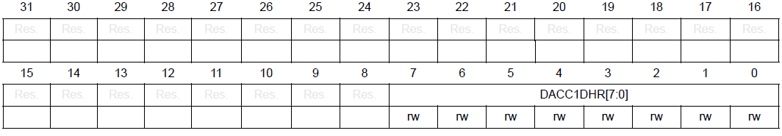
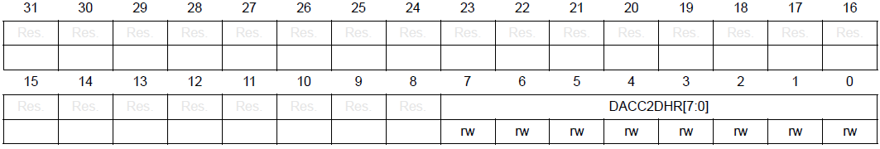
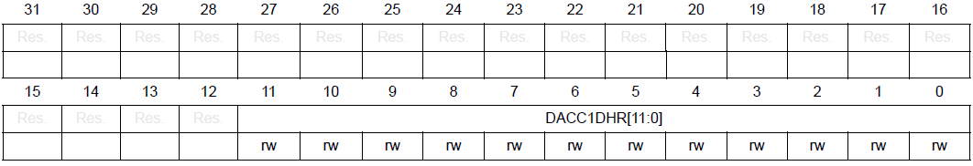
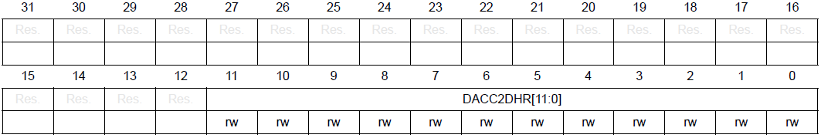
DAC channel-x data holding- register (DAC_DHRx)
DAC channel1 8-bit right aligned data holding register (DAC_DHR8R1)
DAC channel2 8-bit right-aligned data holding register (DAC_DHR8R2)
DAC channel1 12-bit right-aligned data holding register (DAC_DHR12R1)
DAC channel2 12-bit right aligned data holding register (DAC_DHR12R2)

Slide 39
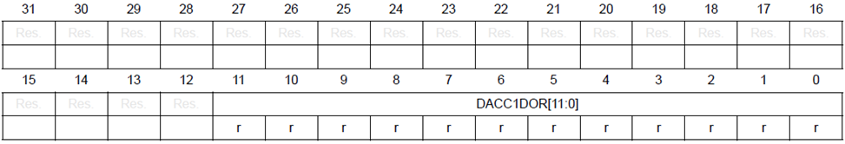
DAC channel1 data output register (DAC_DOR1)

Slide 40
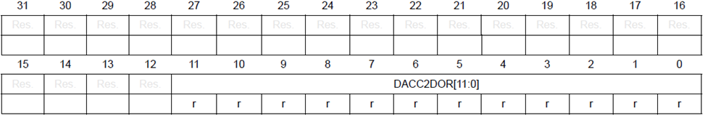
DAC channel2 data output register (DAC_DOR2)

Slide 41
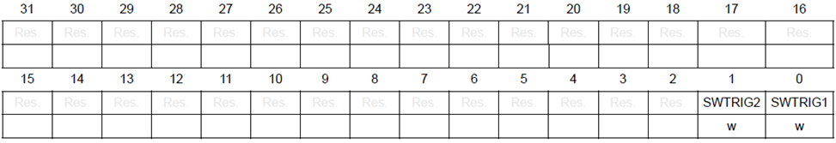
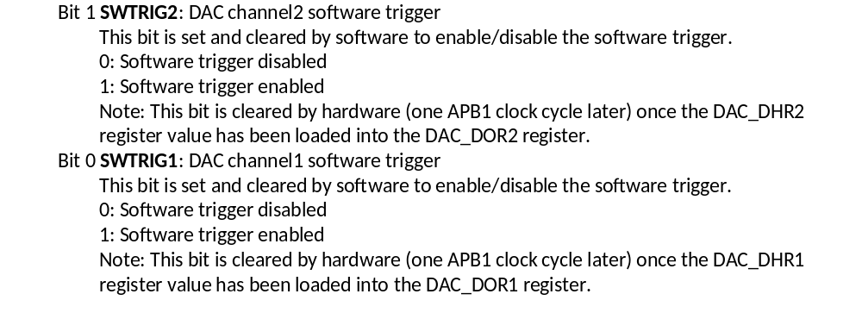
DAC software trigger register (DAC_SWTRIGR)

Slide 42
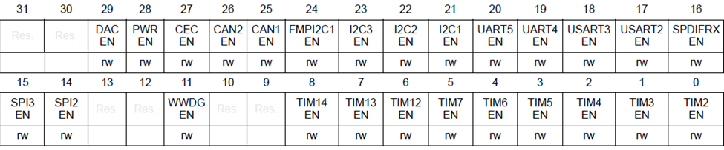

RCC APB1 Peripheral Clock Enable Register (RCC_APB1ENR) to enable clock to DAC

Slide 43
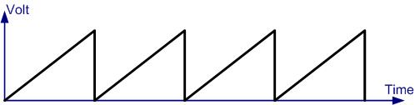
Saw Tooth Wave Form

Slide 44
Angle vs. Voltage Magnitude for Sine Wave
Angle Ɵ (degrees) | Sin Ɵ | V_{OUT} (Voltage Magnitude) 5V + (5V × sin Ɵ) | Values Sent to DAC (decimal) (Voltage Mag. × 25.6)
0 | 0 | 5 | 128
30 | 0.5 | 7.5 | 192
60 | 0.866 | 9.33 | 238
90 | 1.0 | 10 | 255
120 | 0.866 | 9.33 | 238
150 | 0.5 | 7.5 | 192
180 | 0 | 5 | 128
210 | -0.5 | 2.5 | 64
240 | -0.866 | 0.669 | 17
270 | -1.0 | 0 | 0
300 | -0.866 | 0.669 | 17
330 | -0.5 | 2.5 | 64
360 | 0 | 5 | 128

Slide 45
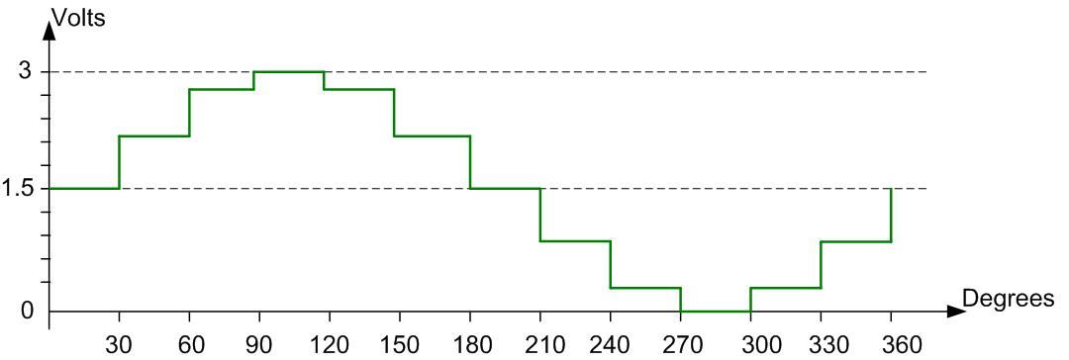
Angle vs. Voltage Magnitude for Sine Wave

