Slide 1
Chapter 8
SPI Protocol and DAC Interfacing

Slide 2
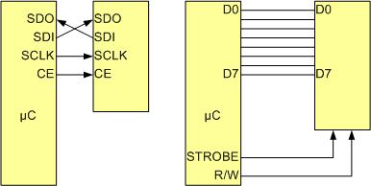
SPI Bus vs. Traditional Parallel Bus Connection to Microcontroller

Slide 3
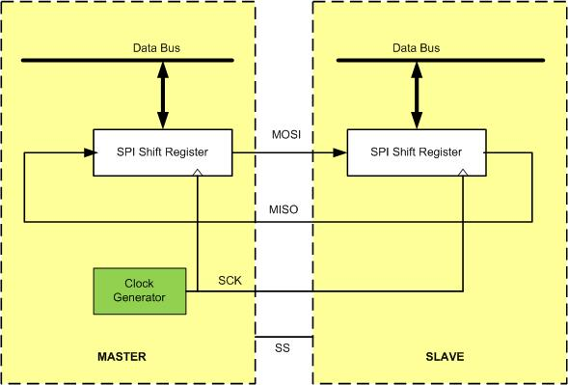
SPI Architecture

Slide 4
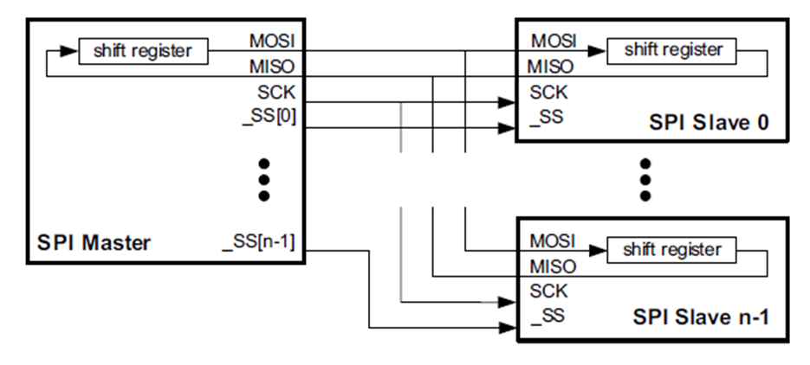
Master SPI Connection to multiple slaves SPI in Parallel

Slide 5
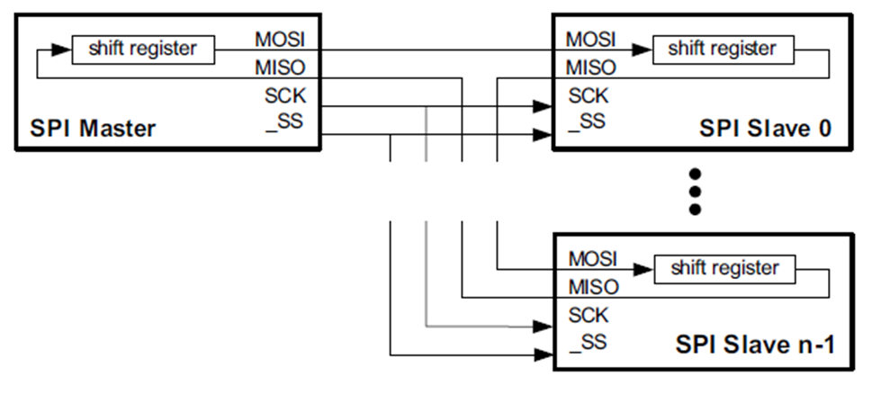
Master SPI Connection to multiple slaves SPI in serial

Slide 6
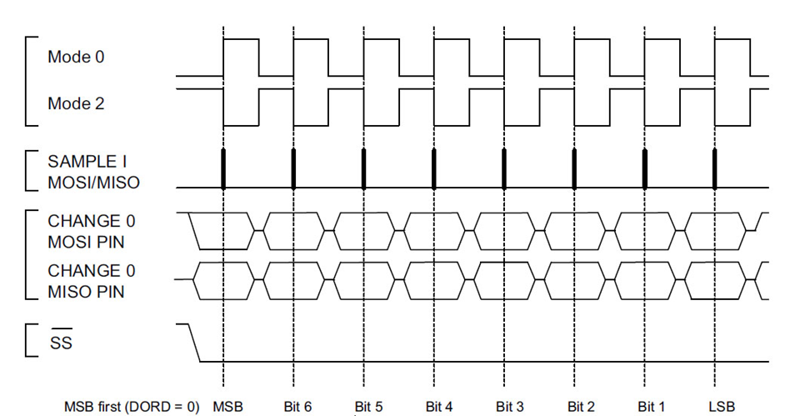
SPI Clock Polarity and phase Mode 0 (CPOL = 0, CPHA = 0) and Mode 2 (CPOL = 1, CPHA = 0)

Slide 7
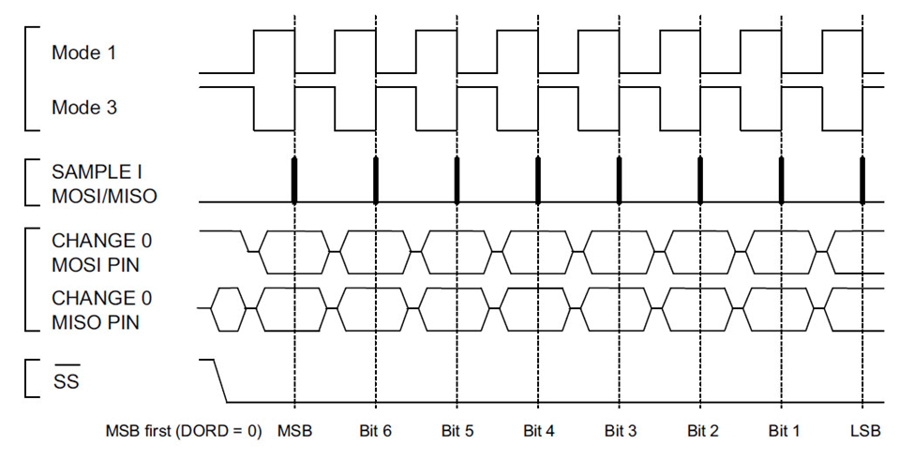
SPI Clock Polarity and phase Mode 1 (CPOL = 0, CPHA = 1) and Mode 3 (CPOL = 1, CPHA = 1)

Slide 8
SPI Clock Polarity and phase
Clock Polarity | Clock Phase | Data read and change time | SPI Mode
0 | 0 | read on rising edge, changed on a falling edge | 0
0 | 1 | read on falling edge, changed on a rising edge | 1
1 | 0 | read on falling edge, changed on a rising edge | 2
1 | 1 | read on rising edge, changed on a falling edge | 3

Slide 9
STM32F4xx Arm SPI Module Base Addresses
SPI Module | Base Address
SPI1 | 0x4001 3000 - 0x4001 33FF
SPI2 | 0x4000 3800 - 0x4000 3BFF
SPI3 | 0x4000 3C00 - 0x4000 3FFF

Slide 10
STM32F4xx SPI Registers
Register Name | Register Function | Register Address Offset
SPI_CR1 | Control 1 | 0x00
SPI_CR2 | Control 2 | 0x04
SPI_SR | Status | 0x08
SPI_DR | Data | 0x0C

Slide 11
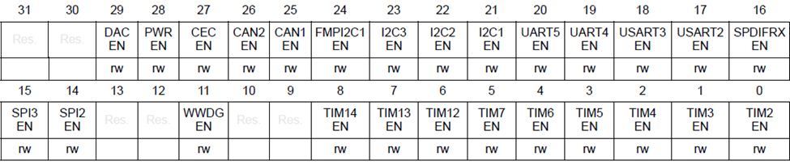
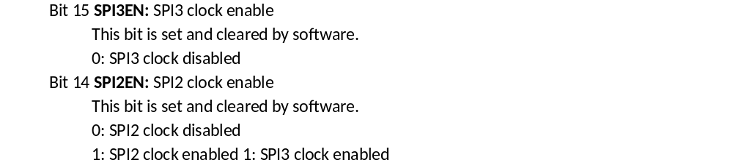
RCC APB1 peripheral clock enable register (RCC_APB1ENR)

Slide 12
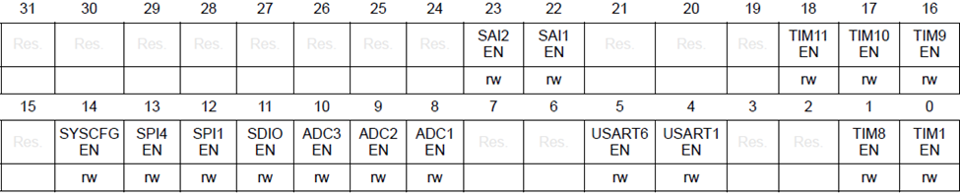
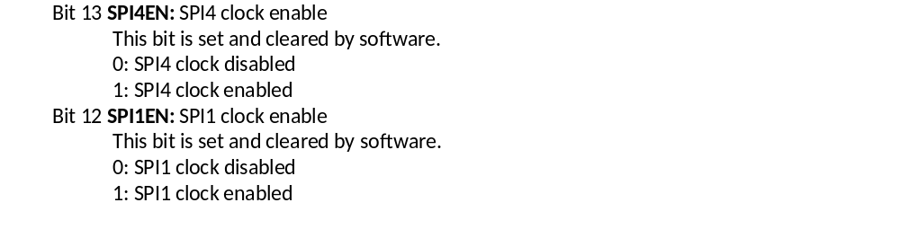
RCC APB2 peripheral clock enable register (RCC_APB2ENR)

Slide 13
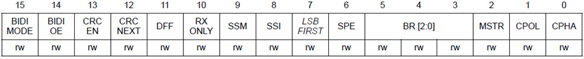
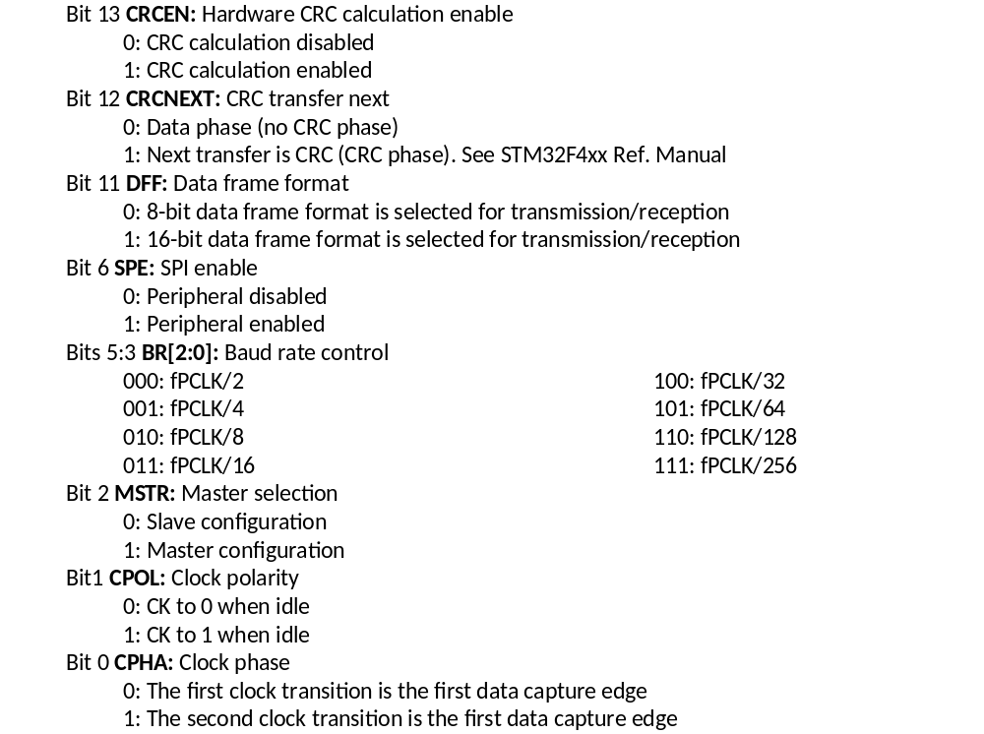
SPI Control 1 (SPI_CR1) Register in STM32F4xx

Slide 14
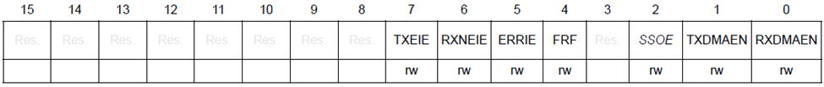
SPI_CR2 (Contolr 2) Registers in STM32F4xx
Bit 7
TXEIE:
Tx buffer empty interrupt enable
0: TXE interrupt masked
1: TXE interrupt not masked. Used to generate an interrupt request when the TXE flag is
set.
Bit 6
RXNEIE:
RX buffer not empty interrupt enable
0: RXNE interrupt masked
1: RXNE interrupt not masked. Used to generate an interrupt request when the RXNE flag is set.
Bit 5
ERRIE:
Error interrupt enable
This bit controls the generation of an
interrupt when an error condition occurs (OVR,
2
CRCERR, MODF, FRE in SPI mode, and UDR, OVR, FRE in I
S mode).
0: Error interrupt is masked
1: Error interrupt is enabled
Bit 4
FRF
: Frame format
0: SPI Motorola mode
1: SPI TI mode

Slide 15
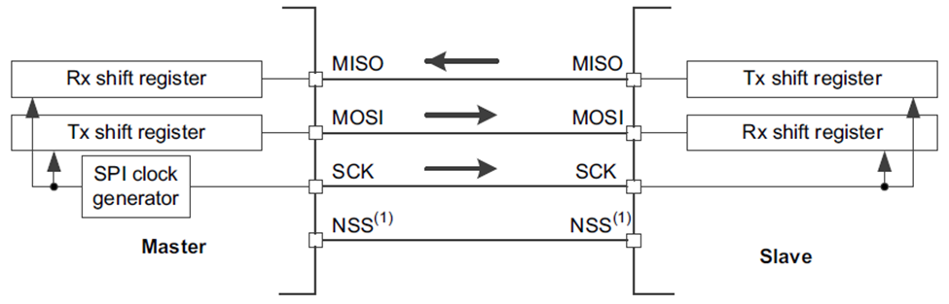
Using STM32F4xx SPI module as Master

Slide 16
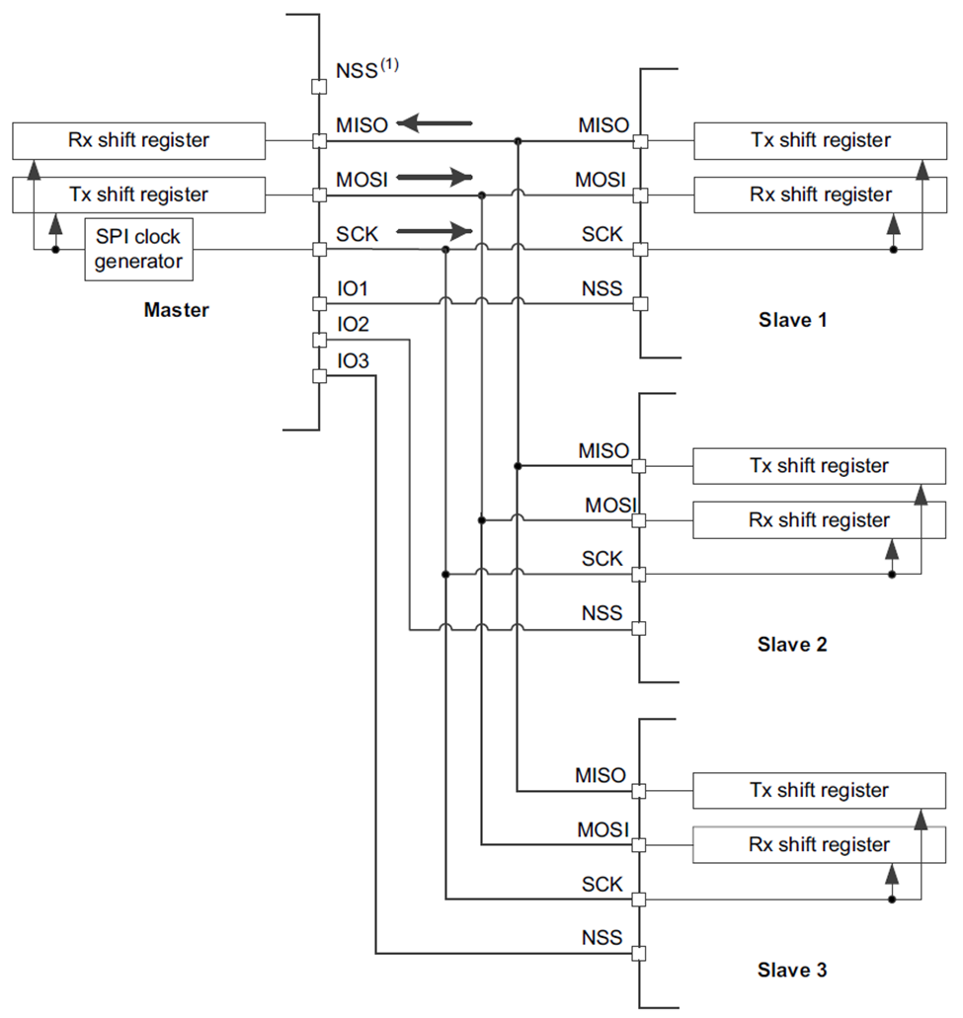
Using STM32F4xx SPI module as Master

Slide 17
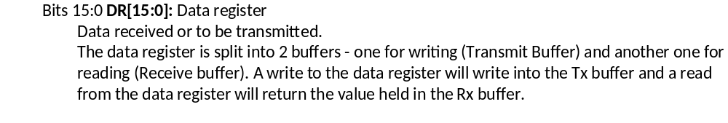
SPI_DR (Data) register

Slide 18
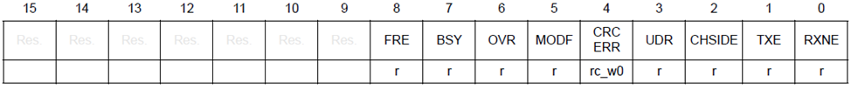
SPI_SR (Status) Register

Slide 19
SPI_SR (Status) Register
Bits | Name | Function | Description
1 | TXE: Transmit buffer empty | Data Register Empty | The bit is 1 when the transmit data is empty and can accept another byte of data.
0 | RXNE: Receive buffer not empty | Receive Complete | The bit is 1 when there is new data in the receive buffer registers. It is cleared when data are read.

Slide 20
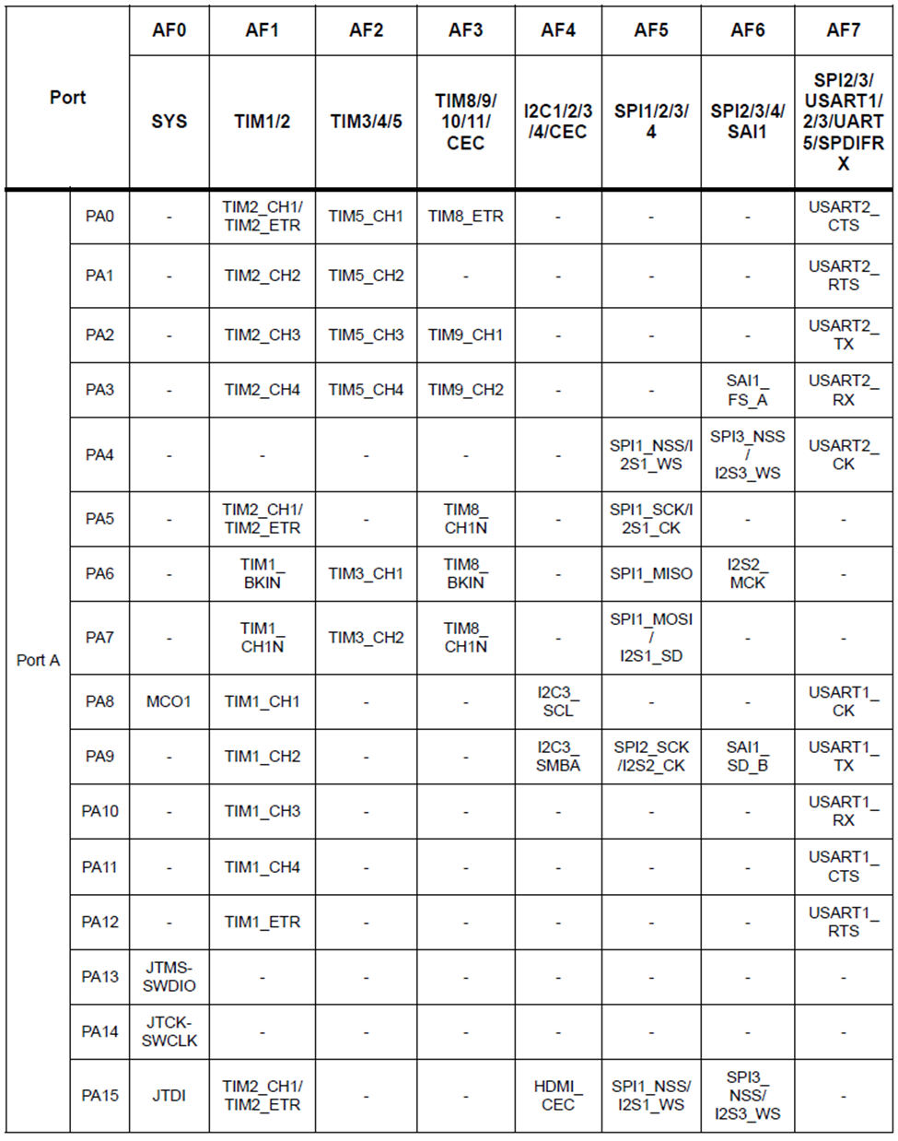
Alternate pin Function multiplexing for STM32F446RE (See Appendix B for complete list)

Slide 21
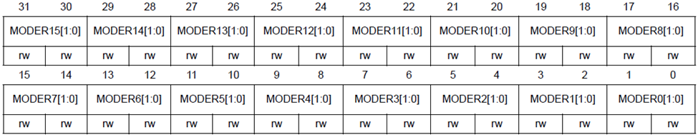
GPIOx_MODER
Bits 2y:2y+1
MODERy[1:0]:
Port x
configuration bits (y = 0..15)
These bits are written by software to configure the I/O direction mode.
00: Input (reset state)
01: General purpose output mode
10: Alternate function mode
11: Analog mode

Slide 22
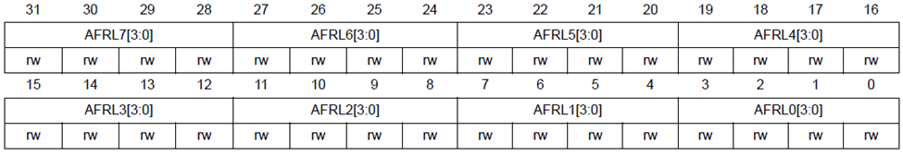
GPIOx_AFRL Register
Bits 31:0 AFRLy: Alternate function selection for port x bit y (y = 0..7)
These bits are written by software to configure alternate function I/Os
AFRLy selection:
0000: AF0
0001: AF1
0010: AF2
0011: AF3
0100: AF4
0101: AF5
0110: AF6
0111: AF7
1000: AF8
1001: AF9
1010: AF10
1011: AF11
1100: AF12
1101: AF13
1110: AF14
1111: AF15

Slide 23
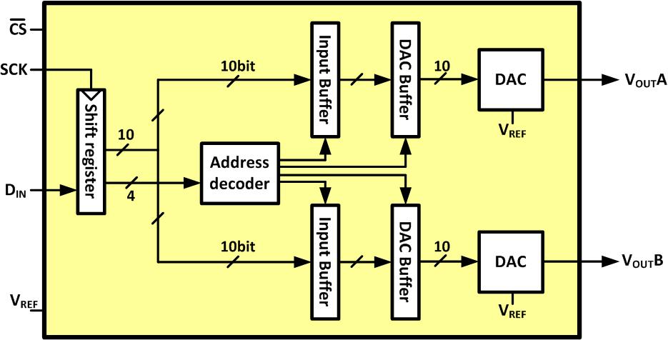
LTC1661 Internal Block Diagram

Slide 24
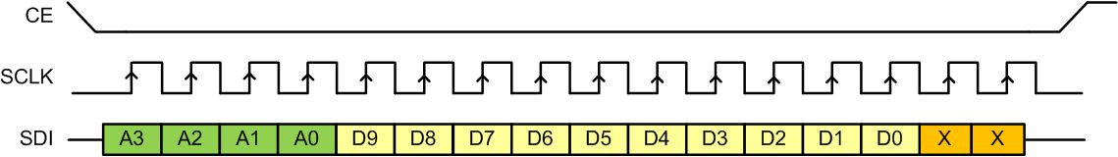
Sending a Packet of Data to LTC166x

Slide 25
LTC1661 DAC Control Functions
A3 A2 A1 A0 | Interrupt Register | DAC Register | Power Down Status | Comments
0 0 0 0 | No Change | No Update | No Change | No operation. power-down status unchanged
0 0 0 1 | Load DAC A | No Update | No Change | Load input register A with data. DAC outputs unchanged. power-down Status unchanged
0 0 1 0 | Load DAC B | No Update | No Change | Load input register B with data. DAC outputs unchanged. power-down status unchanged
0 0 1 1 | - | - | - | Reserved
0 1 0 0 | - | - | - | Reserved
0 1 0 1 | - | - | - | Reserved

Slide 26
LTC1661 DAC Control Functions (Cont.)
A3 A2 A1 A0 | Interrupt Register | DAC Register | Power Down Status | Comments
0 1 1 0 | - | - | - | Reserved
0 1 1 1 | - | - | - | Reserved
1 0 0 0 | No Change | Update Outputs | Wake | Load both DAC Regs with existing contents of input Regs. Outputs update. Part wakes up
1 0 0 1 | Load DAC A | Update Outputs | Wake | Load input Reg A. Load DAC Regs with new contents of input Reg A and existing contents of Reg B. Outputs update.
1 0 1 0 | Load DAC B | Update Outputs | Wake | Load input Reg B. Load DAC Regs with existing contentsof input Reg A and new contents of Reg B. Outputs update

Slide 27
LTC1661 DAC Control Functions (Cont.)
A3 A2 A1 A0 | Interrupt Register | DAC Register | Power Down Status | Comments
1 0 1 1 | - | - | - | Reserved
1 1 0 0 | - | - | - | Reserved
1 1 0 1 | No Change | No Update | Wake | Part wakes up. Input and DAC Regs unchanged. DAC outputs reflect existing contents of DAC Regs
1 1 1 0 | No Change | No Update | Sleep | Part goes to sleep. Input and DAC Regs unchanged. DAC outputs set to high impedance state
1 1 1 1 | Load ADCs A, B with same 10-bit code | Update Outputs | Wake | Load both input Regs. Load both DAC Regs with new contents of input Regs. Outputs update. Part wakes up

Slide 28
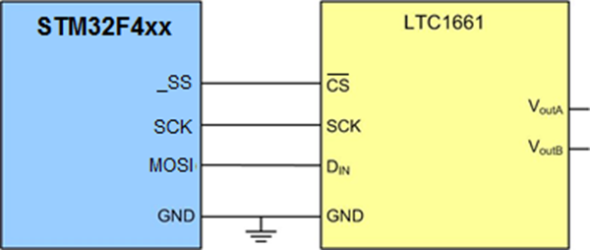
Connecting LTC1661 to the STM32F4xx

Slide 29
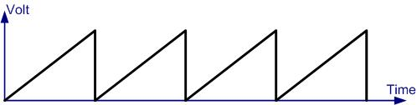
The Generated sawTooth waveform

