Slide 1
Chapter9
I2C Protocol and RTC Interfacing

Slide 2
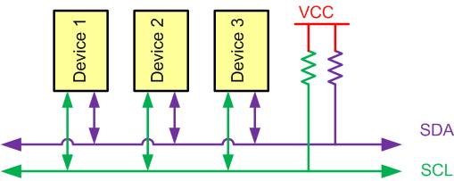
I2C Bus Characteristics

Slide 3
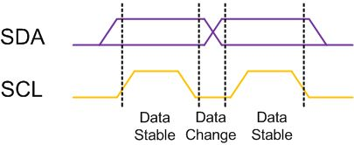
I2C Bit Format

Slide 4
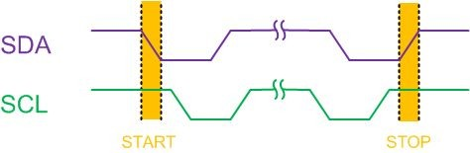
START and STOP Conditions

Slide 5
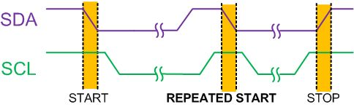
REPEATED START Condition

Slide 6
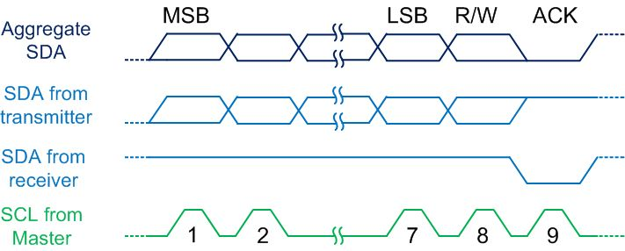
Byte Format in I2C

Slide 7
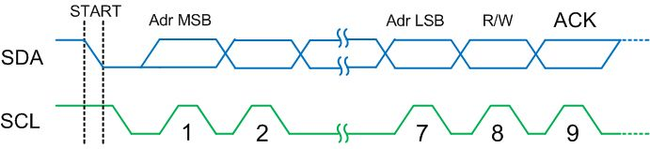
Address Byte Format in I2C

Slide 8
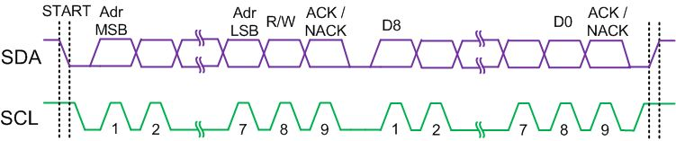
Typical Data Transmission

Slide 9
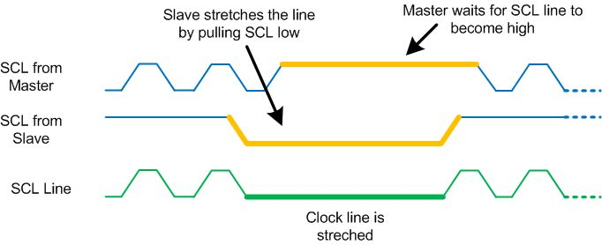
Clock Stretching

Slide 10
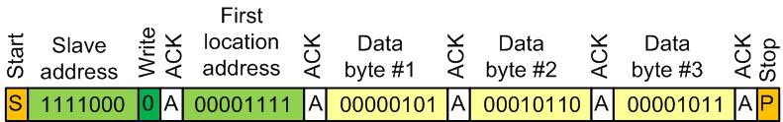
Multi-byte Burst Write

Slide 11
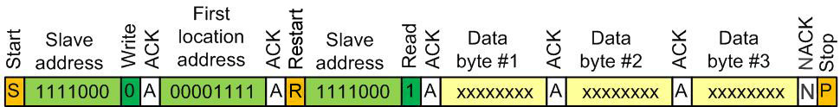
Multi-byte Burst Read

Slide 12
I2C Module Base Address for STM32F4xx
I2C Module | Base Address
I2C1 | 0x4000 5400 - 0x4000 57FF
I2C2 | 0x4000 5800 - 0x4000 5BFF
I2C3 | 0x4000 5C00 - 0x4000 5FFF

Slide 13
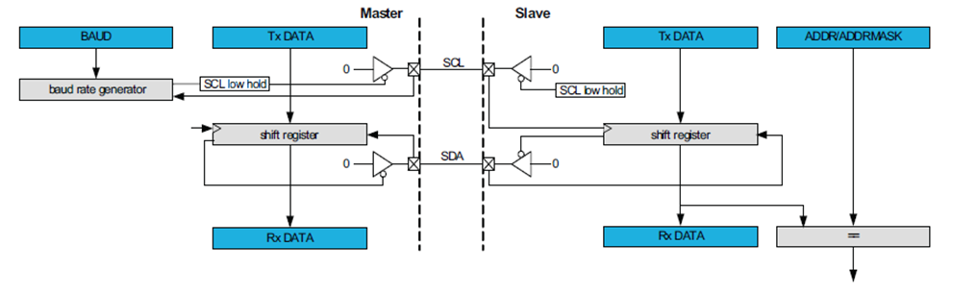
I2C Master Slave connection

Slide 14
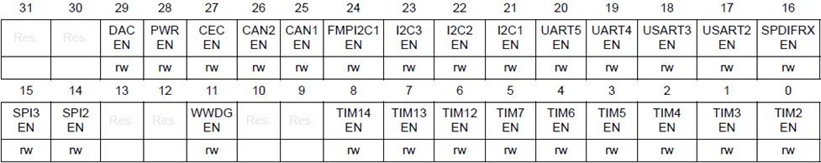
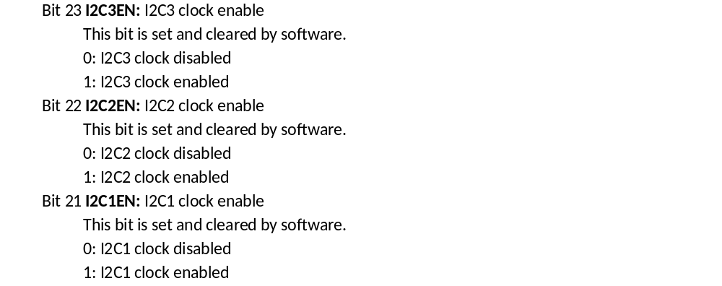
RCC APB1 peripheral clock enable register (RCC_APB1ENR) to enable clock to I2C

Slide 15
Some I2C Registers in STM32F4xx
Register Name | Register Function | Register Address
I2C_CR1 | Control 1 | 0x0000
I2C_CR2 | Control 2 | 0x0004
I2C_DR | Data | 0x0010
I2C_SR1 | Status 1 | 0x0014
I2C_SR2 | Status 2 | 0x0018
I2C_CCR | Clock Control | 0x001C
I2C_TRISE | SCL Rising Time | 0x0020

Slide 16
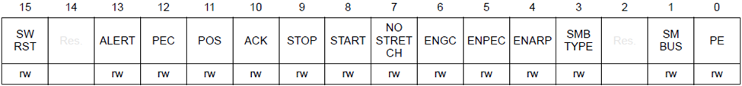
I2C_CR1 (Control 1) Register
Bit 15 SWRST: Software reset
When set, the I2C is under reset state. Before resetting this bit, make sure the I2C lines are
released and the bus is free.
0: I2C Peripheral not under reset
1: I2C Peripheral under reset state
Bit 10 ACK: Acknowledge enable
This bit is set and cleared by software and cleared by hardware when PE=0.
0: No acknowledge returned
1: Acknowledge returned after a byte is received (matched address or data)
Bit 9 STOP: Stop generation
The bit is set and cleared by software, cleared by hardware when a Stop condition is
detected, set by hardware when a timeout error is detected.
In Master Mode:
0: No Stop generation.
1: Stop generation after the current byte transfer or after the current Start condition is sent.
In Slave mode:
0: No Stop generation.
1: Release the SCL and SDA lines after the current byte transfer.
Bit 8 START: Start generation
This bit is set and cleared by software and cleared by hardware when start is sent or PE=0.
In Master Mode:
0: No Start generation
1: Repeated start generation
In Slave mode:
0: No Start generation
1: Start generation when the bus is free
Bit 0 PE: Peripheral enable
0: Peripheral disable
1: Peripheral enable

Slide 17
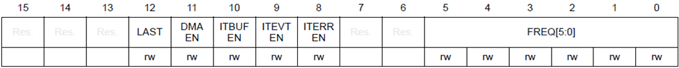
I2C_CR2 (Control 2) Register
Bits 5:0 FREQ[5:0]: Peripheral clock frequency
The FREQ bits must be configured with the APB clock frequency value (I2C peripheral
connected to APB). The FREQ field is used by the peripheral to generate data setup and
hold times compliant with the I2C specifications. The minimum allowed frequency is 2
MHz,
the maximum frequency is limited by the maximum APB frequency (42 MHz) and cannot
exceed 50 MHz (peripheral intrinsic maximum limit).
0b000000: Not allowed
0b000001: Not allowed
0b000010: 2 MHz
...
0b110010: 50 MHz
Higher than 0b101010: Not allowed

Slide 18
I2C Clock Control register (I2C_CCR)
Bit 15 F/S: I2C master mode selection
0: Sm mode I2C
1: Fm mode I2C
Bit 14 DUTY: Fm mode duty cycle
0: Fm mode t_{low}/t_{high} = 2
1: Fm mode t_{low}/t_{high} = 16/9 (see CCR)
Bits 13:12 Reserved, must be kept at reset value
Bits 11:0 CCR[11:0]: Clock control register in Fm/Sm mode (Master mode)
Controls the SCL clock in master mode.
Sm mode or SMBus:
Thigh = CCR * T_{PCLK1}
Tlow = CCR * T_{PCLK1}

Slide 19
I2C Frequency Selection in I2C_CR2 Register
FREQ[5:0] in binary | Allowed Freq
000000 | Not allowed
000001 | Not allowed
000010 | 2 MHz (minimum acceptable for Standard mode)
000011 | 3 MHz
000100 | 4 MHz (minimum acceptable for Fast mode)
000101 | 5 MHz
000110 | 6 MHz
000111 | 7 MHz
001000 | 8 MHz
...
…
010000 | 16 MHz
...
…
110010 | 50 MHz
Higher than 0b100100: Not allowed

Slide 20
I2C TRISE register (I2C_TRISE)
Bits 15:6 Reserved, must be kept at reset value
Bits 5:0 TRISE[5:0]: Maximum rise time in Fm/Sm mode (Master mode)
These bits should provide the maximum duration of the SCL feedback loop in master mode.
The purpose is to keep a stable SCL frequency whatever the SCL rising edge duration.
These bits must be programmed with the maximum SCL rise time given in the I2C bus
specification, incremented by 1.

Slide 21
I2C_DR (Data Register) for Transmit/Receive Buffer Register
Bits 7:0 DR[7:0] 8-bit data register
Byte received or to be transmitted to the bus.
– Transmitter mode: Byte transmission starts automatically when a byte is written in the
DR register. A continuous transmit stream can be maintained if the next data to be
transmitted is put in DR once the transmission is started (TxE=1)
– Receiver mode: Received byte is copied into DR (RxNE=1). A continuous transmit
Stream can be maintained if DR is read before the next data byte is received (RxNE=1).

Slide 22
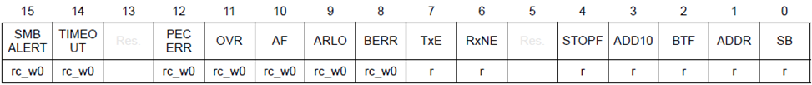
I2C Status Register 1 (I2C_SR1)

Slide 23
I2C Status Register 1(I2C_SR1) Bit Description
Bits | Field | Description
7 | TxE | Data register empty (transmitter) This is set when the transmit data register is empty and a byte of data can be written into the data register 0: Data register not empty 1: Data register empty
6 | RxNE | Data register not empty (receiver) This is set when a byte is received in receive mode 0: Data register empty 1: Data register not empty
2 | BTF | Byte transfer finished In transmit mode, it is set when all the data are transmitted. The program should wait until this bit is set before issuing a stop condition. In receive mode, it is set when a byte of data is received. The program should wait until this bit is set before reading from the data register. 0: data byte transfer not done 1: data byte transfer succeeded

Slide 24
I2C pins in STM32F4xx (See Appendix B full listing)
Pin | Function
PB6 | I2C1_SCL
PB7 | I2C1_SDA
PB8 | I2C1_SCL
PB9 | I2C1_SDA
PB10 | I2C2_SCL
PB11 | I2C2_SDA
PA8 | I2C3_SCL
PC9 | I2C3_SDA

Slide 25
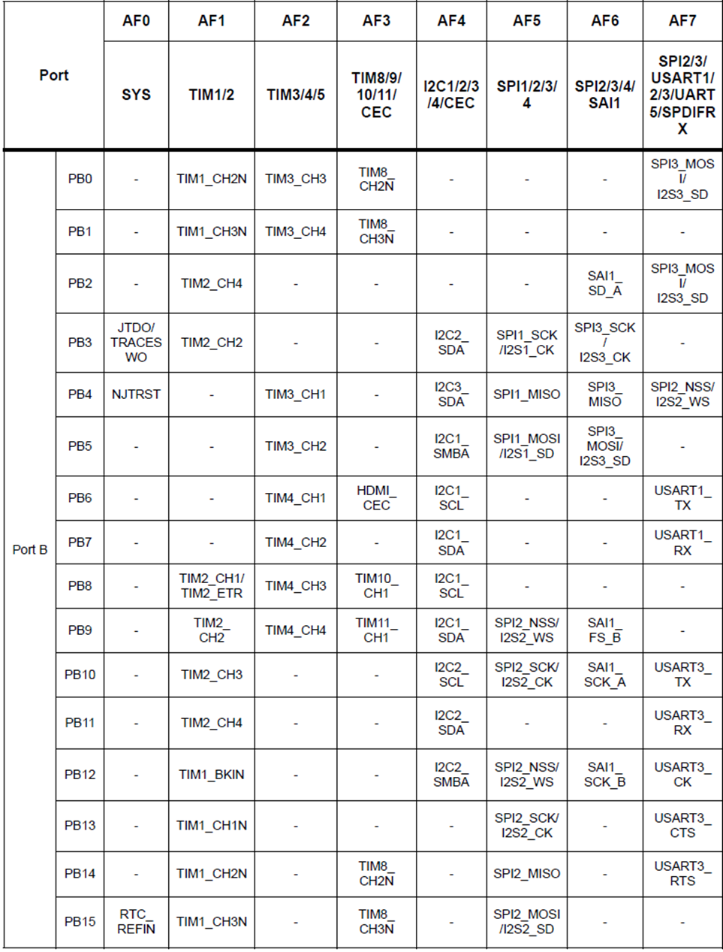
Alternative pin function multiplexing (See Appendix B for full List)

Slide 26
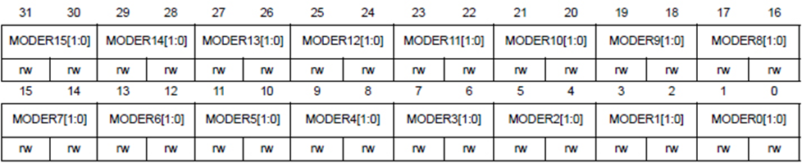
GPIOx_MODER Register Options
Bits 2y:2y+1 MODERy[1:0]: Port x configuration bits (y = 0..15)
These bits are written by software to configure the I/O direction mode.
00: Input (reset state)
01: General purpose output mode
10: Alternate function mode
11: Analog mode

Slide 27
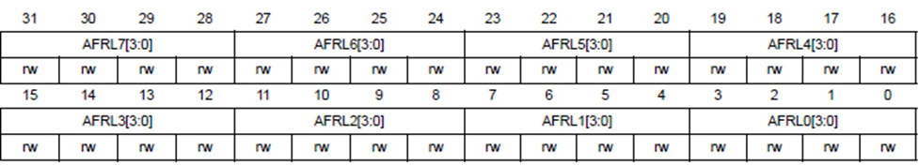
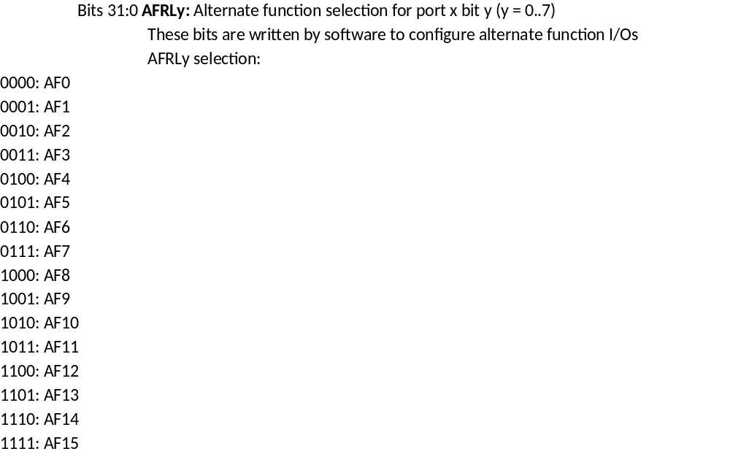
AFRL Register

Slide 28
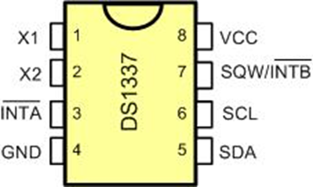
DS1337 Pins

Slide 29
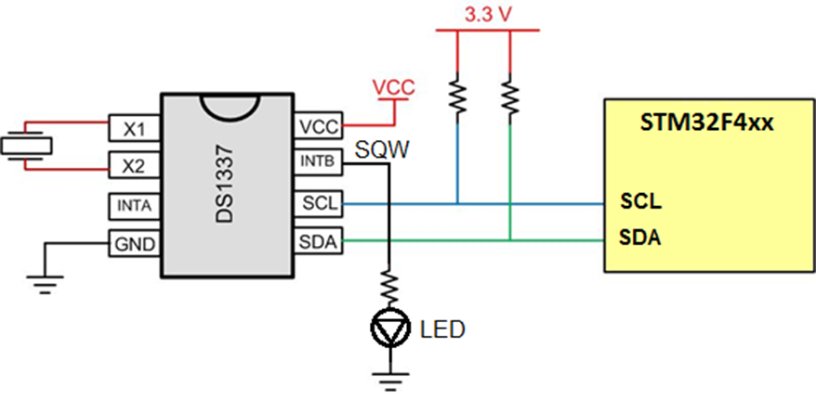
STM32F4xx Connections to RTC

Slide 30
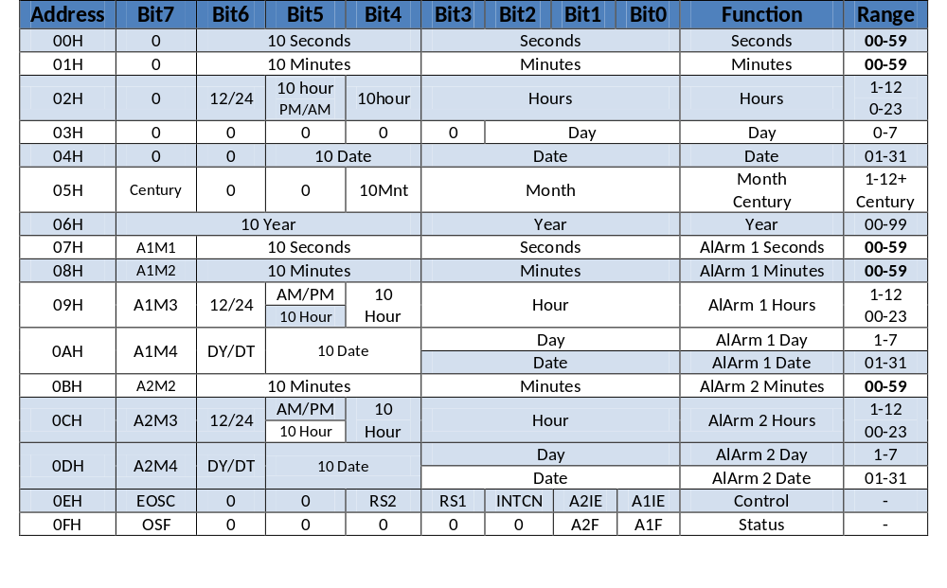
DS1337 Address Map

Slide 31
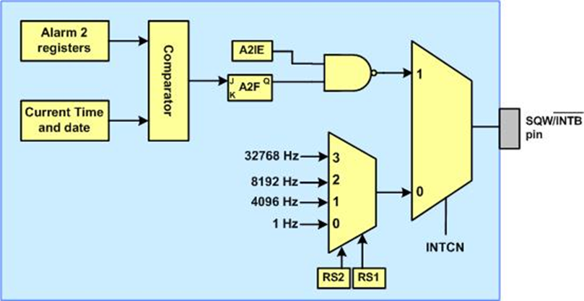
Simplified Structure of SQW/INTB Pin

Slide 32
RS bits
RS2 | RS1 | Output Frequency
0 | 0 | 1 Hz
0 | 1 | 4.096 kHz
1 | 0 | 8.192 kHz
1 | 1 | 32.768 kHz

Slide 33
Alarm 2 Register Mask Bits
DY/DT | A2M4 | A2M3 | A2M2 | Alarm Rate
X | 1 | 1 | 1 | Alarm once per minute
X | 1 | 1 | 0 | Alarm when minutes match
X | 1 | 0 | 0 | Alarm when hours and minutes match
0 | 0 | 0 | 0 | Alarm when date, hours, and minutes match
1 | 0 | 0 | 0 | Alarm when day, hours, and minutes match

