Slide 1
Chapter 3
LCD and Keyboard Interfacing

Slide 2
Pin Descriptions for LCD
Pin | Symbol | I/O | Description
1 | VSS | -- | Ground
2 | VCC | -- | +5V power supply
3 | VEE | -- | Power supply to control contrast
4 | RS | I | RS = 0 to select command register, RS = 1 to select data register
5 | R/W | I | R/W = 0 for write, R/W = 1 for read
6 | E | I | Enable
7 | DB0 | I/O | The 8-bit data bus
8 | DB1 | I/O | The 8-bit data bus
9 | DB2 | I/O | The 8-bit data bus
10 | DB3 | I/O | The 8-bit data bus
11 | DB4 | I/O | The 4/8-bit data bus
12 | DB5 | I/O | The 4/8-bit data bus
13 | DB6 | I/O | The 4/8-bit data bus
14 | DB7 | I/O | The 4/8-bit data bus

Slide 3
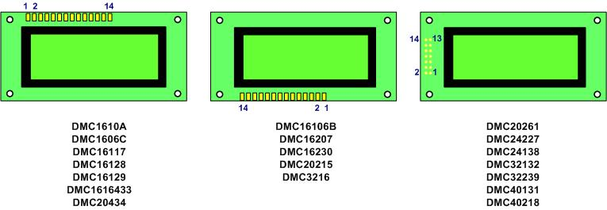
Pin Positions for Various LCDs from Optrex

Slide 4
Some commonly used LCD Command Codes
Code (Hex) | Command to LCD Instruction Register
1 | Clear display screen
2 | Return cursor home
6 | Increment cursor (shift cursor to right)
F | Display on, cursor blinking
80 | Force cursor to beginning of 1st line
C0 | Force cursor to beginning of 2nd line
38 | 2 lines and 5x7 character (8-bit data, D0 to D7)
28 | 2 lines and 5x7 character (4-bit data, D4 to D7)

Slide 5
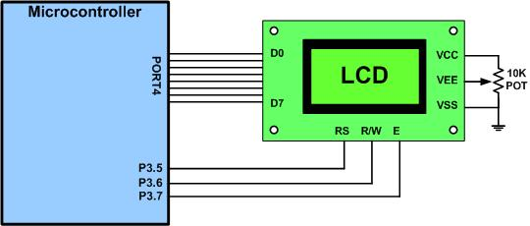
LCD Connection to Microcontroller

Slide 6
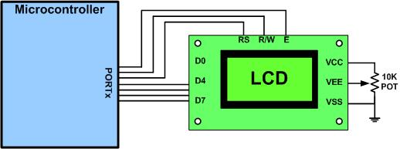
LCD Connection for 4-bit Data

Slide 7
LCD Addressing Commands
 | DB7 | DB6 | DB5 | DB4 | DB3 | DB2 | DB1 | DB0
Line 1 (min) | 1 | 0 | 0 | 0 | 0 | 0 | 0 | 0
Line 1 (max) | 1 | 0 | 1 | 0 | 0 | 1 | 1 | 1
Line 2 (min) | 1 | 1 | 0 | 0 | 0 | 0 | 0 | 0
Line 2 (max) | 1 | 1 | 1 | 0 | 0 | 1 | 1 | 1

Slide 8
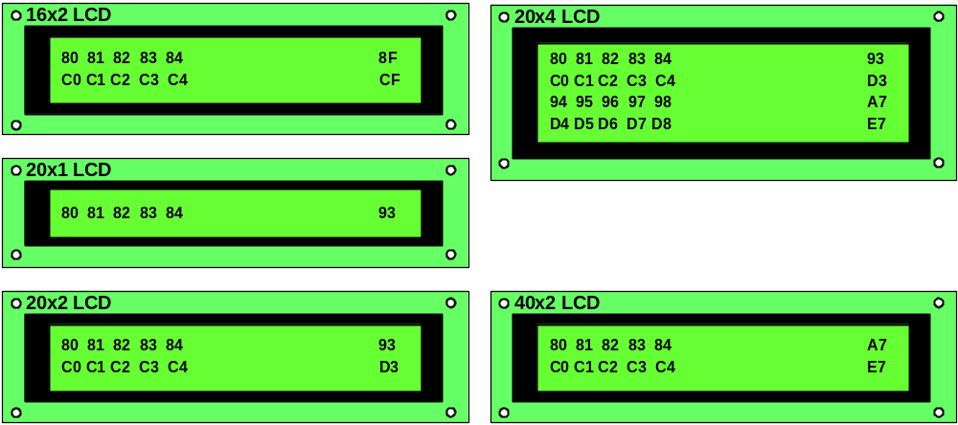
Cursor Addresses for Some LCDs

Slide 9
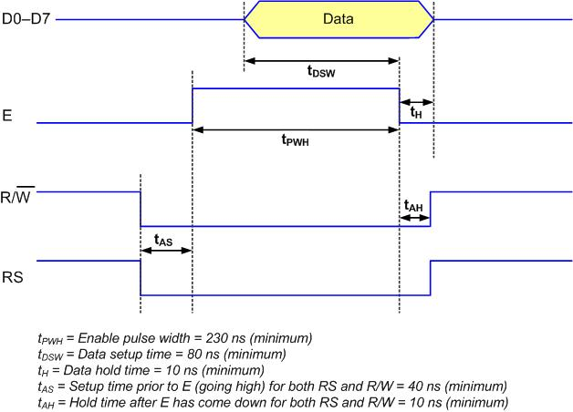
LCD Write Timing

Slide 10
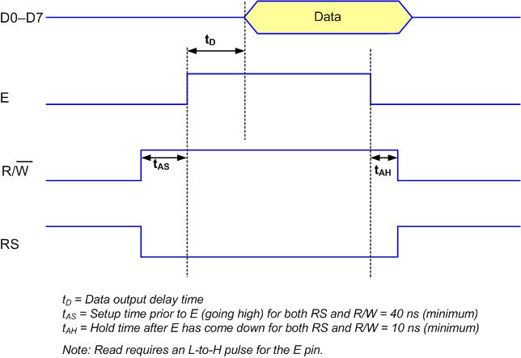
LCD Read Timing

Slide 11
List of LCD Instructions
Instruction | RS | R/W | DB7 | DB6 | DB5 | DB4 | DB3 | DB2 | DB1 | DB0 | Description | Execution Time (Max)
Clear display | 0 | 0 | 0 | 0 | 0 | 0 | 0 | 0 | 0 | 1 | Clears entire display and sets DD RAM address 0 in address counter | 1.64 ms
Return Home | 0 | 0 | 0 | 0 | 0 | 0 | 0 | 0 | 1 | - | Sets DD RAM address to 0 as address counter. Also returns display being shifted to original positions. DD RAM contents remain unchanged. | 1.64 ms
Entry Mode Set | 0 | 0 | 0 | 0 | 0 | 0 | 0 | 1 | I/D | S | Sets cursor move direction and specifies shift of display. These operations are performed during data write and read. | 40µs
Display On/Off Control | 0 | 0 | 0 | 0 | 0 | 0 | 1 | D | C | B | Sets On/Off of entire display (D), cursor On/Off (C), and blink of cursor position character (B). | 40µs
Cursor or Display shift | 0 | 0 | 0 | 0 | 0 | 1 | S/C | R/L | - | - | Moves cursor and shifts display without changing DD RAM contents. | 40µs
Function Set | 0 | 0 | 0 | 0 | 1 | DL | N | F | - | - | Sets interface data length (DL), number of display lines (L), and character font (F) | 40µs
Set CG RAM Address | 0 | 0 | 0 | 1 | AGC |  |  |  |  |  | Sets CG RAM address. CG RAM data is sent and received after this setting. | 40µs
Set DD RAM Address | 0 | 0 | 1 | ADD |  |  |  |  |  |  | Sets DD RAM address. DD RAM data is sent and received after this setting. | 40µs
Read Busy Flag & Address | 0 | 1 | BF | AC |  |  |  |  |  |  | Reads Busy flag (BF) indicating internal operation is being performed and reads address counter contents. | 40µs
Write Data CG or DD RAM | 1 | 0 | Write Data |  |  |  |  |  |  |  | Writes data into DD or CG RAM. | 40µs
Read Data CG or DD RAM | 1 | 1 | Read Data |  |  |  |  |  |  |  | Reads data from DD or CG RAM. | 40µs

Slide 12
List of LCD Instructions (Abbreviations)
DD RAM: Display data RAM
CG RAM: Character generator RAM
AGC: CG RAM address
ADD: DD RAM address, corresponds to cursor address
AC: address counter used for both DD and CG RAM addresses
I/D: 1 = Increment, 0: Decrement
S =1: Accompanies display shift
S/C: 1 = Display shift, 0: Cursor move
R/L: 1: Shift to the right, 0: Shift to the left
DL: 1 = 8 bits, 0 = 4 bits
N: 1 = 2-line, 0 = 1-line
F: 1 = 5 x 10 dots, 0 = 5 x 7 dots
BF: 1 = Internal operation, 0 = Can accept instruction

Slide 13
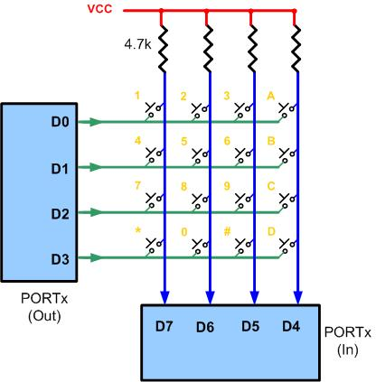
Matrix Keyboard Connection to Ports

Slide 14
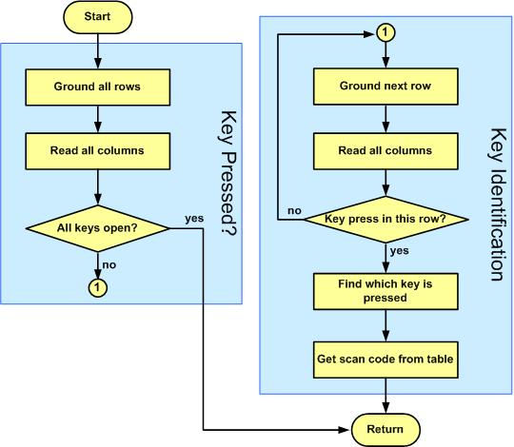
The Flowchart for Key Press Detection and Identification

Slide 15
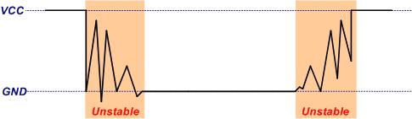
Switch contact bounces

