Slide 1
Chapter 8
SPI Protocol and DAC Interfacing

Slide 2
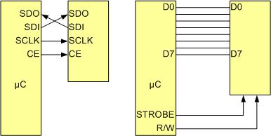
SPI Bus vs. Traditional Parallel Bus Connection to Microcontroller

Slide 3
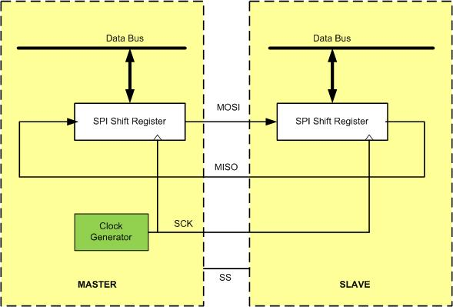
SPI Architecture

Slide 4
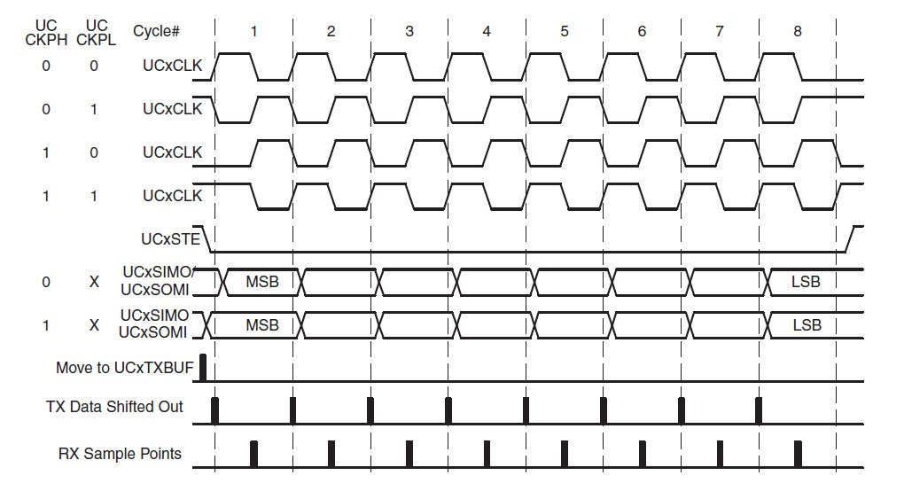
SPI Clock Polarity and phase

Slide 5
SPI Clock Polarity and phase
Clock Polarity | Clock Phase | Data read and change time | SPI Mode
0 | 0 | read on falling edge, changed on a rising edge | 0
0 | 1 | read on rising edge, changed on a falling edge | 1
1 | 0 | read on rising edge, changed on a falling edge | 2
1 | 1 | read on falling edge, changed on a rising edge | 3

Slide 6
SSI Module Base Address
SSI Module | Base Address
SSI0 | 0x40008000
SSI1 | 0x40009000
SSI2 | 0x4000A000
SSI3 | 0x4000B000

Slide 7

RCGCSSI, Offset 0x61C

Slide 8
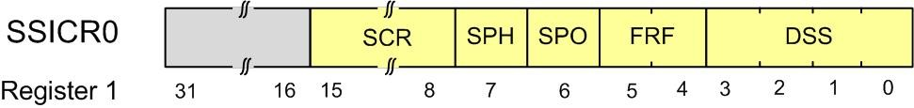
SSICR0, Offset 0

Slide 9
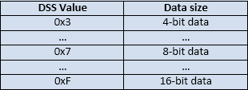
eUSCI Registers
Bits | Name | Function | Description
0-3 | DSS | SSI Data Size Select | 0x03 to 0x0F for 4-bit to 16-bit data size 0x07 means 8-bit data size
4-5 | FRF | SSI Frame Format Select | 0 for SPI, 1 for TI, and 2 for MICROWIRE frame format
6 | SPO | SSI Serial Clock Polarity | Clock polarity
7 | SPH | SSI Serial Clock Phase | Clock phase
8-15 | SCR | SSI Serial Clock Rate | BR=SysClk/(CPSDVSR * (1 + SCR))

Slide 10
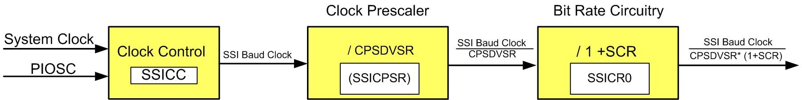
Bit Rate selection

Slide 11

Register 5, SSI Clock Prescale (SSICPSR), offset 0x010

Slide 12
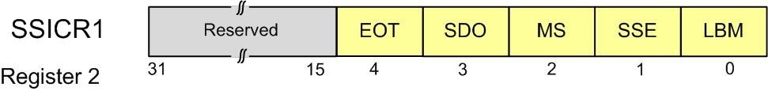
Register 2, SSI Control 1 (SSICR1), offset 0x004

Slide 13

SSIDR register

Slide 14
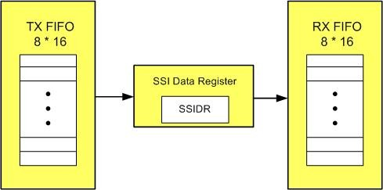
Register 3, SSI Data (SSIDR), offset 0x008

Slide 15

Register 4, SSI Status (SSISR), offset 0x00C

Slide 16
SSI Status (SSISR)
Bits | Name | Function | Description
0 | TFE | SSI Transmit FIFO Empty | The bit is 1 when the transmit FIFO is empty
1 | TNF | SSI Transmit FIFO Not Full | The bit is 1 when the SSI transmit FIFO not full
2 | RNE | SSI Receive FIFO Not Empty | The bit is 1 when the receive FIFO is not empty
3 | RFF | SSI Receive FIFO Full | The bit is 1 when the receive FIFO is full
4 | BSY | SSI Busy Bit | The bit is 1 when the SSI is currently transmitting or receiving

Slide 17
GPIO Pin Assignment for all 4 SSI Modules
SSI Module Pin | GPIO Pin | SSI Module Pin | GPIO Pin
SSI0Clk | PA2 | SSI2Clk | PB4
SSI0Fss | PA3 | SSI2Fss | PB5
SSI0Rx | PA4 | SSI2Rx | PB6
SSI0Tx | PA5 | SSI2TX | PB7
SSI1Clk | PD0 or PF2 | SSI3Clk | PD0
SSI1Fss | PD1 or PF3 | SSI3Fss | PD1
SSI1Rx | PD2 or PF0 | SSI3Rx | PD2
SSI1TX | PD3 or PF1 | SSI3TX | PD3

Slide 18
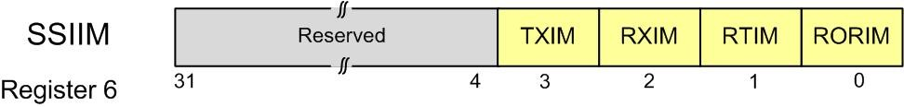
Register 6, SSIIM

Slide 19
Register 6, SSIIM
Bits | Name | Function | Description
0 | RORIM | SSI Receive Overrun Interrupt Mask | The receive FIFO overrun interrupt is masked when RORIM is zero and not masked when it is one
1 | RTIM | SSI Receive Time-Out Interrupt Mask | The receive FIFO time-out interrupt is masked when RTIM is zero and not masked when it is one
2 | RXIM | SSI Receive FIFO Interrupt Mask | The receive FIFO interrupt is masked when RXIM is zero and not masked when it is one
3 | TXIM | SSI Transmit FIFO Interrupt Mask | The transmit FIFO interrupt is masked when TXIM is zero and not masked when it is one

Slide 20
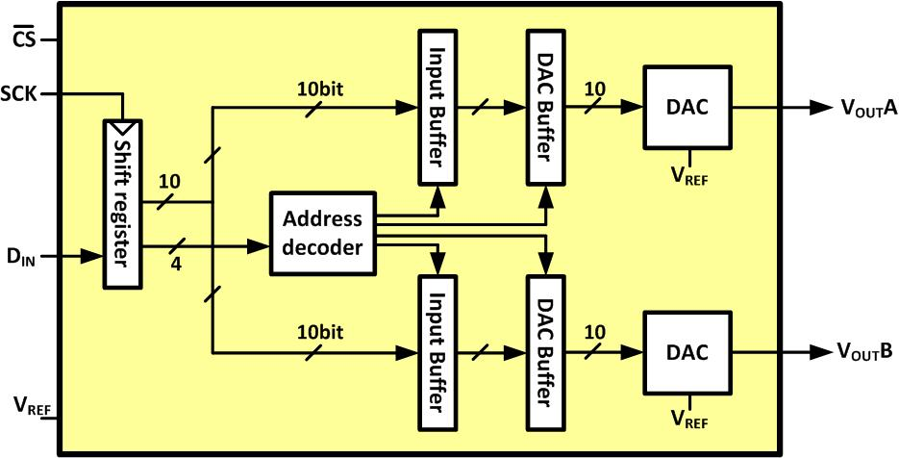
LTC1661 Internal Block Diagram

Slide 21
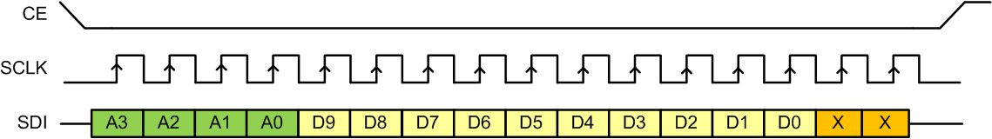
Sending a Packet of Data to LTC166x

Slide 22
LTC1661 DAC Control Functions
A3 A2 A1 A0 | Interrupt Register | DAC Register | Power Down Status | Comments
0 0 0 0 | No Change | No Update | No Change | No operation. power-down status unchanged
0 0 0 1 | Load DAC A | No Update | No Change | Load input register A with data. DAC outputs unchanged. power-down Status unchanged
0 0 1 0 | Load DAC B | No Update | No Change | Load input register B with data. DAC outputs unchanged. power-down status unchanged
0 0 1 1 | - | - | - | Reserved
0 1 0 0 | - | - | - | Reserved
0 1 0 1 | - | - | - | Reserved

Slide 23
LTC1661 DAC Control Functions (Cont.)
A3 A2 A1 A0 | Interrupt Register | DAC Register | Power Down Status | Comments
0 1 1 0 | - | - | - | Reserved
0 1 1 1 | - | - | - | Reserved
1 0 0 0 | No Change | Update Outputs | Wake | Load both DAC Regs with existing contents of input Regs. Outputs update. Part wakes up
1 0 0 1 | Load DAC A | Update Outputs | Wake | Load input Reg A. Load DAC Regs with new contents of input Reg A and existing contents of Reg B. Outputs update.
1 0 1 0 | Load DAC B | Update Outputs | Wake | Load input Reg B. Load DAC Regs with existing contentsof input Reg A and new contents of Reg B. Outputs update

Slide 24
LTC1661 DAC Control Functions (Cont.)
A3 A2 A1 A0 | Interrupt Register | DAC Register | Power Down Status | Comments
1 0 1 1 | - | - | - | Reserved
1 1 0 0 | - | - | - | Reserved
1 1 0 1 | No Change | No Update | Wake | Part wakes up. Input and DAC Regs unchanged. DAC outputs reflect existing contents of DAC Regs
1 1 1 0 | No Change | No Update | Sleep | Part goes to sleep. Input and DAC Regs unchanged. DAC outputs set to high impedance state
1 1 1 1 | Load ADCs A, B with same 10-bit code | Update Outputs | Wake | Load both input Regs. Load both DAC Regs with new contents of input Regs. Outputs update. Part wakes up

Slide 25
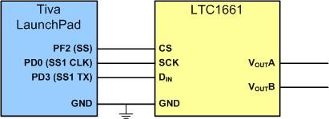
Connecting LTC1661 to the Microcontroller

Slide 26
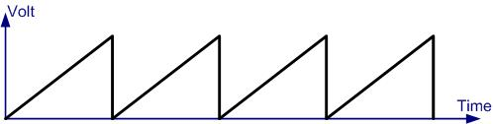
The Generated sawTooth waveform

