Slide 1
Chapter 1
I/O Programming with Arduino

Slide 2
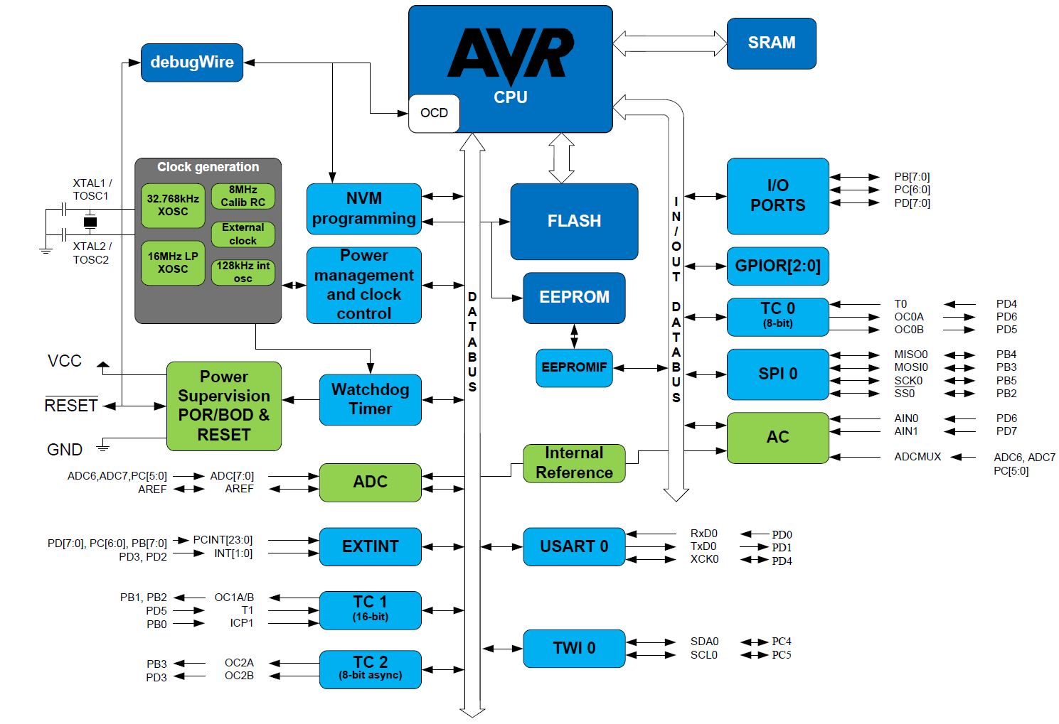
AVR ATmega328 Microcontroller High-Level Block Diagram

Slide 3
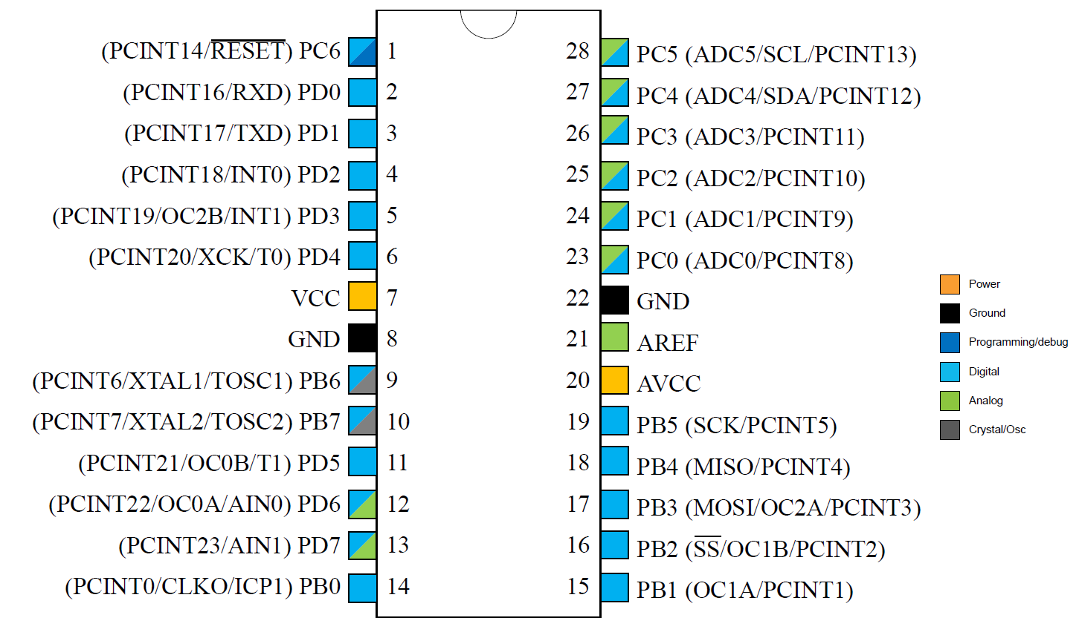
AVR ATmega328 28-pin Package Pin-out

Slide 4
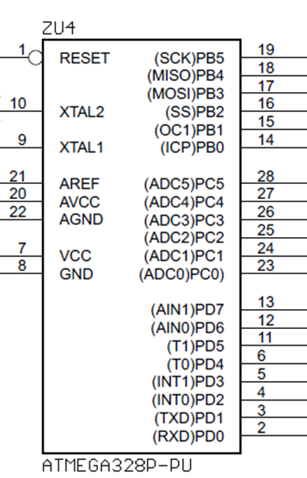
ATmega328 Pin-out

Slide 5
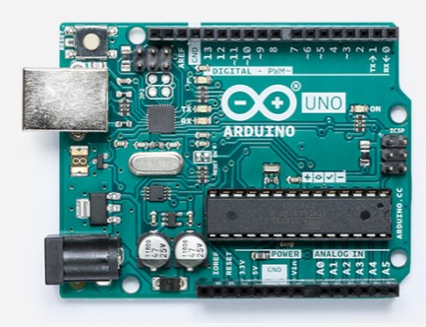
Arduino board from https://store.arduino.cc/usa/arduino-uno-rev3

Slide 6
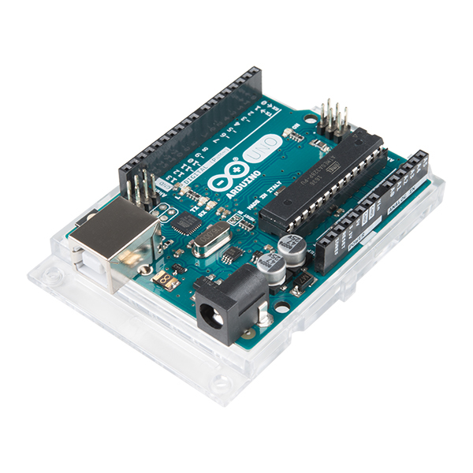
Arduino board https://store.arduino.cc/usa/arduino-uno-rev3

Slide 7
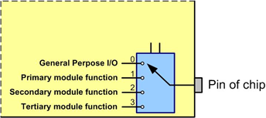
Alternate functions of a pin are selected by a multiplexer

Slide 8
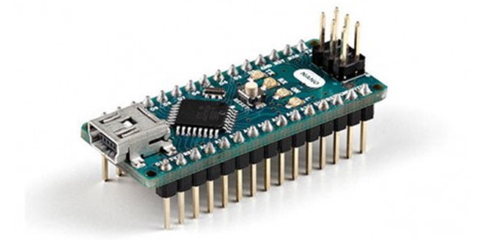
Arduino Nano board from https://store.arduino.cc/usa/arduino-nano

Slide 9
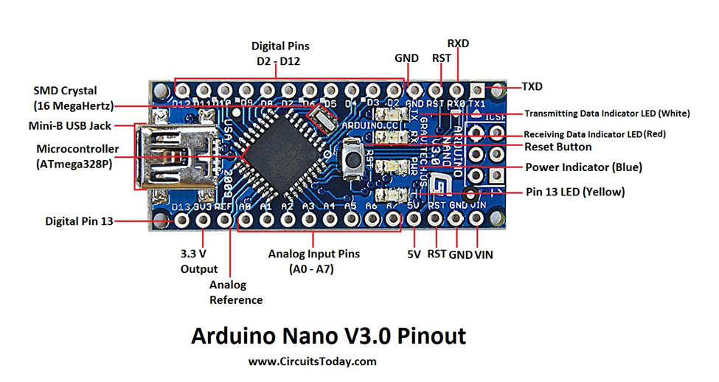
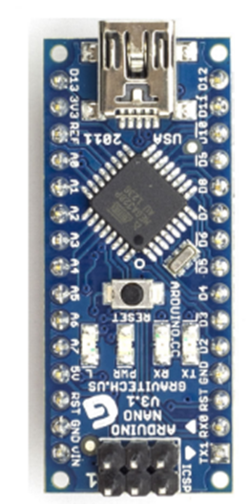
Arduino Nano Board

Slide 10
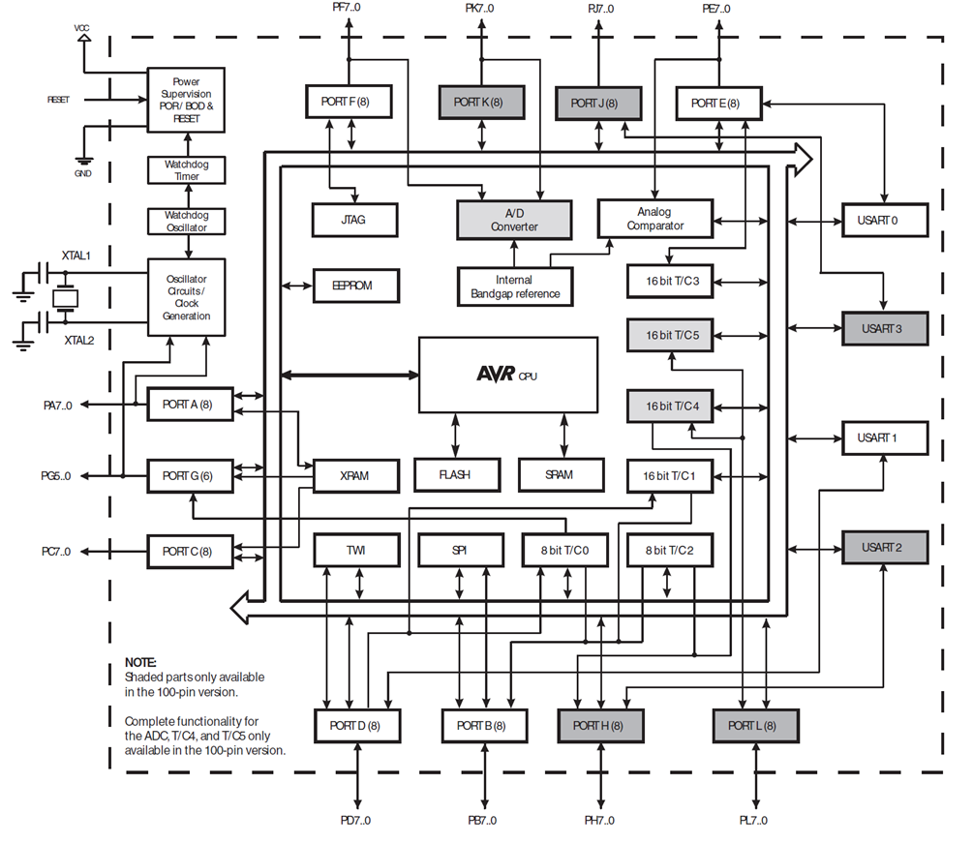
ATmega2560 Block Diagram

Slide 11
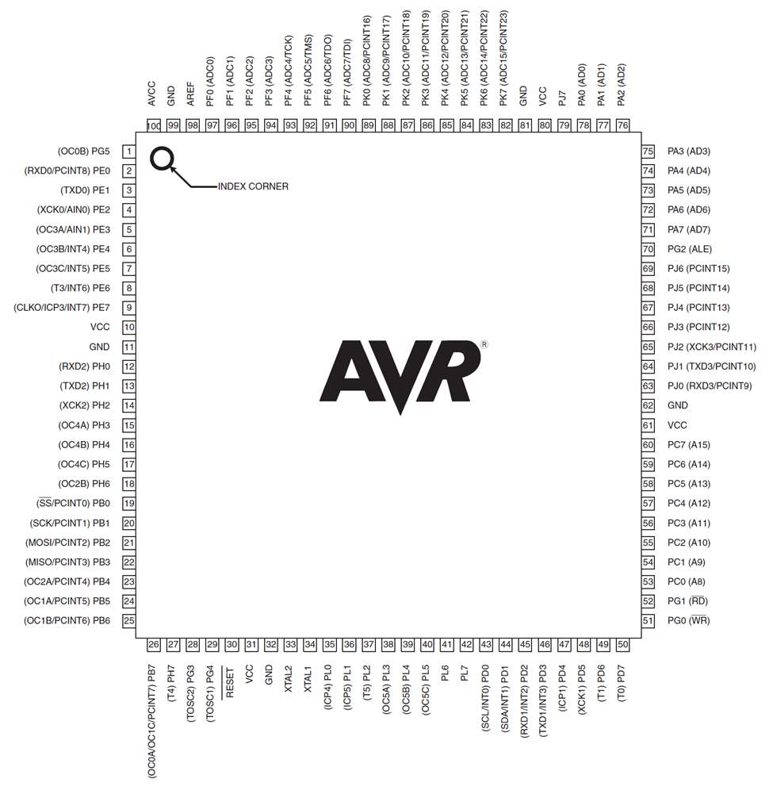
ATmega2560 pins

Slide 12
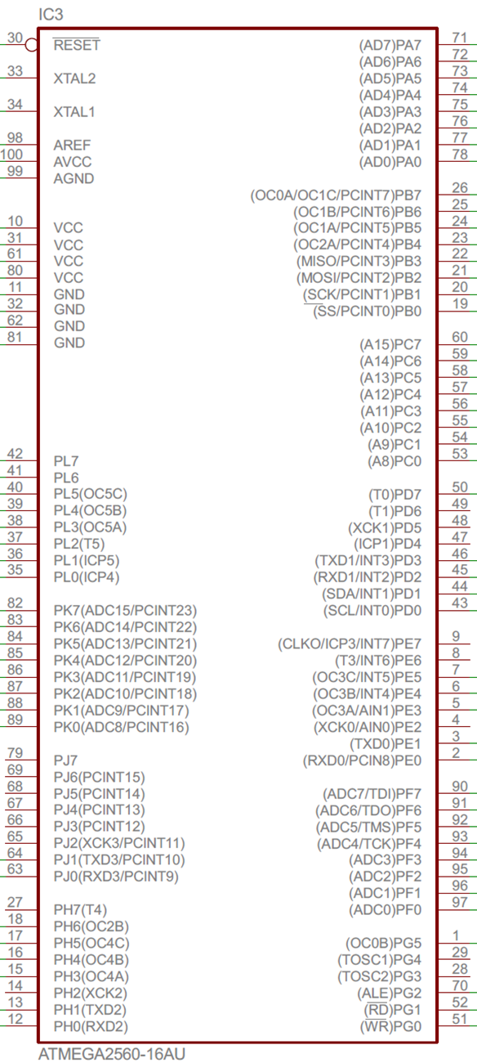
ATmega2560 Pin-out

Slide 13
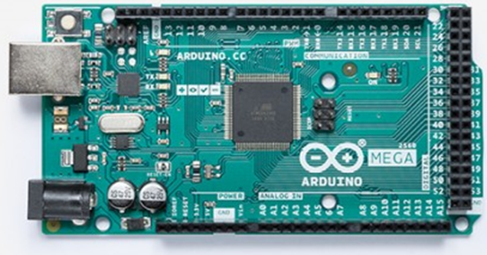
Arduino Mega Board

Slide 14
Some of the Atmel chips used in Arduino boards
Chip Number On-Chip Flash RAM I/O pins Pin numbers Arduino Board
ATmega16 16K 1K 14 28 Nano or Uno
ATmega328 32K 2K 14 28 Nano or Uno
ATmega2560 256K 4K 54 100 Mega

Slide 15
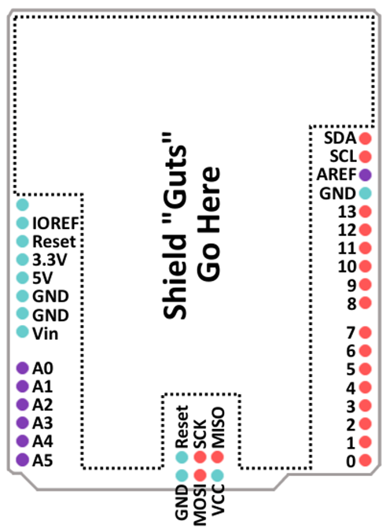
Arduino Uno Board Pin Map

Slide 16
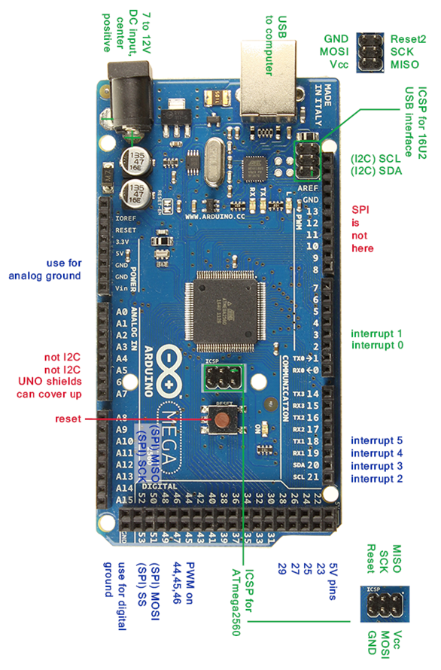
Arduino Mega Board Pin Map (From https://forum.arduino.cc/index.php?topic=125908.0)

Slide 17
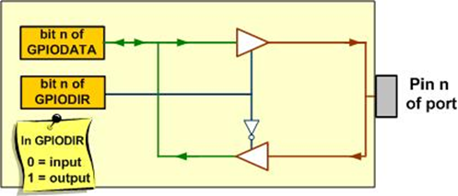
The Data and Direction Registers and a Simplified View of an I/O pin

Slide 18
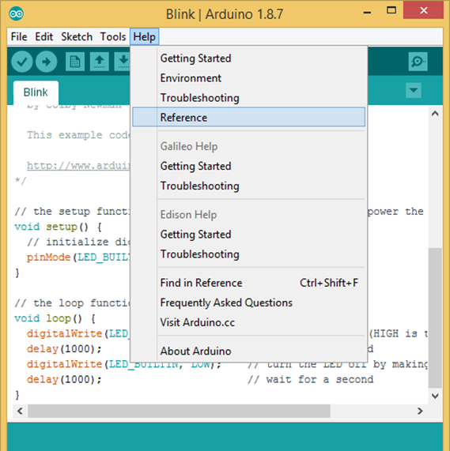
Accessing various commands in Arduino IDE Reference

Slide 19
Some Arduino Functions Used for I/O
Function | Description Syntax
pinMode(); | Designate the pin as OUTPUT or INPUT | pinMode(pin#, mode);
digitalWrite(); | Write a LOW or HIGH to a pin | digitalWrite(pin#, value);
digitalRead(); | Read the status of pin | digitalRead(pin#);
delay(); | Create a delay in millisecond | delay(ms);

Slide 20
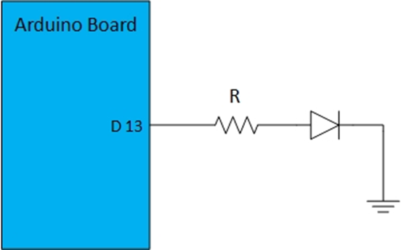
Built-in LED connected to digital pin 13

