Slide 1
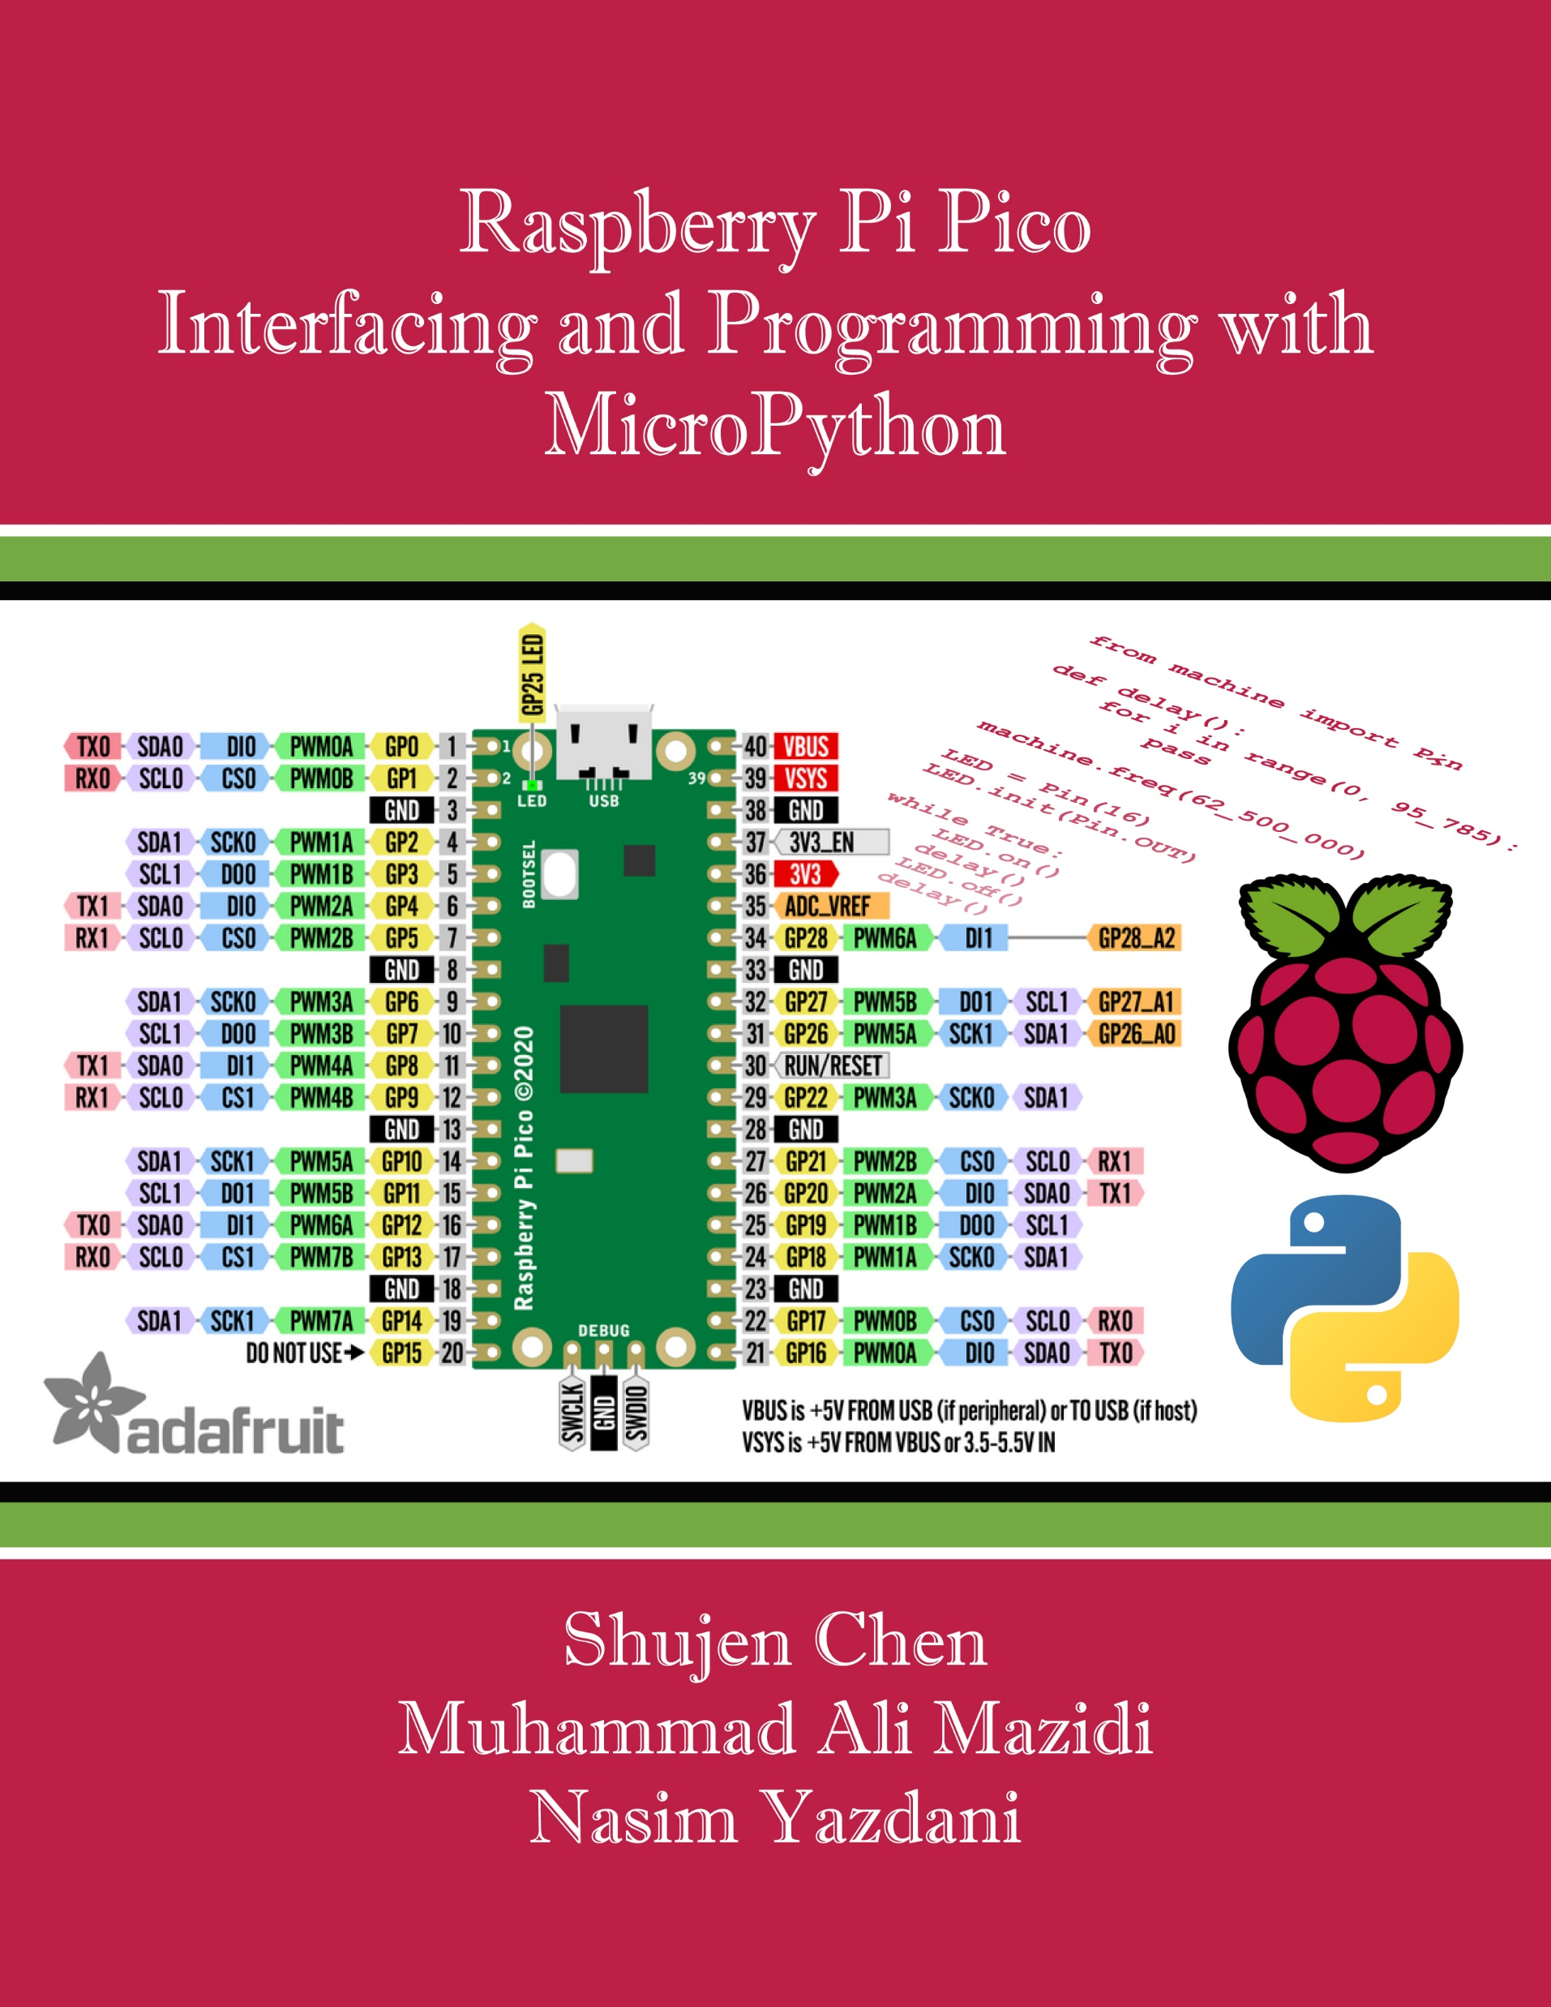
Appendix A:
Pico Pins and Block Diagram
Raspberry Pi Pico
Interfacing and Programming
with MicroPython
www.MicroDigitalEd.com

Slide 2
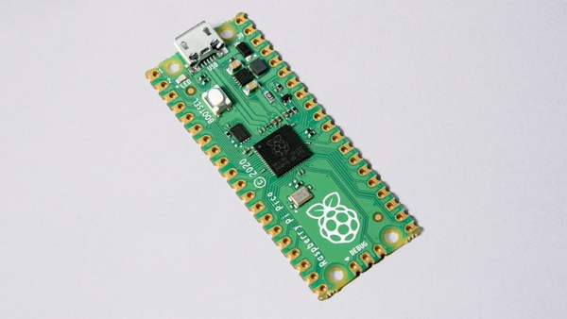
Figure A-1: Pico

Slide 3
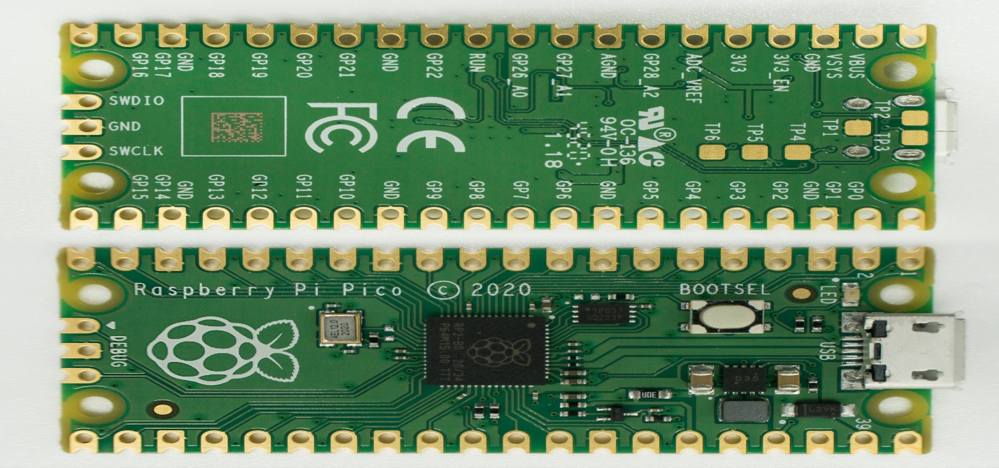
Figure A-2: Pico Board

Slide 4
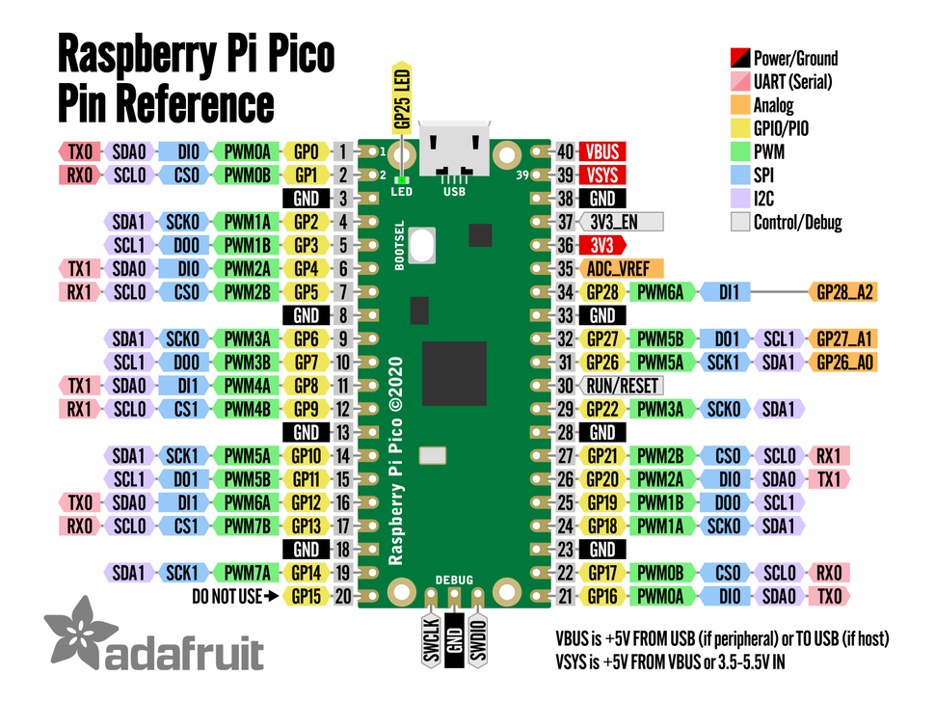
Figure A-3: Pico Pins

Slide 5
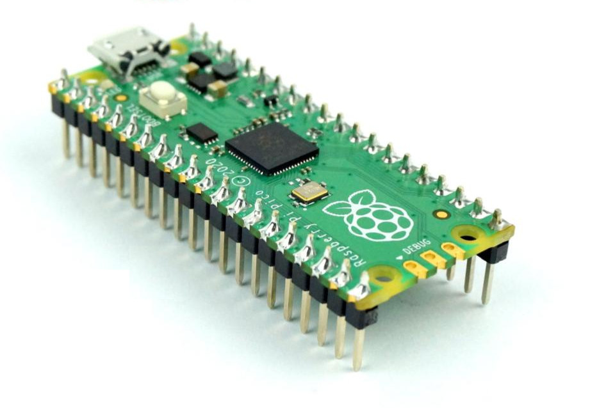
Figure A-4: Pico board with header

Slide 6
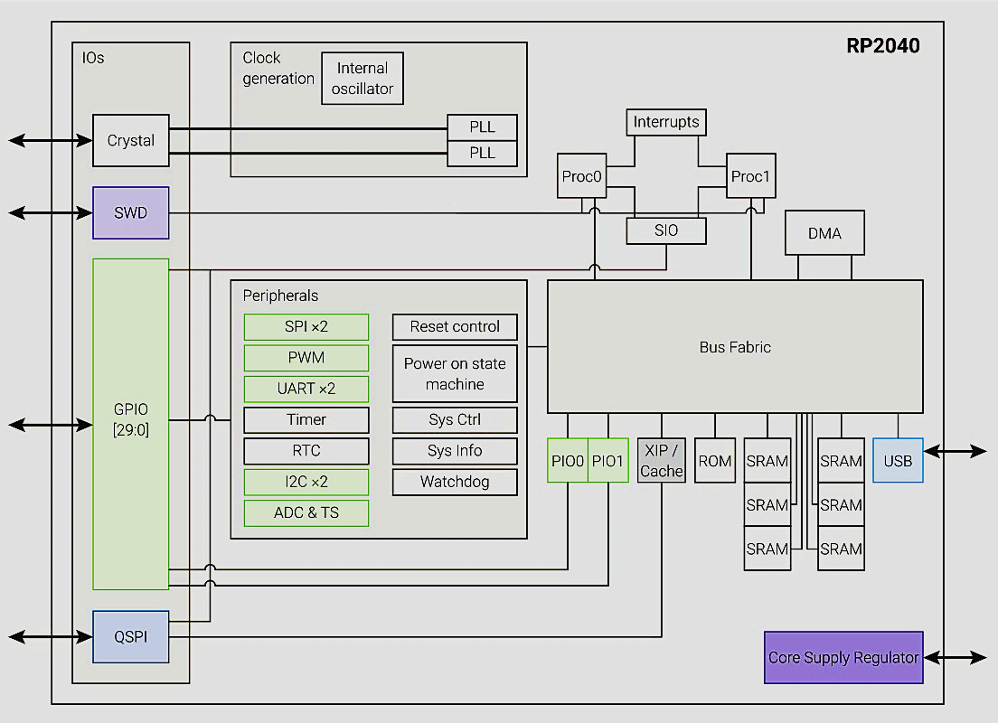
Figure A-5: RP2040 Microcontroller High-Level Block Diagram

Slide 7
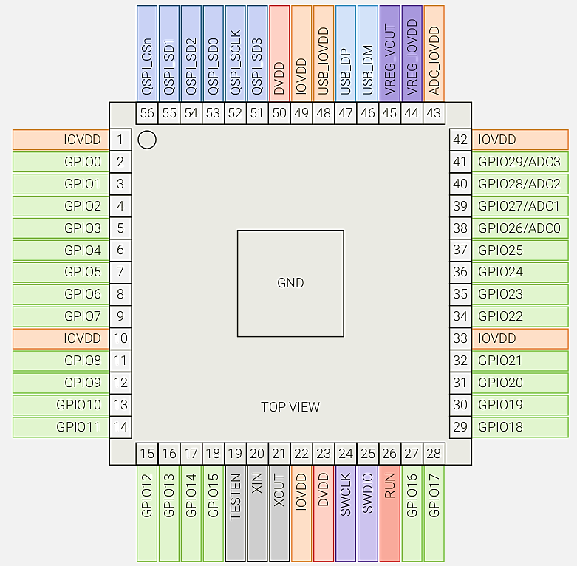
Figure A-6: RP2040 Pin-out

Slide 8
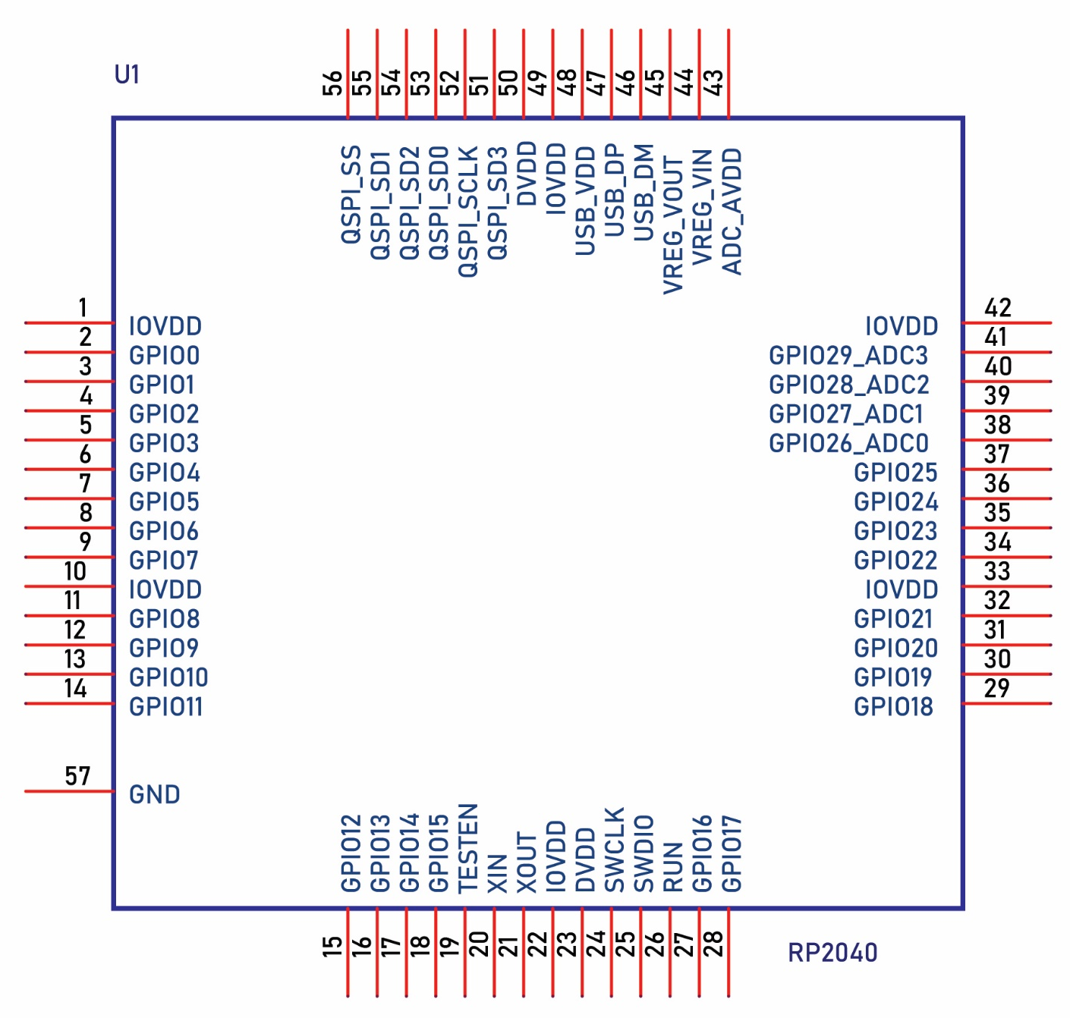
Figure A-7: RP2040 pin functions

Slide 9
Figure A-8: RP2040 GPIO Alternate Functions
 | Function
GPIO | F1 | F2 | F3 | F4 | F5 | F6 | F7 | F8 | F9
0 | SPI0 RX | UART0 TX | I2C0 SDA | PWM0 A | SIO | PIO0 | PIO1 |  | USB OVCUR DET
1 | SPI0 CSn | UART0 RX | I2C0 SCL | PWM0 B | SIO | PIO0 | PIO1 |  | USB VBUS DET
2 | SPI0 SCK | UART0 CTS | I2C1 SDA | PWM1 A | SIO | PIO0 | PIO1 |  | USB VBUS EN
3 | SPI0 TX | UART0 RTS | I2C1 SCL | PWM1 B | SIO | PIO0 | PIO1 |  | USB OVCUR DET
4 | SPI0 RX | UART1 TX | I2C0 SDA | PWM2 A | SIO | PIO0 | PIO1 |  | USB VBUS DET
5 | SPI0 CSn | UART1 RX | I2C0 SCL | PWM2 B | SIO | PIO0 | PIO1 |  | USB VBUS EN
6 | SPI0 SCK | UART1 CTS | I2C1 SDA | PWM3 A | SIO | PIO0 | PIO1 |  | USB OVCUR DET
7 | SPI0 TX | UART1 RTS | I2C1 SCL | PWM3 B | SIO | PIO0 | PIO1 |  | USB VBUS DET
8 | SPI1 RX | UART1 TX | I2C0 SDA | PWM4 A | SIO | PIO0 | PIO1 |  | USB VBUS EN
9 | SPI1 CSn | UART1 RX | I2C0 SCL | PWM4 B | SIO | PIO0 | PIO1 |  | USB OVCUR DET
10 | SPI1 SCK | UART1 CTS | I2C1 SDA | PWM5 A | SIO | PIO0 | PIO1 |  | USB VBUS DET
11 | SPI1 TX | UART1 RTS | I2C1 SCL | PWM5 B | SIO | PIO0 | PIO1 |  | USB VBUS EN
12 | SPI1 RX | UART0 TX | I2C0 SDA | PWM6 A | SIO | PIO0 | PIO1 |  | USB OVCUR DET
13 | SPI1 CSn | UART0 RX | I2C0 SCL | PWM6 B | SIO | PIO0 | PIO1 |  | USB VBUS DET
14 | SPI1 SCK | UART0 CTS | I2C1 SDA | PWM7 A | SIO | PIO0 | PIO1 |  | USB VBUS EN
15 | SPI1 TX | UART0 RTS | I2C1 SCL | PWM7 B | SIO | PIO0 | PIO1 |  | USB OVCUR DET
16 | SPI0 RX | UART0 TX | I2C0 SDA | PWM0 A | SIO | PIO0 | PIO1 |  | USB VBUS DET
17 | SPI0 CSn | UART0 RX | I2C0 SCL | PWM0 B | SIO | PIO0 | PIO1 |  | USB VBUS EN
18 | SPI0 SCK | UART0 CTS | I2C1 SDA | PWM1 A | SIO | PIO0 | PIO1 |  | USB OVCUR DET
19 | SPI0 TX | UART0 RTS | I2C1 SCL | PWM1 B | SIO | PIO0 | PIO1 |  | USB VBUS DET
20 | SPI0 RX | UART1 TX | I2C0 SDA | PWM2 A | SIO | PIO0 | PIO1 | CLOCK GPIN0 | USB VBUS EN
21 | SPI0 CSn | UART1 RX | I2C0 SCL | PWM2 B | SIO | PIO0 | PIO1 | CLOCK GPOUT0 | USB OVCUR DET
22 | SPI0 SCK | UART1 CTS | I2C1 SDA | PWM3 A | SIO | PIO0 | PIO1 | CLOCK GPIN1 | USB VBUS DET
23 | SPI0 TX | UART1 RTS | I2C1 SCL | PWM3 B | SIO | PIO0 | PIO1 | CLOCK GPOUT1 | USB VBUS EN
24 | SPI1 RX | UART1 TX | I2C0 SDA | PWM4 A | SIO | PIO0 | PIO1 | CLOCK GPOUT2 | USB OVCUR DET
25 | SPI1 CSn | UART1 RX | I2C0 SCL | PWM4 B | SIO | PIO0 | PIO1 | CLOCK GPOUT3 | USB VBUS DET
26 | SPI1 SCK | UART1 CTS | I2C1 SDA | PWM5 A | SIO | PIO0 | PIO1 |  | USB VBUS EN
27 | SPI1 TX | UART1 RTS | I2C1 SCL | PWM5 B | SIO | PIO0 | PIO1 |  | USB OVCUR DET
28 | SPI1 RX | UART0 TX | I2C0 SDA | PWM6 A | SIO | PIO0 | PIO1 |  | USB VBUS DET
29 | SPI1 CSn | UART0 RX | I2C0 SCL | PWM6 B | SIO | PIO0 | PIO1 |  | USB VBUS EN

