Slide 1

Appendix B:
UART, SPI, and I2C Serial Communication Protocols
Raspberry Pi Pico
Interfacing and Programming
with MicroPython
www.MicroDigitalEd.com

Slide 2
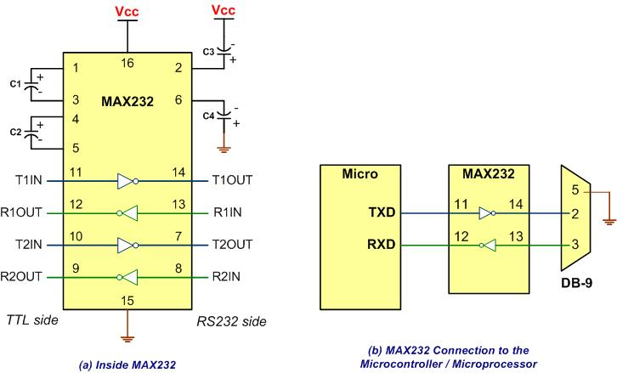
Figure B-1: MAX232

Slide 3
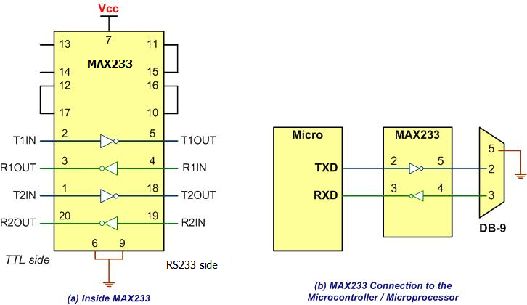
Figure B-2: MAX233

Slide 4
Table B-1: RS232 Pins
Pin | Description
1 | Data carrier detect (DCD)
2 | Received data (RxD)
3 | Transmitted data (TxD)
4 | Data terminal ready (DTR)
5 | Signal ground (GND)
6 | Data set ready (DSR)
7 | Request to send (RTS)
8 | Clear to send (CTS)
9 | Ring indicator (RI)

Slide 5
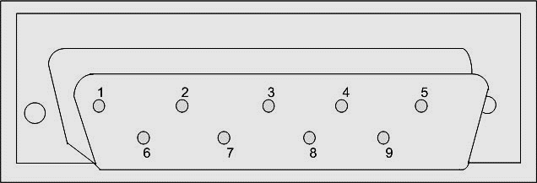
Figure B-3: 9-Pin Male Connector

Slide 6
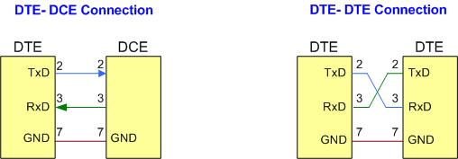
Figure B-4: DTE-DCE and DTE-DTE Connections

Slide 7
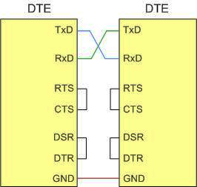
Figure B-5: Null Modem Connection with Flow Control Signals

Slide 8
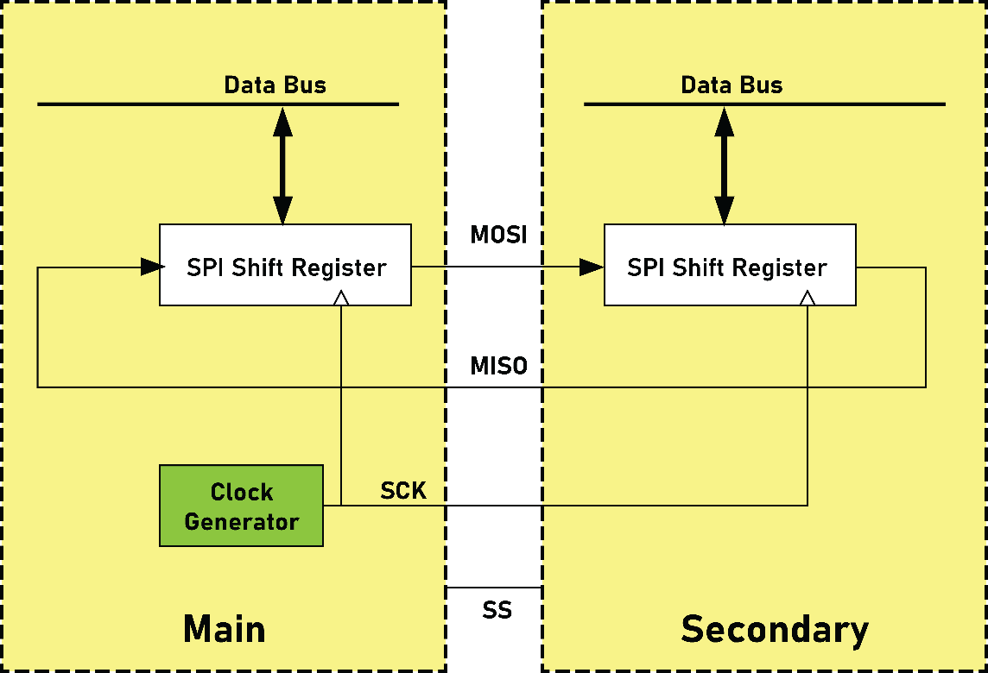
Figure B-6A: SPI Architecture

Slide 9
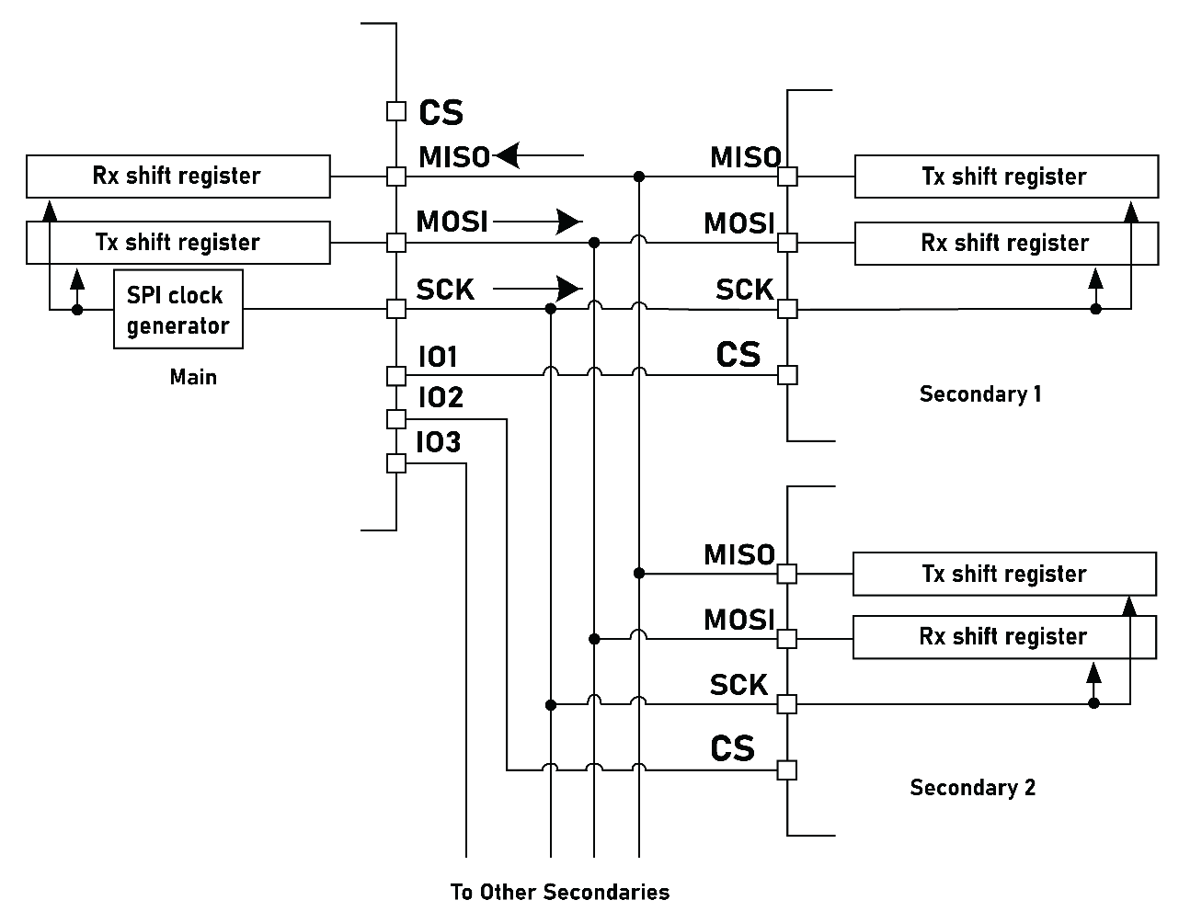
Figure B-6B: SPI Bus Connection to Multiple devices

Slide 10
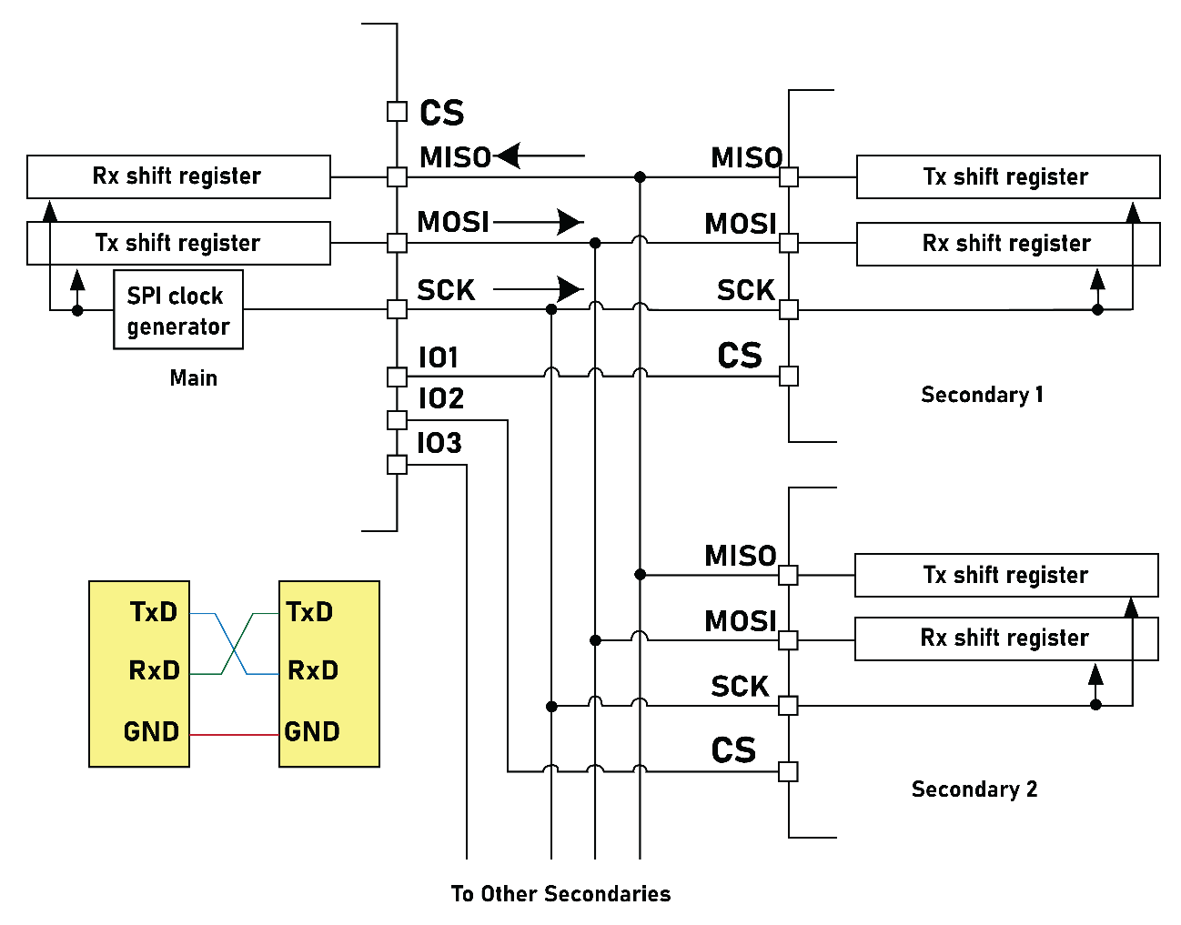
Figure B-6C: SPI and UART Comparison

Slide 11
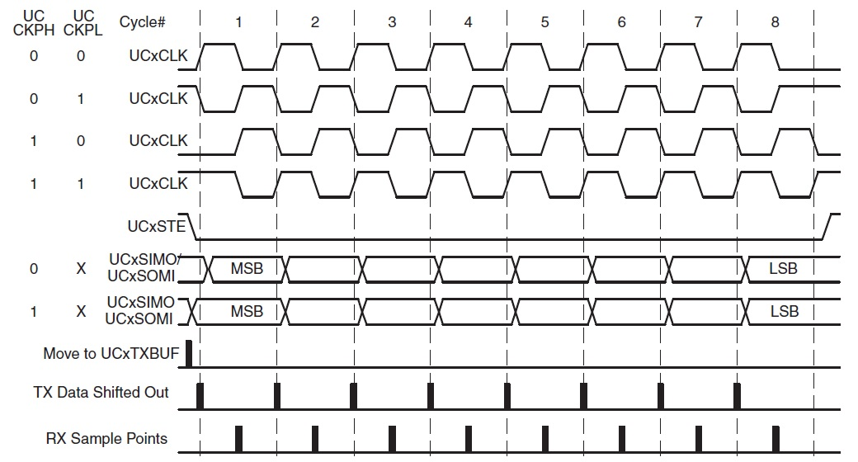
Figure B-7: SPI Clock Polarity and phase

Slide 12
Table B-2: SPI Clock Polarity and phase
Clock Polarity | Clock Phase | Data read and change time | SPI Mode
0 | 0 | read on falling edge, changed on a rising edge | 0
0 | 1 | read on rising edge, changed on a falling edge | 1
1 | 0 | read on rising edge, changed on a falling edge | 2
1 | 1 | read on falling edge, changed on a rising edge | 3

Slide 13
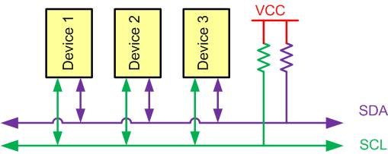
Figure B-8: I2C connection to multiple devices

Slide 14
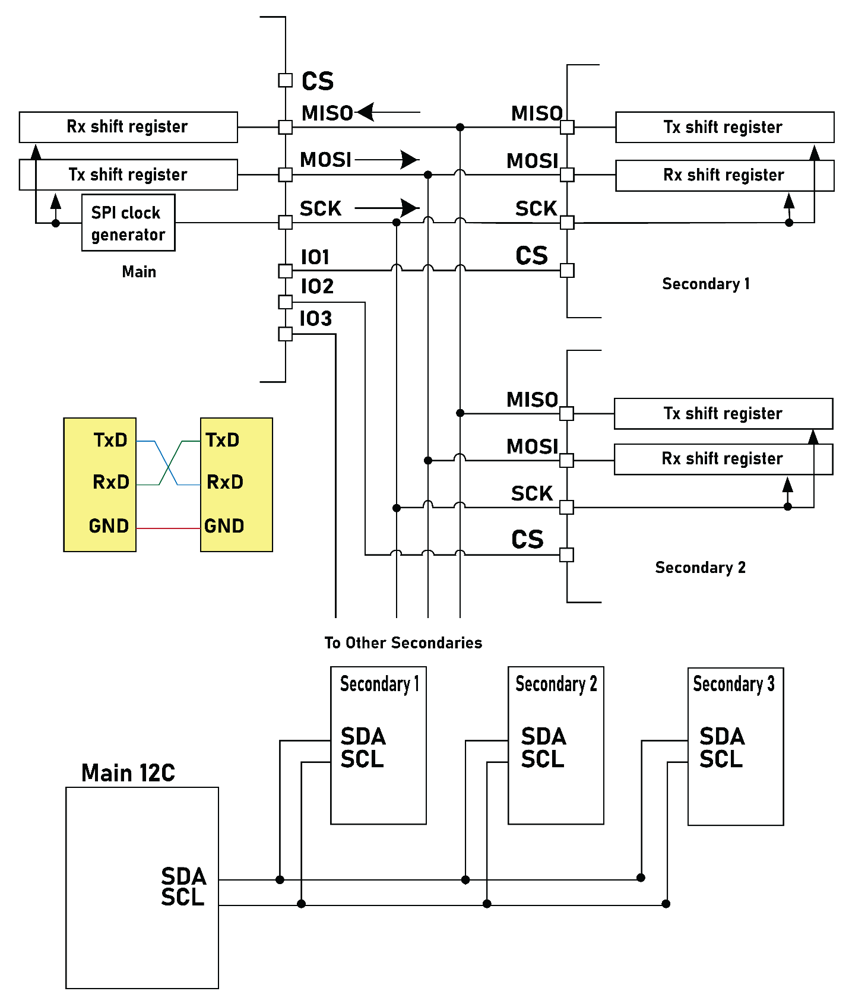
Figure B-9: UART, SPI and I2C Comparison

Slide 15
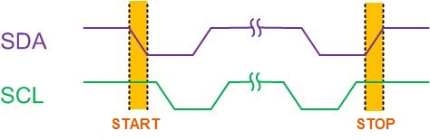
Figure B-10: START and STOP Conditions

Slide 16
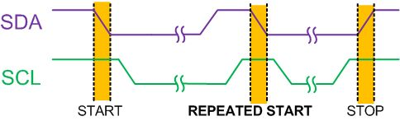
Figure B-11: REPEATED START Condition

Slide 17
Example B-1
Give an example to show when a main must use REPEATED START condition. What will happen if the main does not use it?
Solution
If you connect two microcontrollers (uA and uB) and an EEPROM with I2C, and the uA wants to display the sum of the contents at address 0x34 and 0x35 of EEPROM, it has to use REPEATED START condition. Let’s see what may happen if the uA does not use REPEATED START condition. uA transmit a START condition, reads the content of address 0x34 of EEPROM and transmit a STOP condition to release the bus. Before uA reads the contents of address 0x35, the uB seize the bus and change the contents of address 0x34 and 0x35 of EEPROM. Then uA reads the content of address 0x35, adds it to last content of address 0x34 and display the result to LCD. The result on the LCD is neither the sum of old values of address 0x34 and 0x35 nor the sum of the new values of address 0x34 and 0x35 of EEPROM!

Slide 18
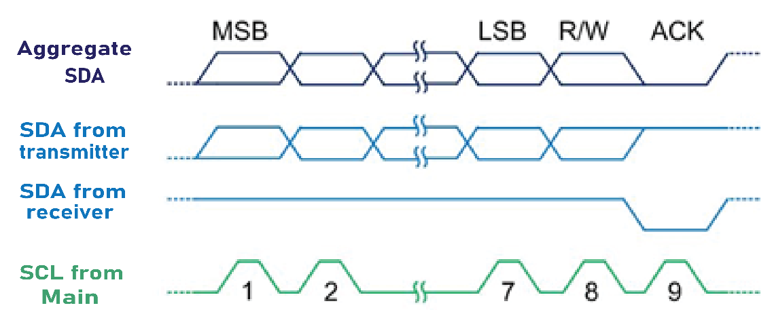
Figure B-12: Byte Format in I2C

Slide 19
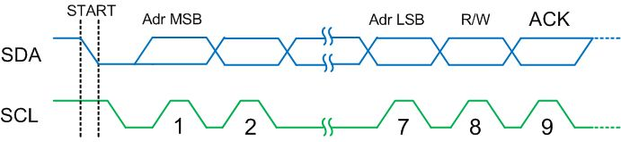
Figure B-13: Address Byte Format in I2C

Slide 20
Example B-2
Show how a main initiates a write to a secondary with address 1001101?
Solution
The following actions are performed by the main:
1) The main put a high to low pulse on SDA while SCL is high to generate a start condition to start the transmission
2) The main transmit 1001101 0 into the bus. The first seven bits (1001101) indicates the secondary address and the 8th bit (0) indicates write operation and the main will write the next byte (data) to the secondary.

Slide 21
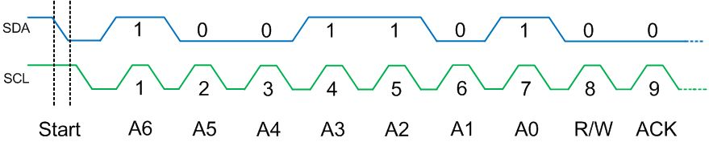
Example B-2
Show how a main initiates a write to a secondary with address 1001101?
Solution

Slide 22
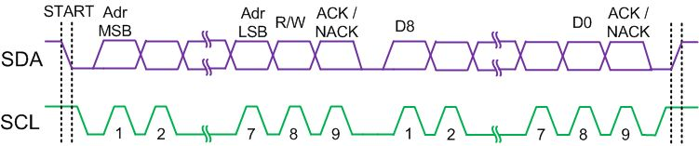
Figure B-14: Typical Data Transmission

Slide 23
Example B-3
Show how a main writes data value 1111 0000 to a secondary with an address 1001 101?
Solution
The following actions are performed by the main:
1) The main puts a high to low transition on SDA while SCL is high to generate a START condition to start the transmission
2) The main transmits 1001 101 0 on the bus. The first seven bits (1001 101) indicate the secondary address and the 8th bit (0) indicates a write operation and says that the main will write the next byte (data) to the secondary.
3) The secondary pulls the SDA line low at the 9th clock pulse to signal an ACK to say that it is ready to receive data
4) After receiving the ACK, the main will transmit the data byte (1111 0000) on the SDA line. (MSB first)
5) When the secondary device receives the data, it leaves the SDA line high to signal NACK and inform the main that the secondary received the last data byte and does not need any more data
6) After receiving the NACK, the main will know that no more data should be transmitted. The main changes the SDA line from low to high when the SCL line is high to transmit a STOP condition and then releases the bus.

Slide 24
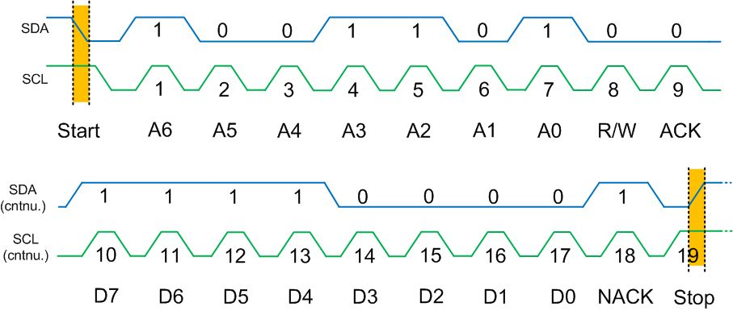
Example B-3
Show how a main writes data value 1111 0000 to a secondary with an address 1001 101?
Solution

Slide 25
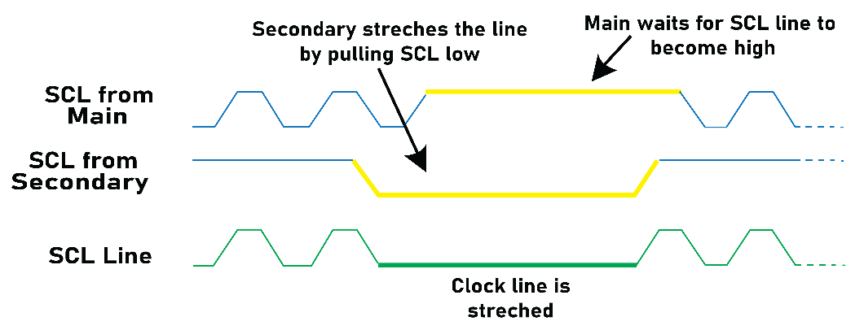
Figure B-15: Clock Stretching

Slide 26
Example B-4
If two main A and B start at about the same time, what happens if main A wants to write to secondary 0010 000 and main B wants to write to secondary 0001 111?
Solution
Main A will lose the arbitration in the third clock because the SDA line is different from output of main A at the third clock. Main A switches to secondary mode and stops driving the bus after losing the arbitration.

Slide 27
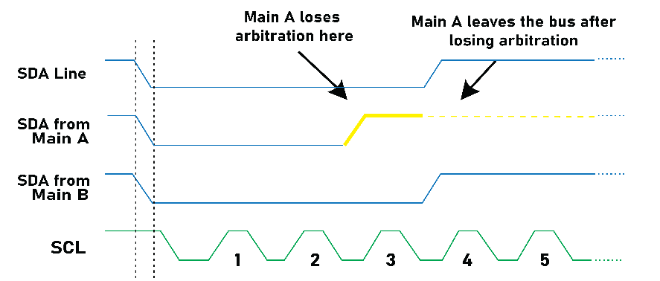
Example B-4
If two main A and B start at about the same time, what happens if main A wants to write to secondary 0010 000 and main B wants to write to secondary 0001 111?
Solution

Slide 28
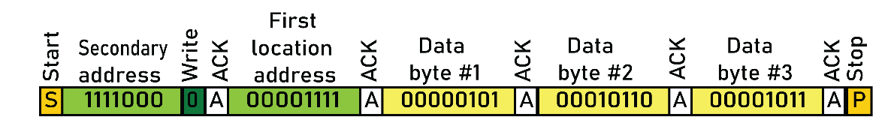
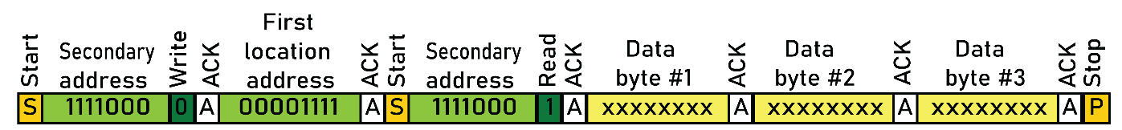
Figure B-16: Multi-byte Burst Write
Figure B-17: Multi-byte Burst Read

