Slide 1
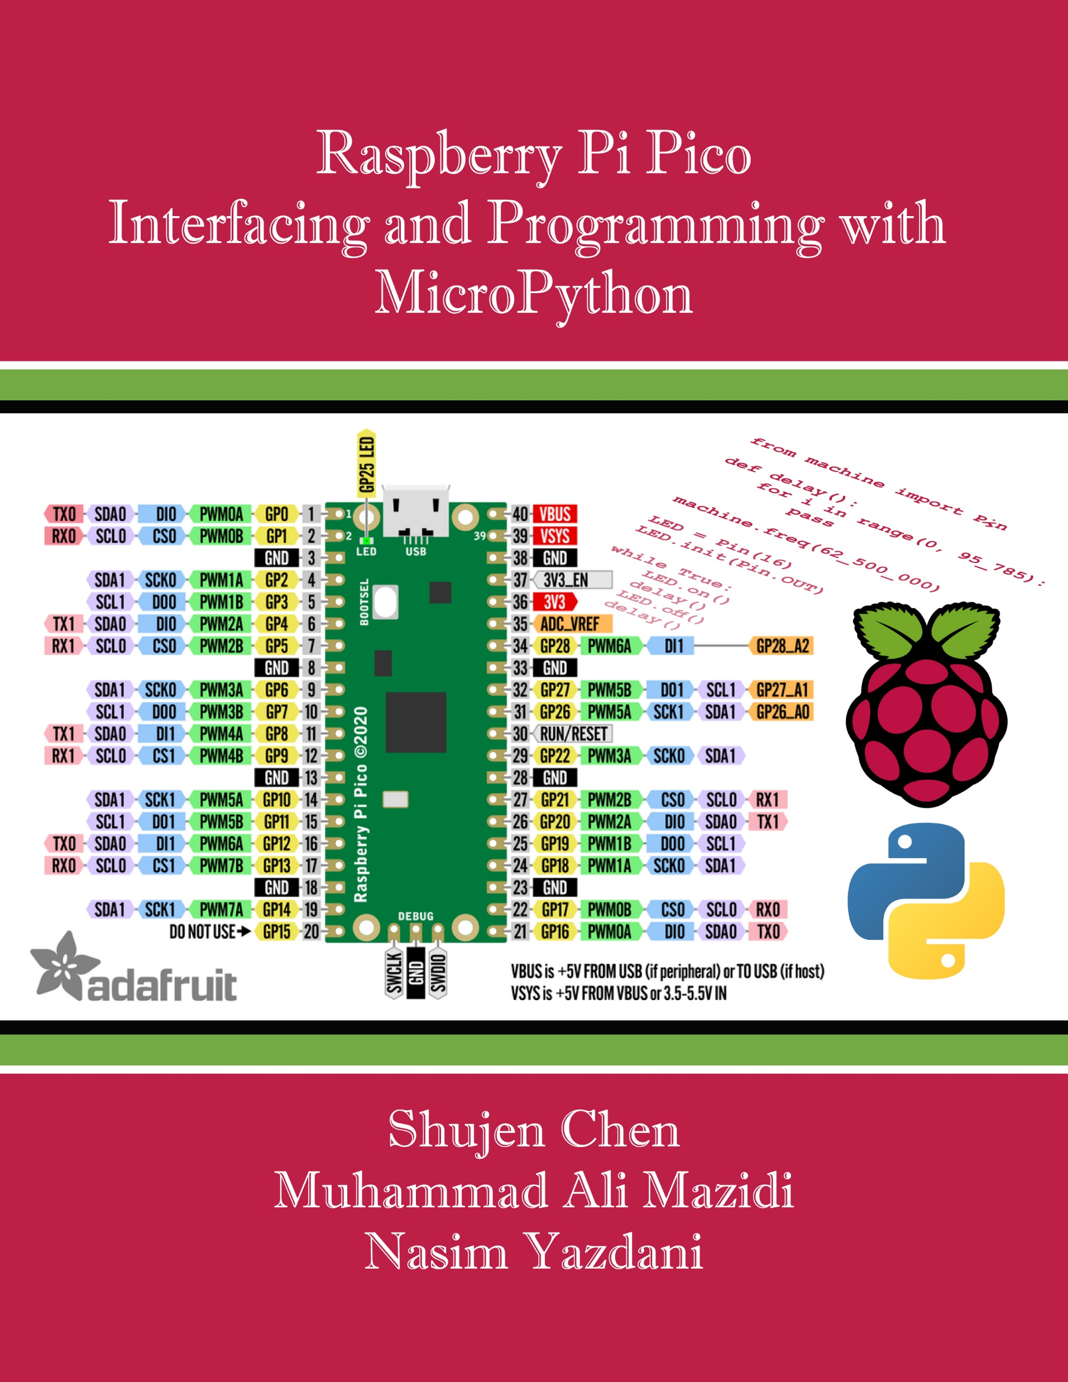
Appendix D:
Stand-alone Pico
Raspberry Pi Pico
Interfacing and Programming
with MicroPython
www.MicroDigitalEd.com

Slide 2
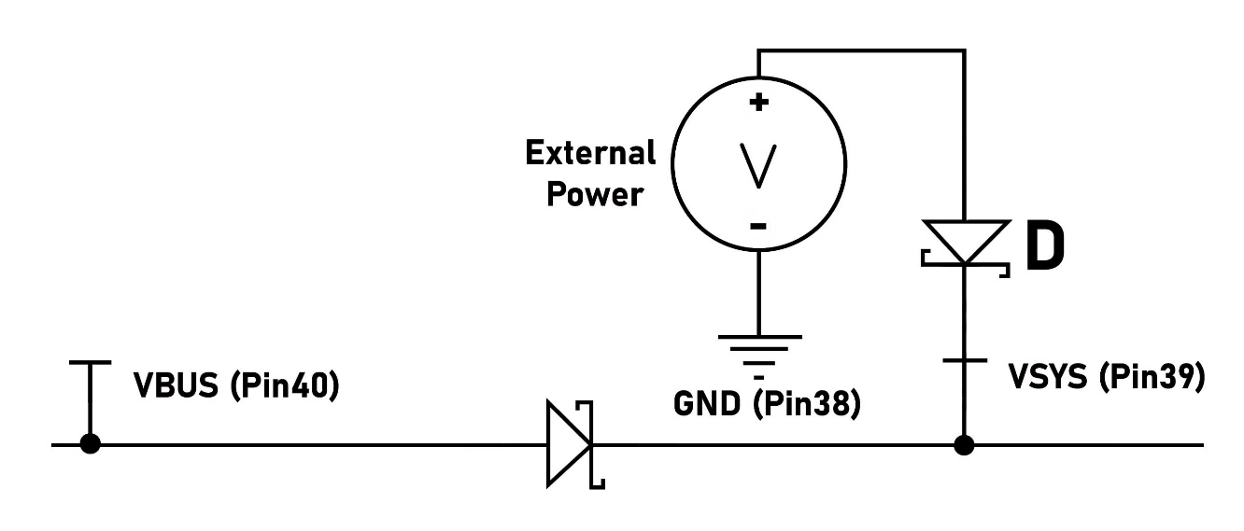
Figure D-1: External power source connection to Pico through a Schottky diode

