Slide 1
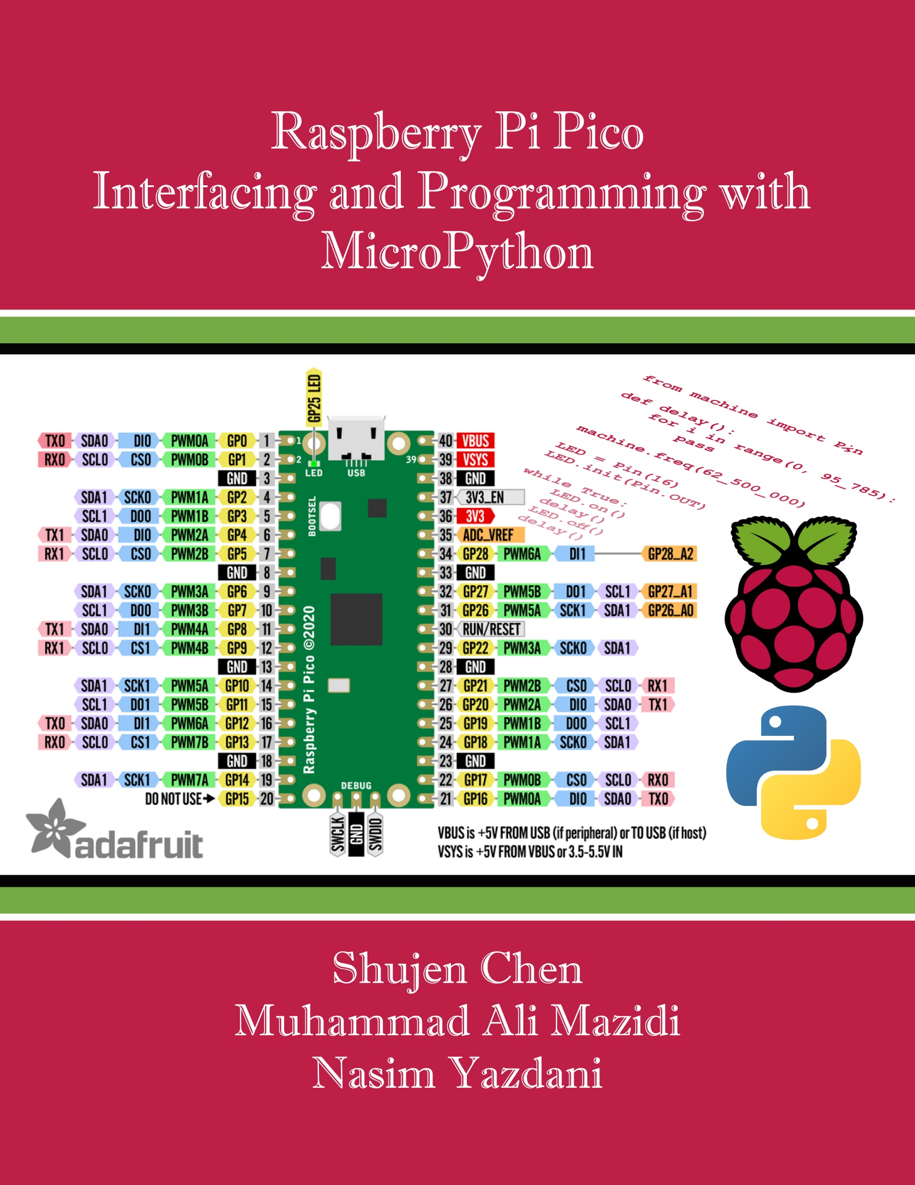
Chapter 1:
Getting Started with Pico and Micropython
Raspberry Pi Pico
Interfacing and Programming
with MicroPython
www.MicroDigitalEd.com

Slide 2
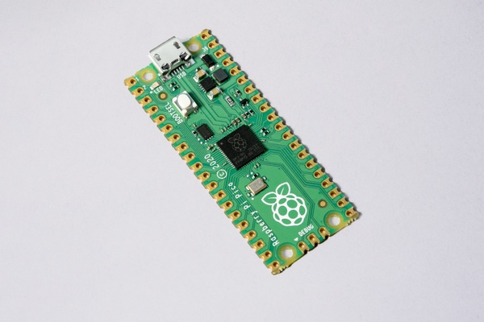
Figure 1-1: RP Pico board

Slide 3
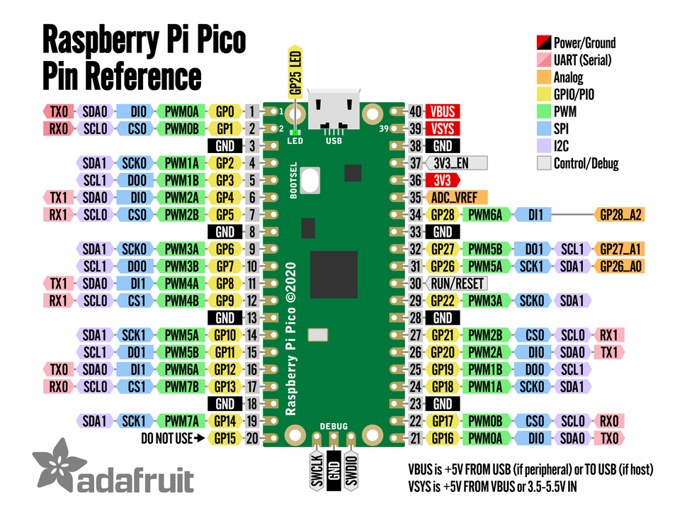
Figure 1-2: Raspberry Pi Pico Pin Reference

Slide 4
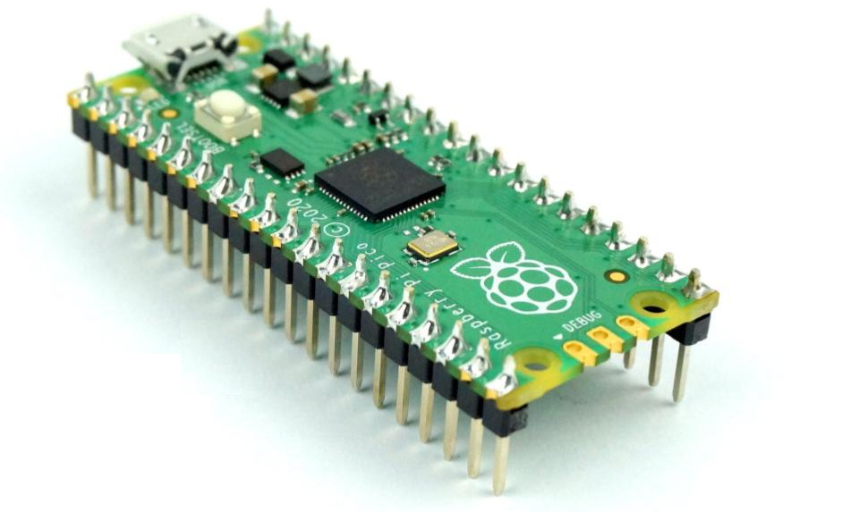
Figure 1-3: RP Pico board with pin headers

Slide 5
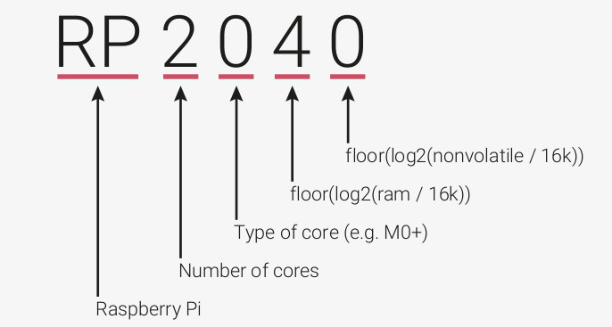
Figure 1-4: RP 2040 naming convention

Slide 6
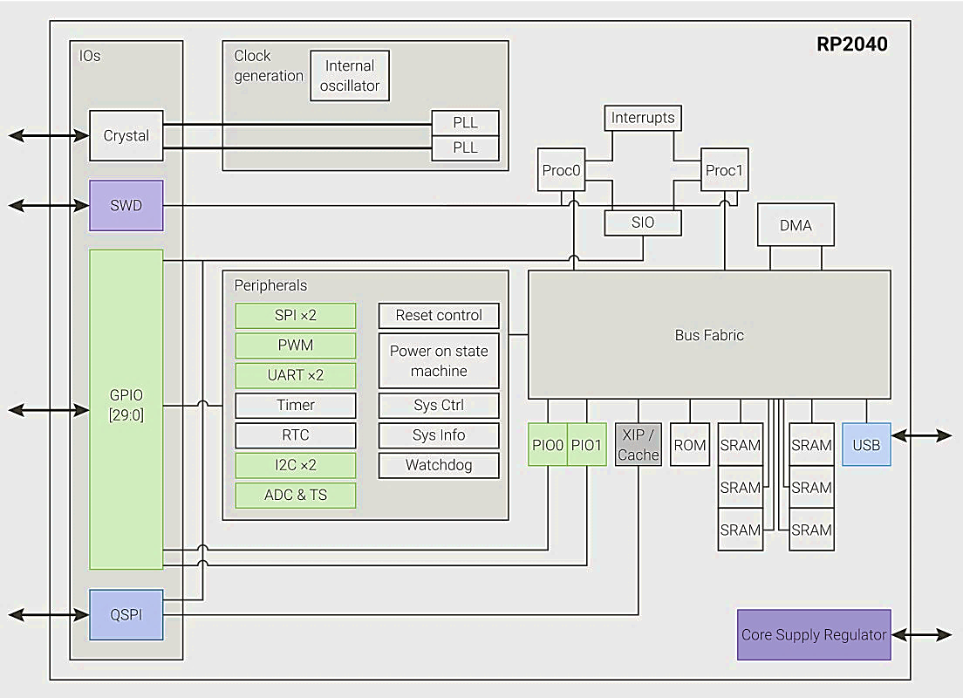
Figure 1-5: RP2040 Microcontroller High-Level Block Diagram

Slide 7
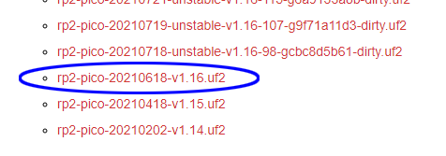
Figure 1-6: From the MicroPython.org website, choose the latest stable release.

Slide 8
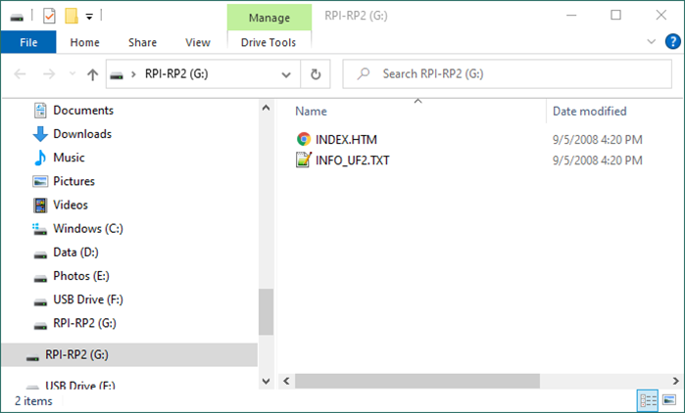
Figure 1-7: Pico board bootloader appears as a folder on the host computer display

Slide 9
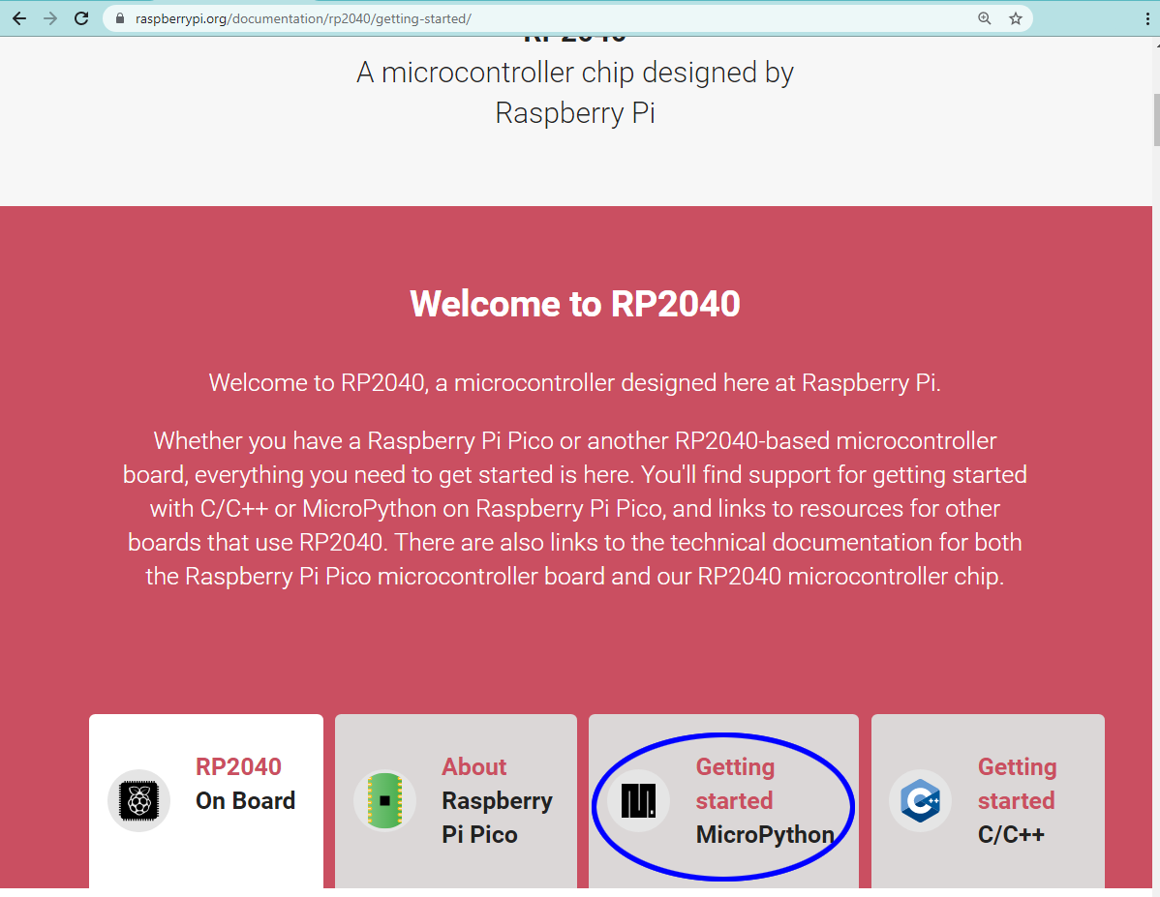
Figure 1-8: Link to step-by-step instructions to download and install MicroPython on Raspberry Pi Pico board

Slide 10
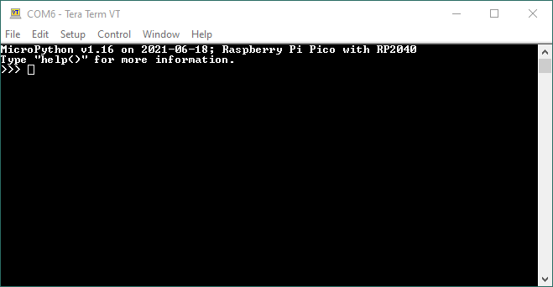
Figure 1-9: MicroPython launch message and REPL prompt from Raspberry Pi Pico

Slide 11
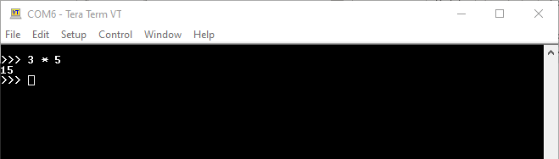
Figure 1-10: MicroPython evaluates 3 * 5 and prints the result 15 followed by a new prompt.

Slide 12
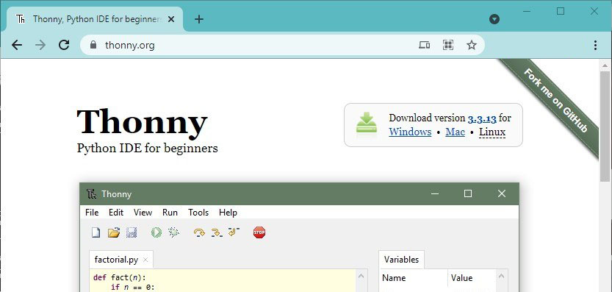
Figure 1-11: Thonny website, where the download links are in the upper-right corner

Slide 13
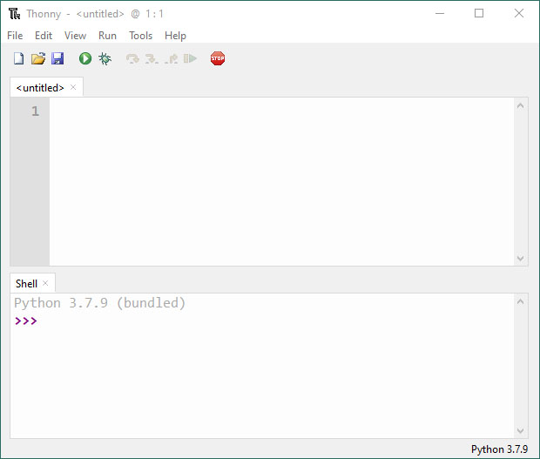
Figure 1-12: The default configuration launch of Thonny

Slide 14
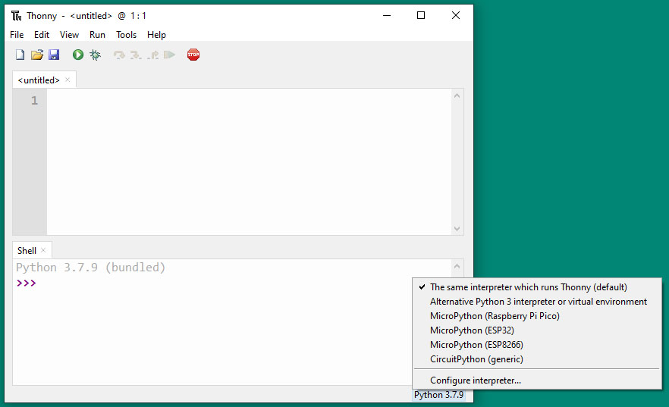
Figure 1-13: When Thonny detects an external Python connection, it displays the possible connections to choose from.

Slide 15
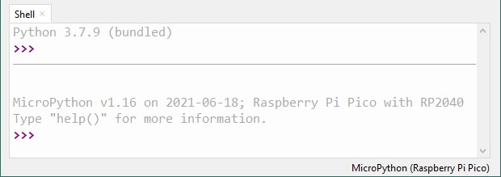
Figure 1-14: When MicroPython (Raspberry Pi Pico) is selected, the Shell makes the connection and displays the REPL prompt.

Slide 16
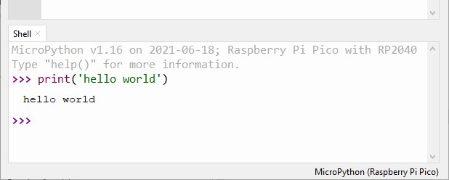
Figure 1-15: The REPL prompt in the Shell pane works the same except the outputs have different fonts and colors for different contexts.

Slide 17
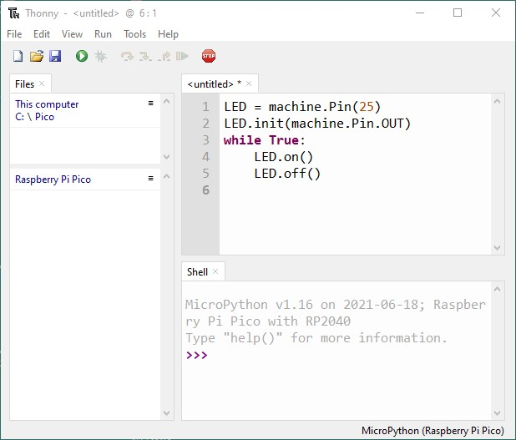
Figure 1-16: Enter the program in the editor pane

Slide 18
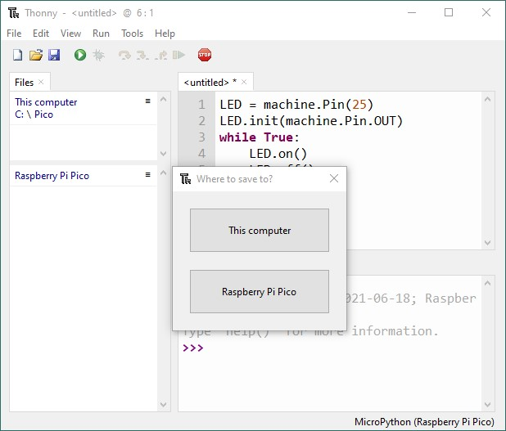
Figure 1-17: Before running the code, Thonny requires you to save it in a file first and offers the choice of saving it at the host computer or the Pico board.

Slide 19
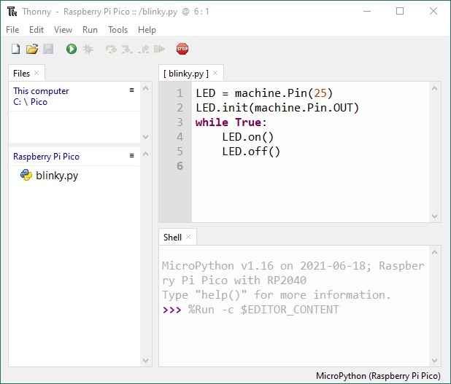
Figure 1-18: After giving a file name, the file should appear in the Files pane, and the program run on the Pico board.

Slide 20
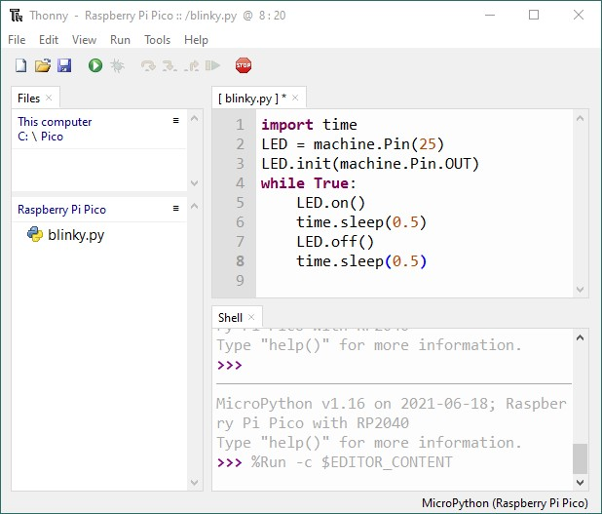
Figure 1-19: Add calls to sleep() function.

