Slide 1
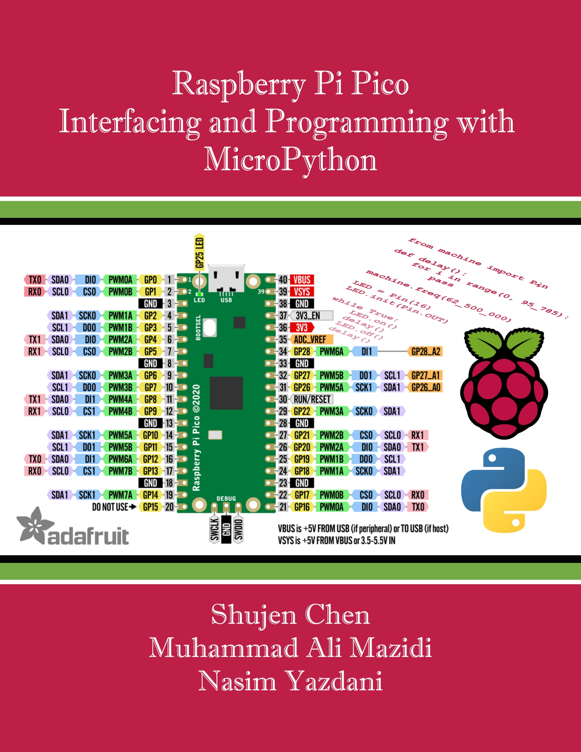
Chapter 10:
Relay, Optoisolator, and Stepper Motor Interfacing
Raspberry Pi Pico
Interfacing and Programming
with MicroPython
www.MicroDigitalEd.com

Slide 2
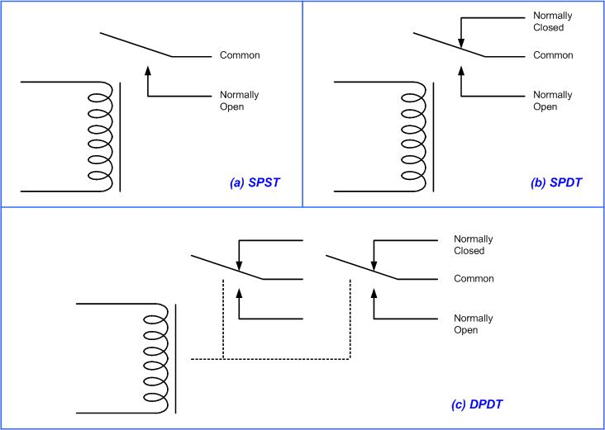
Figure 10-1: Relay Diagrams

Slide 3
Table 10-1: Selected DIP Relay Characteristics (www.Jameco.com)
Part No. | Contact Form | Coil Volts | Coil Ohms | Contact Volts | Current
106462CP | SPST-NO | 5 VDC | 500 | 100 VDC | 0.5 A
138430CP | SPST-NO | 5 VDC | 500 | 100 VDC | 0.5 A
106471CP | SPST-NO | 12 VDC | 1000 | 100 VDC | 0.5 A
138448CP | SPST-NO | 12 VDC | 1000 | 100 VDC | 0.5 A
129875CP | DPDT | 5 VDC | 62.5 | 30 VDC | 1 A

Slide 4
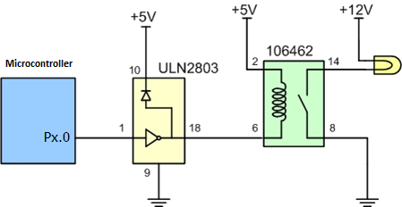
Figure 10-2: Microcontroller Connection to Relay

Slide 5
Table 10-2: Selected Solid-State Relay Characteristics (www.Jameco.com)
Part No. | Contact Style | Control Volts | Contact Volts | Contact Current
143058CP | SPST | 4-32 VDC | 240 VAC | 3 A
139053CP | SPST | 3-32 VDC | 240 VAC | 25 A
162341CP | SPST | 3-32 VDC | 240 VAC | 10 A
172591CP | SPST | 3-32 VDC | 60 VAC | 2 A
175222CP | SPST | 3-32 VDC | 60 VAC | 4 A
176647CP | SPST | 3-32 VDC | 120 VAC | 5 A

Slide 6
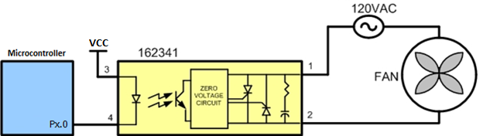
Figure 10-3: Microcontroller Connection to a Solid-State Relay

Slide 7
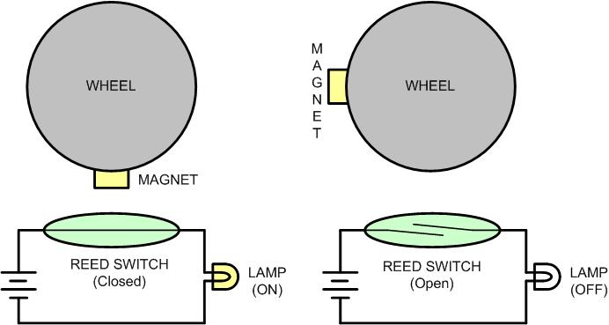
Figure 10-4: Reed Switch and Magnet Combination

Slide 8
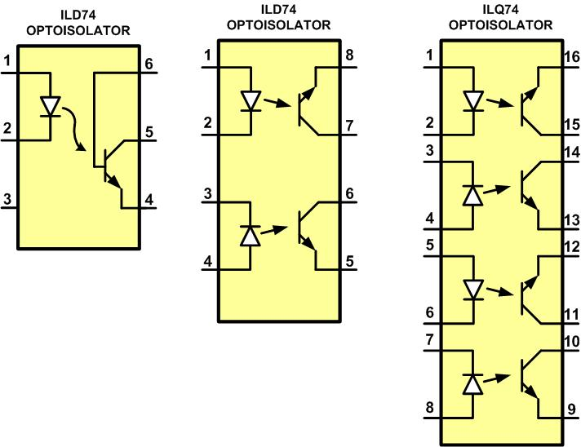
Figure 10-5: Optoisolator Package Examples

Slide 9
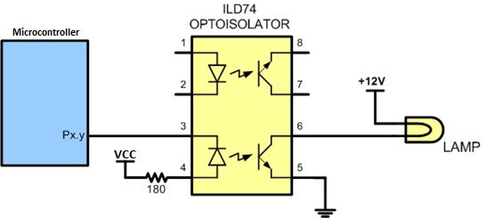
Figure 10-6: Controlling a Lamp via an Optoisolator

Slide 10
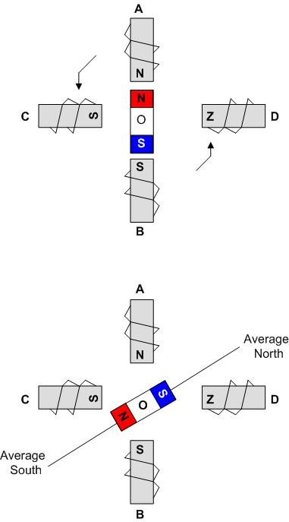
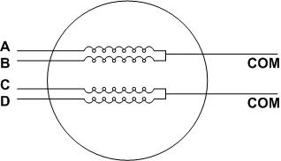
Figure 10-7: Stator Winding Configuration
Figure 10-8: Rotor Alignment

Slide 11


Table 10-3: Normal Four-Step Sequence
Clockwise | Step # | Winding D | Winding C | Winding B | Winding A | Counter Clockwise
 | 1 | 1 | 0 | 0 | 1
 | 2 | 0 | 1 | 0 | 1
 | 3 | 0 | 1 | 1 | 0
 | 4 | 1 | 0 | 1 | 0

Slide 12
Table 10-4: Stepper Motor Step Angles
Step Angle | Steps per Revolution
0.72 | 500
1.8 | 200
2.0 | 180
2.5 | 144
5.0 | 72
7.5 | 48
15 | 24

Slide 13
Example 10-1
Describe the Microcontroller connection to the stepper motor in Figure 10-9.
Solution
The following steps show the Microcontroller connection to the stepper motor and its programming:
1. Use an ohmmeter to measure the resistance of the leads. This should identify which COM leads are connected to which winding leads.
2. The common wire(s) are connected to the positive side of the motor's power supply. In many motors, +5 V is sufficient.
3. The four leads of the stator winding are controlled by four bits of the microcontroller port. Because the microcontroller lacks sufficient current to drive the stepper motor windings, we must use a driver such as the ULN2003 (or ULN2803) to energize the stator. Instead of the ULN2003, we could have used transistors as drivers, as shown in Figure 10-11. However, notice that if transistors are used as drivers, we must also use diodes to take care of the inductive current generated when the coil is turned off. One reason that using the ULN2003 is preferable to the use of transistors as drivers is that the ULN2003 has an internal diode to take care of back EMF.

Slide 14
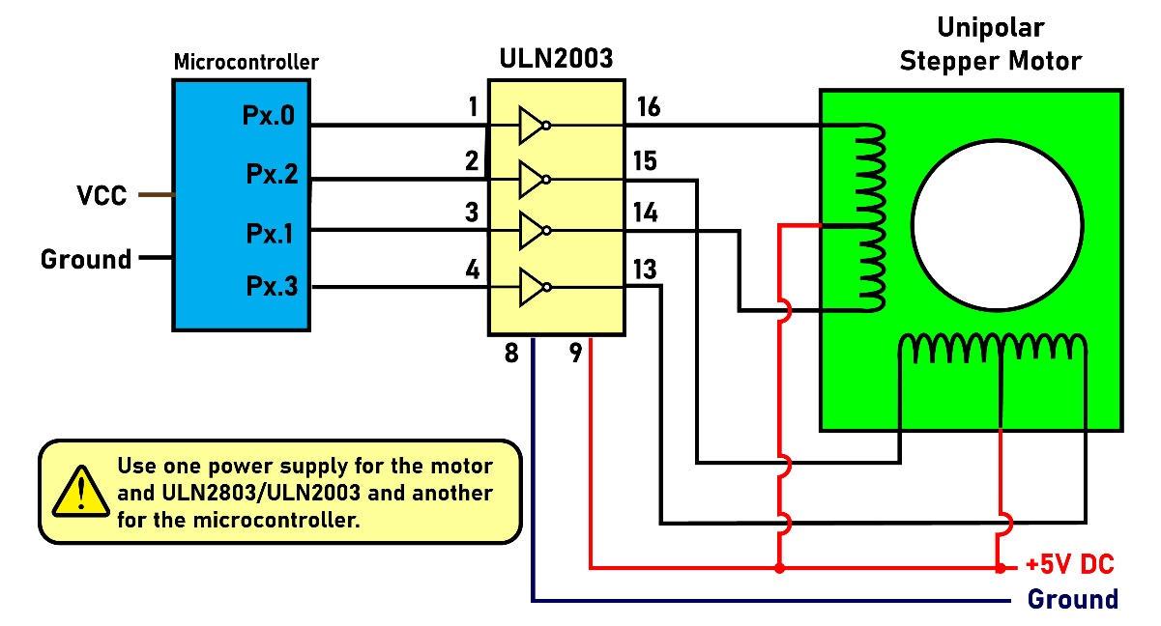
Figure 10-9: Microcontroller Connection to Stepper Motor

Slide 15
Example 10-2
Give the number of times the four-step sequence in Table 10-3 must be applied to a stepper motor to make an 80-degree move if the motor has a 2-degree step angle.
Solution
A motor with a 2-degree step angle has the following characteristics:
Step angle: 2 degrees
Steps per revolution: 180
Number of rotor teeth: 45
Movement per 4-step sequence: 8 degrees
To move the rotor 80 degrees, we need to send 10 consecutive 4-step sequences, because 10 × 4 steps × 2 degrees = 80 degrees.

Slide 16
Table 10-5: Half-Step 8-Step Sequence
Clockwise | Step # | Winding D | Winding C | Winding B | Winding A | Counter Clockwise
 | 1 | 1 | 0 | 0 | 1
 | 2 | 0 | 0 | 0 | 1
 | 3 | 0 | 1 | 0 | 1
 | 4 | 0 | 1 | 0 | 0
 | 5 | 0 | 1 | 1 | 0
 | 6 | 0 | 0 | 1 | 0
 | 7 | 1 | 0 | 1 | 0
 | 8 | 1 | 0 | 0 | 0

Slide 17
Table 10-6: Selected Stepper Motor Characteristics (www.Jameco.com)
Part No. | Step Angle | Drive System | Volts | Phase Resistance | Current
151861CP | 7.5 | unipolar | 5 V | 9 ohms | 550 mA
171601CP | 3.6 | unipolar | 7 V | 20 ohms | 350 mA
164056CP | 7.5 | bipolar | 5 V | 6 ohms | 800 mA

Slide 18
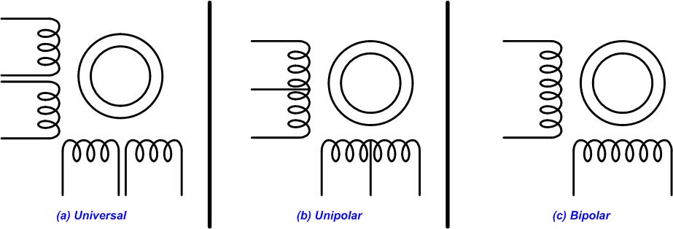
Figure 10-10: Common Stepper Motor Types

Slide 19
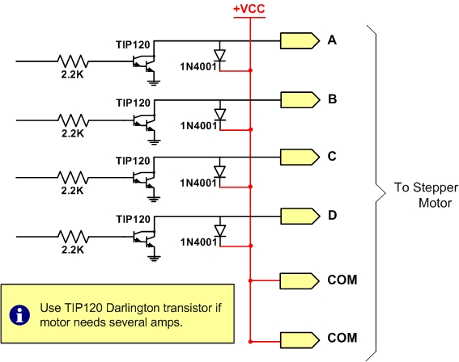
Figure 10-11: Using Transistors for Stepper Motor Driver

Slide 20
Table 10-7: Darlington Transistor Listing
NPN | PNP | V_{CEO} (volts) | I_{C} (amps) | hfe (common)
TIP110 | TIP115 | 60 | 2 | 1000
TIP111 | TIP116 | 80 | 2 | 1000
TIP112 | TIP117 | 100 | 2 | 1000
TIP120 | TIP125 | 60 | 5 | 1000
TIP121 | TIP126 | 80 | 5 | 1000
TIP122 | TIP127 | 100 | 5 | 1000
TIP140 | TIP145 | 60 | 10 | 1000
TIP141 | TIP146 | 80 | 10 | 1000
TIP142 | TIP147 | 100 | 10 | 1000

Slide 21
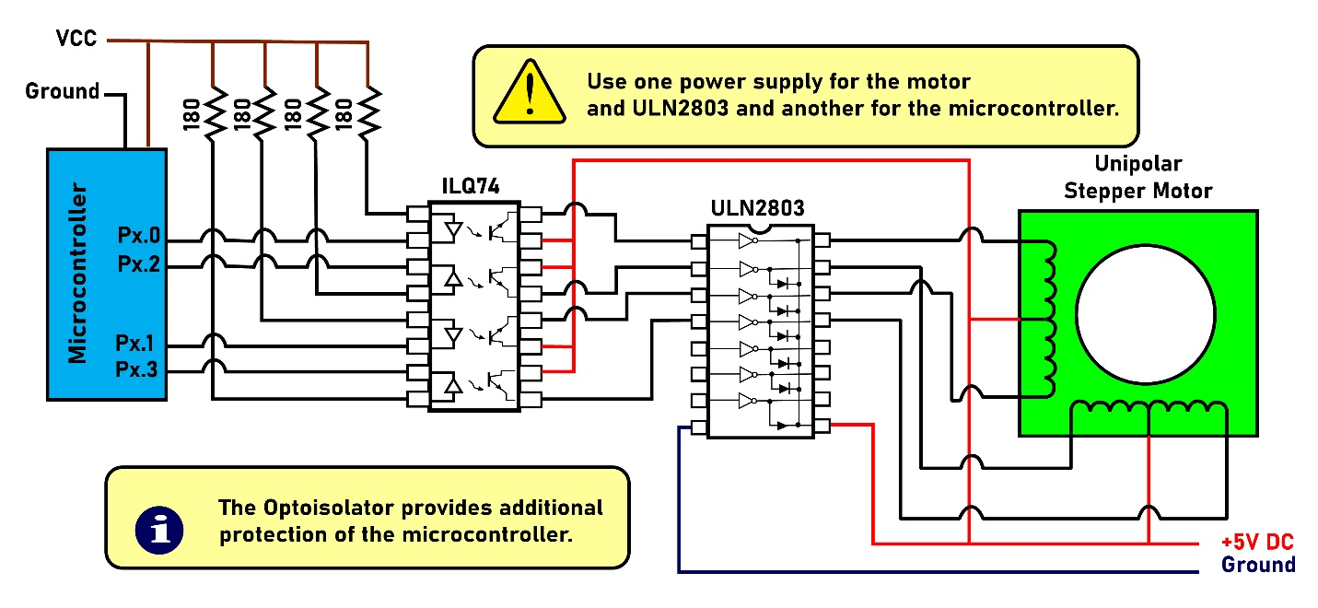
Figure 10-12: Controlling Stepper Motor via Optoisolator

Slide 22
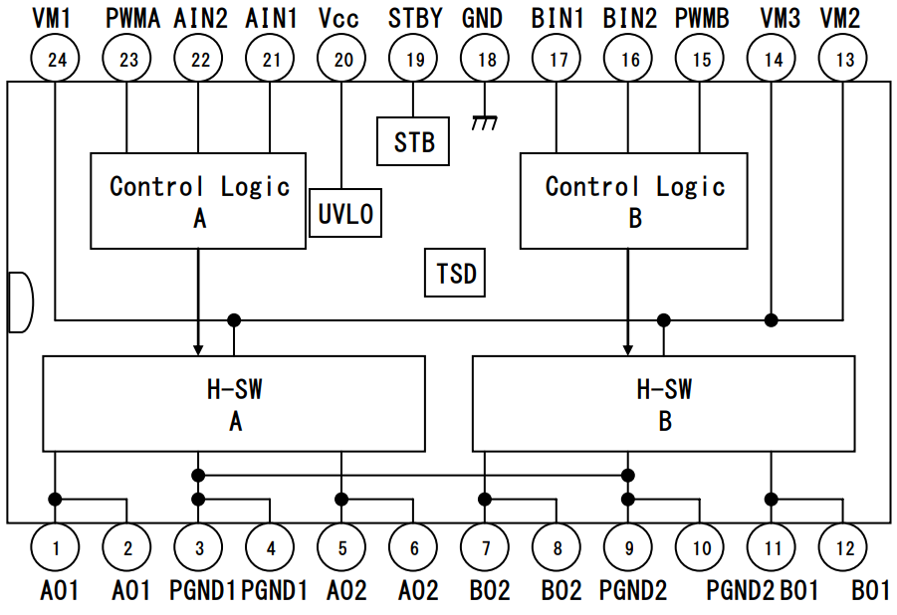
Figure 10-13: H-bridge Driver TB6612FNG Block Diagram

Slide 23
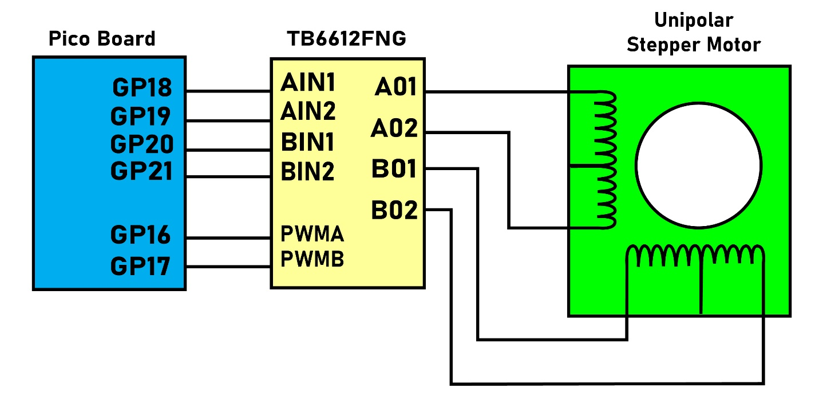
Figure 10-14: H-bridge Driver Connection to Stepper Motor

