Slide 1
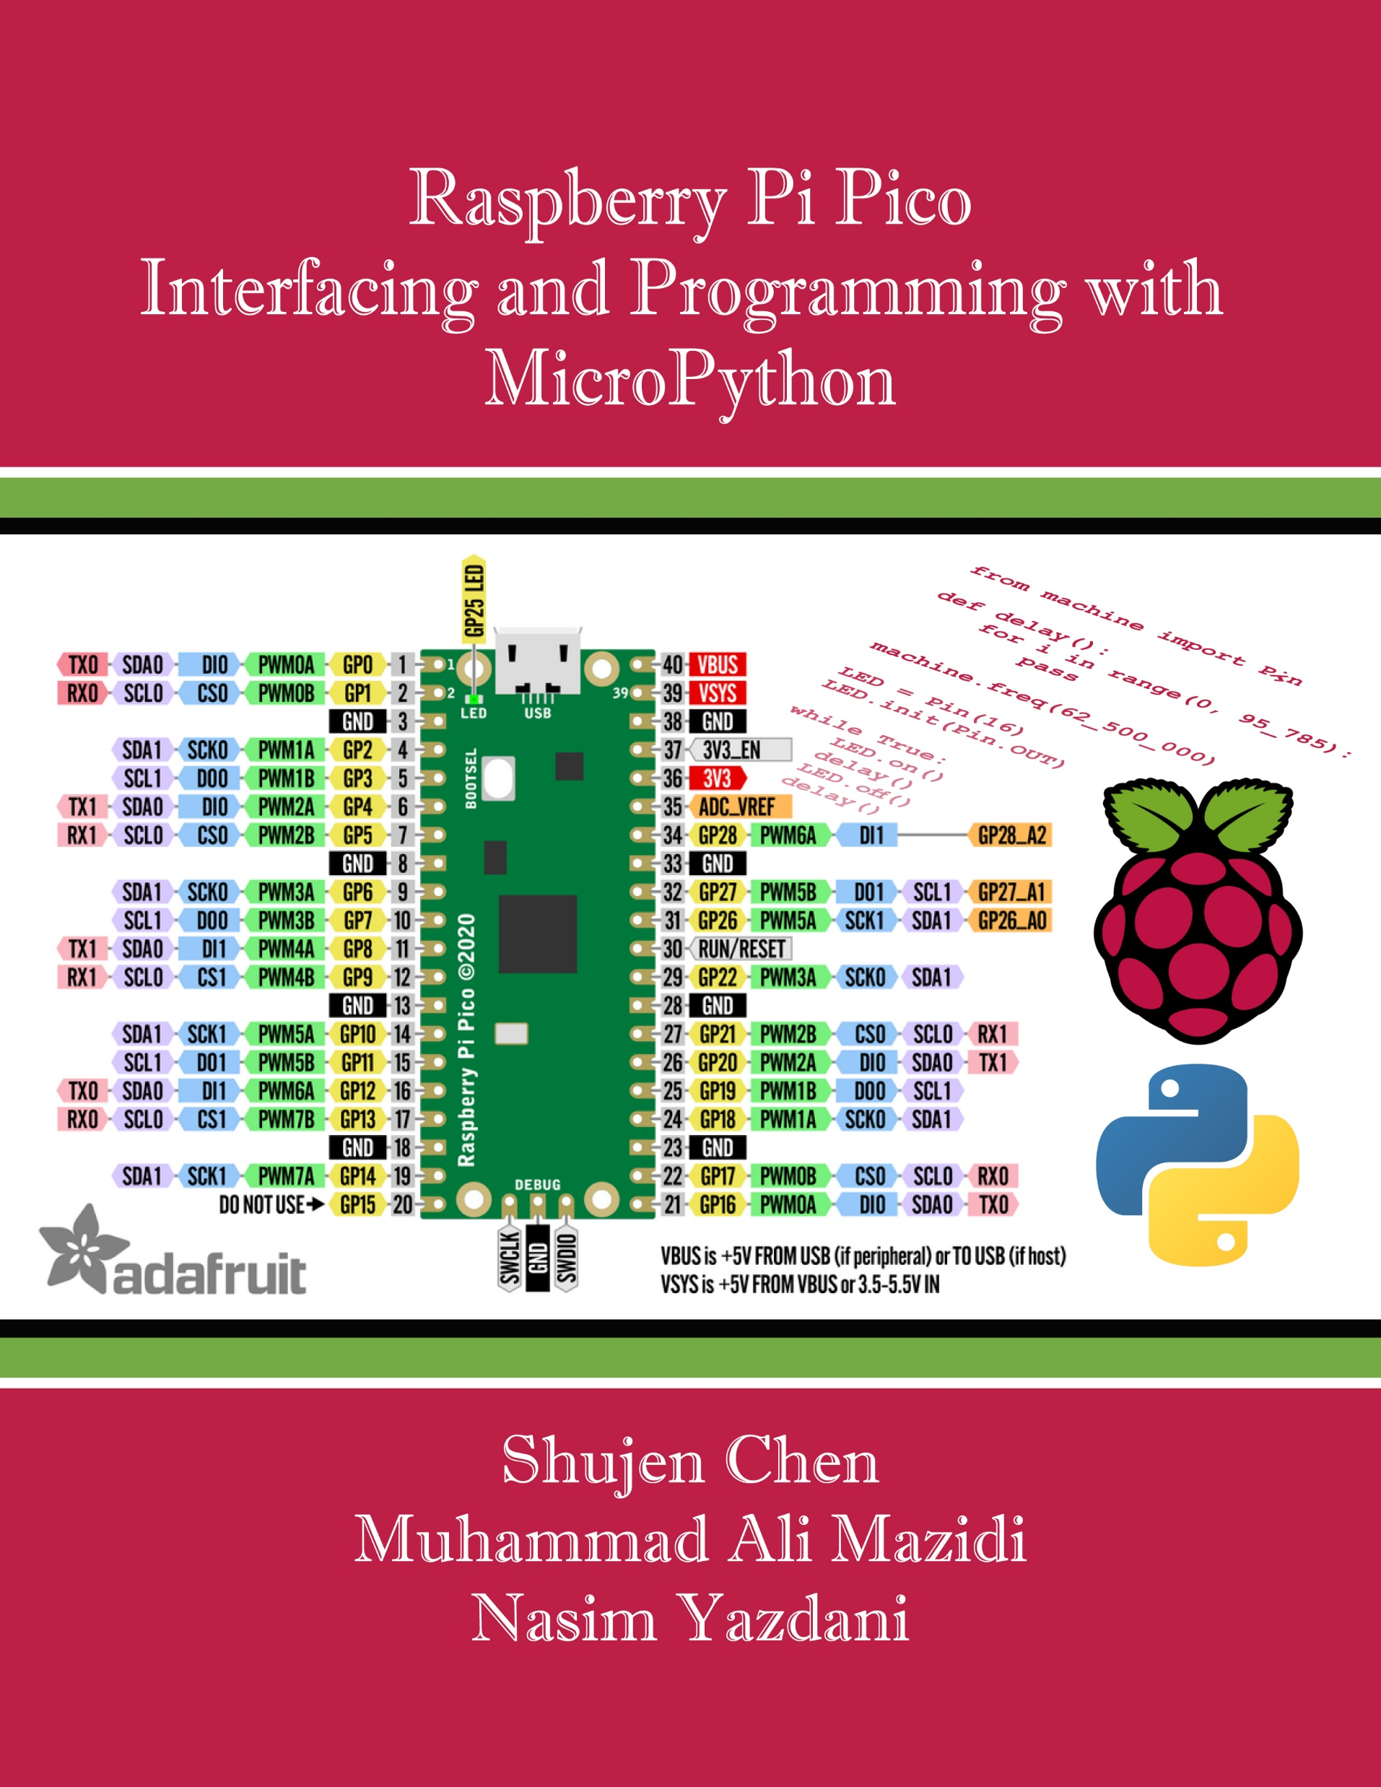
Chapter 12:
Programming Graphic LCD
Raspberry Pi Pico
Interfacing and Programming
with MicroPython
www.MicroDigitalEd.com

Slide 2

Figure 12-1: A picture on a Mono-color LCD
Figure 12-2: A Zoomed Picture on a Mono-color LCD

Slide 3

Figure 12-3: Dot Pitch and Dot Size

Slide 4
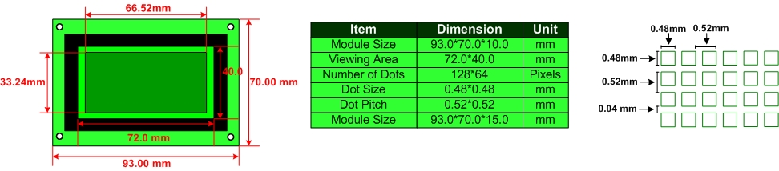
Figure 12-4: Mechanical specifications of a GDM12864 128x64 LCD

Slide 5
Example 12-1
A manufacturer has advertised a 14-inch monitor of 1024 × 768 resolution with a dot pitch of 0.28.
Calculate the diagonal size of the image on the screen. It must be less than 14 inches.
Solution
The calculation is as follows:
(image diagonal size)2 = (number of horizontal pixels × dot pitch)2 + (number of vertical pixels × dot pitch)2
(diagonal size)2 = (1024 × 0.28 mm)2 + (768 × 0.28 mm)2 = 358.4 mm
diagonal size (inches) = 358.4 mm × 0.039 inch per mm = 13.98 inches
In the LCD the diagonal size of the image area is 13.98 inches while the diagonal size of the viewing area is 14 inches.

Slide 6
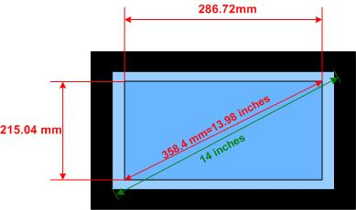
Example 12-1
A manufacturer has advertised a 14-inch monitor of 1024 × 768 resolution with a dot pitch of 0.28.
Calculate the diagonal size of the image on the screen. It must be less than 14 inches.
Solution

Slide 7
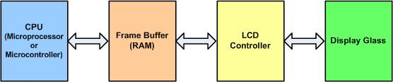
Figure 12-5: The Relationship between CPU and LCD

Slide 8
Table 12-1: BPP (bit per pixel) vs. color
BPP | Colors
1 | on or off (monochrome)
2 | 4
4 | 16
8 | 256
16 | 65,536
24 | 16,777,216

Slide 9
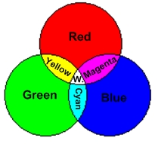
Figure 12-6: Making New Light Colors by Mixing the 3 Primary Light Colors

Slide 10
Table 12-2: The 16 Possible Colors
I | R | G | B | Color
0 | 0 | 0 | 0 | Black
0 | 0 | 0 | 1 | Blue
0 | 0 | 1 | 0 | Green
0 | 0 | 1 | 1 | Cyan
0 | 1 | 0 | 0 | Red
0 | 1 | 0 | 1 | Magenta
0 | 1 | 1 | 0 | Brown
0 | 1 | 1 | 1 | Light Gray
1 | 0 | 0 | 0 | Dark Gray
1 | 0 | 0 | 1 | Light blue
1 | 0 | 1 | 0 | Light green
1 | 0 | 1 | 1 | Light cyan
1 | 1 | 0 | 0 | Light red
1 | 1 | 0 | 1 | Light Magenta
1 | 1 | 1 | 0 | Yellow
1 | 1 | 1 | 1 | White

Slide 11
Example 12-2
In a certain graphic LCD, a maximum of 256 colors can be displayed at one time. How many bits are set aside for the color of the pixels?
Solution
To display 256 colors at once, we must have 8 bits set for color since 2⁸ = 256.

Slide 12
Example 12-3
Find the frame buffer RAM needed for (a) 176x144 with 4 BPP and (b) 640x480 resolution with 256 colors.
Solution
(a) For this resolution, there are a total of 25,344 pixels (176 columns × 144 rows = 25,344). With 4 bits for the color of each pixel, we need a total of (25,344 × 4)/8= 16,672 bytes of frame buffer RAM. These 4 bits give rise to 16 colors.
(b) For this resolution, there are a total of 640 × 480=307200 pixels. With 256 colors, we need 8 bits for the color of each pixel. Now, total of (640 × 480 × 8) / 8 = 307200 bytes of frame buffer RAM needed.

Slide 13
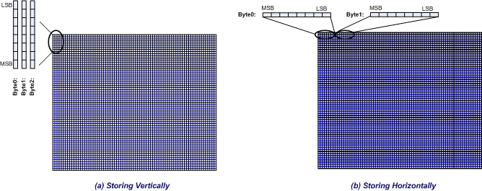
Figure 12-7: Storing Data in the LCD Memory of Mono-colored LCDs

Slide 14
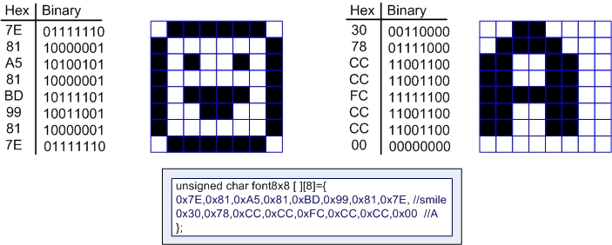
Figure 12-8: Pixel Patterns of Characters Happy Face and Letter A

Slide 15
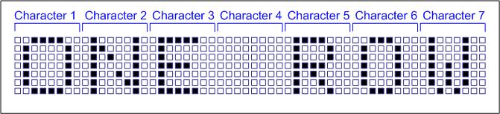
Figure 12-9: A Sample Text

Slide 16
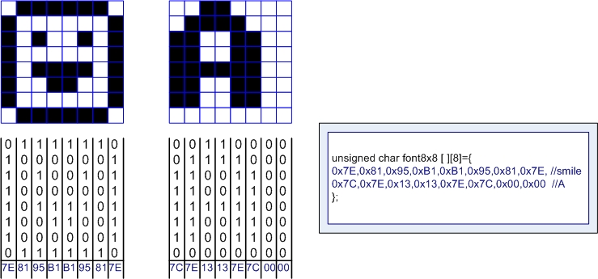
Figure 12-10: Pixel Patterns of Happy Face and Character A and its Font for Vertical LCD

Slide 17
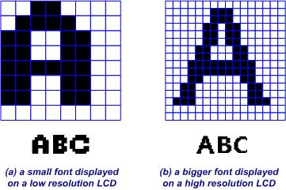
Figure 12-11: A Bigger Font vs. a Smaller Font

Slide 18
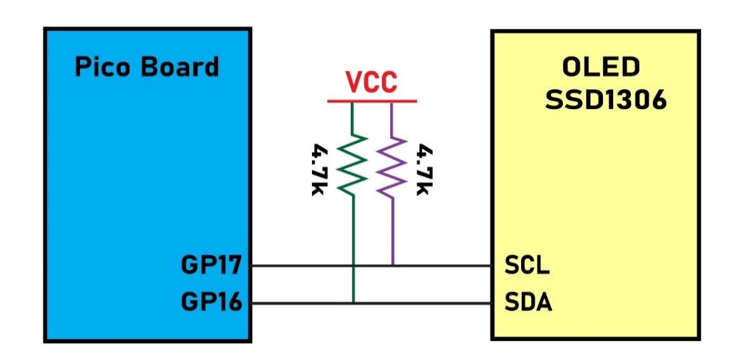
Figure 12-12: The SSD1306 OLED Connection in Pico

Slide 19
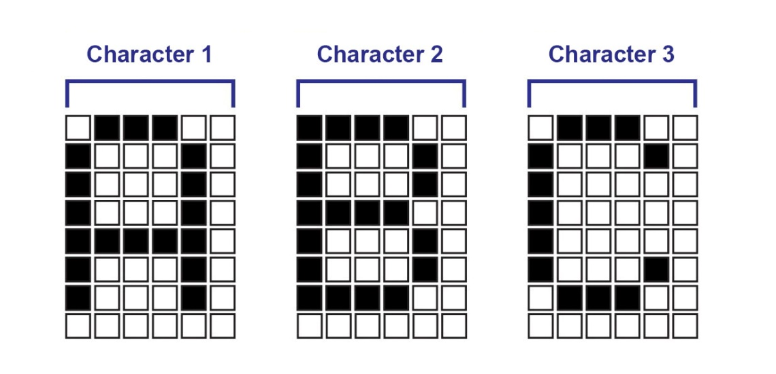
Figure 12-13: Font glyphs used in Program 12-1

