Slide 1
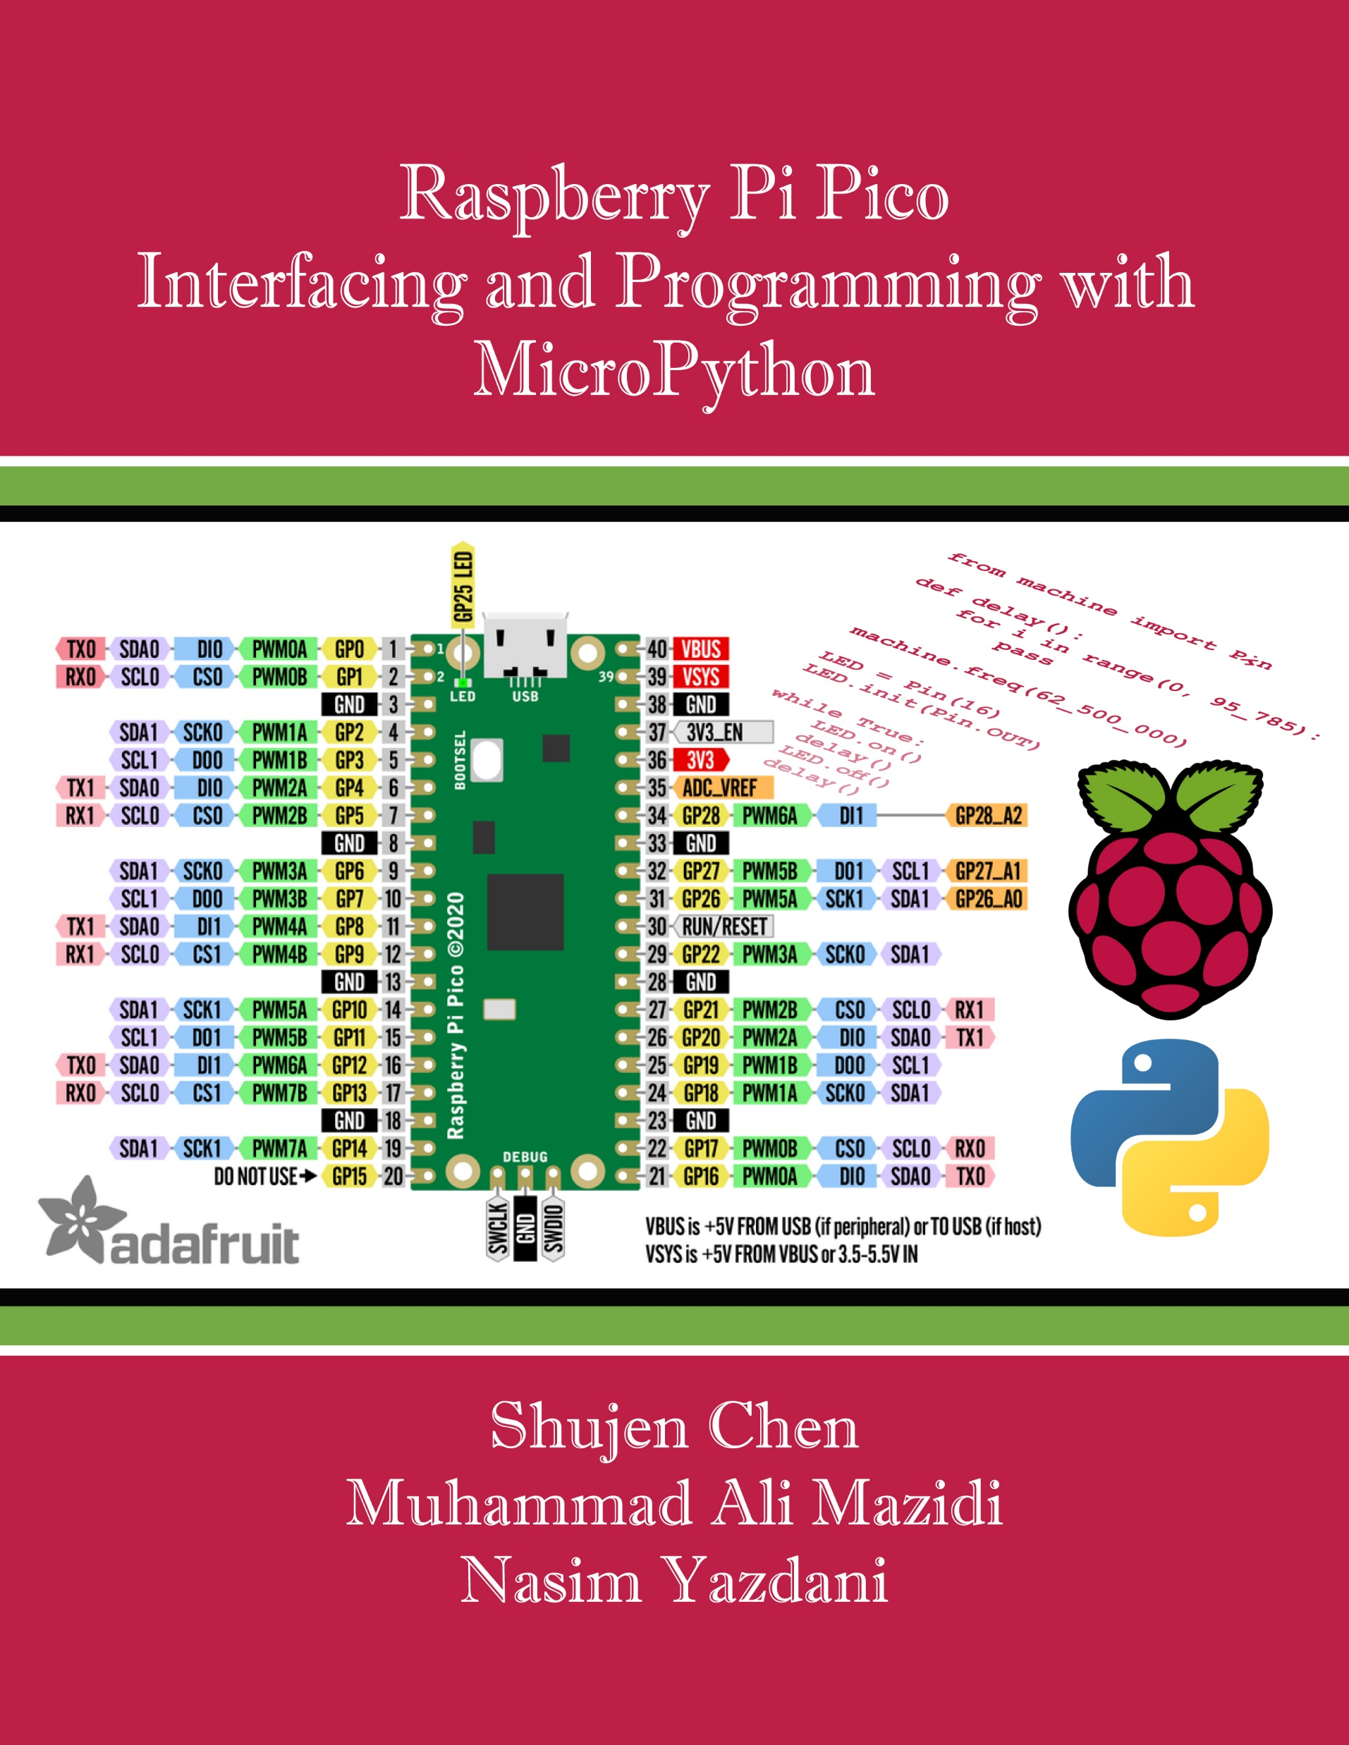
Chapter 2:
Python I/O Programming with Pico
Raspberry Pi Pico
Interfacing and Programming
with MicroPython
www.MicroDigitalEd.com

Slide 2
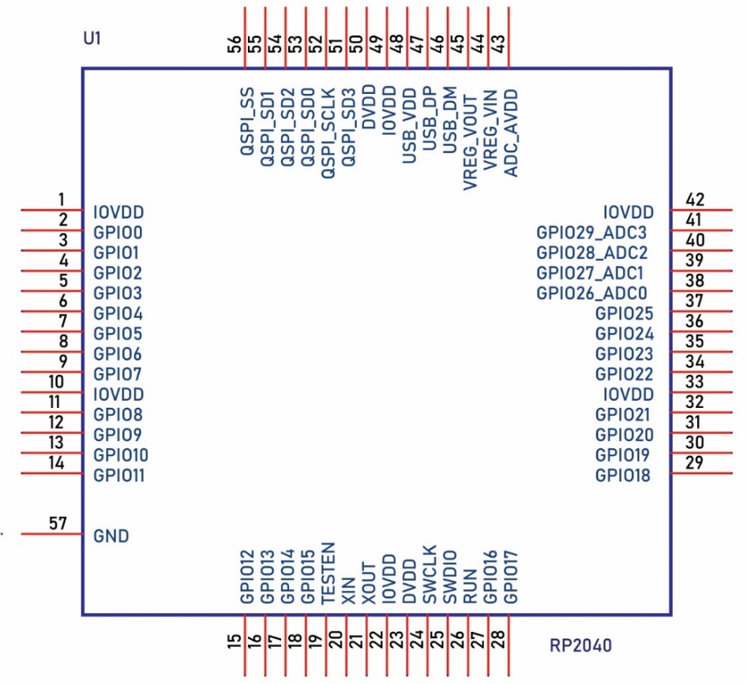
Figure 2-1: RP2040 microcontroller pins

Slide 3
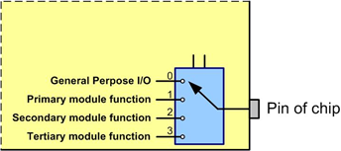
Figure 2-2: Alternate functions of a pin are selected by a multiplexer

Slide 4
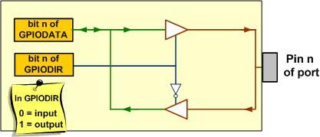
Figure 2-3: The Data and Direction Registers and a Simplified View of an I/O pin

Slide 5
Example 2-1
Pin GP25 of RP2040 is connected to an LED on the Pico board. Show the code that makes the pin an output pin.
Solution
LED = machine.Pin(25)
LED.init(machine.Pin.OUT)
This will make pin GPIO25 an output pin.

Slide 6
Example 2-2
Pin GP25 of Pico is connected to an onboard LED. Show
a) how to make the pin an output pin,
b) how to make the output high, and
c) how to make the output low.
Solution
a) from machine import Pin
LED = Pin(25)
LED.init(Pin.OUT)
b) LED.on()
c) LED.off()

Slide 7
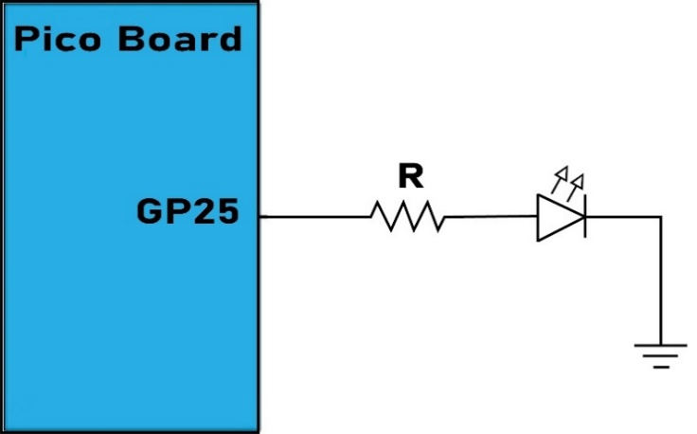
Figure 2-4: Built-in LED connected to the pin

Slide 8
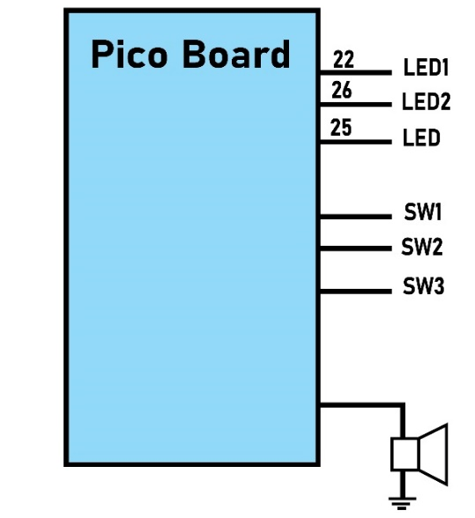
Figure 2-5: Pico External Connections to LED, Switches, and Buzzer

Slide 9
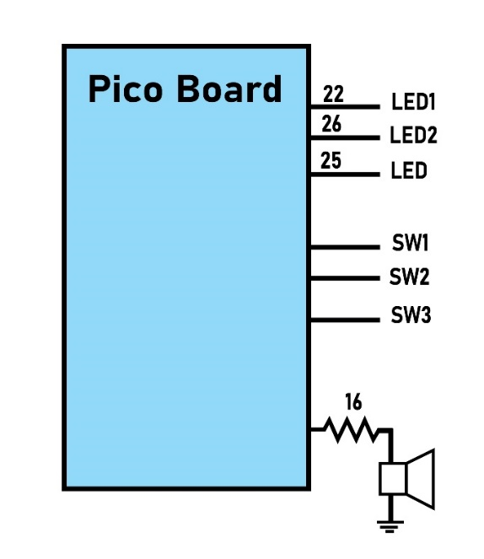
Figure 2-6: Pico External Connection to Buzzer

Slide 10
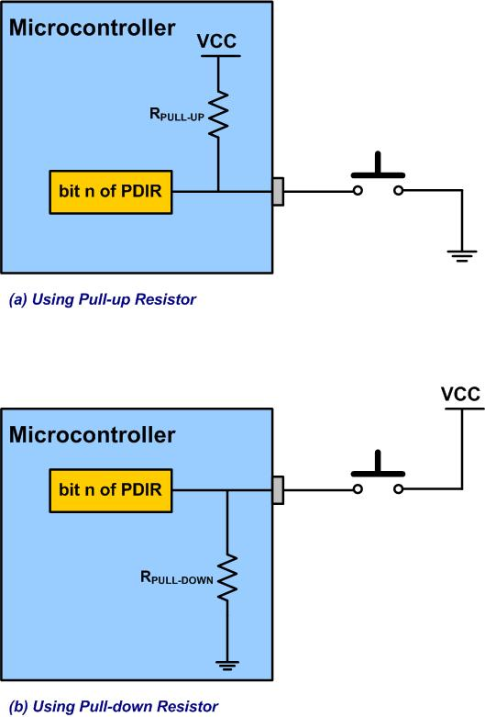
Figure 2-7: Connecting External Switches to the Microcontroller

Slide 11
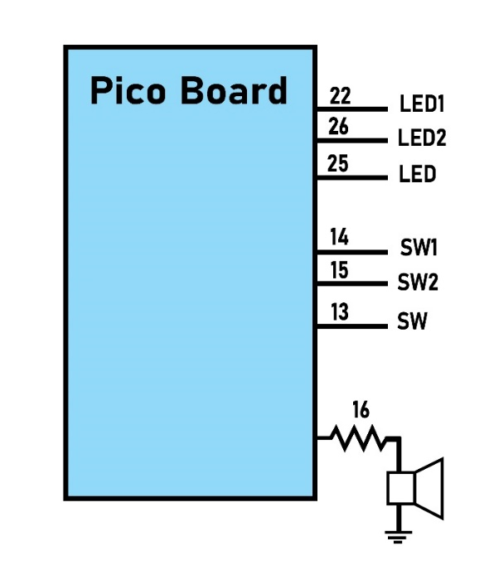
Figure 2-8: User Push-button External Connections

