Slide 1

Chapter 3:
Character LCD and Keyboard Interfacing to Pico Board
Raspberry Pi Pico
Interfacing and Programming
with MicroPython
www.MicroDigitalEd.com

Slide 2
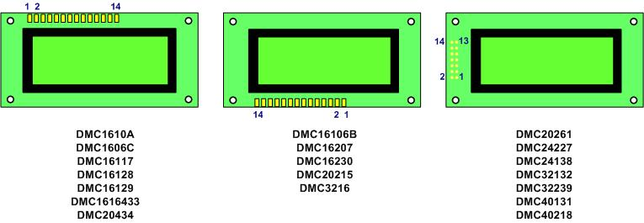
Figure 3-1: Pin Positions for Various LCDs from Optrex

Slide 3
Table 3-1: Pin Descriptions for LCD
Pin | Symbol | I/O | Description
1 | VSS | -- | Ground
2 | VCC | -- | +5V power supply
3 | VEE | -- | contrast control
4 | RS | I | RS = 0 to select command register, RS = 1 to select data register
5 | R/W | I | R/W = 0 for write, R/W = 1 for read
6 | E | I | Enable
7 | DB0 | I/O | The 8-bit data bus
8 | DB1 | I/O | The 8-bit data bus
9 | DB2 | I/O | The 8-bit data bus
10 | DB3 | I/O | The 8-bit data bus
11 | DB4 | I/O | The 4/8-bit data bus
12 | DB5 | I/O | The 4/8-bit data bus
13 | DB6 | I/O | The 4/8-bit data bus
14 | DB7 | I/O | The 4/8-bit data bus

Slide 4
Table 3-2: Some commonly used LCD Command Codes
Code (Hex) | Command to LCD Instruction Register
1 | Clear display screen
2 | Return cursor home
6 | Increment cursor (shift cursor to right)
F | Display on, cursor blinking
80 | Force cursor to the beginning of 1st line
C0 | Force cursor to the beginning of 2nd line
38 | 2 lines and 5x7 character (8-bit data, D0 to D7)
28 | 2 lines and 5x7 character (4-bit data, D4 to D7)

Slide 5
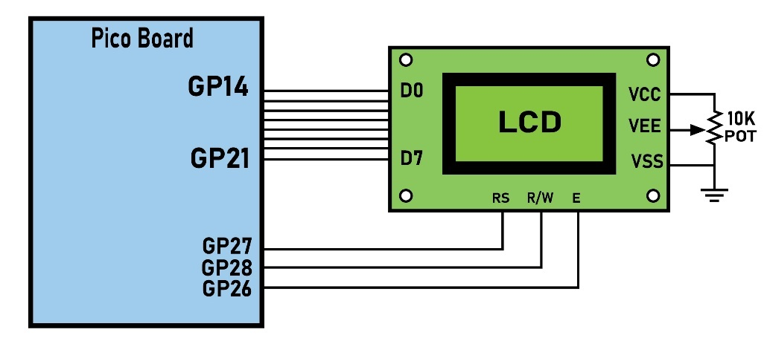
Figure 3-2: LCD Connection to Microcontroller with Busy Flag

Slide 6
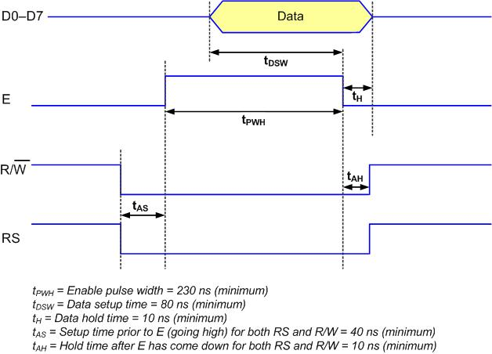
Figure 3-3: LCD Write Timing

Slide 7
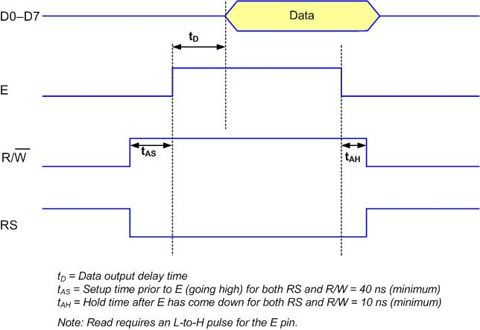
Figure 3-4: LCD Read Timing

Slide 8
Table 3-3: List of LCD Instructions
Instruction | RS | R/W | DB7 | DB6 | DB5 | DB4 | DB3 | DB2 | DB1 |  | DB0 | Description | Execution Time (Max)
Clear display | 0 | 0 | 0 | 0 | 0 | 0 | 0 | 0 | 0 |  | 1 | Clears entire display and sets DD RAM address 0 in the address counter. | 1.64 ms
Return Home | 0 | 0 | 0 | 0 | 0 | 0 | 0 | 0 | 1 |  | - | Sets DD RAM address to 0 as address counter. Also, returns display being shifted to original positions. DD RAM contents remain unchanged. | 1.64 ms
Entry Mode Set | 0 | 0 | 0 | 0 | 0 | 0 | 0 | 1 | I/D |  | S | Sets cursor move direction and specifies shift of display. These operations are performed during data write and read. | 40µs
Display On/Off Control | 0 | 0 | 0 | 0 | 0 | 0 | 1 | D | C |  | B | Sets On/Off of entire display (D), cursor On/Off (C), and blink of cursor position character (B). | 40µs
Cursor or Display shift | 0 | 0 | 0 | 0 | 0 | 1 | S/C | R/L | - |  | - | Moves cursor and shifts display without changing DD RAM contents. | 40µs
Function Set | 0 | 0 | 0 | 0 | 1 | DL | N | F | - |  | - | Sets interface data length (DL), number of display lines (L), and character font (F) | 40µs
Set CG RAM Address | 0 | 0 | 0 | 1 | AGC |  |  |  |  |  |  | Sets CG RAM address. CG RAM data is sent and received after this setting. | 40µs
Set DD RAM Address | 0 | 0 | 1 | ADD |  |  |  |  |  |  |  | Sets DD RAM address. DD RAM data is sent and received after this setting. | 40µs
Read Busy Flag & Address | 0 | 1 | BF | AC |  |  |  |  |  |  |  | Reads Busy flag (BF) indicating internal operation is being performed and reads address counter contents. | 40µs
Write Data CG or DD RAM | 1 | 0 | Write Data |  |  |  |  |  |  |  |  | Writes data into DD or CG RAM. | 40µs
Read Data CG or DD RAM | 1 | 1 | Read Data |  |  |  |  |  |  |  |  | Reads data from DD or CG RAM. | 40µs
Abbreviations: DD RAM: Display data RAM CG RAM: Character generator RAM AGC: CG RAM address ADD: DD RAM address, corresponds to cursor address AC: address counter used for both DD and CG RAM addresses I/D: 1 = Increment, 0: Decrement |  |  |  |  |  |  |  |  |  | Abbreviations: S =1: Accompanies display shift S/C: 1 = Display shift, 0: Cursor move R/L: 1: Shift to the right, 0: Shift to the left DL: 1 = 8 bits, 0 = 4 bits N: 1 = 2-line, 0 = 1-line F: 1 = 5 x 10 dots, 0 = 5 x 7 dots BF: 1 = Internal operation, 0 = Can accept instruction

Slide 9

Figure 3-5: LCD Connection to Microcontroller without Busy Flag

Slide 10
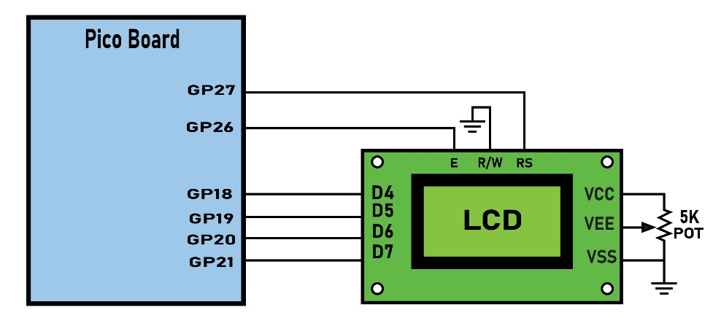
Figure 3-6: LCD Parallel Connection

Slide 11
LCD Cursor Position
where A₆A₅A₄A₃A₂A₁A₀= 0000000b to 0101111b for line 1 and A₆A₅A₄A₃A₂A₁A₀ = 1000000b to 1101111b for line 2. See Table 3-4.

Slide 12
Table 3-4: LCD Addressing Commands
 | DB7 | DB6 | DB5 | DB4 | DB3 | DB2 | DB1 | DB0
Line 1 (min) | 1 | 0 | 0 | 0 | 0 | 0 | 0 | 0
Line 1 (max) | 1 | 0 | 1 | 0 | 1 | 1 | 1 | 1
Line 2 (min) | 1 | 1 | 0 | 0 | 0 | 0 | 0 | 0
Line 2 (max) | 1 | 1 | 1 | 0 | 1 | 1 | 1 | 1

Slide 13
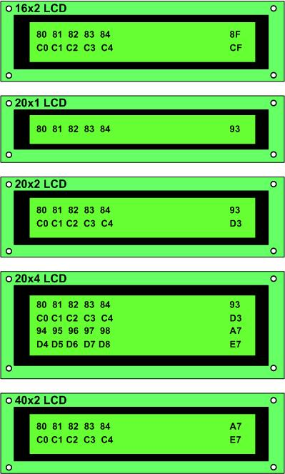
Figure 3-7: Cursor Addresses for Some LCDs

Slide 14
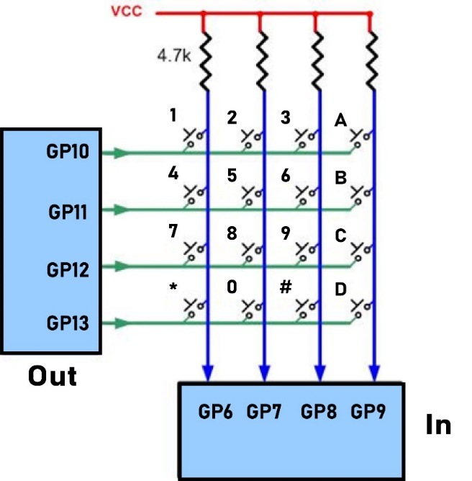
Figure 3-8: Matrix Keypad Connection to the Pico board

Slide 15
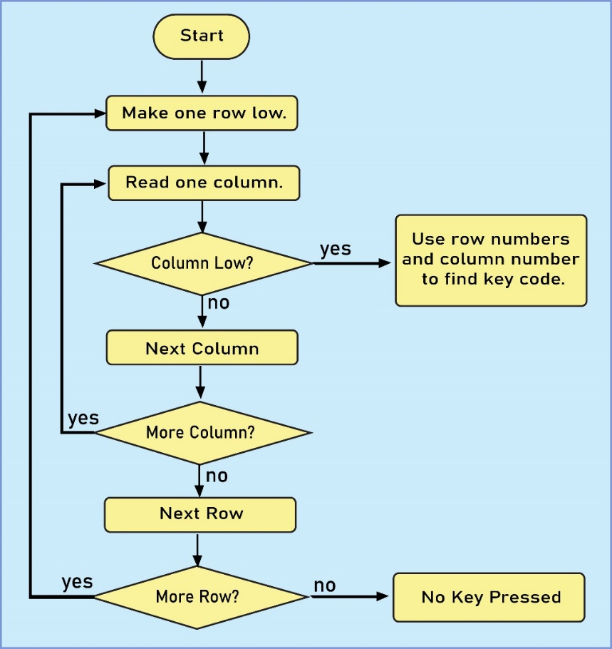
Figure 3-9: The Flowchart for Key Press Detection and Identification

Slide 16
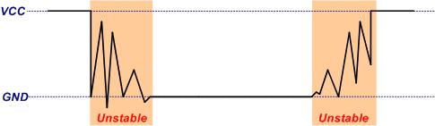
Figure 3-10: Switch contact bounces

