Slide 1
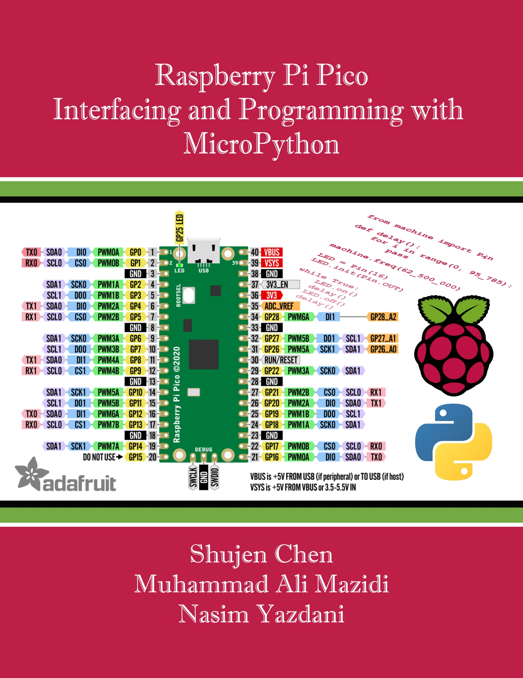
Chapter 4:
UART Serial Port Programming
Raspberry Pi Pico
Interfacing and Programming
with MicroPython
www.MicroDigitalEd.com

Slide 2
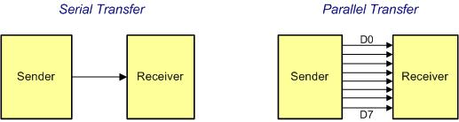
Figure 4-1: Serial vs. Parallel Data Transfer

Slide 3
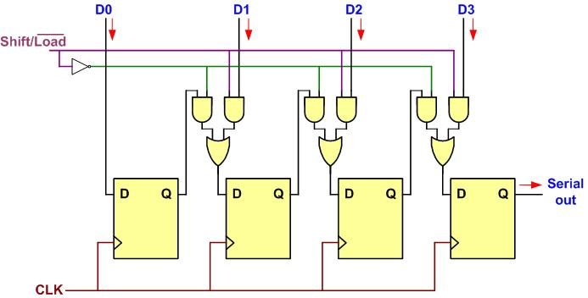
Figure 4-2: Parallel In Serial Out

Slide 4
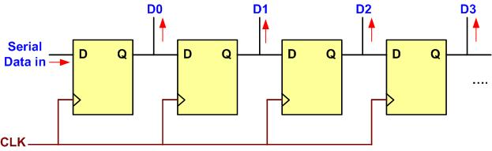
Figure 4-3: Serial In Parallel Out

Slide 5
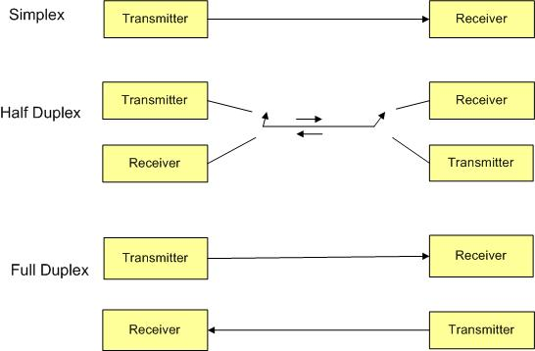
Figure 4-4: Simplex, Half-, and Full-Duplex Transfers

Slide 6
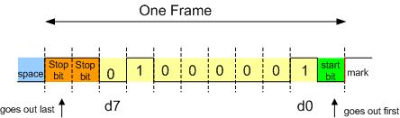
Figure 4-5: Framing ASCII "A" (0x41)

Slide 7
Example 4-1
Calculate the total number of bits used in transferring 50 pages of text, each with 80 × 25 characters. Assume 8 bits per character and 1 stop bit.
Solution
For each character a total of 10 bits is used, 8 bits for the character, 1 stop bit, and 1 start bit. Therefore, the total number of bits is 80 × 25 × 10 = 20,000 bits per page. For 50 pages, 1,000,000 bits will be transferred.

Slide 8
Example 4-2
Calculate the time it takes to transfer the entire 50 pages of data in Example 4-1 using a baud rate of:
(a) 9600 (b) 57,600
Solution
(a) 1,000,000 / 9600 = 104 seconds
(b) 1,000,000 / 57,600 = 17 seconds

Slide 9
Example 4-3
Calculate the time it takes to download a movie of 2 gigabytes using a telephone line. Assume 8 bits, 1 stop bit, no parity, and 57,600 baud rate.
Solution
2 × 2³⁰ × 10 / 57,600 = 347,222 seconds = 4 days

Slide 10
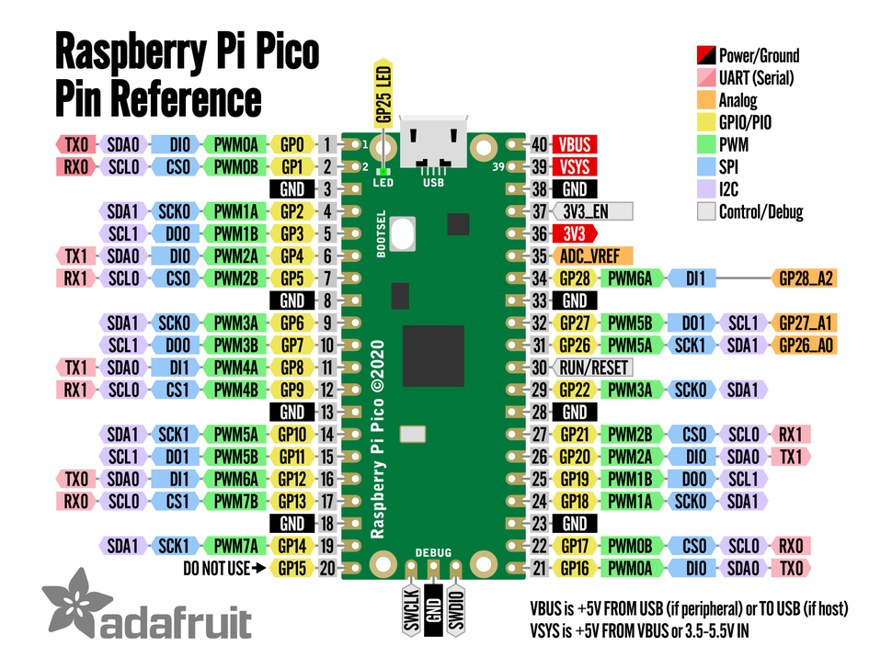
Figure 4-6: Raspberry Pi Pico Pinout

Slide 11
Table 4-1A: UART0 Pins
UART pin | GPIO pin number
UART0_TX | GP0, GP12, GP16
UART0_RX | GP1, GP13, GP17
Table 4-1B: UART1 Pins
UART pin | GPIO pin number
UART1_TX | GP4, GP8, GP20
UART1_RX | GP5, GP9, GP21

Slide 12
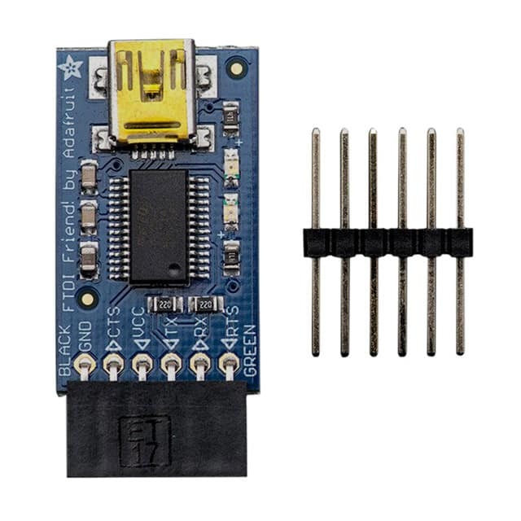
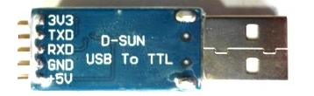
Figure 4-7: USB-to-Serial Converters

Slide 13
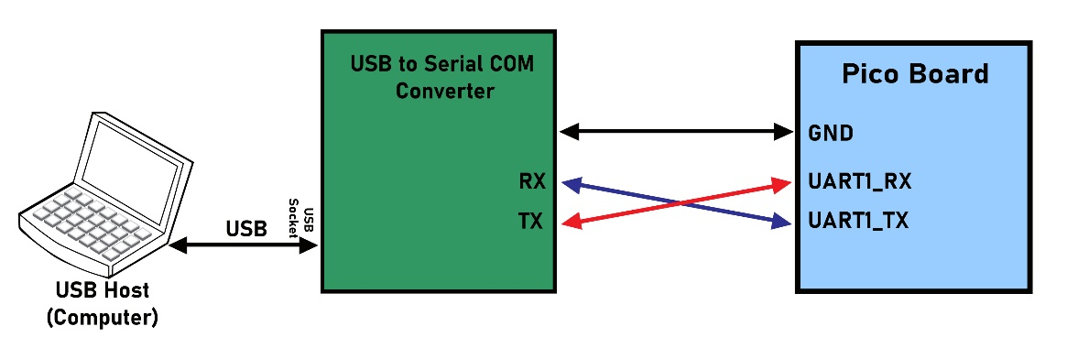
Figure 4-8: Pico UARTX Serial Connection

