Slide 1
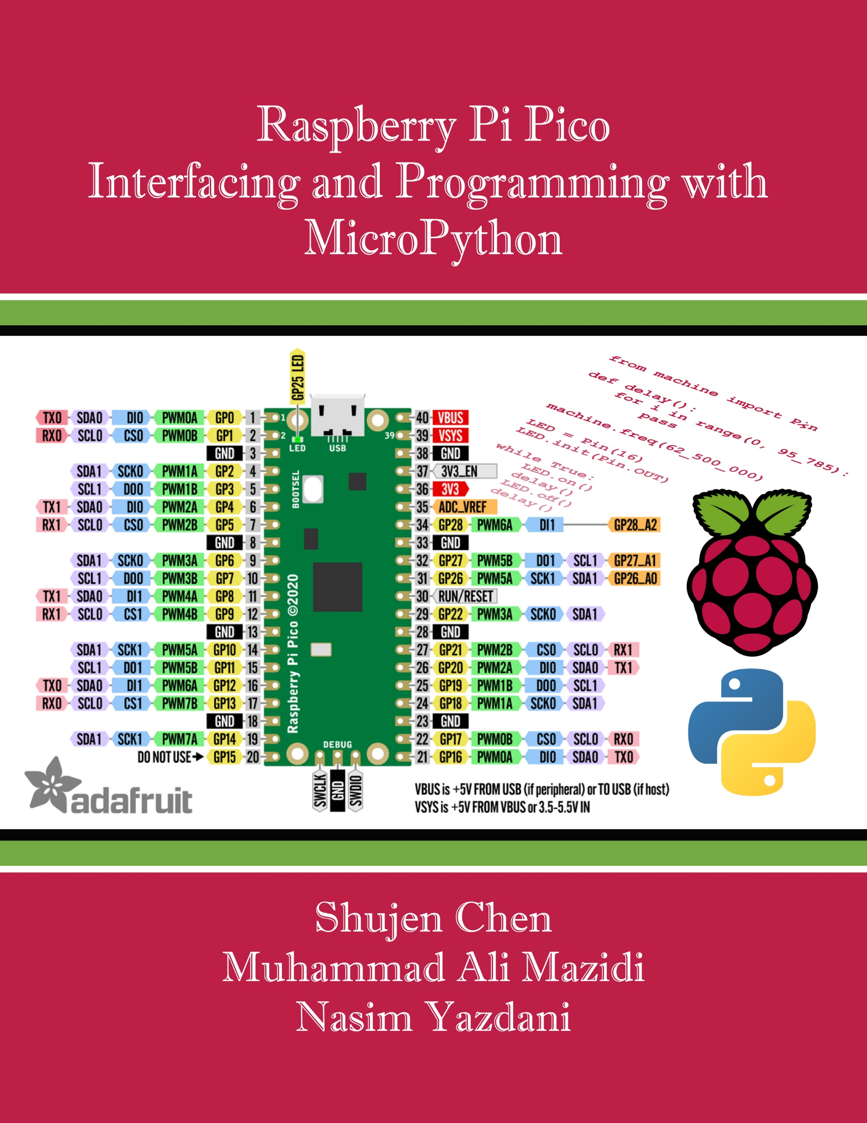
Chapter 6:
Interrupt Programming in Pico
Raspberry Pi Pico
Interfacing and Programming
with MicroPython
www.MicroDigitalEd.com

Slide 2
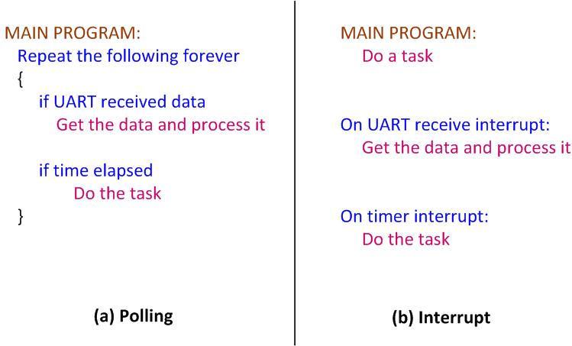
Figure 6‑1: Polling vs. Interrupts

Slide 3
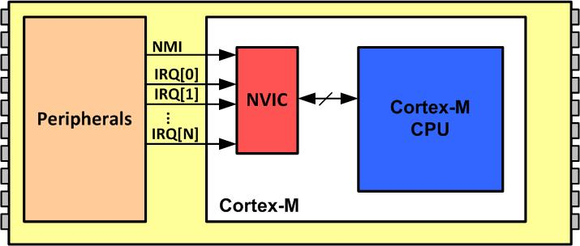
Figure 6‑2: NVIC in Arm Cortex-M

Slide 4
Table 6-1: Interrupt Vector Table for Arm Cortex-M
INT # | Interrupt | Memory Location
 | Stack Pointer initial value | 0x00000000
1 | Reset | 0x00000004
2 | NMI | 0x00000008
3 | Hard Fault | 0x0000000C
4 | Reserved | 0x00000010
5 | Reserved | 0x00000014
6 | Reserved | 0x00000018
7 | Reserved | 0x0000001C
8 | Reserved | 0x00000020
9 | Reserved | 0x00000024
10 | Reserved | 0x00000028
11 | SVCall | 0x0000002C
12 | Reserved | 0x00000030
13 | Reserved | 0x00000034
14 | PendSV | 0x00000038
15 | SysTick | 0x0000003C
16 | IRQ0 for peripherals | 0x00000040
17 | IRQ1 for peripherals | 0x00000044
… | … | …
255 | IRQ239 for peripherals | 0x000003FC

Slide 5
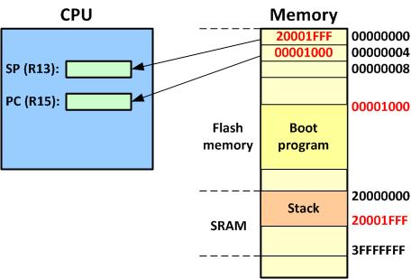
Figure 6‑3: Going from Reset to Boot Program

Slide 6
Table 6-2: IRQ assignment in RP2040
INT# | IRQ# | Vector location | Device
1-15 |  | 0000 0000 to 0000 003C | CPU Exceptions
16 | 0 | 0000 0040 | Timer_IRQ_0
17 | 1 | 0000 0044 | Timer_IRQ_1
18 | 2 | 0000 0048 | Timer_IRQ_2
19 | 3 | 0000 004C | Timer_IRQ_3
20 | 4 | 0000 0050 | PWM_IRQ_WRAP
21 | 5 | 0000 0054 | USBCTRL_IRQ
22 | 6 | 0000 0058 | XIP_IRQ
23 | 7 | 0000 005C | PIO0_IRQ_0
24 | 8 | 0000 0060 | PIO0_IRQ_1
25 | 9 | 0800 0064 | PIO1_IRQ_0
26 | 10 | 0000 0068 | PIO1_IRQ_1
27 | 11 | 0000 006C | DMA_IRQ_0
28 | 12 | 0000 0070 | DMA_IRQ_1
29 | 13 | 0000 0074 | IO_IRQ_BANK0
30 | 14 | 0000 0078 | IO_IRQ_QSPI
31 | 15 | 0000 007C | SIO_IRQ_PROC0
32 | 16 | 0000 0080 | SIO_IRQ_PROC1
33 | 17 | 0000 0084 | CLOCKS_IRQ
34 | 18 | 0000 0088 | SPI0_IRQ
35 | 19 | 0000 008C | SPI1_IRQ
36 | 20 | 0000 0090 | UART0_IRQ
37 | 21 | 0000 0094 | UART1_IRQ
38 | 22 | 0000 0098 | ADC_IRQ_FIFO
39 | 23 | 0000 009C | I2C0_IRQ
40 | 24 | 0000 00A0 | I2C1_IRQ
41 | 25 | 0000 00A4 | RTC_IRQ

Slide 7
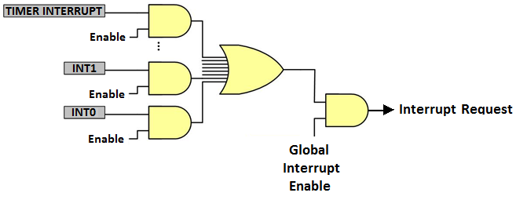
Figure 6-4: Interrupt enabling at both levels

Slide 8
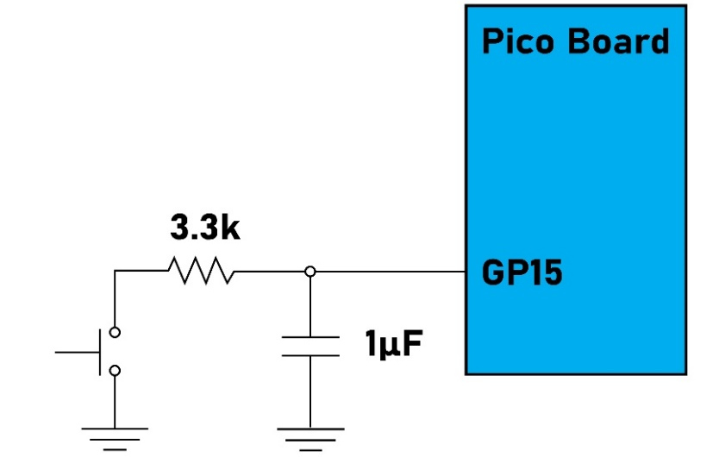
Figure 6-5: Using Interrupt with a Switch Connected to Pico board

Slide 9
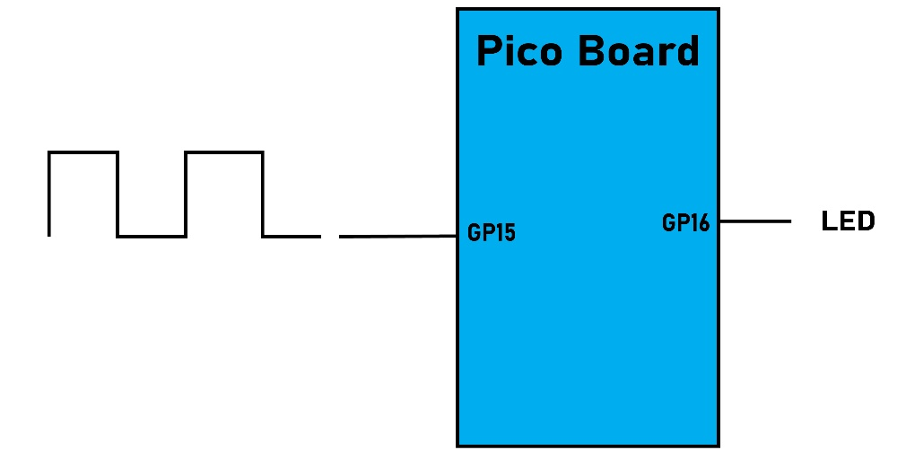
Figure 6-6: Counting Pulses From External Source

Slide 10
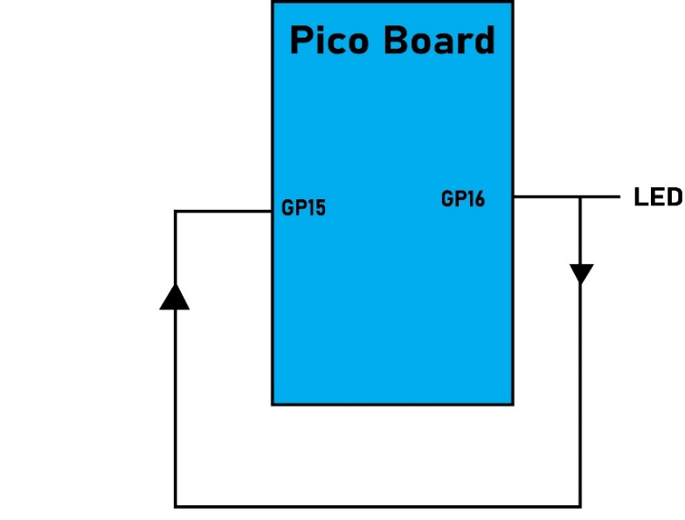
Figure 6-7: Counting Pulses Coming From GP16 Pin

Slide 11
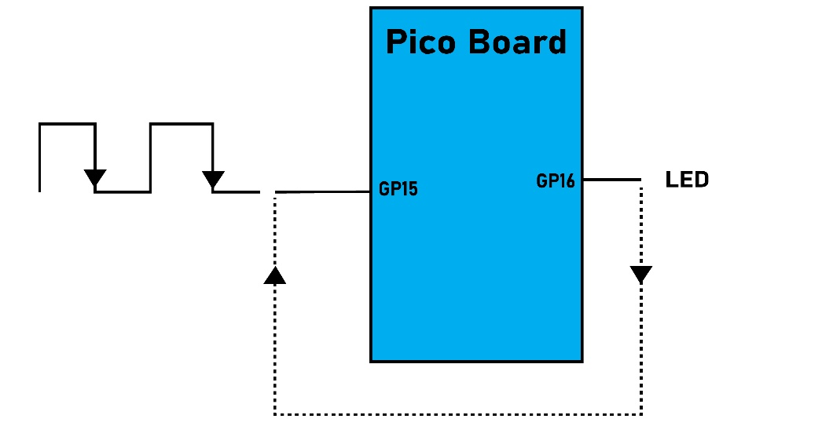
Figure 6-8: Measuring Frequency Coming from External Source

Slide 12
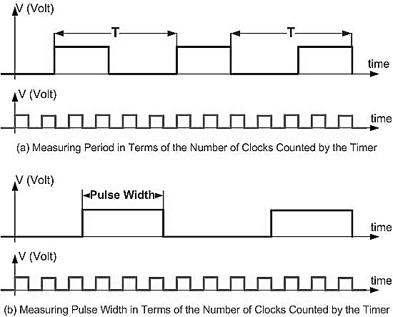
Figure 6-9: Measuring Period and Pulse Width

