Slide 1
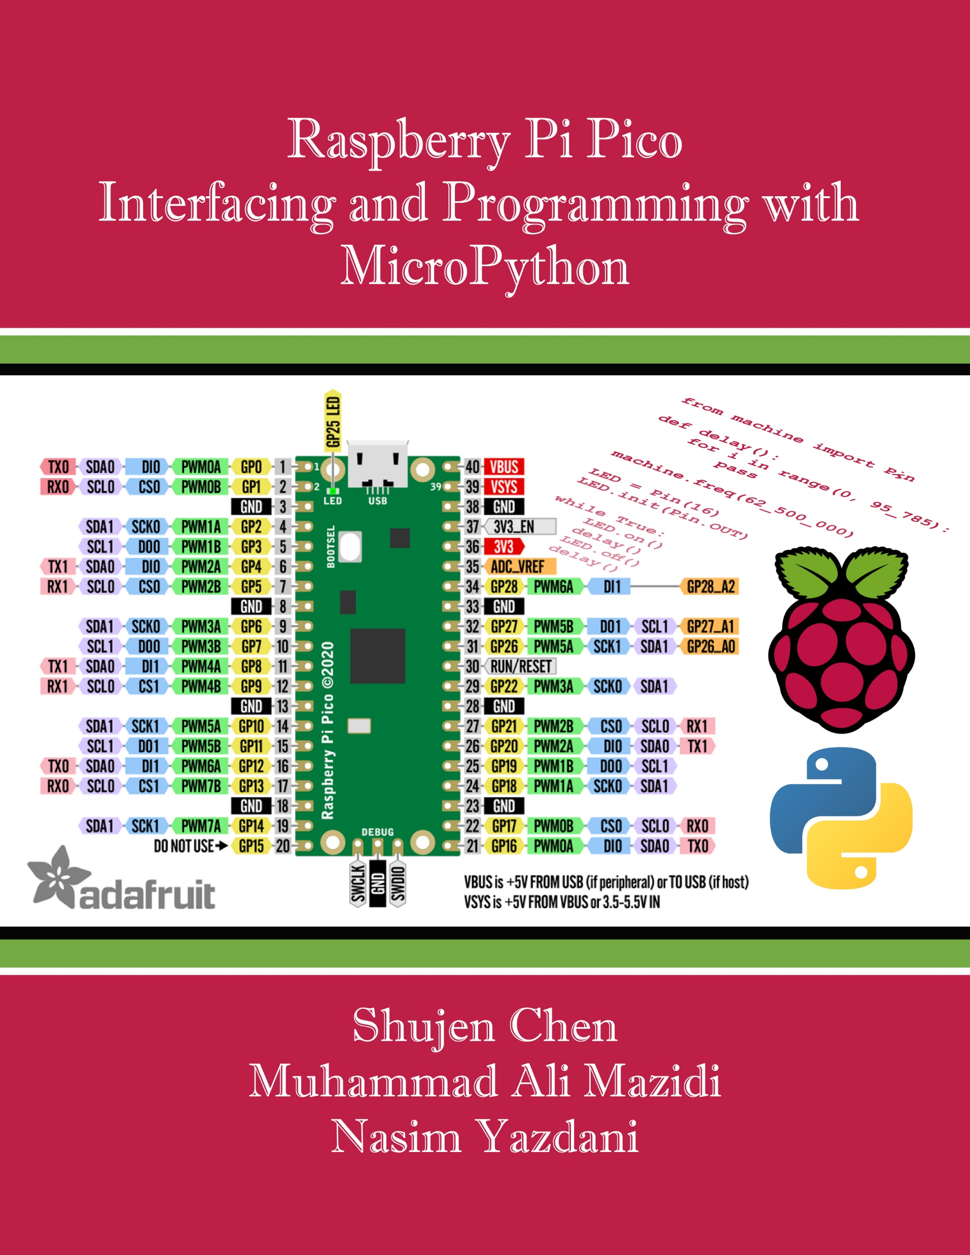
Chapter 7:
ADC, DAC, and Sensor Interfacing and Programming in Pico
Raspberry Pi Pico
Interfacing and Programming
with MicroPython
www.MicroDigitalEd.com

Slide 2
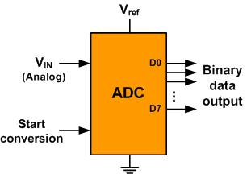
7-1: Microcontroller Connection to Sensor via ADC in Arm Cortex-M
Figure 7-2: An 8-bit ADC Block Diagram

Slide 3
Table 7-1: Resolution versus Step Size for ADC (Vref = 5V)
n-bit | Number of steps | Step size
8 | 256 | 5V /256 = 19.53 mV
10 | 1024 | 5V /1024 = 4.88 mV
12 | 4096 | 5V /4096 = 1.2 mV
16 | 65,536 | 5V /65,536 = 0.076 mV
Note: V_{ref} = 5V

Slide 4
Table 7-2: Vref Relation to Vin Range for an 8-bit ADC
V_{ref} (V) | Vin Range (V) | Step Size (mV)
5.00 | 0 to 5 | 5 / 256 = 19.53
4.00 | 0 to 4 | 4 / 256 = 15.62
3.00 | 0 to 3 | 3 / 256 = 11.71
2.56 | 0 to 2.56 | 2.56 / 256 = 10
2.00 | 0 to 2 | 2 / 256 = 7.81
1.28 | 0 to 1.28 | 1.28 / 256 = 5
1.00 | 0 to 1 | 1 / 256 = 3.90
Note: In an 8-bit ADC, the step size is V_{ref}/256

Slide 5
Table 7-3: Vref Relation to Vin Range for a 10-bit ADC
Vref (V) | Vin Range (V) | Step Size (mV)
5.00 | 0 to 5 | 5 / 1024 = 4.88
4.96 | 0 to 4.096 | 4.096 / 1024 = 4
3.00 | 0 to 3 | 3 / 1024 = 2.93
2.56 | 0 to 2.56 | 2.56 / 1024 = 2.5
2.00 | 0 to 2 | 2 / 1024 = 2
1.28 | 0 to 1.28 | 1.28 / 1024 = 1.25
1.024 | 0 to 1.024 | 1.024 / 1024 = 1
Note: In a 10-bit ADC, the step size is V_{ref}/1024

Slide 6
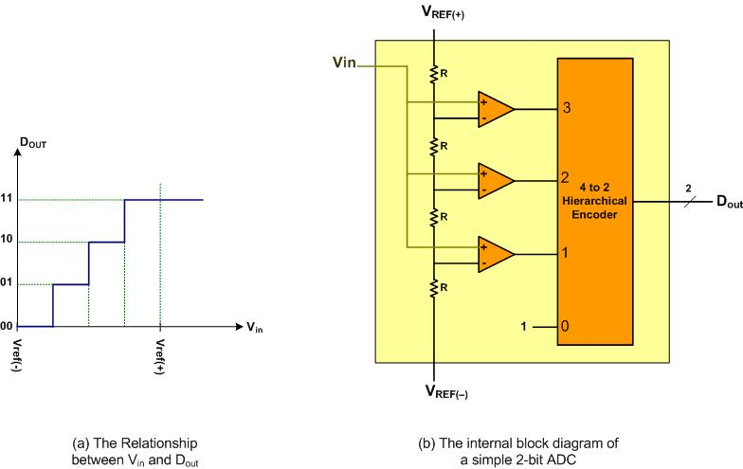
Figure 7-3: A Simultaneous 2-bit ADC

Slide 7
Example 7-1
For a given 8-bit ADC (e.g. ADC0848), we have Vref = 2.56 V. Calculate the D0–D7 output if the analog input is: (a)1.7 V, and (b) 2.1 V.
Solution
Since the step size is 2.56/256 = 10 mV, we have the following.
(a)DOUT = 1.7V/10 mV = 170 in decimal, which gives us 10101011 in binary for D7–D0.
(b)DOUT = 2.1V/10 mV = 210 in decimal, which gives us 11010010 in binary for D7–D0.

Slide 8
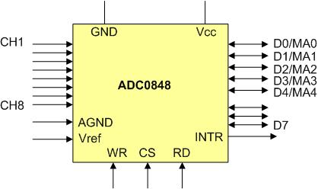
Figure 7-4: ADC0848 Parallel ADC Block Diagram

Slide 9
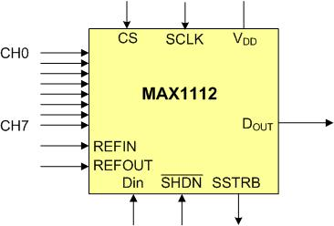
Figure 7-5: MAX1112 Serial ADC Block Diagram

Slide 10
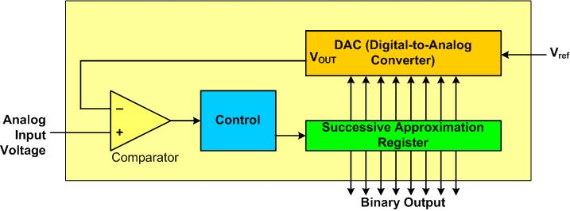
Figure 7-6: Successive Approximation ADC

Slide 11
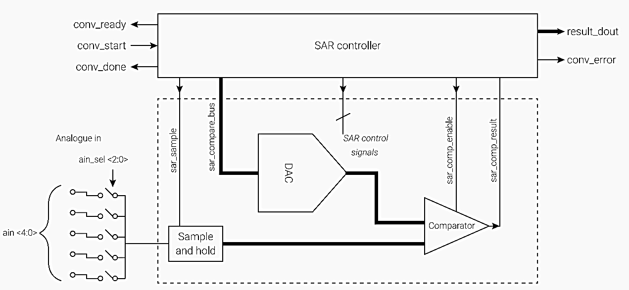
Figure 7-7: On-Chip Successive Approximation ADC in RP2040 Microcontroller

Slide 12
Table 7-4: Thermistor Resistance vs. Temperature
Temperature ('C) | Tf (K ohms)
0 | 29.490
25 | 10.000
50 | 3.893
75 | 1.700
100 | 0.817

Slide 13
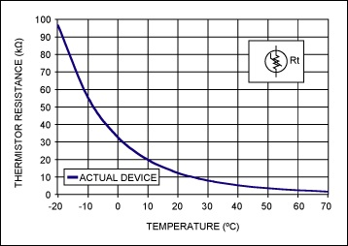
Figure 7-8: Thermistor (Copied from http://www.maximintegrated.com)

Slide 14
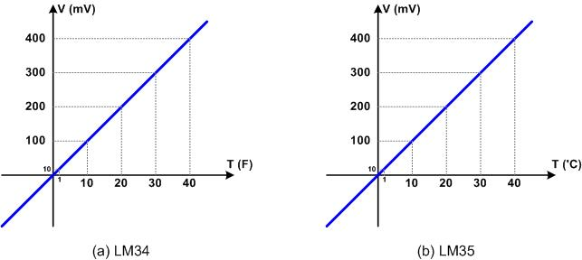
Figure 7-9: LM34 and LM35

Slide 15
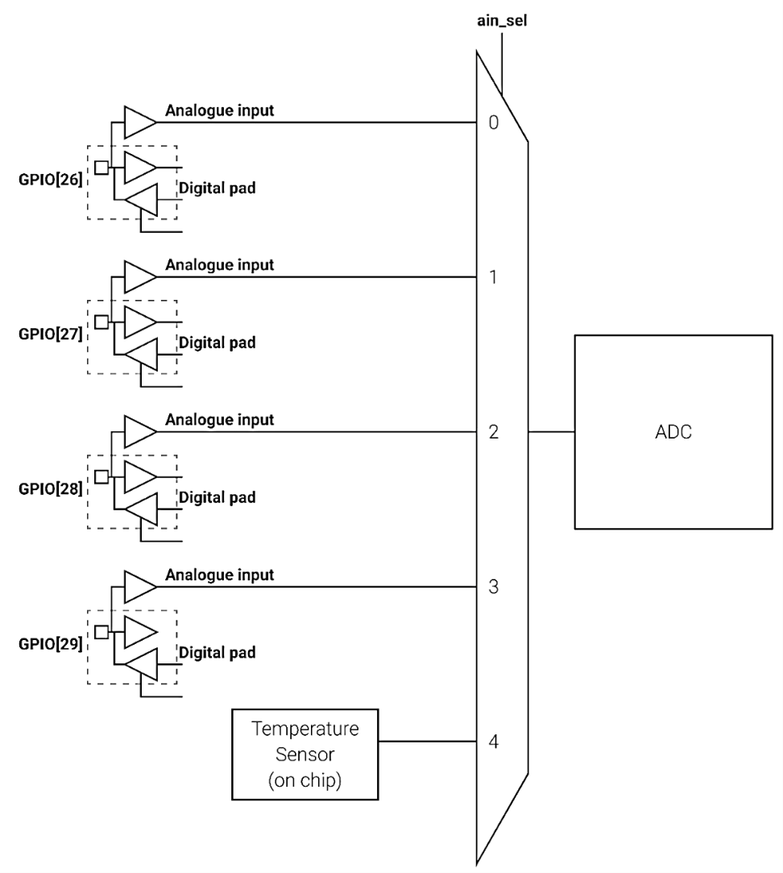
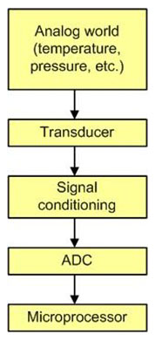
Figure 7-10: Getting Data to the CPU
Figure 7-11: On-Chip ADC in RP2040

Slide 16
Table 7-5: Pico ADC Channels
ADC Pin | GPIO Pins
ADC0 | GP26
ADC1 | GP27
ADC2 | GP28

Slide 17
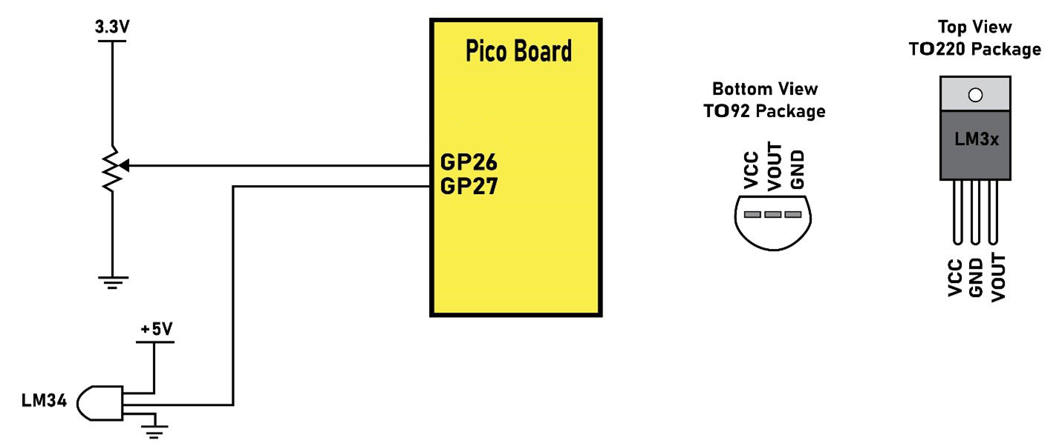
Figure 7-12: Pico Connection to external devices for ADC

Slide 18
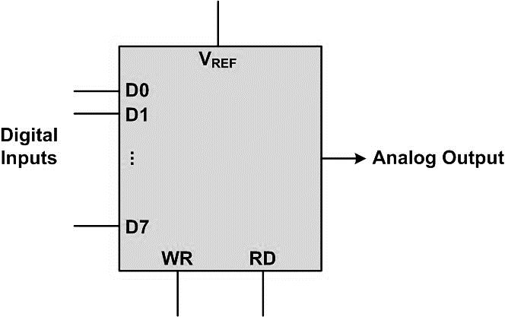
Figure 7-13: DAC Block Diagram

Slide 19
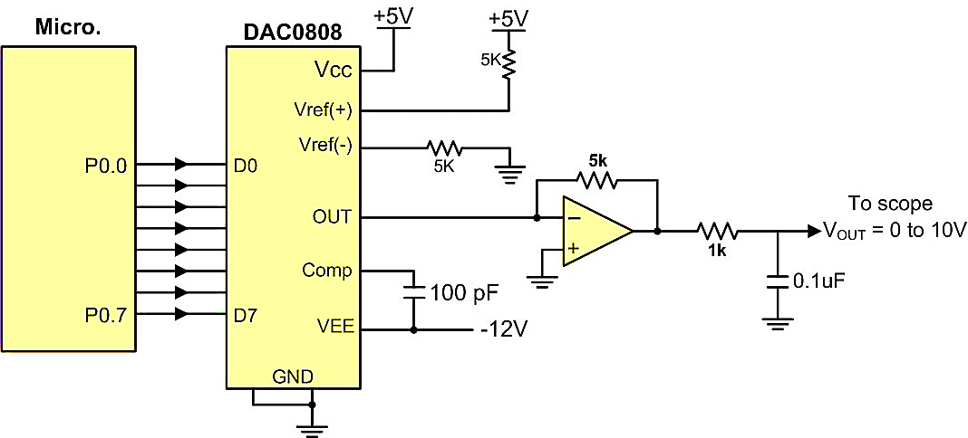
Figure 7-14: Microcontroller Connection to DAC0808

Slide 20
Example 7-2
Assuming that R = 5K and Iref = 2 mA, calculate Vout for the following binary inputs:
(a) 10011001 binary (0x99) (b) 11001000 (0xC8)
Solution
(a) Iout = 2 mA (153/255) = 1.195 mA and Vout = 1.195 mA × 5K = 5.975 V
(b) Iout = 2 mA (200/256) = 1.562 mA and Vout = 1.562 mA × 5K = 7.8125 V

