Slide 1
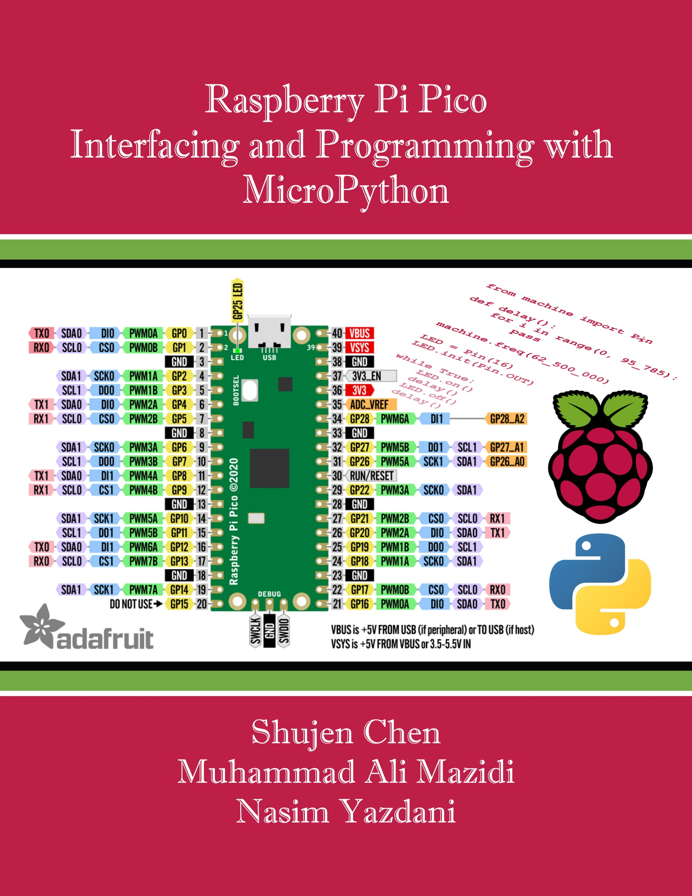
Chapter 9:
I2C and DAC Interfacing and Programming
Raspberry Pi Pico
Interfacing and Programming
with MicroPython
www.MicroDigitalEd.com

Slide 2
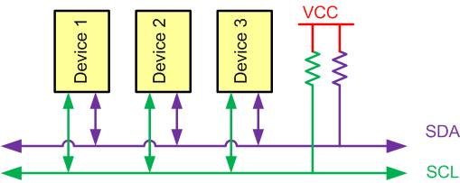
Figure 9-1: I2C Bus Characteristics

Slide 3
Example 9-1
Give an example to show how a device (node) can use more than one mode of operation.
Solution
If you connect a microcontroller to an EEPROM with I2C, the microcontroller does main transmit operation to write to EEPROM and main receive operation to read from EEPROM.

Slide 4
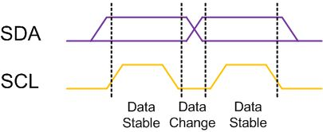
Figure 9-2: I2C Bit Format

Slide 5
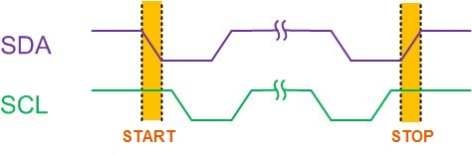
Figure 9-3: START and STOP Conditions in I2C

Slide 6
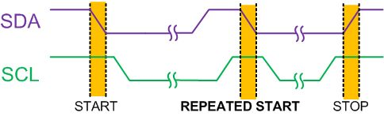
Figure9-4: REPEATED START Condition

Slide 7
Example 9-2
Give an example to show when a main must use the RESTART condition. What will happen if the main does not use it?
Solution
If you connect two microcontrollers (uA and uB) and an EEPROM with I2C, the uA wants to display the sum of the contents at addresses 0x34 and 0x35 of a serial EEPROM. Let’s see what may happen if the uA does not use a RESTART condition. uA transmits a START condition, reads the content of address 0x34 of EEPROM, and sends a STOP condition to release the bus. Before uA reads the contents of address 0x35, the uB seizes the bus and changes the contents of addresses 0x34 and 0x35 of the EEPROM. Then uA reads the content of address 0x35, adds it to the last content of address 0x34, and displays the result to LCD. The result on the LCD is neither the sum of old values of address 0x34 and 0x35 nor the sum of the new values of the EEPROM!

Slide 8
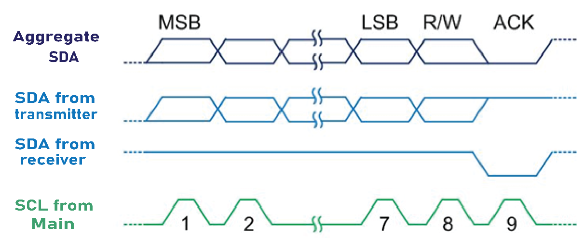
Figure 9-5: Byte Format in I2C

Slide 9
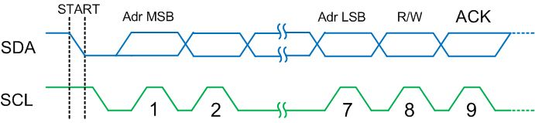
Figure 9-6: Address Byte Format in I2C

Slide 10
Example 9-3
If two mains A and B start at about the same time, what happens if main A wants to write to secondary 0010 000 and main B wants to write to secondary 0001 111?
Solution
The I2C bus is a wired-AND bus. If one main drives the signal low and the other one does not drive the signal, the signal on the bus will appear low. In the timing diagram below, during the third clock cycle, Main A does not drive the bus but Main B drives the bus low. Main A sees the bus signal is different, knows it loses the arbitration because the SDA line is different from the output. Main A switches to secondary mode and stops driving the bus. On the other hand, Main B has no idea of the bus collision and will continue the transmission.

Slide 11
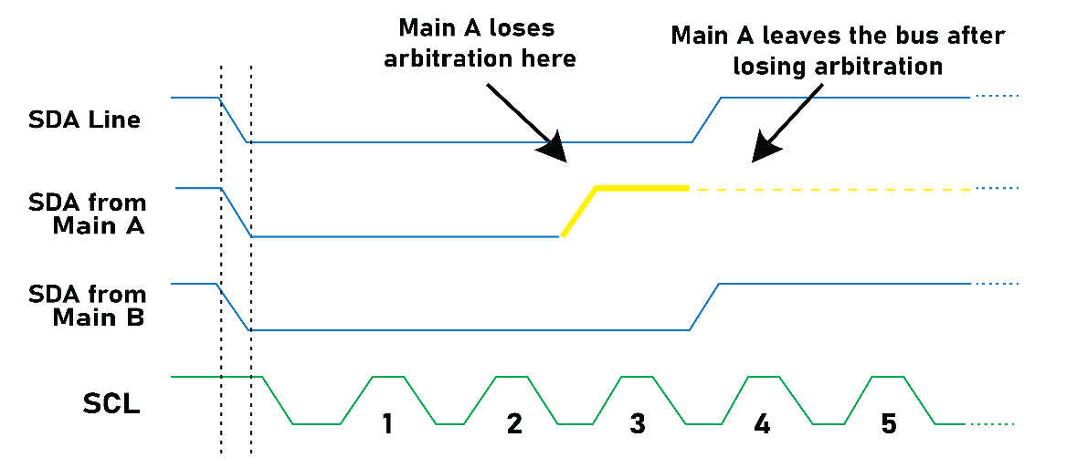
Example 9-3
If two mains A and B start at about the same time, what happens if main A wants to write to secondary 0010 000 and main B wants to write to secondary 0001 111?
Solution

Slide 12
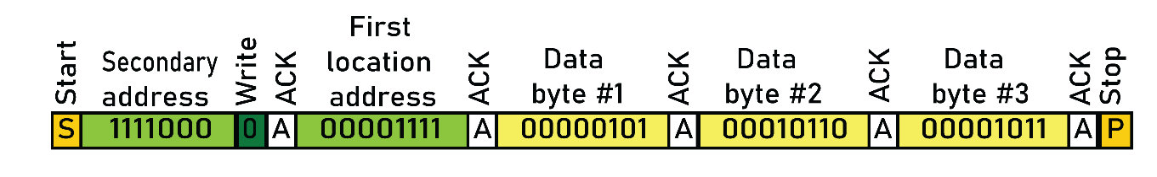
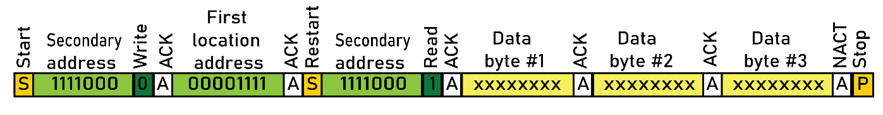
Figure 9-7A: Multi-byte Burst Write
Figure 9-7B: Multi-byte Burst Read

Slide 13
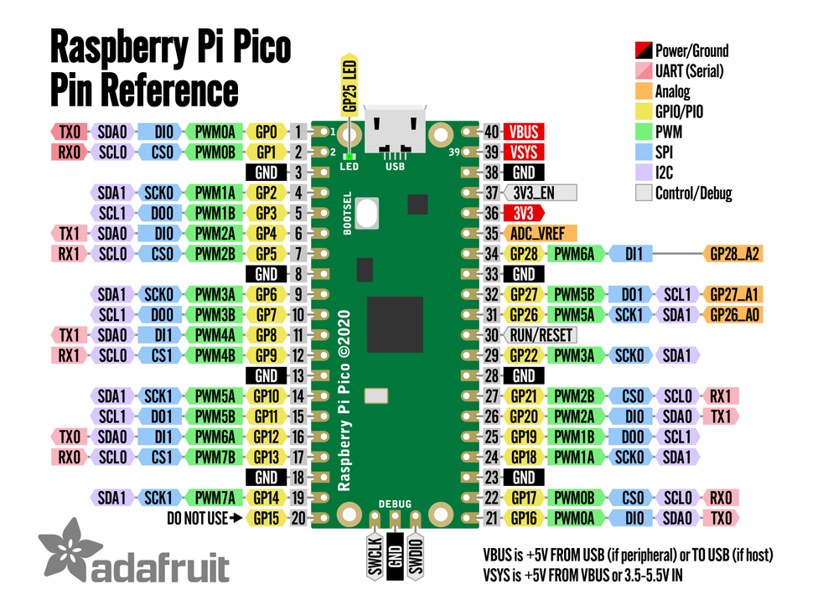
Figure 9-8: I2C Pins in Pico

Slide 14
Figure 9-8: I2C Pins in Pico
I2C Controller | GPIO Pins
I2C0 SDA | GP0/GP4/GP8/GP12/GP16/GP20
I2C0 SCL | GP1/GP5/GP9/GP13/GP17/GP21
I2C1 SDA | GP2/GP6/GP10/GP14/GP18/GP26
I2C1 SCL | GP3/GP7/GP11/GP15/GP19/GP27

Slide 15
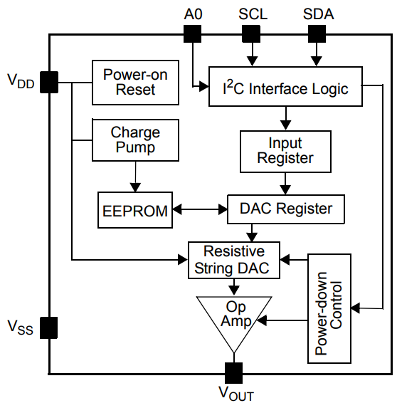
Figure 9-9: MCP4725 DAC Block Diagram

Slide 16
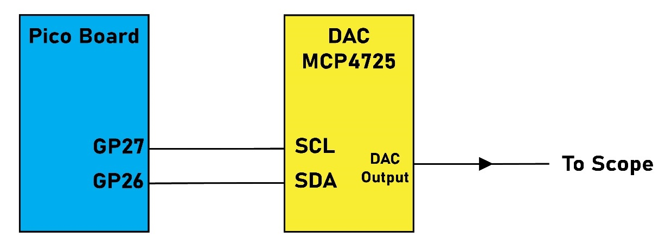
Figure 9-10: Pico I2C Pin Connection to MCP4725 DAC

Slide 17
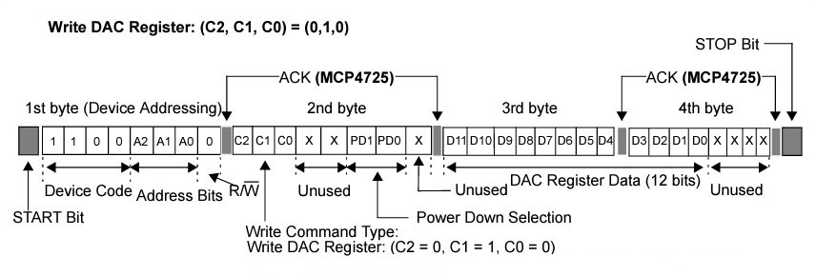
Figure 9-11: Data format to write to the DAC register of MCP4725

Slide 18
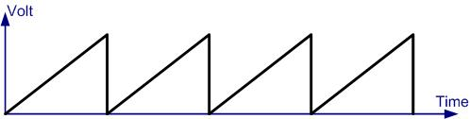
Figure 9-12: Saw Tooth WaveForm

Slide 19
Table 9-1: Angle vs. Voltage Magnitude for Sine Wave
Angle Ɵ (degrees) | Sin Ɵ | V_{OUT} (Voltage Magnitude) 1. 65V + (1. 65V × sin Ɵ) | Values Sent to DAC (decimal) (Voltage Mag. × 310)
0 | 0 | 1.65 | 2048
30 | 0.5 | 2.475 | 3071
60 | 0.866 | 3.0789 | 3821
90 | 1.0 | 3.3 | 4095
120 | 0.866 | 3.0789 | 3821
150 | 0.5 | 2.475 | 3071
180 | 0 | 1.65 | 2048
210 | -0.5 | 0.825 | 1024
240 | -0.866 | 0.2211 | 274
270 | -1.0 | 0 | 0
300 | -0.866 | 0.2211 | 274
330 | -0.5 | 0.825 | 1024
360 | 0 | 1.65 | 2048

Slide 20
Example 9-4
Verify the values of Table 9-1 for the following angles: (a) 30 (b) 60.
Solution
(a) VOUT = 1.65 V × (sin Ɵ + 1) = 1.65 V × (sin 30 + 1) = 1.65 V × 1.5 = 2.475 V
DAC input values = 2.475 V × 1241 = 3071 (decimal)
(b) VOUT = 1.65 V ×(sin Ɵ + 1) = 1.65 V × sin 60 = 1.65 V × 1.866 = 3.079 V
DAC input values = 3.079 V × 1241 = 3821 (decimal)

Slide 21
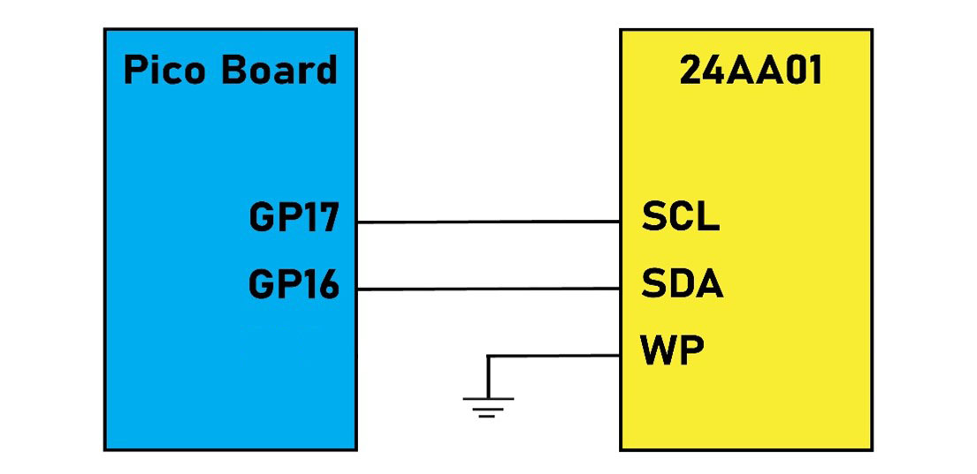
Figure 9-14: Pico I2C Pin Connection to 24AA01

Slide 22
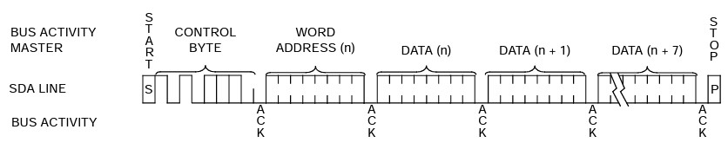
Figure 9-15: Page Write byte sequence

Slide 23
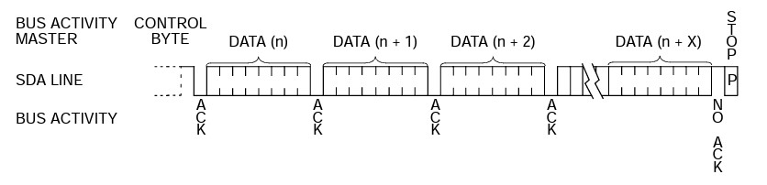
Figure 9-16: Sequential read byte sequence

